Slide 1
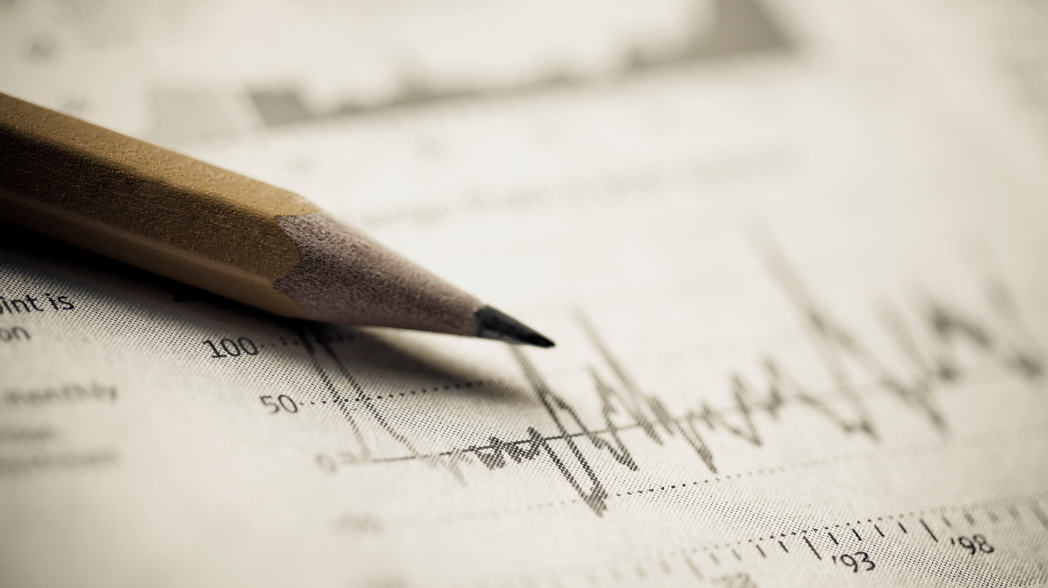
End of sprint presentation sprint 3
Rob Meulenkamp
Pascal Visser
Rienk Heins

Slide 2
Sprint 3
Goals of sprint 3
Tested algorithms
Gaussian mixture model
OPTICS
DBSCAN
Positives and negatives
Goals for sprint 4

Slide 3
Goals of sprint 3
Create a machine learning algorithm
Cluster bacteria and plastics
Outcome should be useable to show movement of cluster centers
Should have statistics to show quality of outcome

Slide 4
Algorithm 1: Gaussian mixture model
*ROB

Slide 5
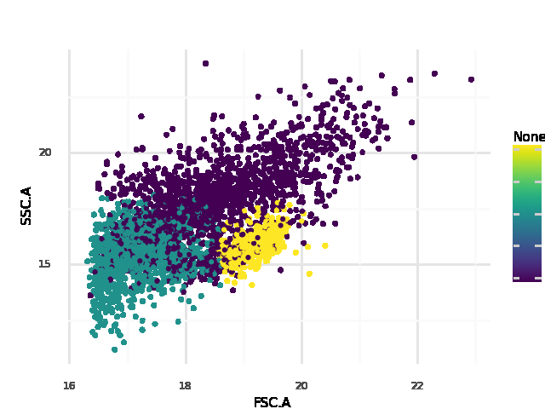
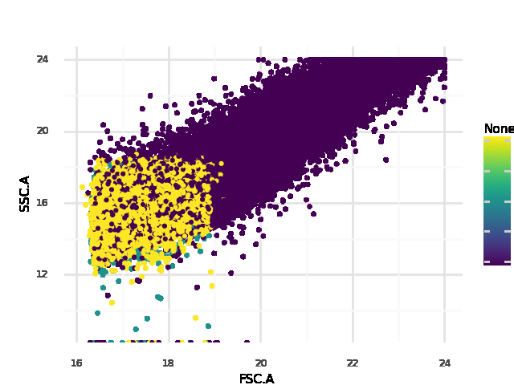
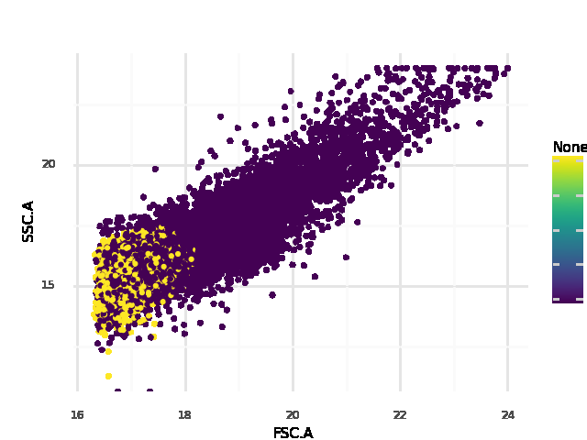
Algorithm 2: OPTICS
Density based algorithm
Looks promising on clearly separated datasets
Has a lot of problems with overlap

Slide 6
Algorithm 3: DBSCAN
*PASCAL

Slide 7
Final decision

Slide 8
Positives and negatives
Positives:
HDBSCAN results look promising and are already useable for end result
Clear plan for sprint 4
Negatives:
Optics and GMM both didn’t create desired output
Still a decent number of points not clustered with final algorithm

Slide 9
Goals for sprint 4
Optimizing the algorithm
Creation of an application for results and use of new datasets
Should give movement of clusters for degradation
Give statistics about the quality of the results
Useable for the lab

Slide 10

Questions?

