Slide 1
Degradation of bioplastics
By Pascal Visser, Rob Meulenkamp and Rienk Heins

Slide 2
Goals of sprint 2
Finish data analysis
Sort data
Study variables
Look at effects of special case samples
Create final dataset
Start building a machine learning algorithm
Start machine learning on smaller dataset

Slide 3
Reordering of the data
Talk with Micha
Understanding the species cases
Freeze thaw
Coloring
Difference in samples
Reorganized data

Slide 4
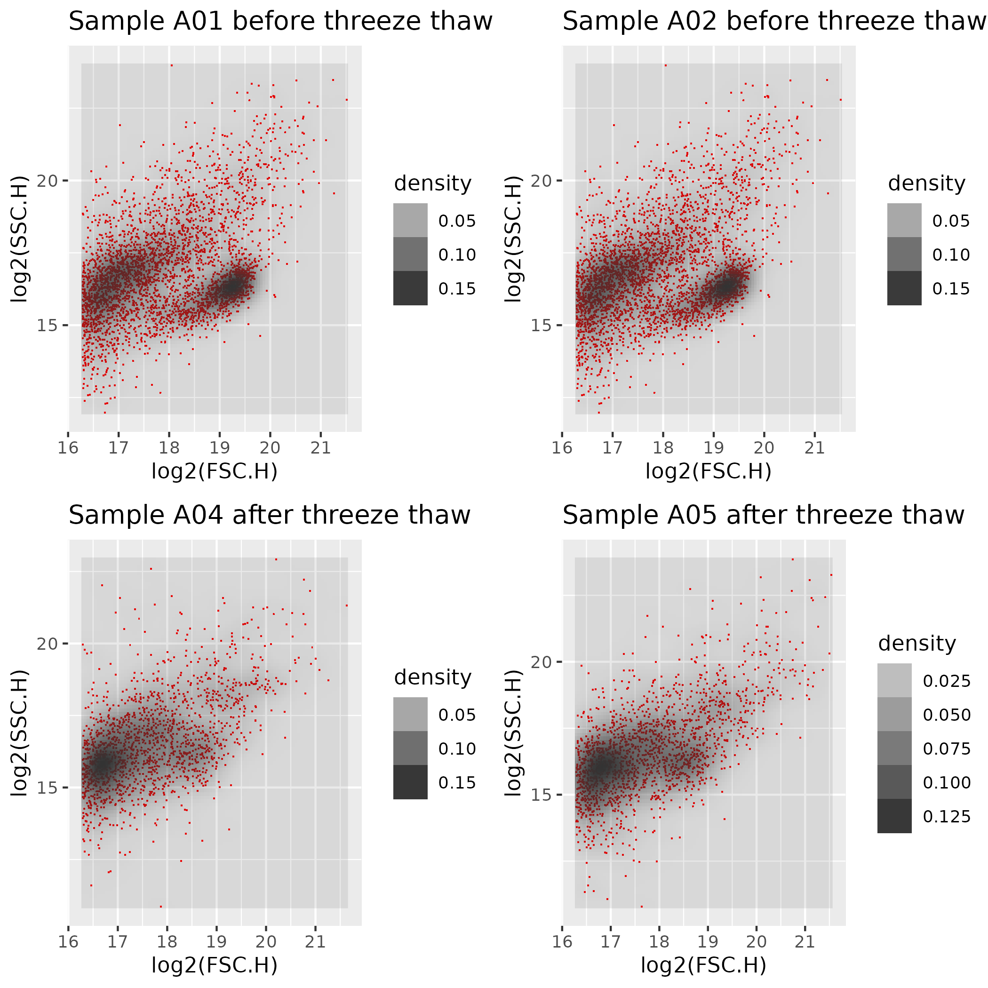
Freeze thaw method
Method used in Micha's project to kill bacteria
Shows a disappearing cluster in samples following freeze thaw

Slide 5

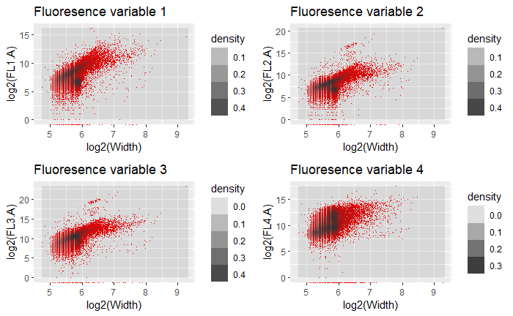
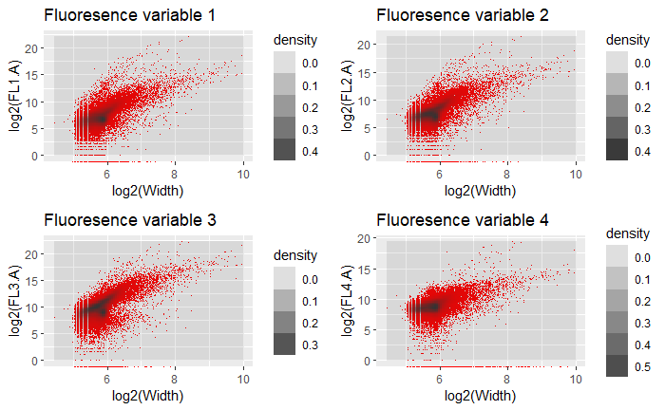
Coloring of the data
Used in a few samples to detect plastics using fluorescence data
Doesn’t show expected effect
Fluorescence can still be used

Slide 6
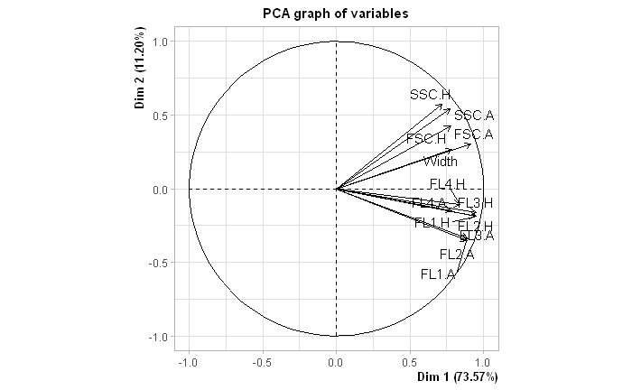
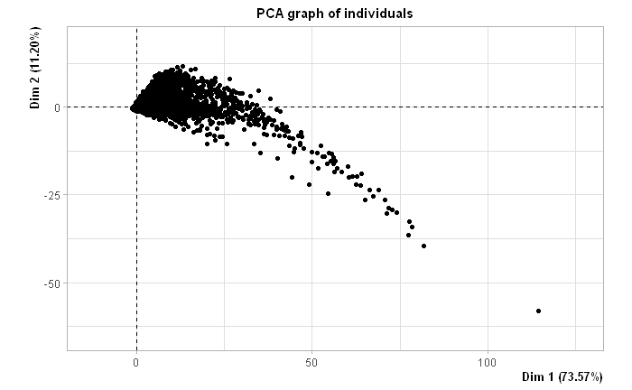
PCA
Used to find variance in variables

Slide 7
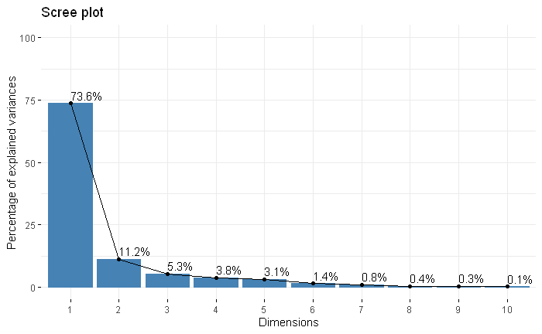
PCA
Used to find variance in variables

Slide 8
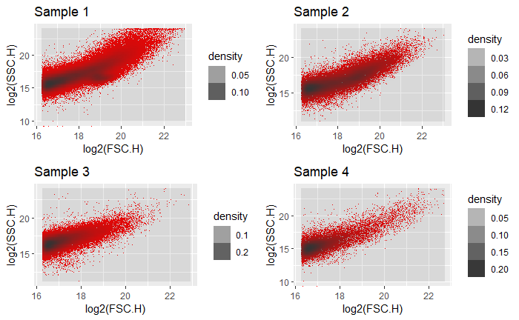
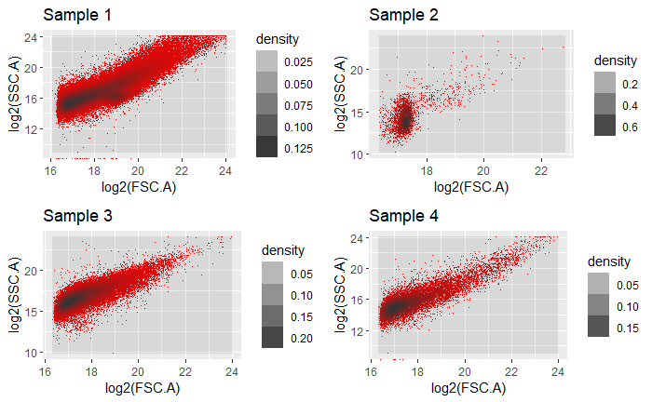
Difference in samples

Slide 9

Finalized dataset
Sample 1
No special cases
Incorrect files removed

Slide 10
Positives
Found difference in bacteria and plastics with freeze thaw
Better overview of data
Dataset that can be used for machine learning
Clearer idea for result

Slide 11
Problems and bumps
Data processing took longer than planned
Machine learning not started yet
Data is hard to work with at times
Side goal of determining difference in bacteria seems unreachable

Slide 12
Objectives for next sprint
Create machine learning algorithm
Capable of classifying points as bacteria or plastics
Able to show plastic degradation over time
Usable to create a scoring system for plastic degradation

Slide 13




Any questions?

