Slide 1
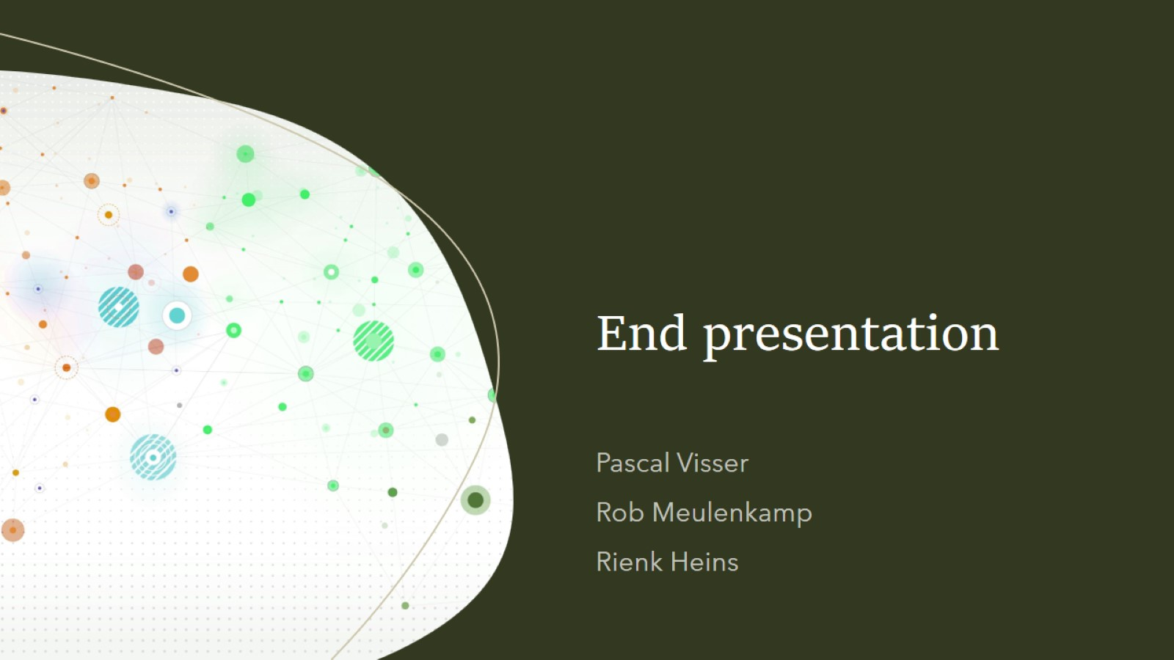
End presentation

Slide 2
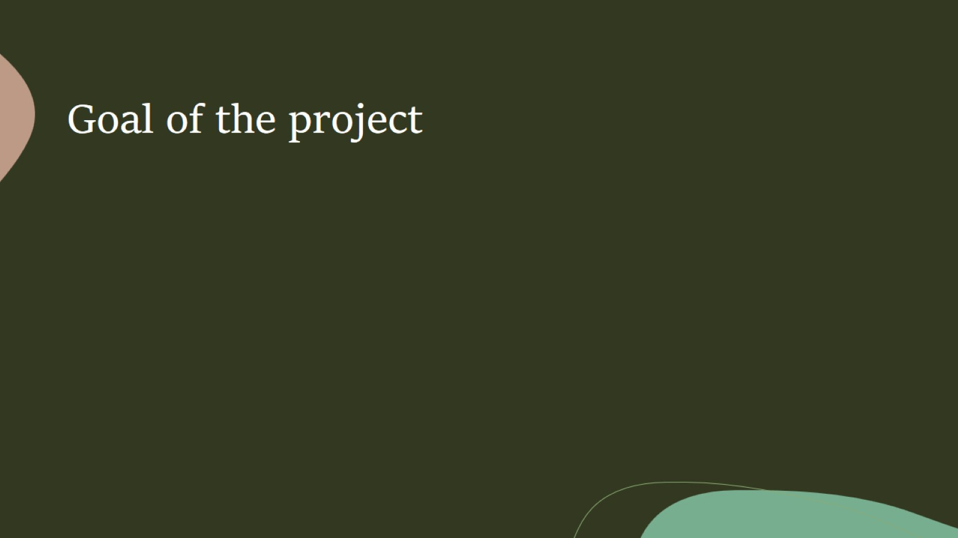
Goal of the project
Create an algorithm that can determine the degradation of bioplastics
Create an app and pipeline to use this algorithm for future research

Slide 3
Created products: - Pipeline with HBDSCAN algorithm - Application

Slide 4
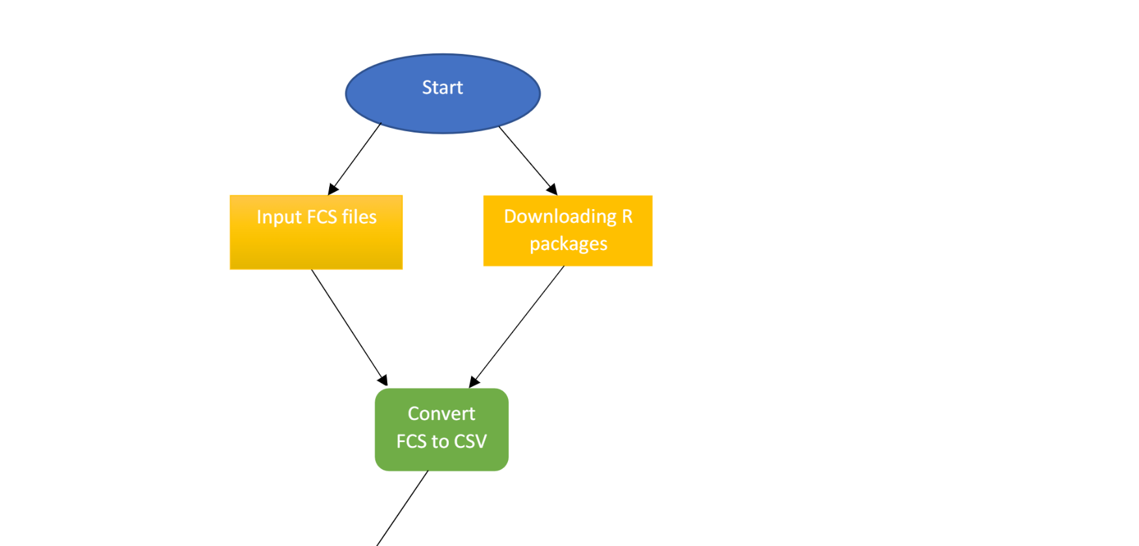
The pipeline

Slide 5

The pipeline

Slide 6
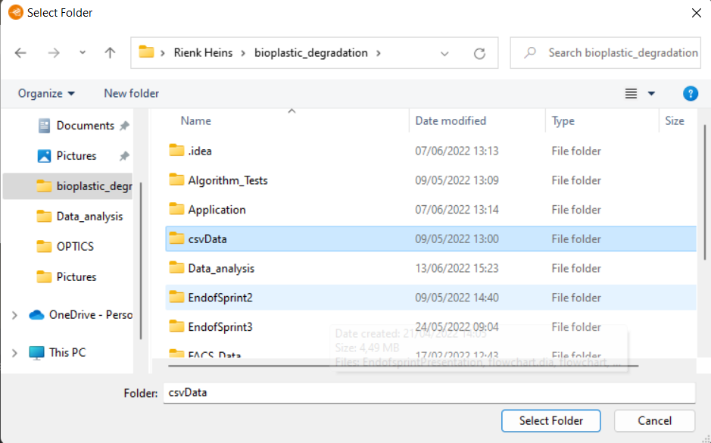
The application

Slide 7
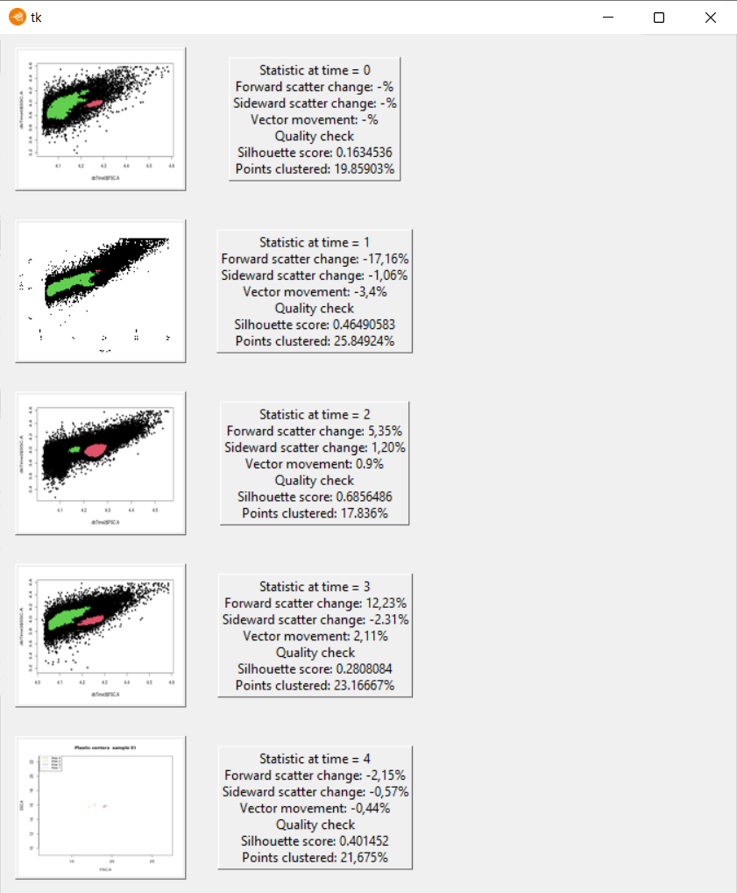
The application

Slide 8
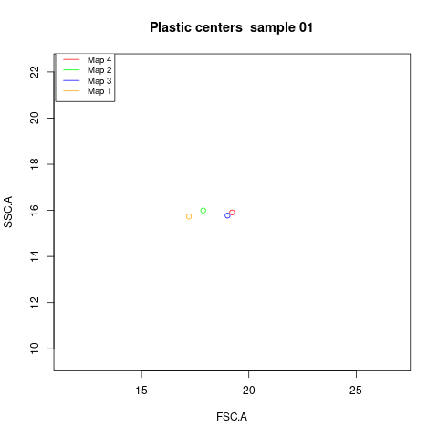
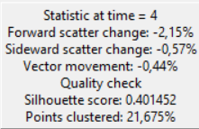
End result

Slide 9
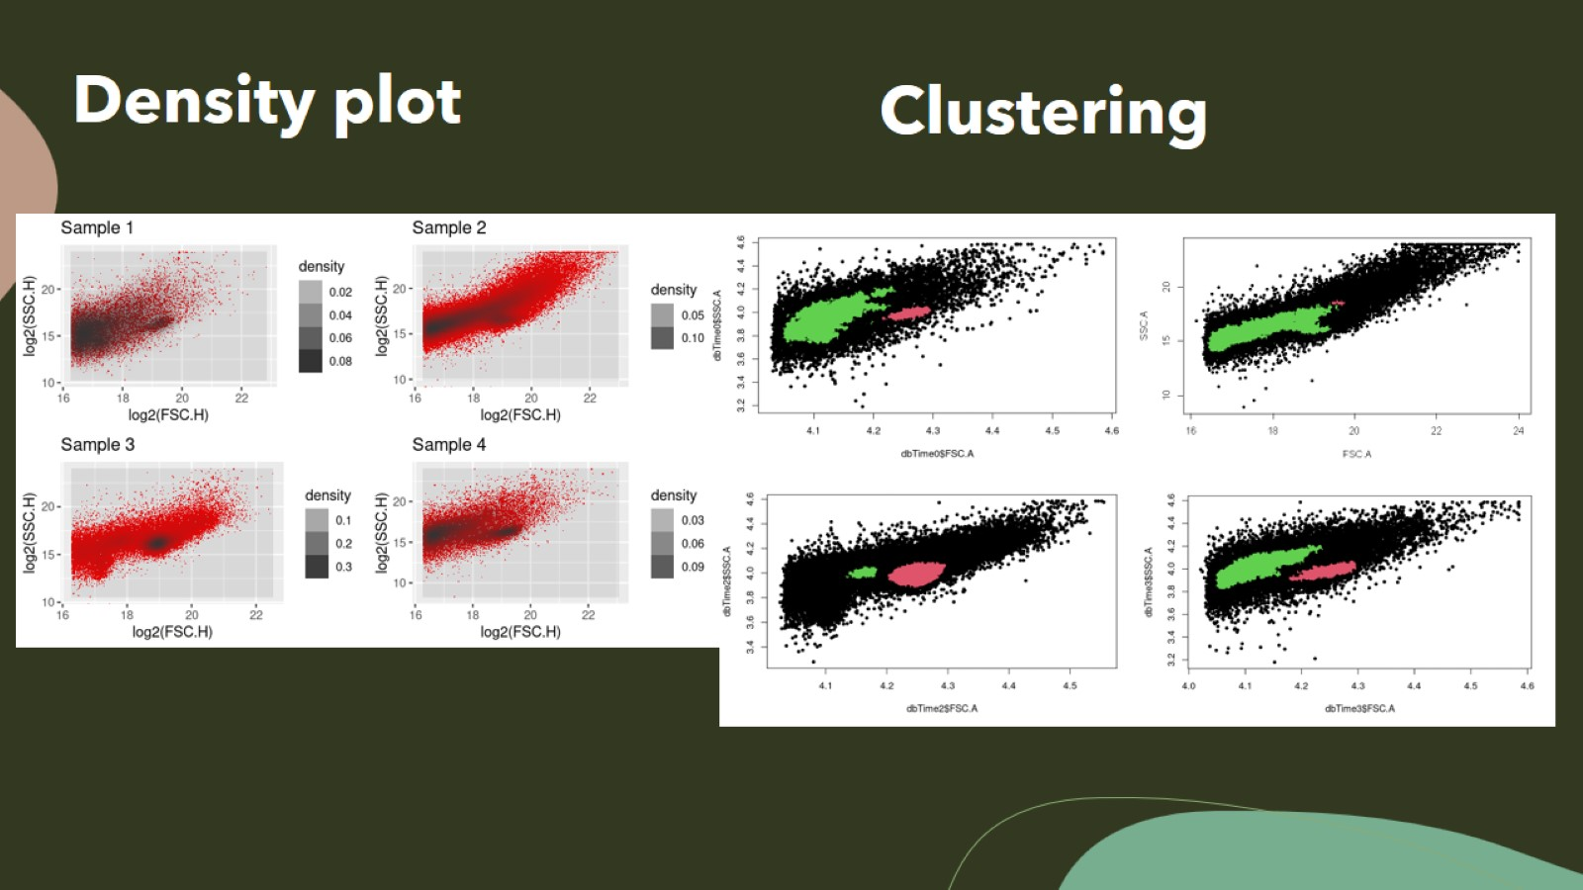
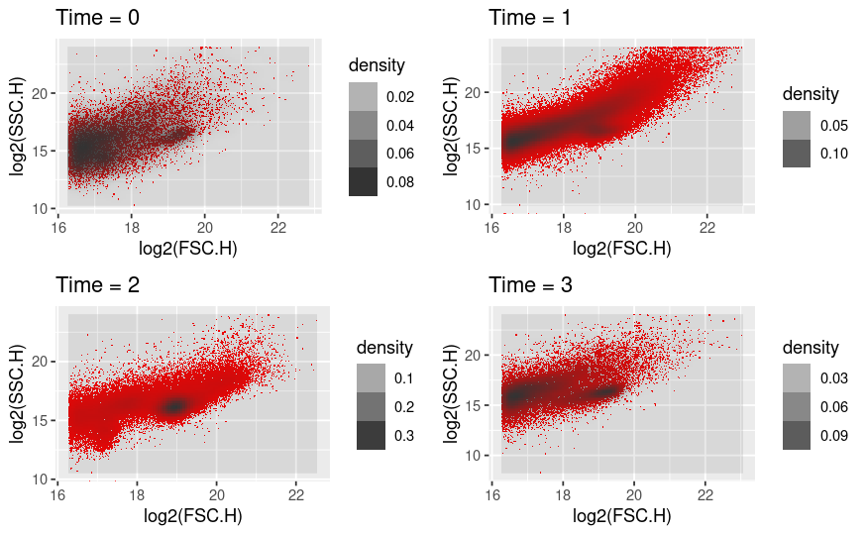

Slide 10
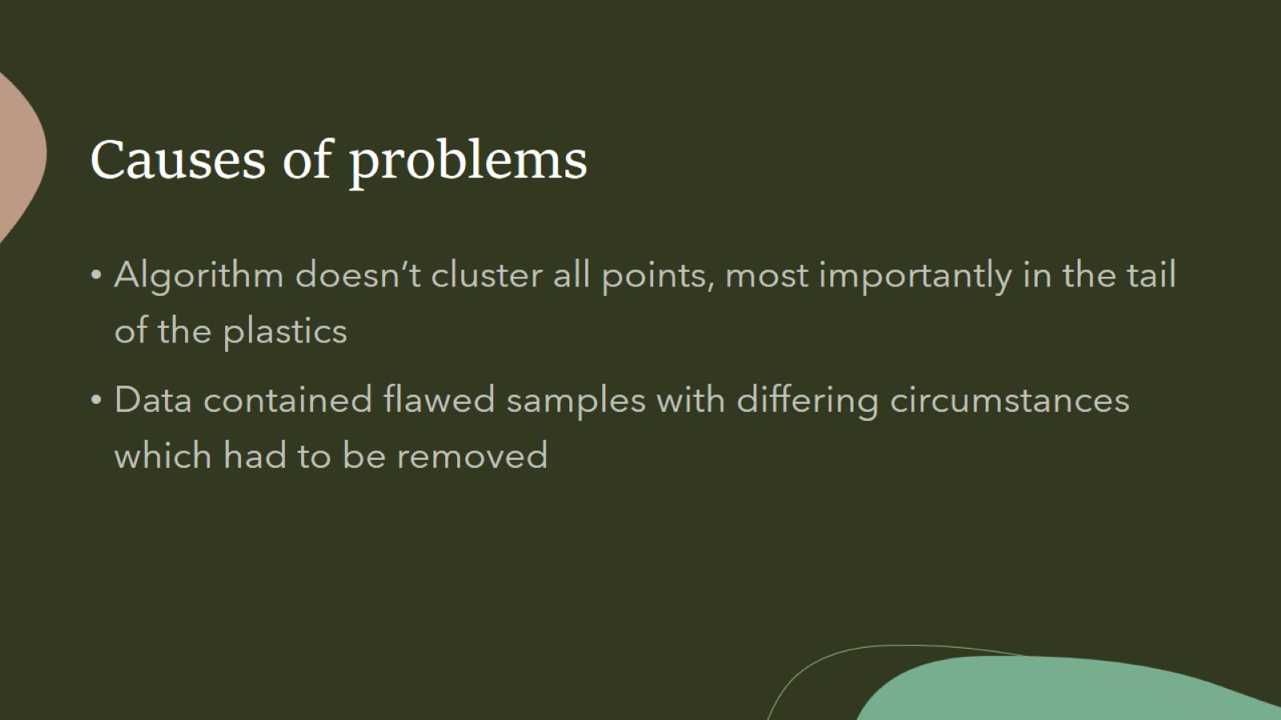
Causes of problems

Slide 11
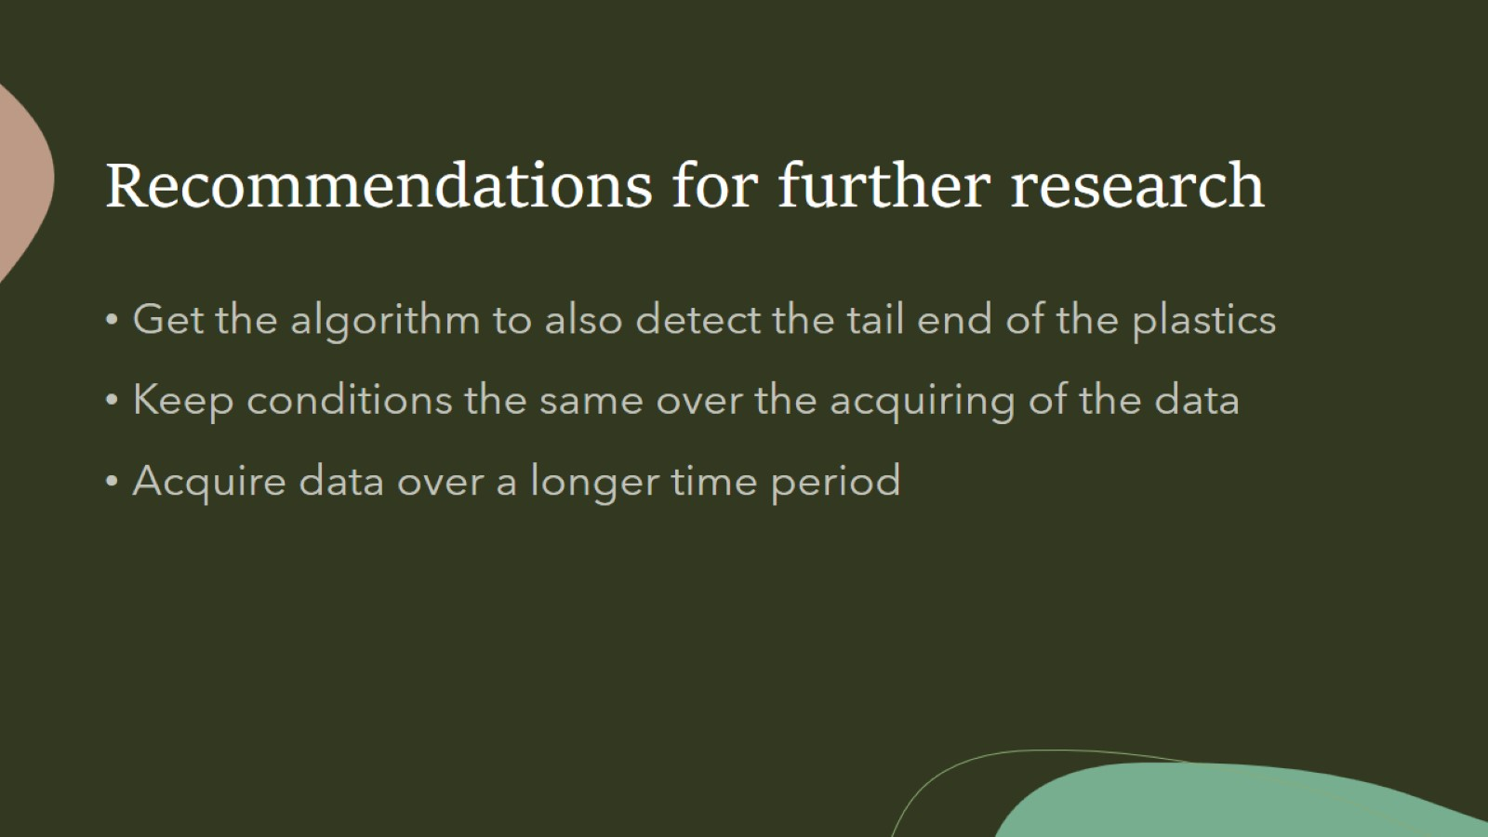
Recommendations for further research

Slide 12

Questions?

