Slide 1
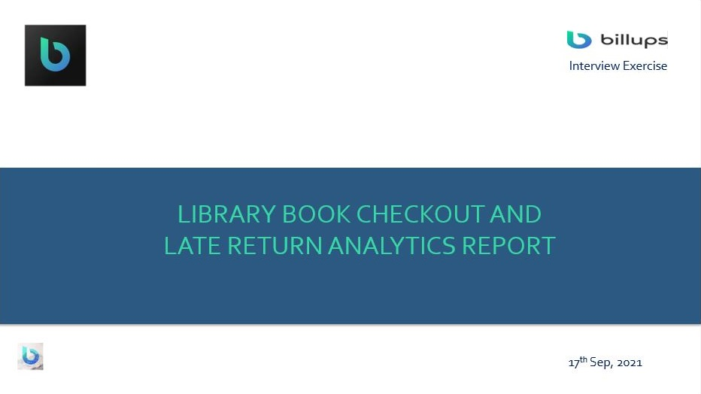

Slide 2




Book Checkout and Return Analysis
Based on the distribution of customers by level of education and state, a higher proportion of customers who access the libraries are High School students and 93% of the entire customers live in Oregon.
COUNT OF DISTINCT LIBRARIES
COUNT OF DISTINCT BOOKS
COUNT OF DISTINCT CUSTOMERS
Level of
Education
104 (5%)
High School
476 (24%)
506 (25%)
College
Graduate Degree
2,000
Others
Males customers (967) who have accessed the libraries are more than the females. However, the gender of 101 customers are not defined.
Oregon
1,851 (93%)
461 (23%)
Undefined
State
453 (23%)
Undefined
102 (5%)
Count of Customers by Gender
Washington
47 (2%)
967
932
2,000
Male customers (70) return checked out books late compared to the female (60) customers.
Gender
Male
Female
Undefined
Count of Customers by Age
Customers above age 50 (>50 Years) return checked out books late compared to customers within other age range.
546
2,000
Count
<30 Years
(30 - 50) Years
>50 Years
Undefined
The age of customers who have accessed the libraries more fall within the age of 30 to 50 years. However, the age of 413 customers who have accessed the libraries are not defined.

Slide 3
TOTAL COUNT OF CUSTOMERS
TOTAL COUNT OF BOOKS
TOTAL COUNT OF LIBRARIES
TOTAL LATE RETURN(>28 DAYS)
TOTAL EARLY RETURN(>28 DAYS)
2000
240
18
132 Times
1318 Times
Books above 500 pages are returned late than books with less than 50 pages. Also, the price of books is seen to have an impact on the late returns of books as more customers checkout books within 100.00 and 500.00 price range. However, 29% of customers who lives in Washington return books after 28 days which is considered late.
Across Education level, college customers has the highest impact of late book returns compared to other levels.
For customers across different occupations, the Business & Finance customers pool the highest proportion of late returned books.
Count of Customers by City and Books Return Period
Count of Books by Price Range and Return Period
Count of Books by Pages and Return Period
>28days (Late Return)
<=28days (Early Return)
Portland
85 (7%)
1,181 (93%)
Vancouver
9 (31%)
20 (69%)
Lake Oswego
5 (22%)
18 (78%)
Happy Valley
5 (23%)
17 (77%)
Beaverton
9 (47%)
10 (53%)
Count of Customers by State and Books Return Period
Distribution of Customers by Education and Books Return Period
Distribution of Customers by Occupation and Books Return Period
<=28days (Early Return)
>28days (Late Return)
Education | <=28days (Early Return) | >28days (Late Return) | Total
College | 305 (89%) | 38 (11%) | 343
Graduate Degree | 293 (92%) | 26 (8%) | 319
High School | 348 (92%) | 30 (8%) | 378
Others | 314 (91%) | 31 (9%) | 345
Undefined | 58 (89%) | 7 (11%) | 65
Total | 1318 | 132 | 1450
Occupation | <=28days (Early Return) | >28days (Late Return) | Total
Admin & Support | 194 (90%) | 21 (10%) | 215
Blue Collar | 170 (92%) | 15 (8%) | 185
Business & Finance | 171 (88%) | 23 (12%) | 194
Education & Health | 191 (92%) | 17 (8%) | 208
Others | 173 (92%) | 15 (8%) | 188
Sales | 164 (90%) | 18 (10%) | 182
Tech | 178 (90%) | 19 (10%) | 197
Undefined | 77 (95%) | 4 (5%) | 81
Total | 1318 | 132 | 1450
20 (71%)
1,233 (91%)
8 (29%)
116 (9%)
Oregon
Washington

Slide 4
Observation
Male customers (70) return checked out books late compared to the female (60) customers.
Customers above age 50 (>50 Years) return checked out books late compared to customers within other age range.
Books above 500 pages are returned late than books with less than 50 pages. Also, the price of books is seen to have an impact on the late returns of books as more customers checkout books within 100.00 and 500.00 price range. However, 29% of customers who lives in Washington return books after 28 days which is considered late.
Across Education level, college customers has the highest impact of late book returns compared to other levels.
For customers across different occupations, the Business & Finance customers pool the highest proportion of late returned books.
Customers who lives in Beaverton has the highest proportion of late returned books. However, Portland has the largest count of customers which if proportional to the number of late returned books.
Recommendation
All factors connected with the late return of books, minimum of 20p and £5 maximum per day charge (according to the age group, education and occupation) for an overdue book should automatically be applied to customers’ profile/account and borrowing privileges suspended if charges accumulates to £20 and above. These conditions should be applied to customers across all segments (i.e. gender, age, occupation, education, and location).
The more pages a book has, the longer a customer takes to return after checkout time. Return period of books should be based on the number of pages; books with 500 pages and above should be given more time of return than books with fewer pages.
Customer engagement/intervention should be adopted towards borrowed book due dates. A “kind reminder” mail should be sent to customers few days to their due dates, stating the implication of overdue books and the charges incurred daily after their due dates.

Slide 5
