Slide 1

Biodiversity Analysis and Conservation Insights
Analyzing Species Data to Drive Conservation Decisions
by
Paschalis Agapitos

Slide 2
Introduction
Objective: Analyze biodiversity data to uncover patterns and insights
Dataset: Summary of biodiversity-related data
Approach:
Data preparation
Visualisation & Analysis
Key findings

Slide 3
Data Overview
Datasets:
`observations`: contains observations of species in various national parks, including scientific names, park names, and observation counts
`species_info`: provides species information, including taxonomic categories, scientific names, common names, and conservation status
Key Observations:
5,824 species records.
Conservation status available for only 191 species.
Categories include Mammals, Birds, Reptiles, and more.

Slide 4
Methods
Data Cleaning: Addressed duplicates, missing values, and ensured consistency in datasets.
Exploratory Data Analysis (EDA): Identified trends, patterns, and potential outliers in the biodiversity data.
Integration of Multiple Datasets: Combined species observations with taxonomic information for comprehensive analysis.
Statistical Insights: Extracted metrics such as species frequency, regional diversity, and conservation status distribution.

Slide 5
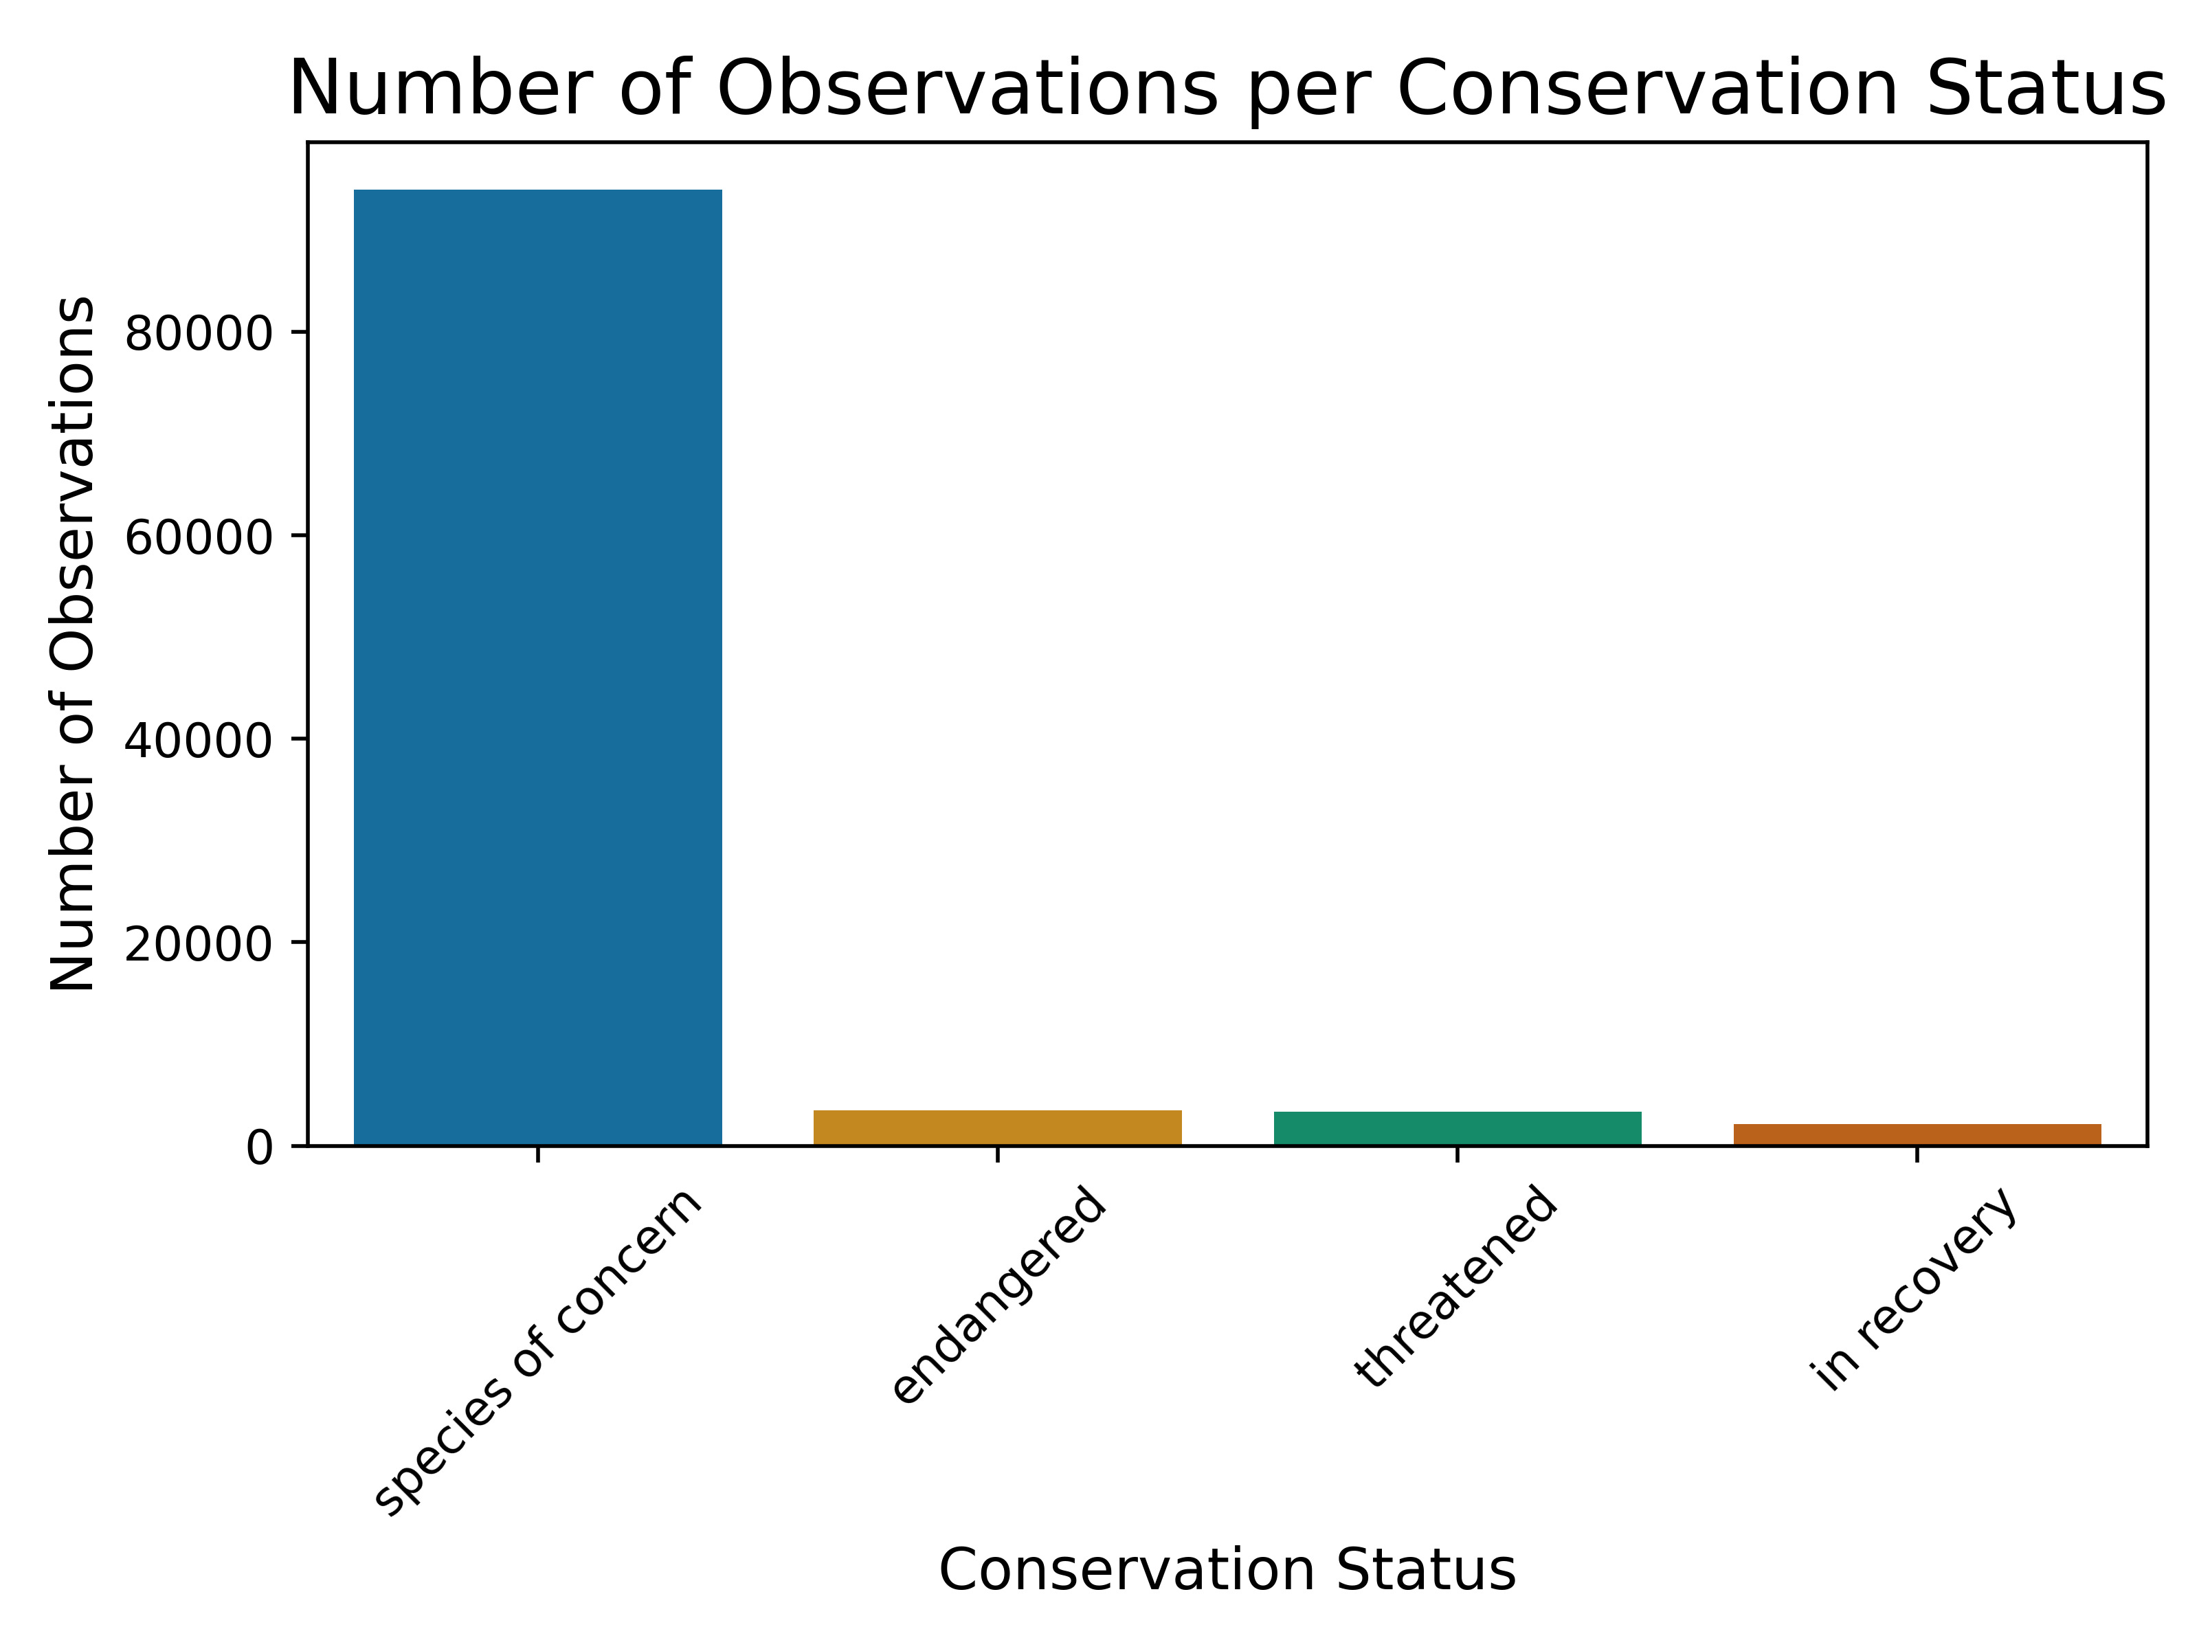
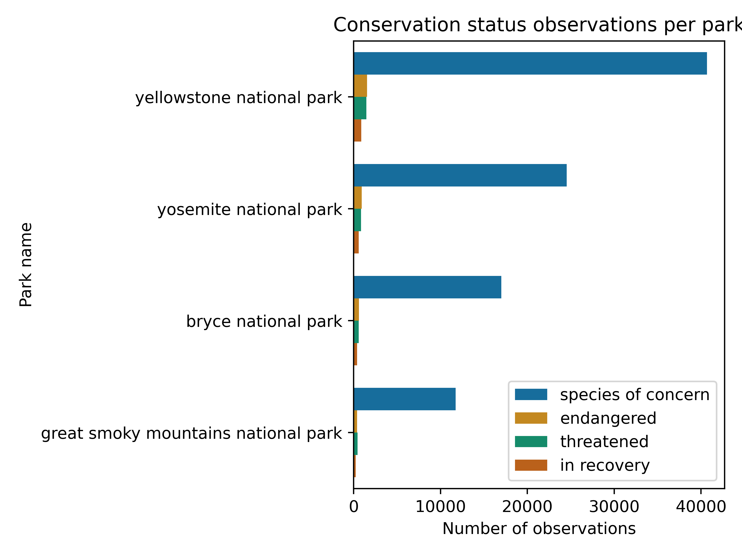
Exploratory Data Analysis (1)

Slide 6
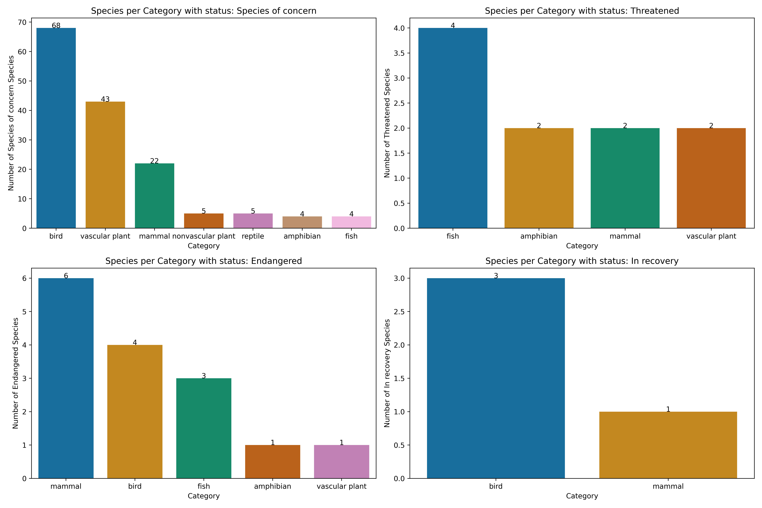
Exploratory Data Analysis (2)
species of concern dominate the conservation status across all parks (93962).
birds are more likely to be in recover or of concern
mammals are more likely to be endangered
fishes most likely are threatened species’ categories

Slide 7
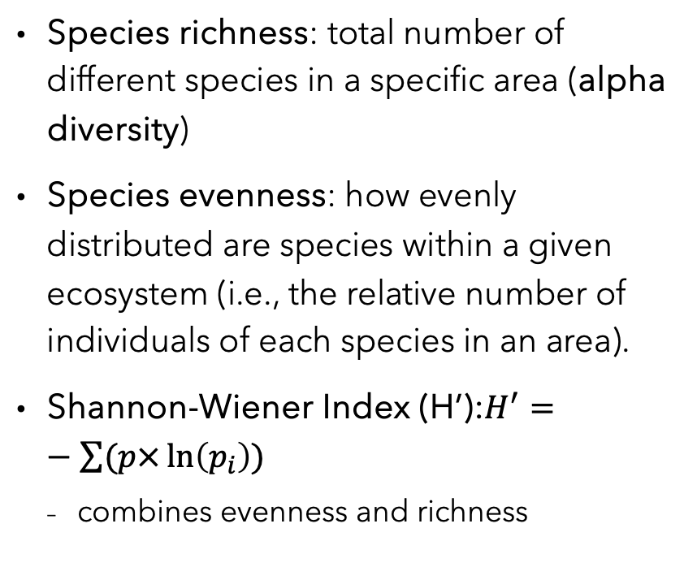
Biodiversity Analysis (1)
Species richness: total number of different species in a specific area (alpha diversity)
Species evenness: how evenly distributed are species within a given ecosystem (i.e., the relative number of individuals of each species in an area).
Shannon-Wiener Index (H’):$H^{′}=−\sum{(p×\ln\left(p_{i}\right))}$
combines evenness and richness
park name | species richness | species evenness | H’
Bryce | 5541 | 1.014 | 8.742
Great Smoky Mountains | 5541 | 1.012 | 8.725
Yellowstone | 5541 | 1.016 | 8.760
Yosemite | 5541 | 1.015 | 8.754

Slide 8
Biodiversity Analysis - Findings
The slight differences in H' values are driven by how evenly species are distributed across the parks.
Yellowstone has the most even distribution.
Great Smoky Mountains is slightly less balanced.

Slide 9
Is there an association between the species’ cateogories and the conservation status?
Data Preparation: Removed missing values, ”in recovery” are labeled as “safe” (24) and the rest as ”danger” (856)
Chi-Square Test Findings:
Null hypothesis (H₀): There is no association between a species' category (e.g., bird, mammal) and its status (e.g., danger, safe).
Alternative hypothesis (H₁): There is some association between category and status
P-value: ≈ 0.026 (Significant at α = 0.05).
Interpretation:
H₀ is rejected, indicating a significant association between species category and their conservation status.

Slide 10
Which categories drive the association?
Post-hoc analysis findings:
mammals which have more safe individuals than expected (2.255)
vascular plants which have fewer safe individuals than expected (2.240)
Interpretation:
the species categories that drive the association observed in the significance test (chi-squared test) are mammals and vascular plants

