Slide 1
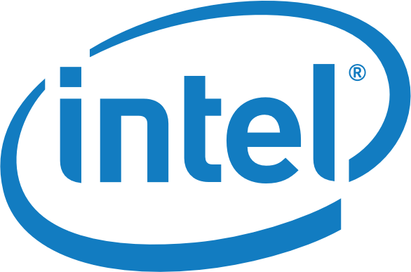

Powered by
DPDK Enabled Virtual Traffic Classifier over SR-IOV accelerated networks
Akis Kourtis - NCSR Demokritos

Slide 2
vTC Progress
Successfully integrated vTC into DPDK framework
Performance Benchmark with 2 scenarios
One physical DPDK vs PCAP
One virtualized, on SR-IOV enabled environment
DPDK vs PCAP
All scenarios are done with DPDK vs PF_RING vs Docker(PF_RING)
Implementation of a SR-IOV environment with near line-rate capabilities
DPDK integration on a virtualized environment
OpenStack traffic mirroring implementation, with OVS manual modifications.

Slide 3
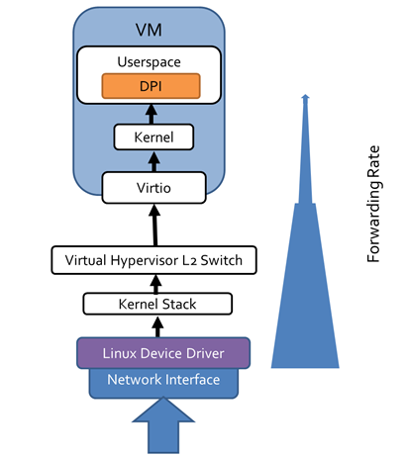
Standard Architecture

Slide 4
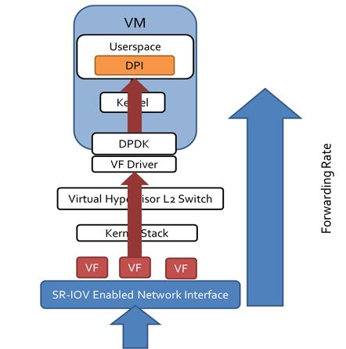
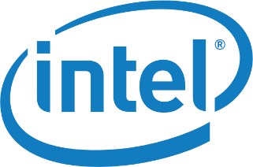

SR-IOV Enabled Architecture with DPDK

Slide 5
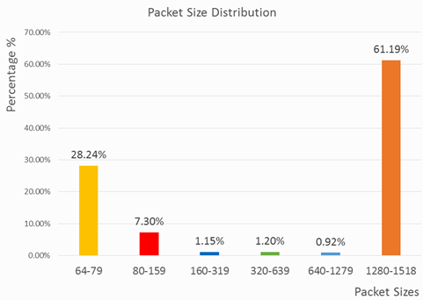
SR-IOV Enabled Architecture with DPDK

Slide 6
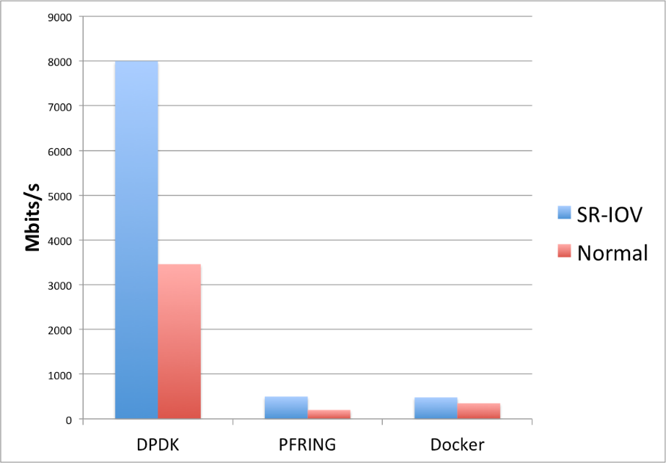


Experimental results for all scenarios

Slide 7
OpenStack Deployment
VNF deployments in an OpenStack generate various networking issues
Service Function Chaining (SFC)
Traffic forwarding / Mirroring
Inter-VM communication
VNFC is directly connected to virtual network interface of another VNFC’s,
Requires modification of Neutron’s OVS.
Each virtual network interface of a VNFC is reflected upon
one TAP-virtual network kernel device
a virtual port on Neutron’s OVS
a virtual bridge connecting them.

Slide 8
OpenStack Deployment
Direct connect virtual kernel interfaces of the 2 VNFCs
Tap interfaces need to be shut down
Removed from the OVS-OpenStack br-int
Kernel Bridges removed
Openflow rule application at the Neutron OVS
All-forwarding policy between VNFC1 -> VNFC2
Tap interfaces up again in promiscuous mode!
All traffic goes from VNFC1 to VNFC2, no questions asked!

