Slide 1
RL: REINFORCE and PPO
Pavel E. Dolgirev

Slide 2
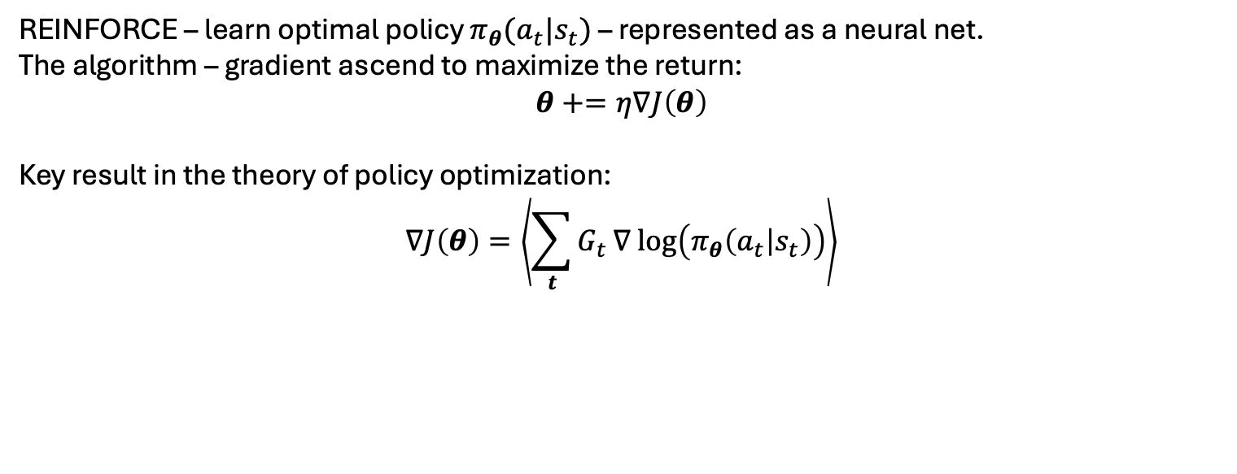

CartPole with REINFORCE
This is our baseline to beat
Max_num_steps = 500
REINFORCE – learn optimal policy $π_{θ}(a_{t}|s_{t})$ – represented as a neural net.
The algorithm – gradient ascend to maximize the return:
$$θ+=η∇J\left(θ\right)$$
Key result in the theory of policy optimization:
$$∇J\left(θ\right)=\left\langle \sum_{t}{G_{t}}∇ log\left(π_{θ}\left(a_{t} | s_{t}\right)\right)\right\rangle$$
Return that follows: $G_{t}=R_{t+1}+γR_{t+2}+…$

Slide 3
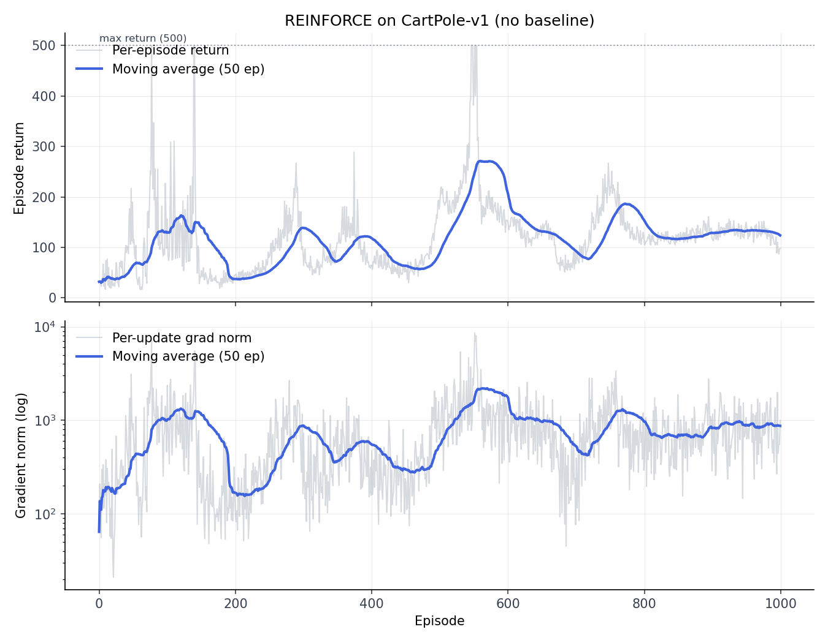
CartPole with REINFORCE, lr=1e-2
REINFORCE, no baseline
Trained policy = NN, one hidden layer, 128 neurons
Learning rate is such that when we get to have a good policy, it results in a large return, which also implies large gradient.
Large gradient then moves away from a good policy. Instability of convergence.

Slide 4
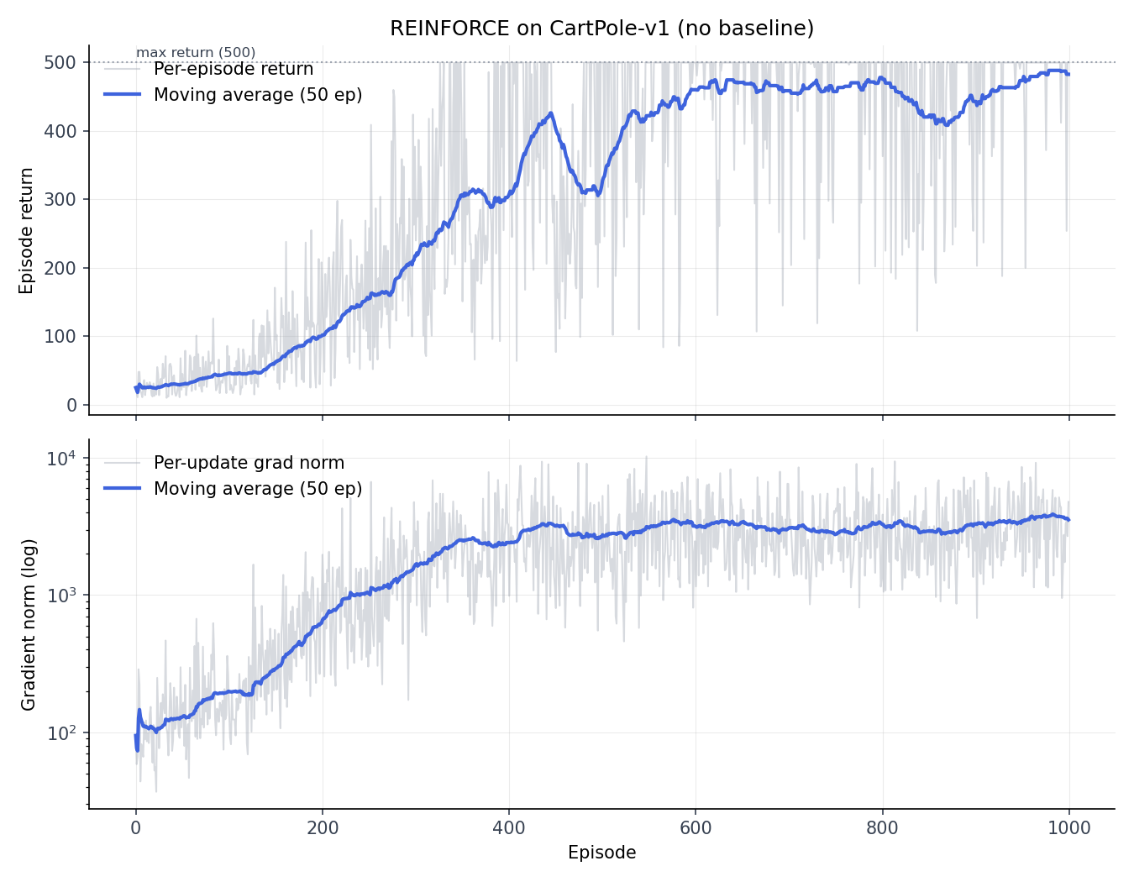
CartPole with REINFORCE, lr=1e-3
REINFORCE, no baseline, reduced LR
Small LR helped a lot but we still sometimes get instability and lose a good policy
Also note strong fluctuations in training

Slide 5
Five steps toward PPO
Batch episodes – simplest baseline
Value baseline (VPG)
Fixed-horizon rollout and bootstrapping
GAE
PPO

Slide 6
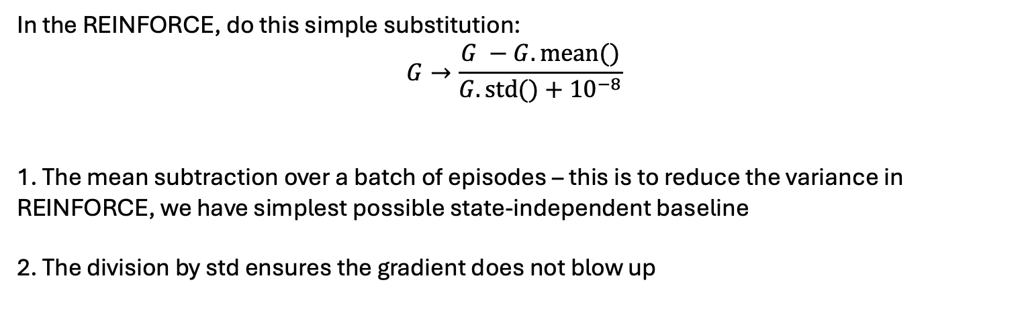
Step 1: batch-normalized returns
In the REINFORCE, do this simple substitution:
$$G→\frac{G −G.mean()}{G.std()+{10}^{−8}}$$
1. The mean subtraction over a batch of episodes – this is to reduce the variance in REINFORCE, we have simplest possible state-independent baseline
2. The division by std ensures the gradient does not blow up

Slide 7
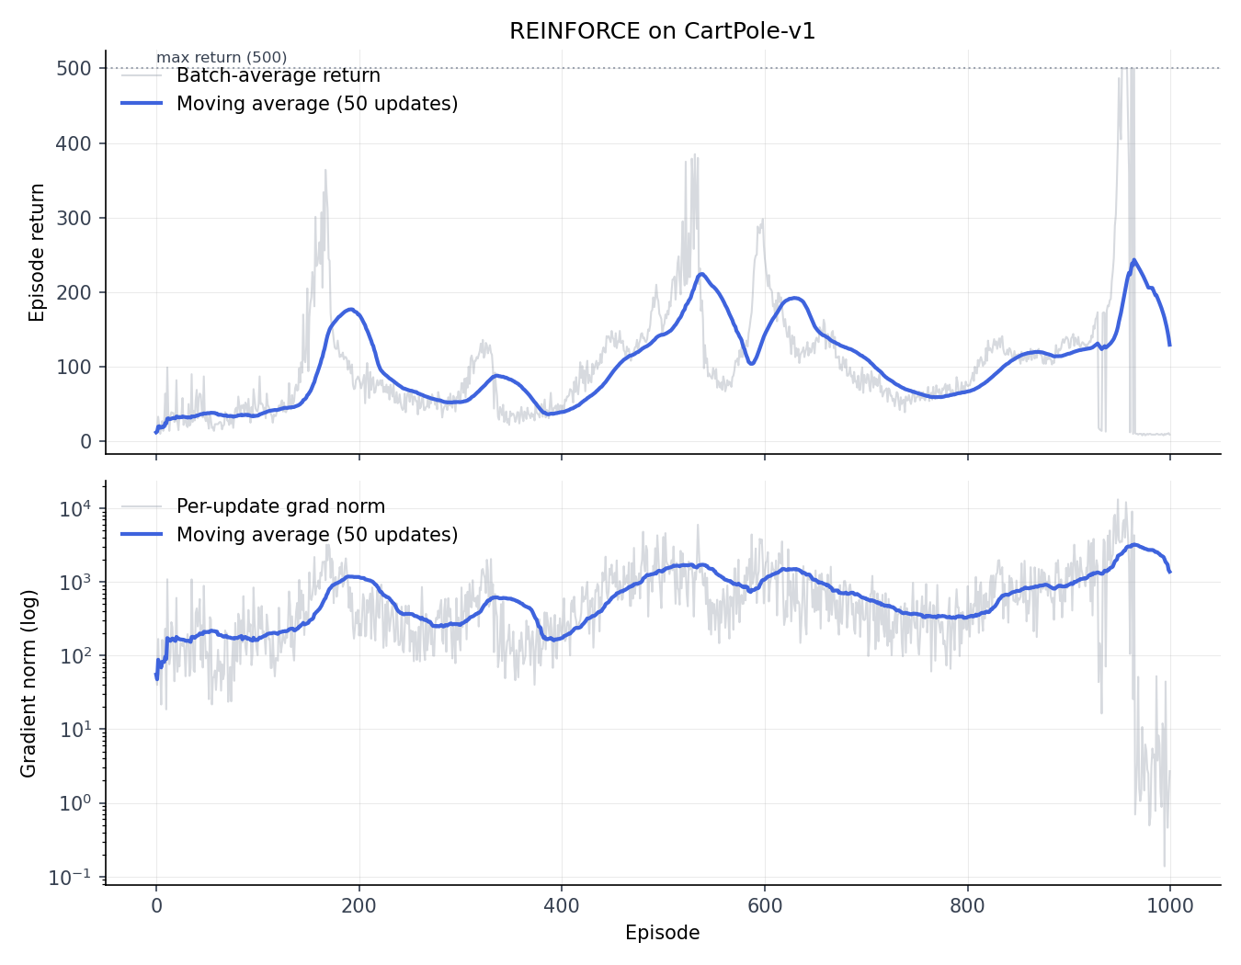
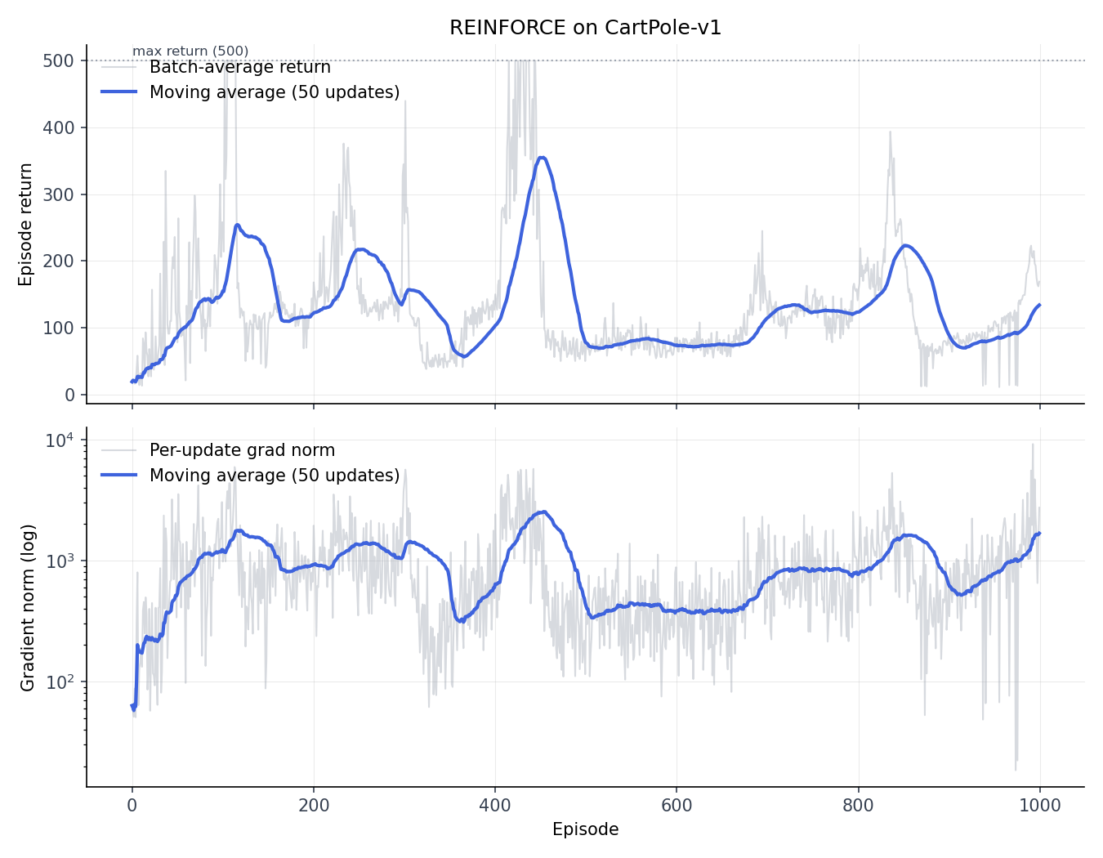
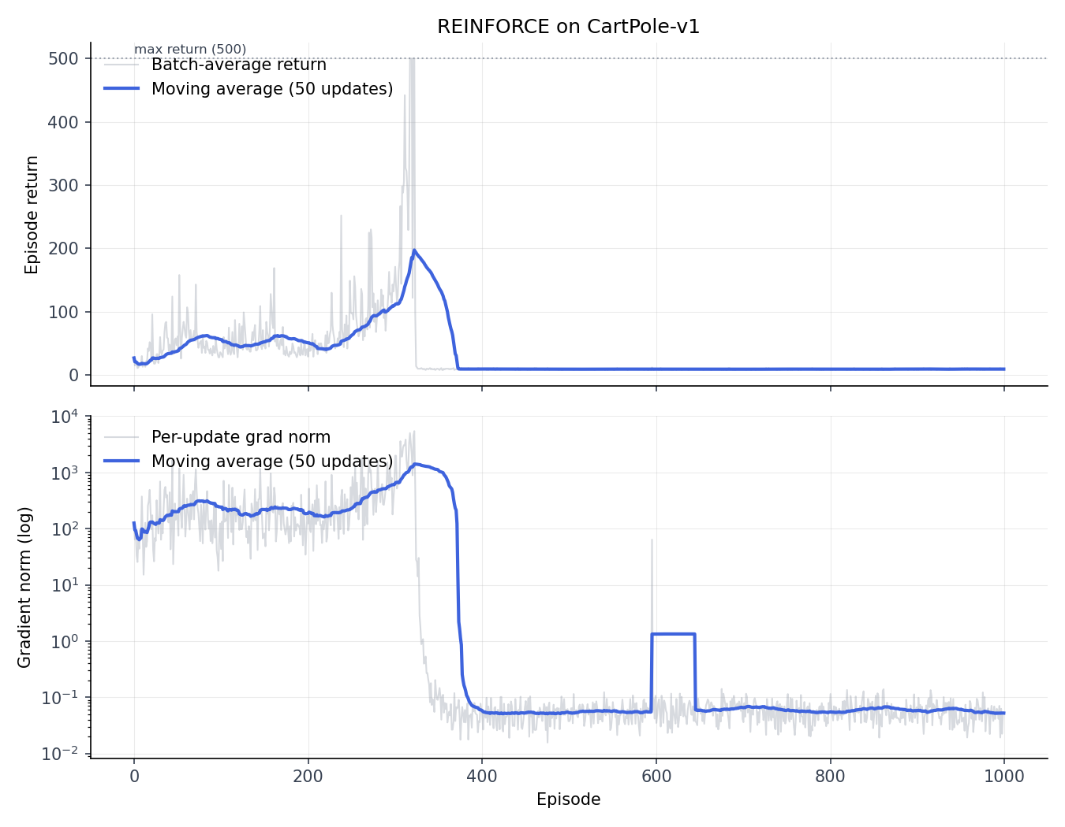
Seed-to-seed variation
Here N_batch = 1, lr = 1e-2
Note strong seed dependence
Note fluctuations
Note instability of the trajectories

Slide 8
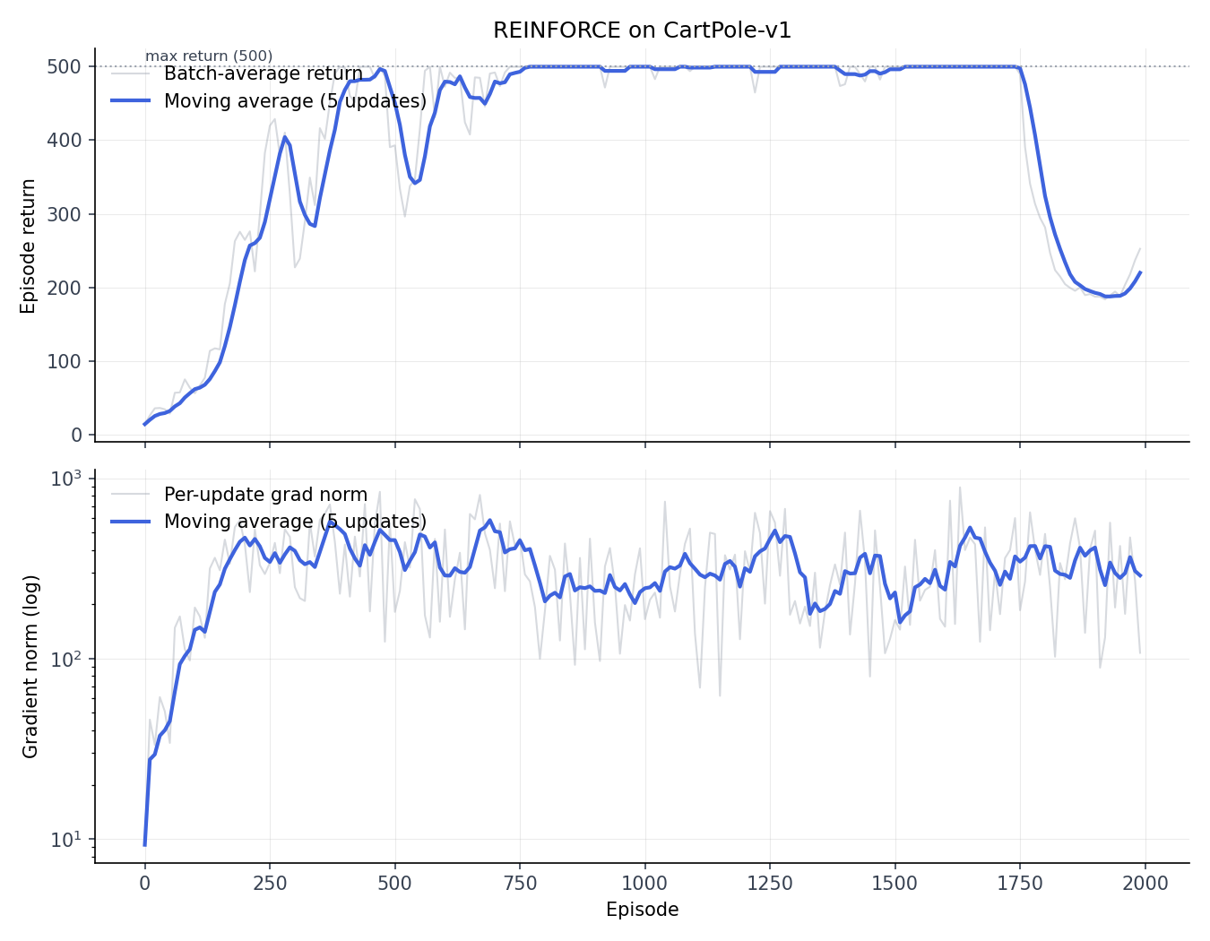
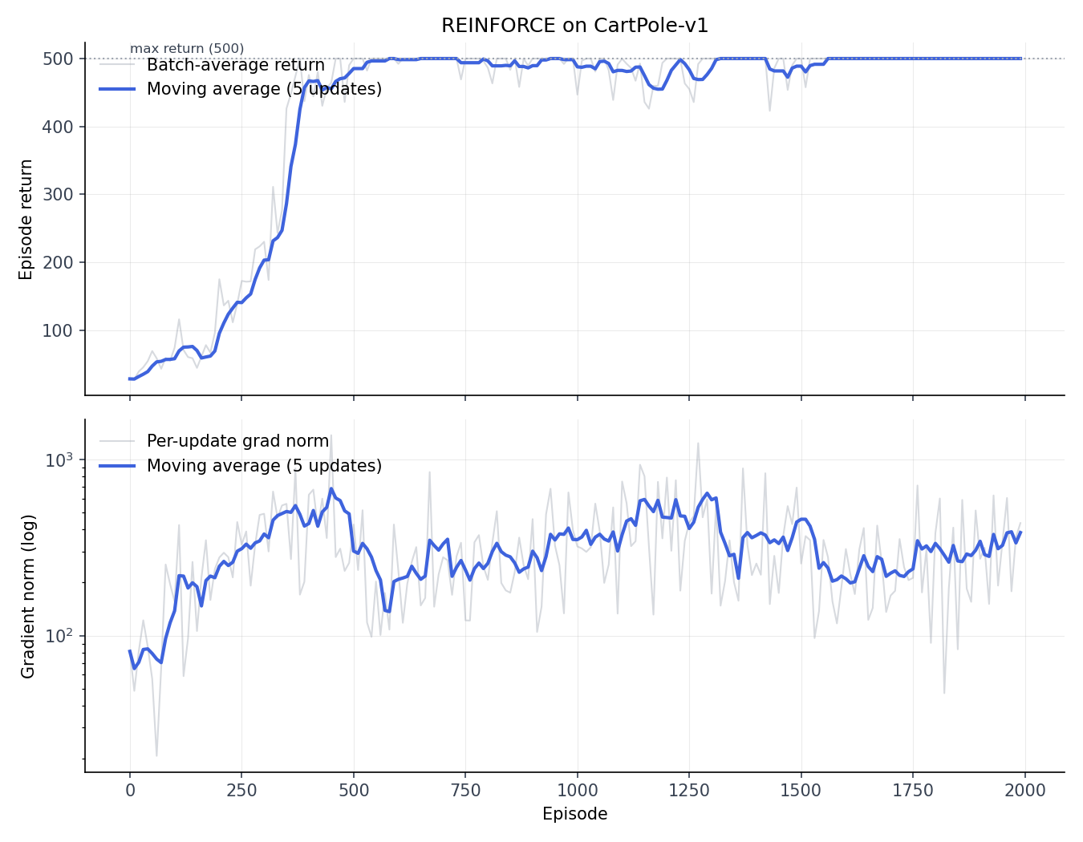
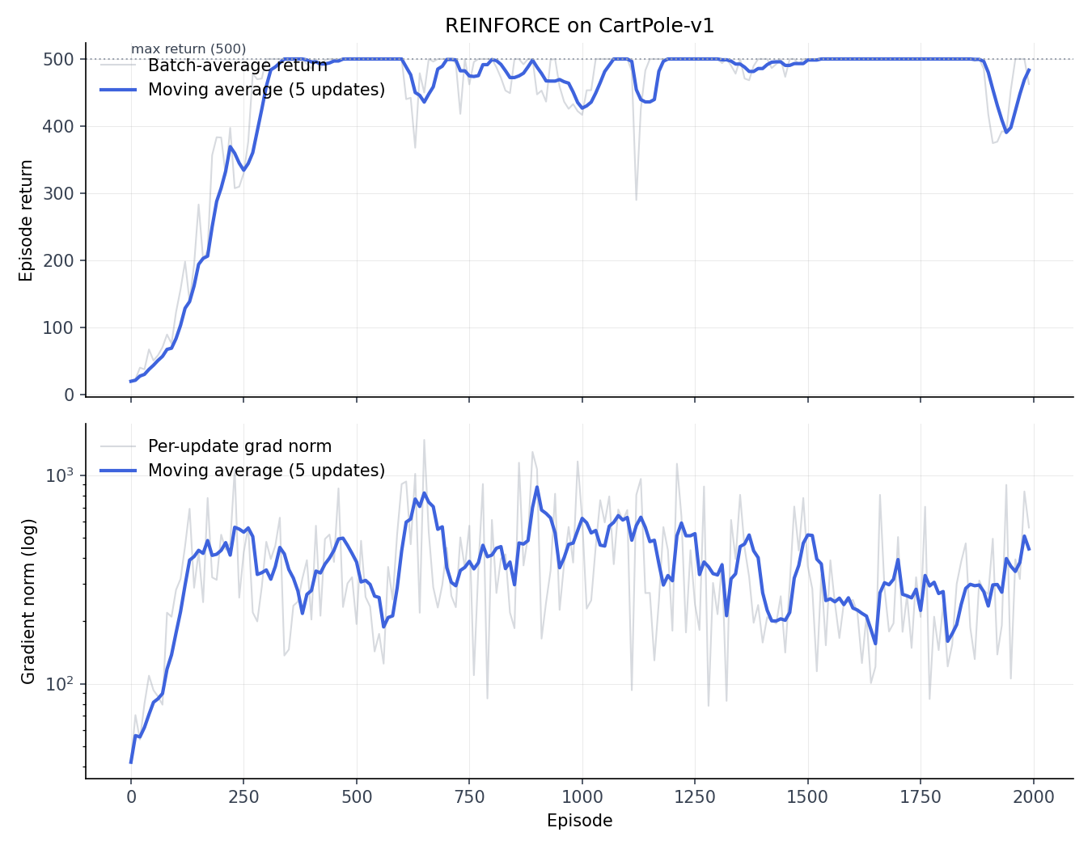
Subtract mean baseline
Here N_batch = 10, lr = 1e-2
Note significantly reduced noise
Node reduced seed dependence
Note reduced gradients

Slide 9
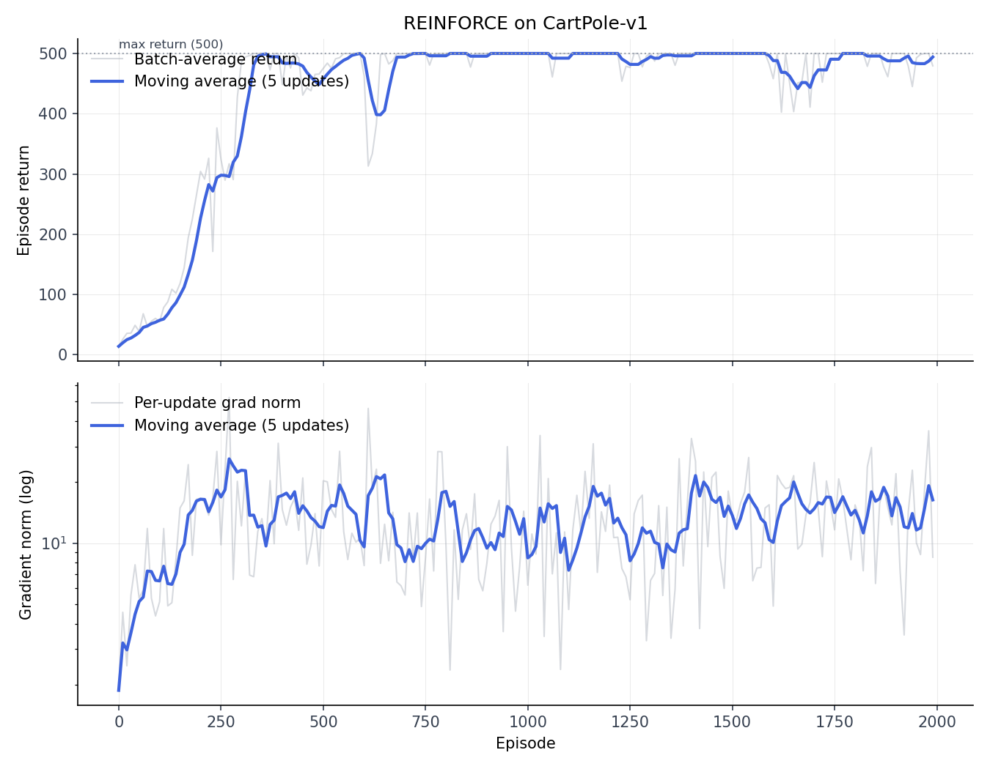
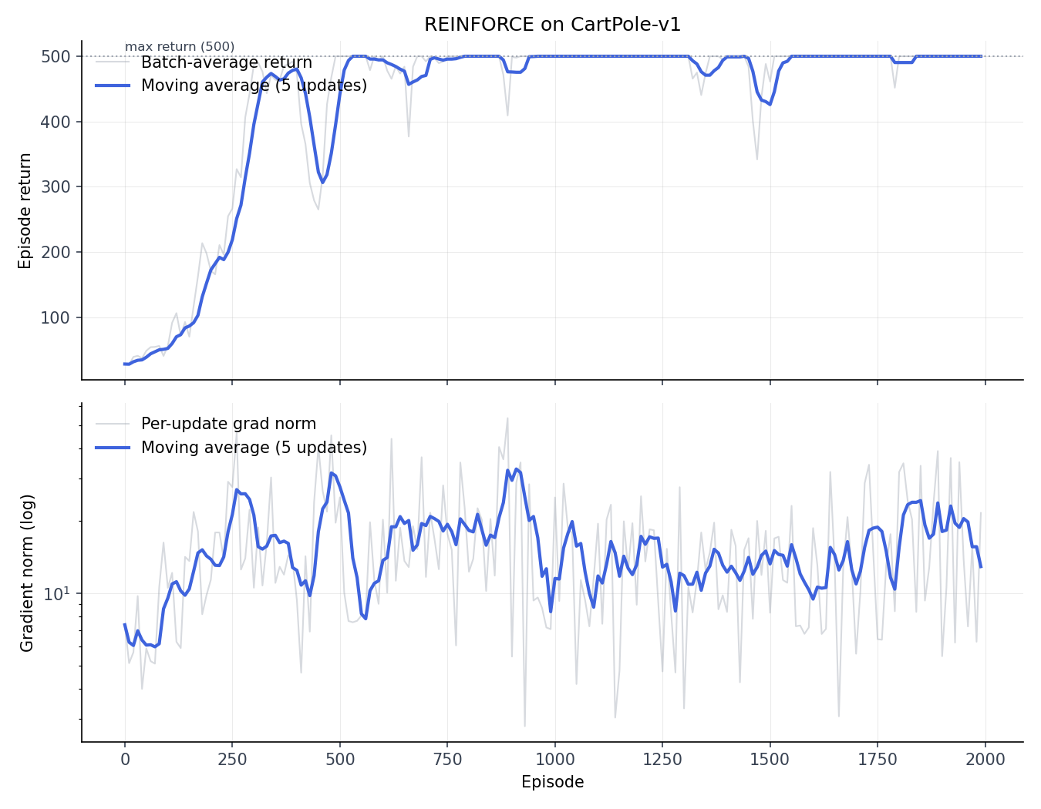
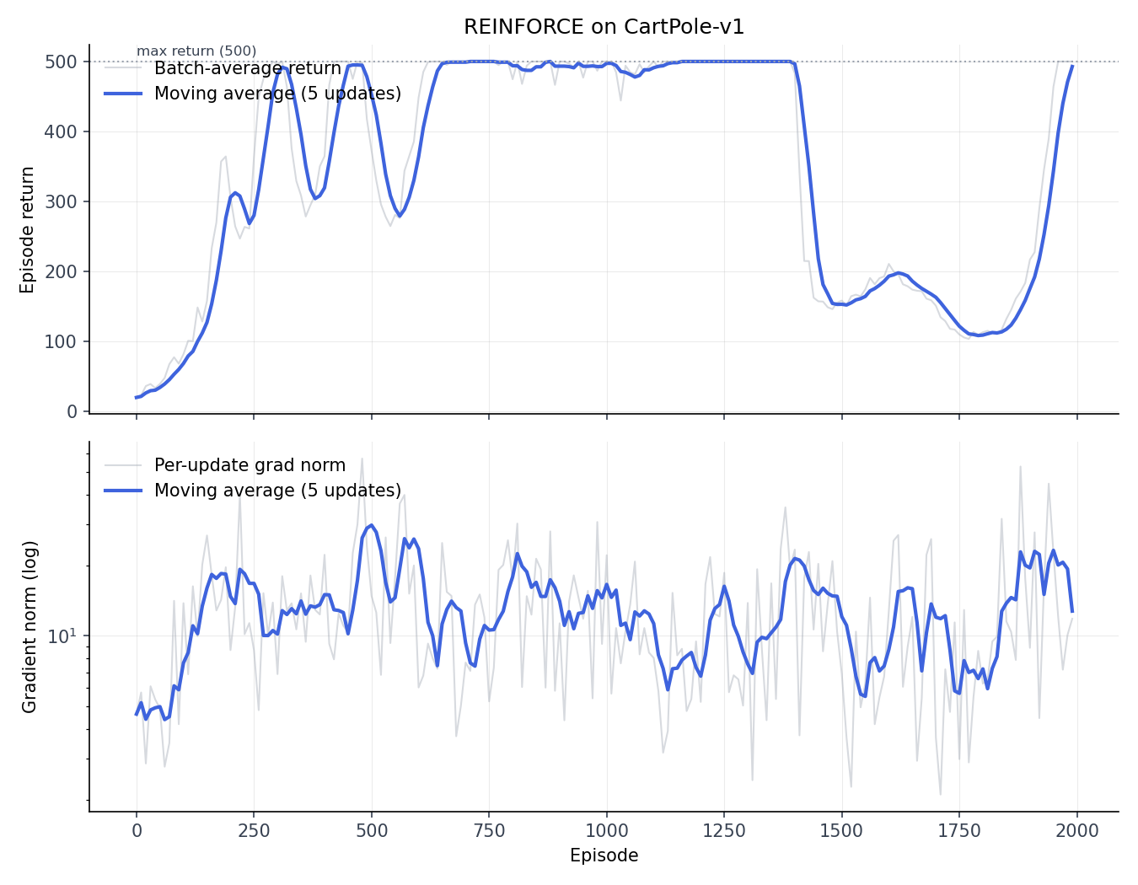
Subtract and normalize
Here N_batch = 10, lr = 1e-2
Note further reduction and stability of gradients

Slide 10
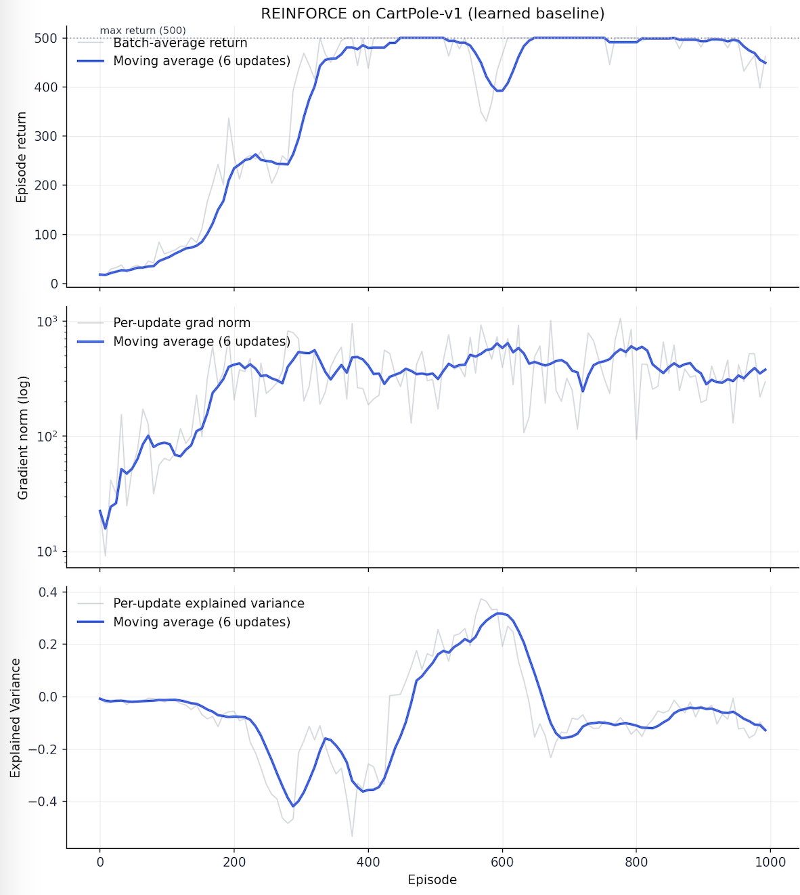
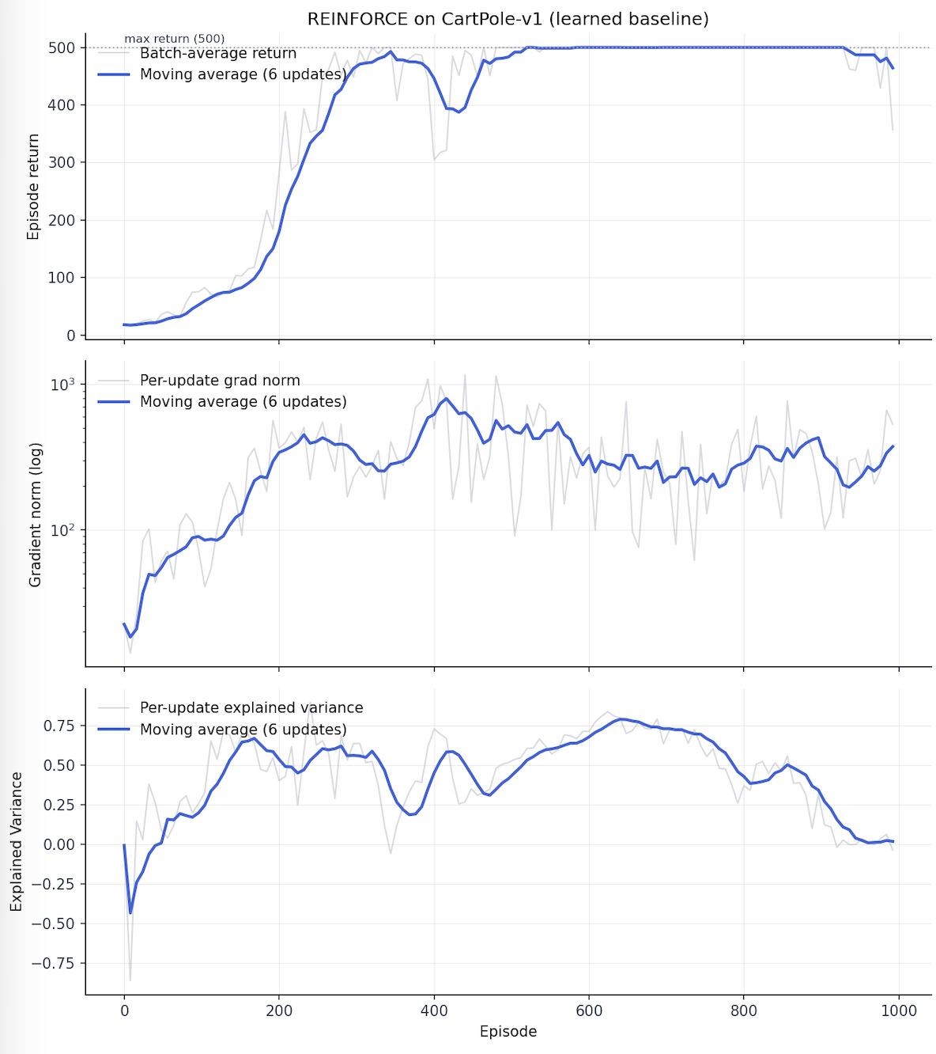
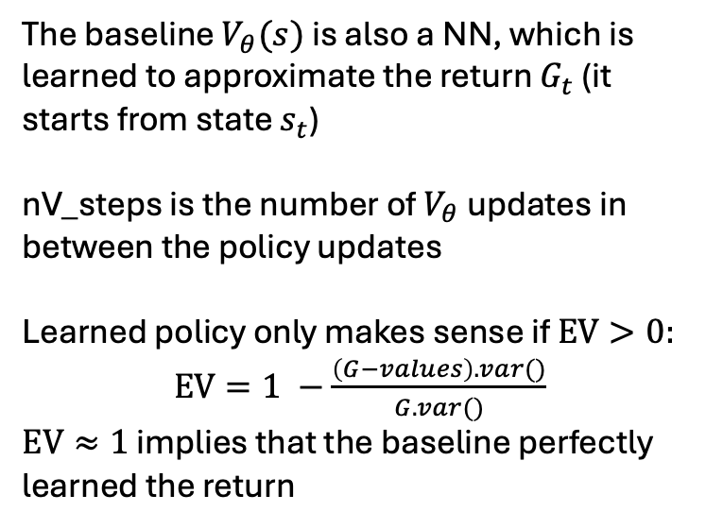
Step 2: learning state-dependent baseline
nV_steps = 1
nV_steps = 20
The baseline $V_{θ}(s)$ is also a NN, which is learned to approximate the return $G_{t}$ (it starts from state $s_{t}$)
nV_steps is the number of $V_{θ}$ updates in between the policy updates
Learned policy only makes sense if $EV>0:$
$EV=1 −\frac{\left(G−values\right).var()}{G.var()}$
$EV≈1$ implies that the baseline perfectly learned the return
lr = 1e-2

Slide 11
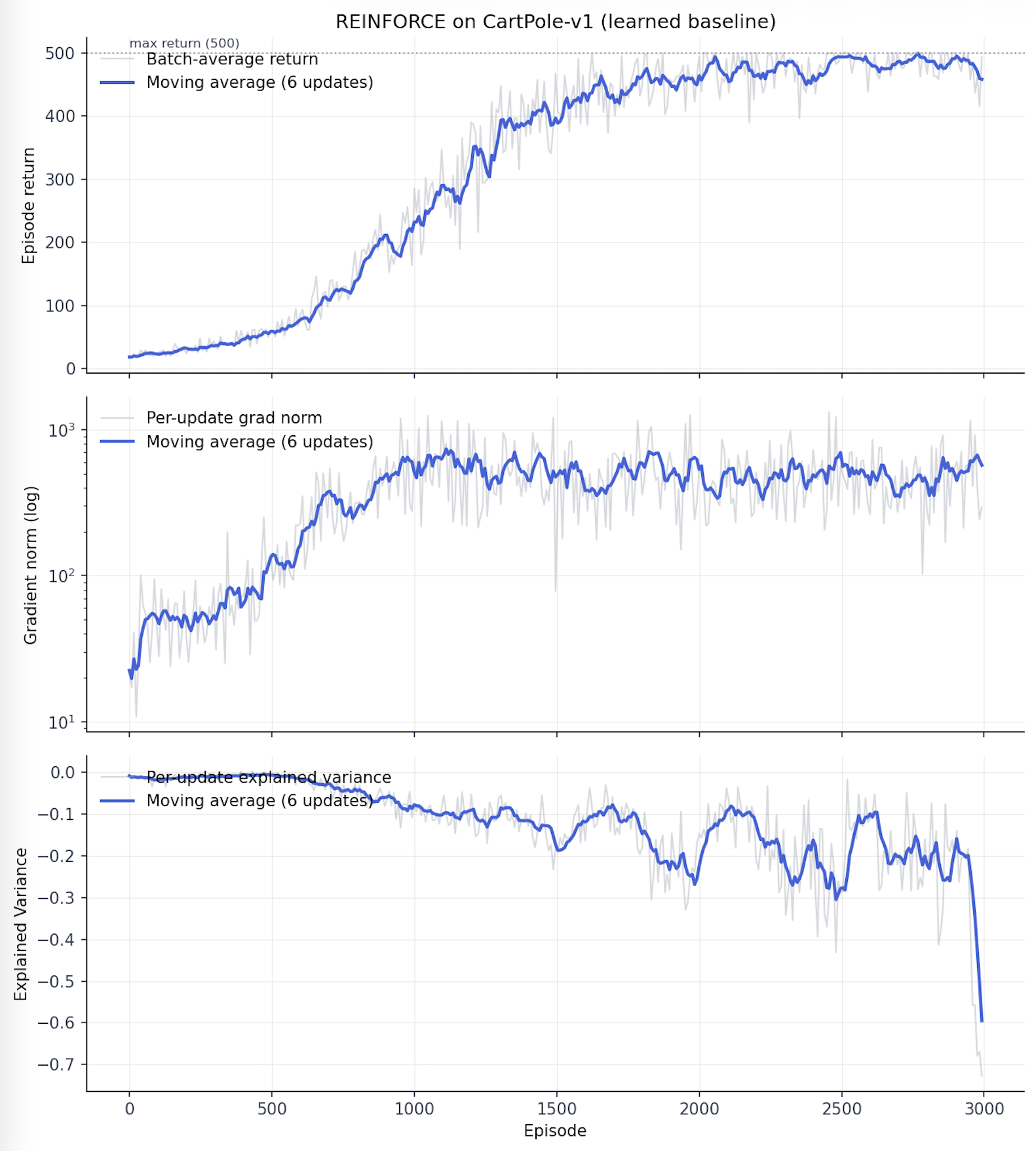
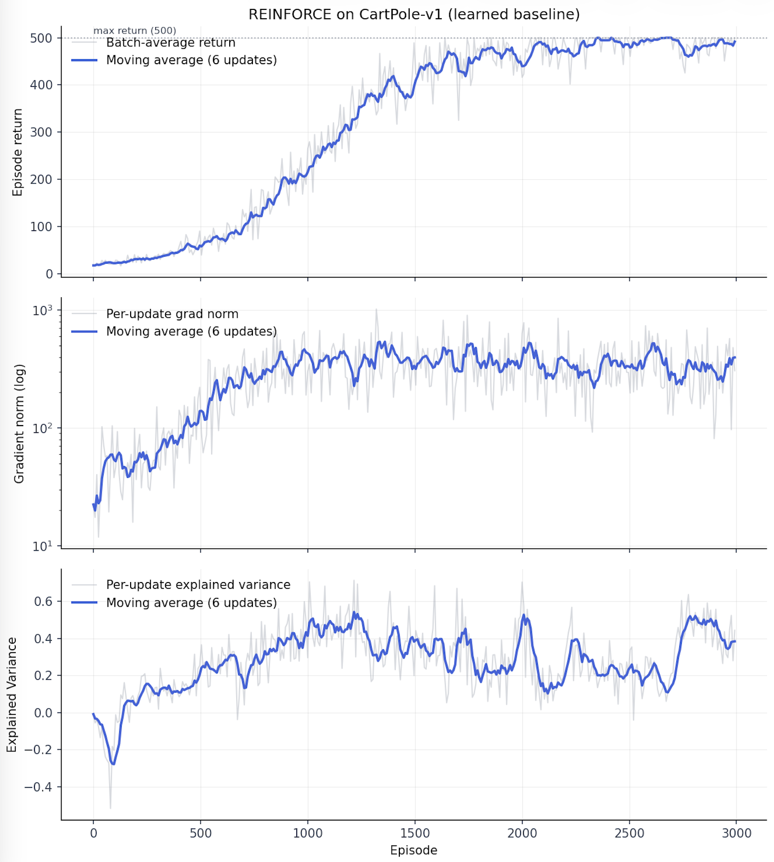
Step 2: learning state-dependent baseline
nV_steps = 1
nV_steps = 20
Lr = 1e-3

Slide 12
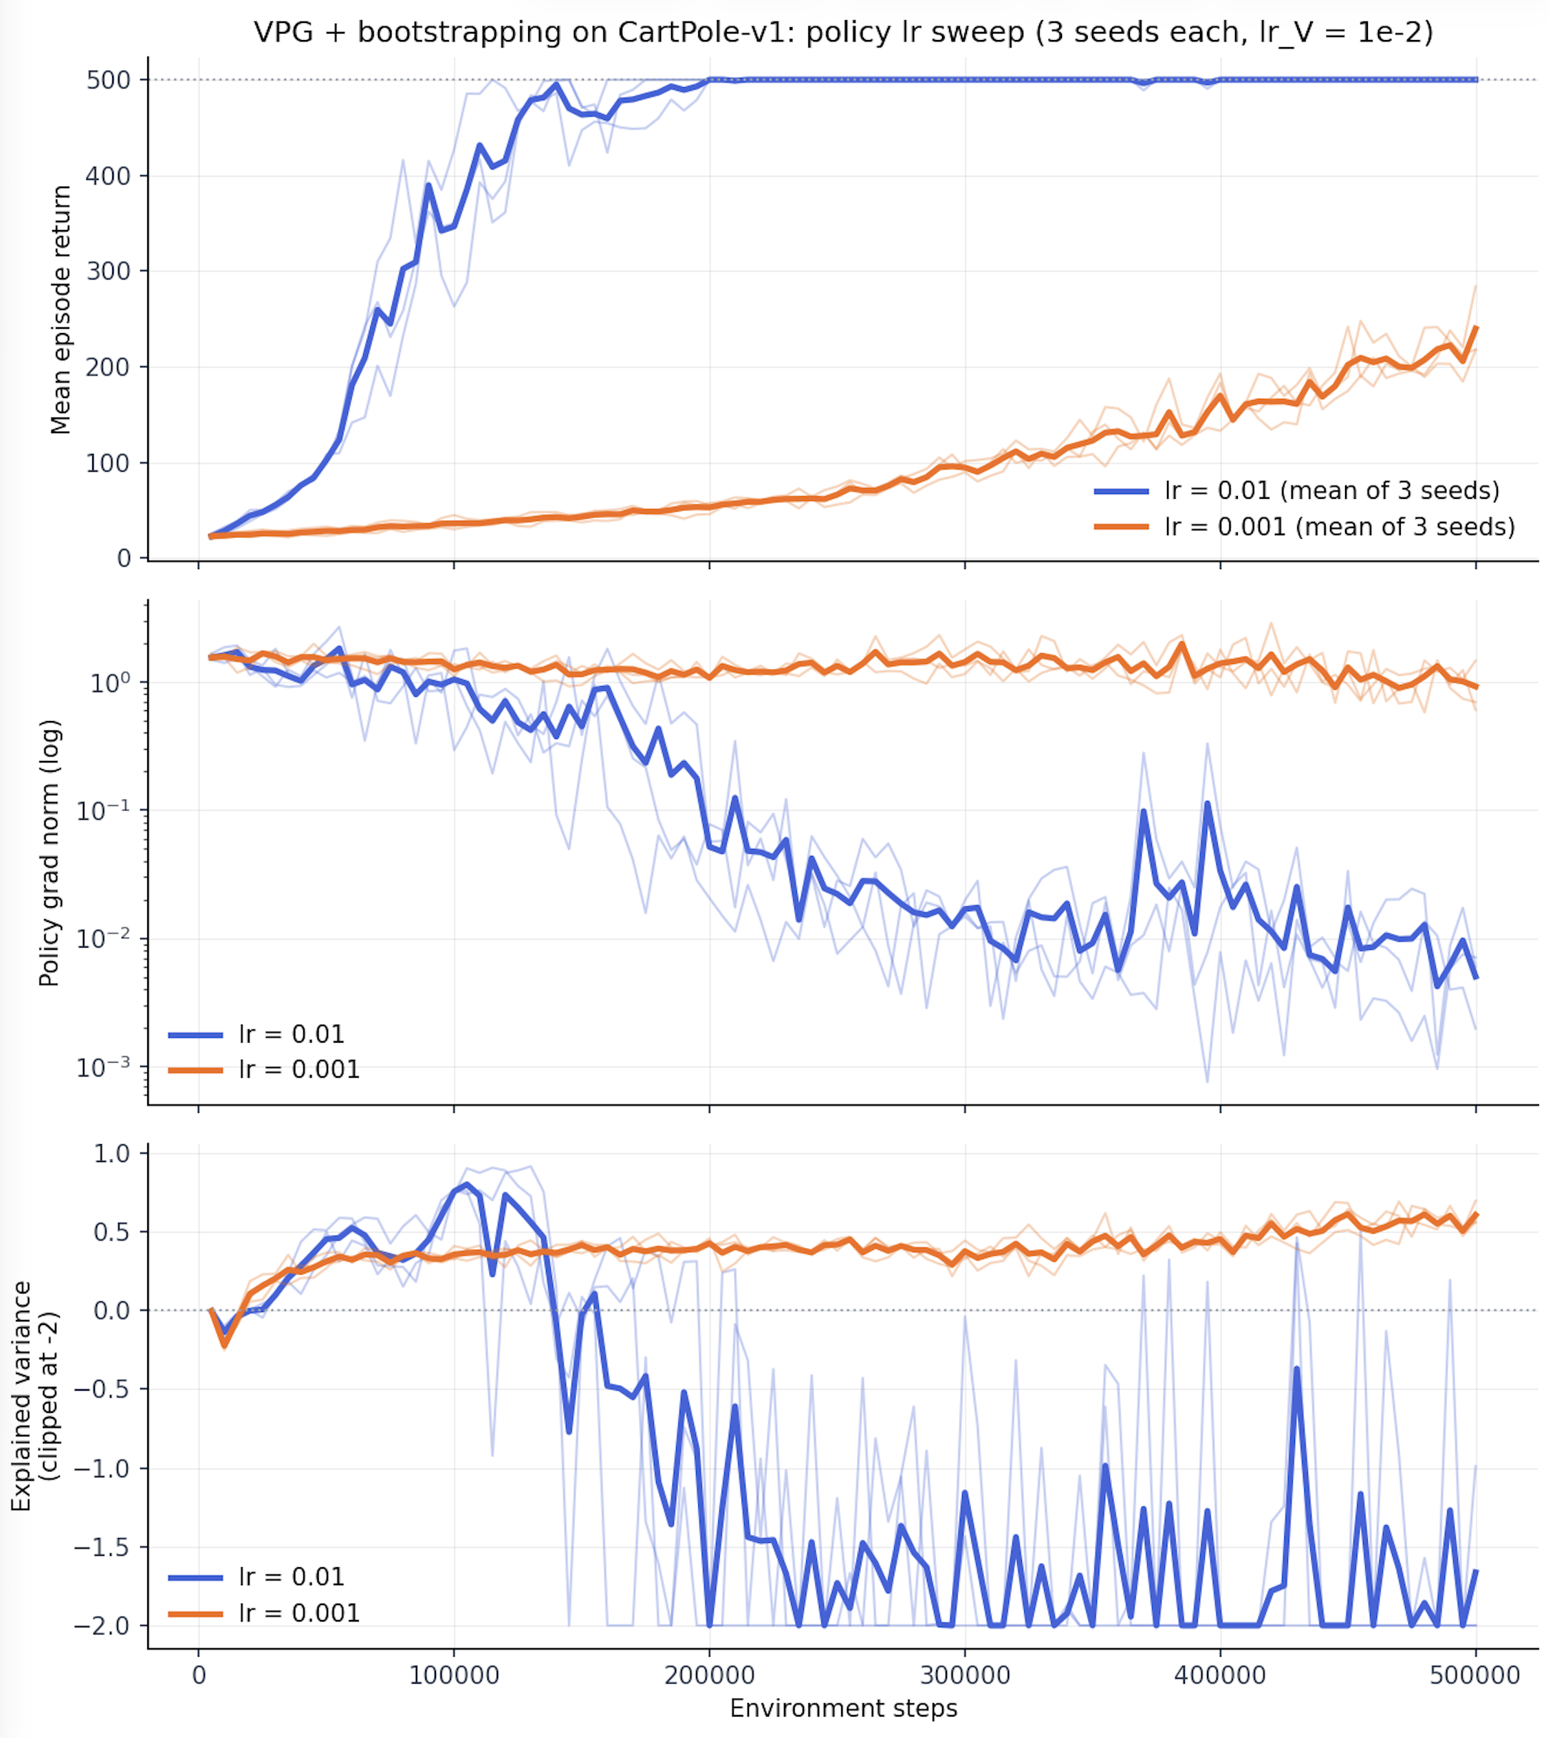
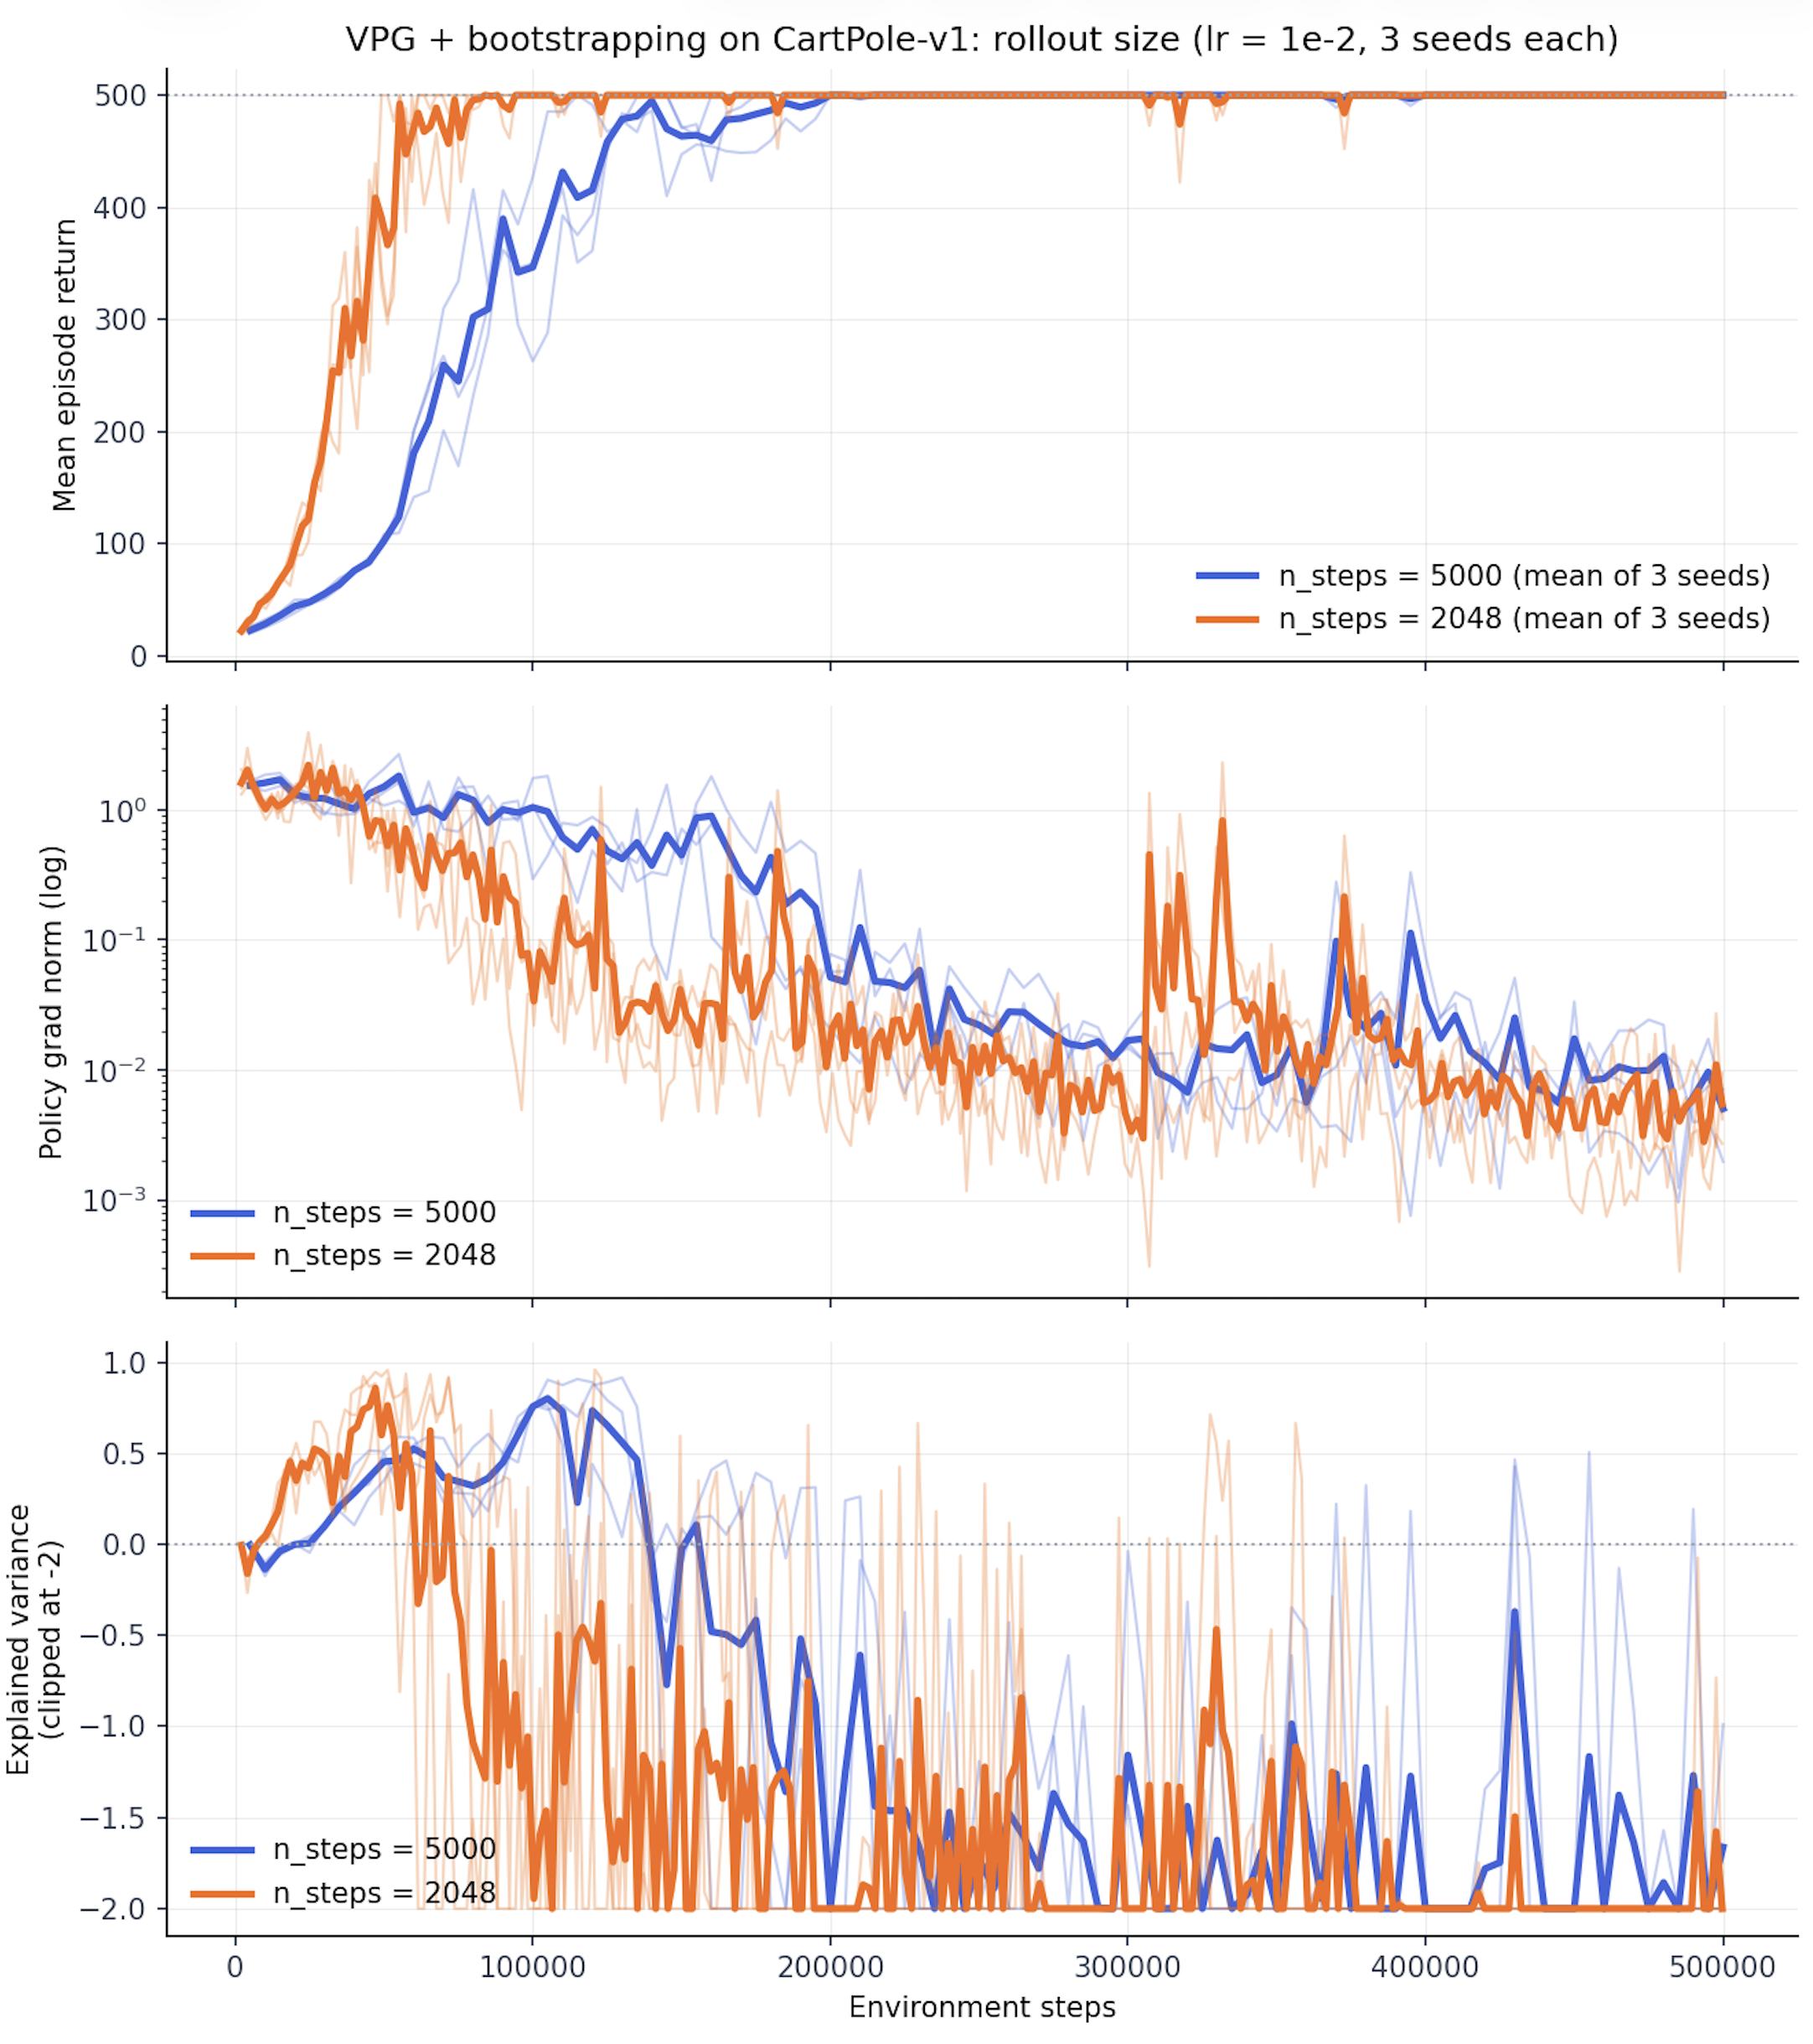
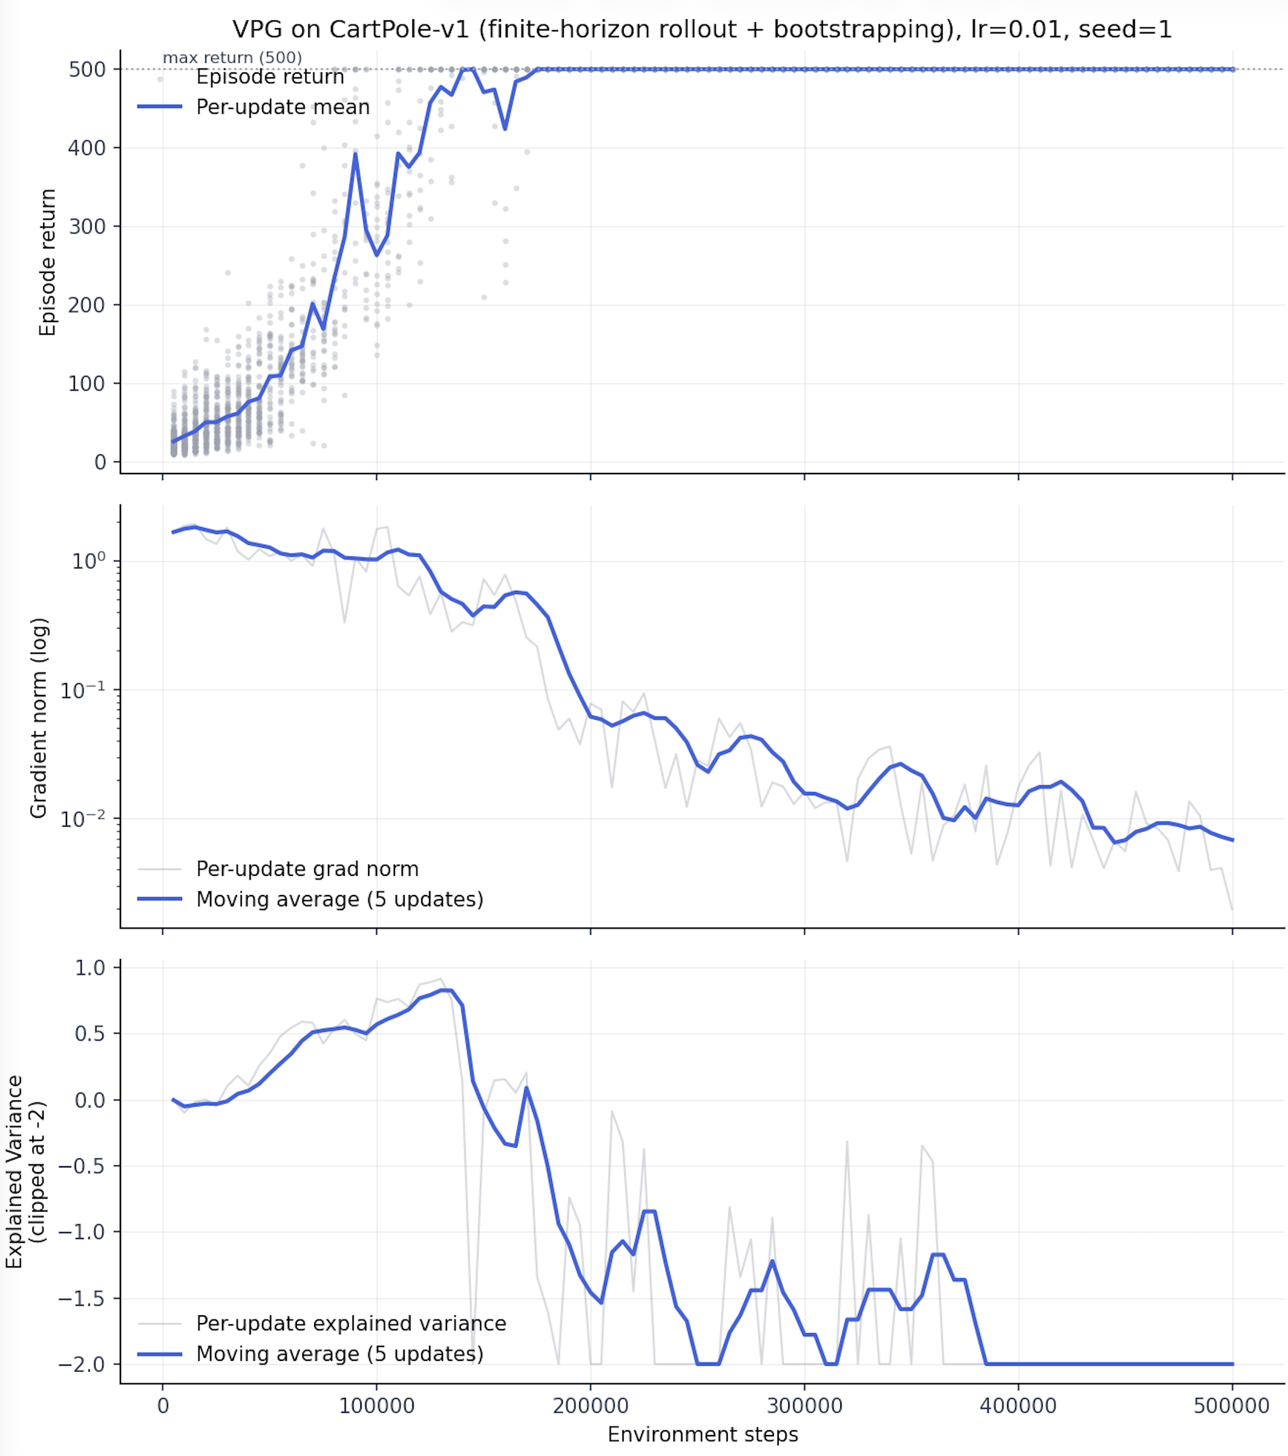
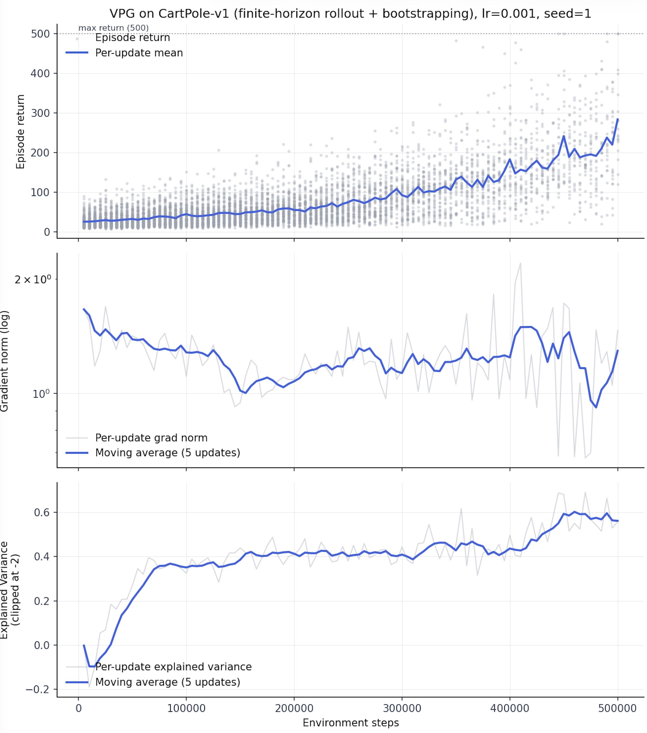
Step 3: Fixed-horizon rollout and bootstrapping
Negative EV here just means the conditioning for it is not well defined (G.var() becomes zero), it does not mean critic is poor.
New elements is that now the unit of data is no longer an episode. Now, the unit of the data is a step.
Main reason for this: in the previous case, as the policy becomes more skilled it sees longer episodes = gets more experience. Now we fix this by having a fixed number of steps.

Slide 13
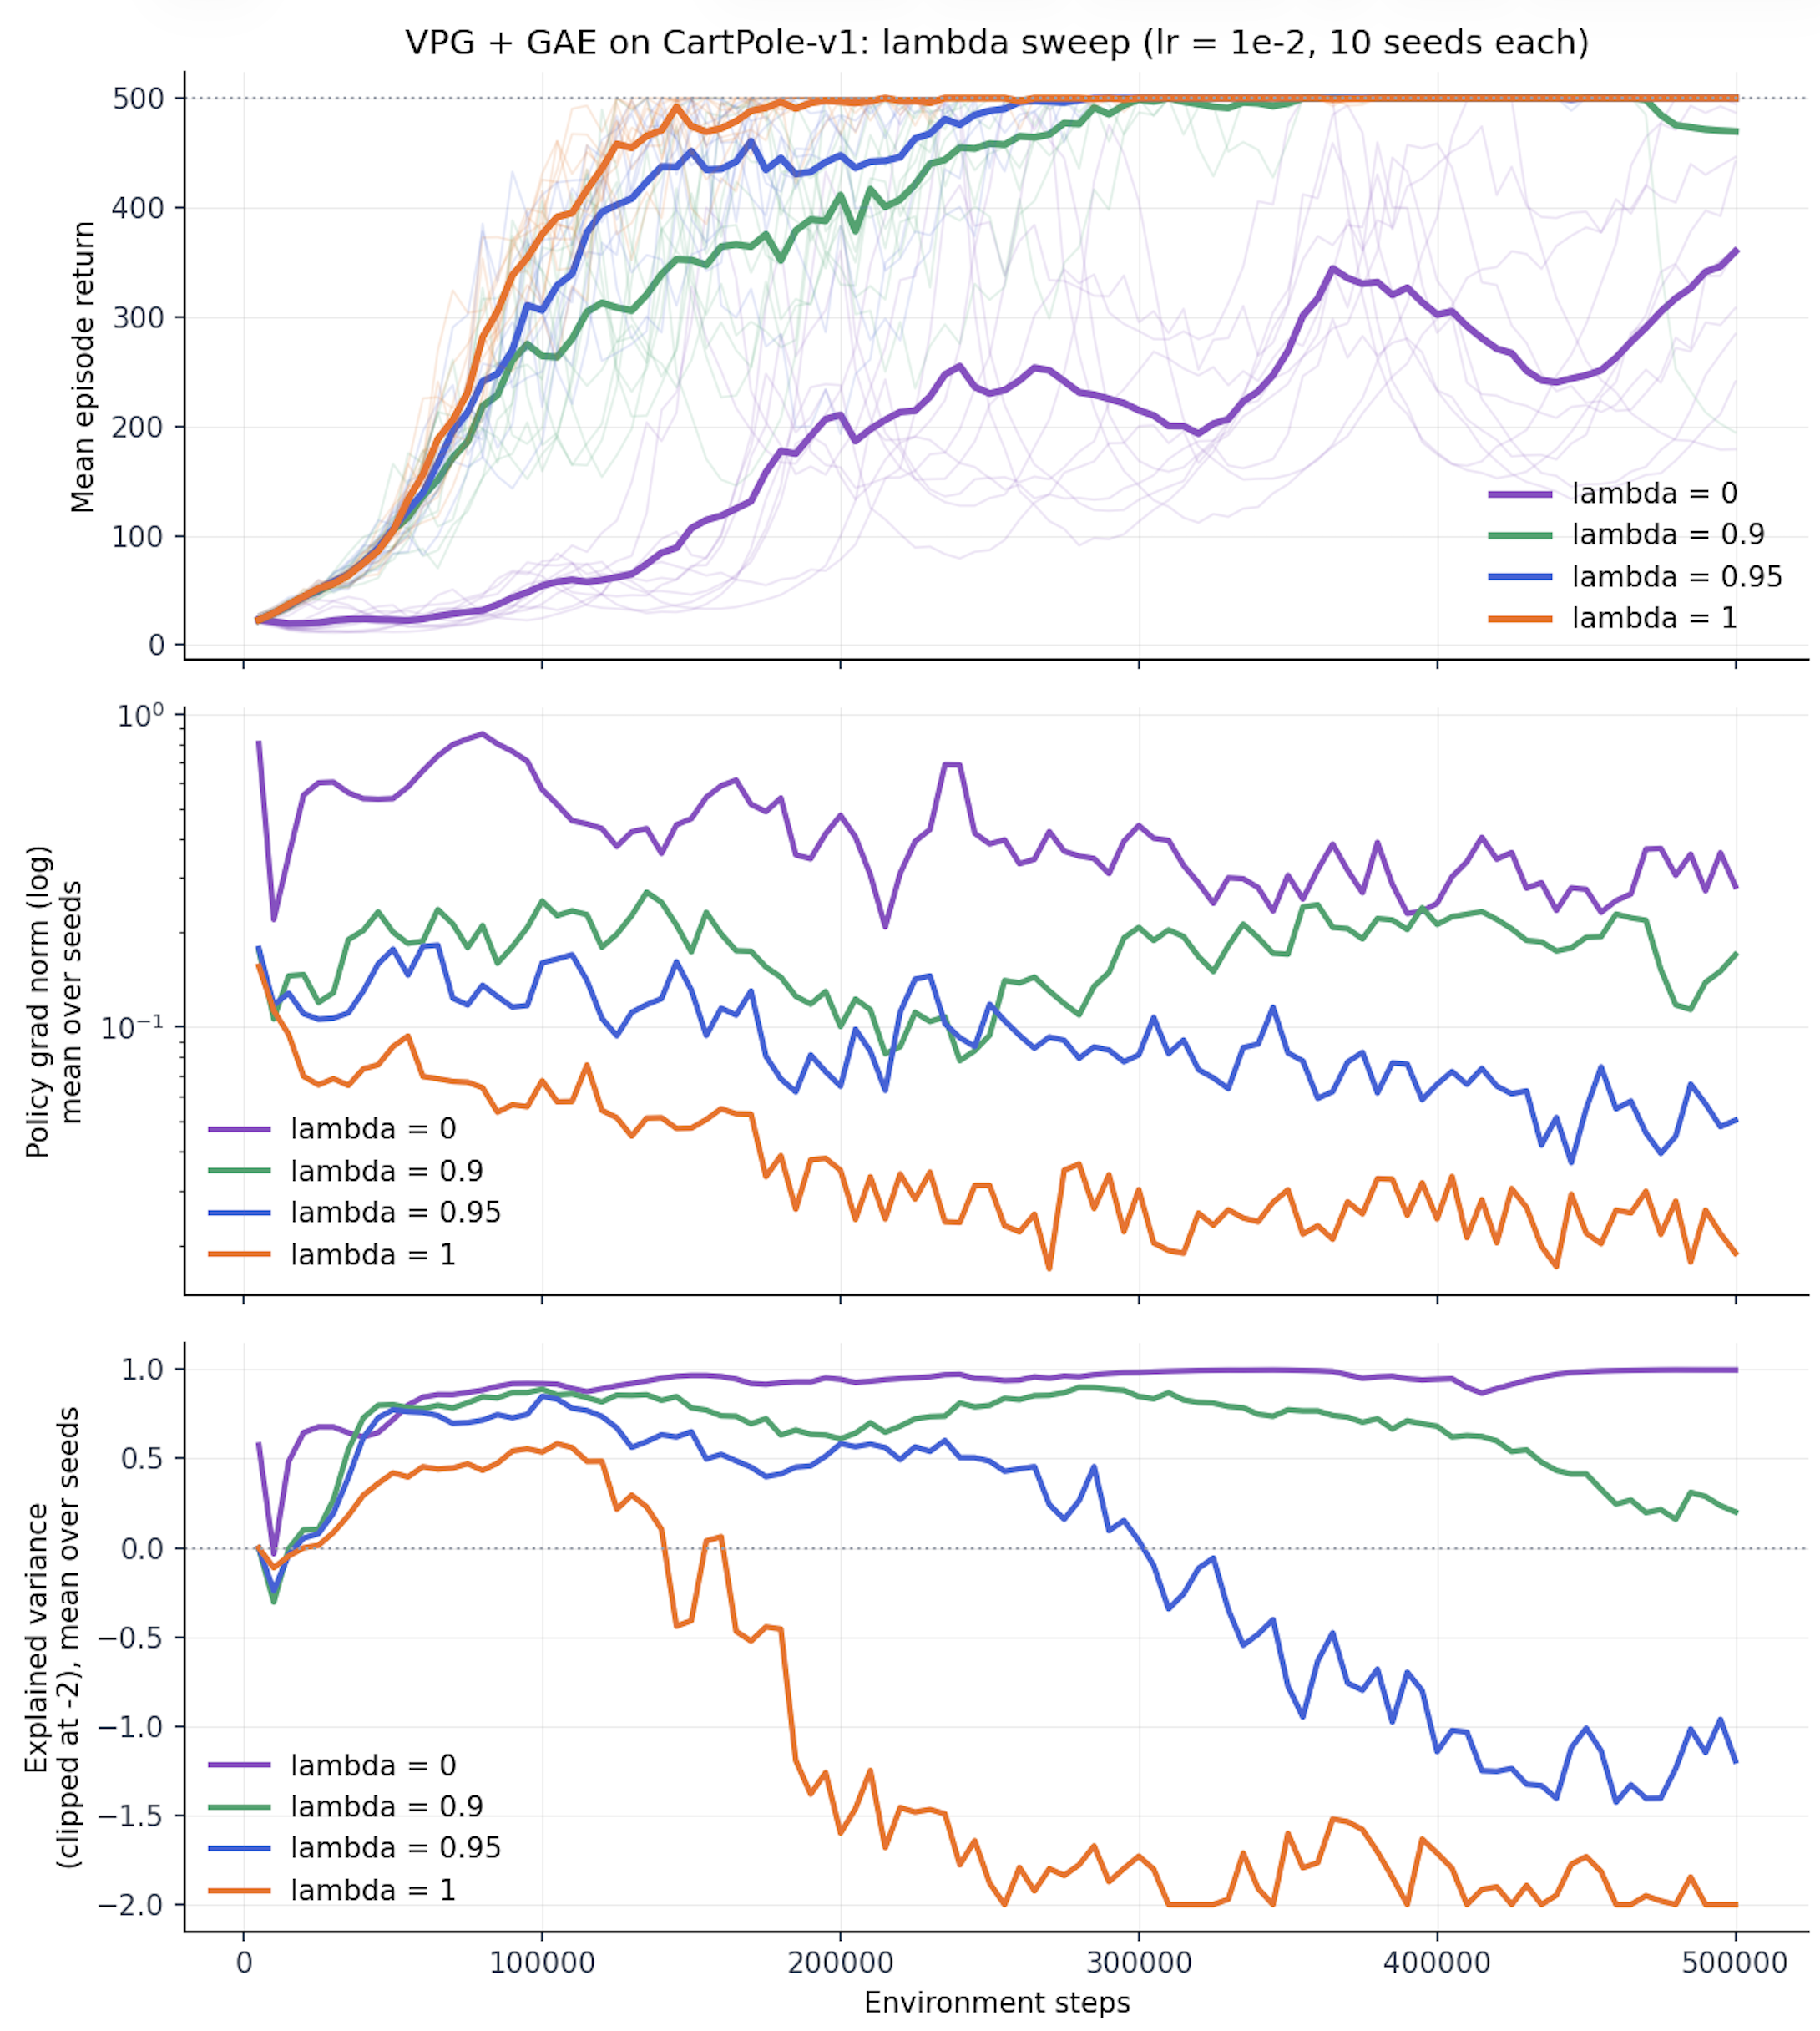
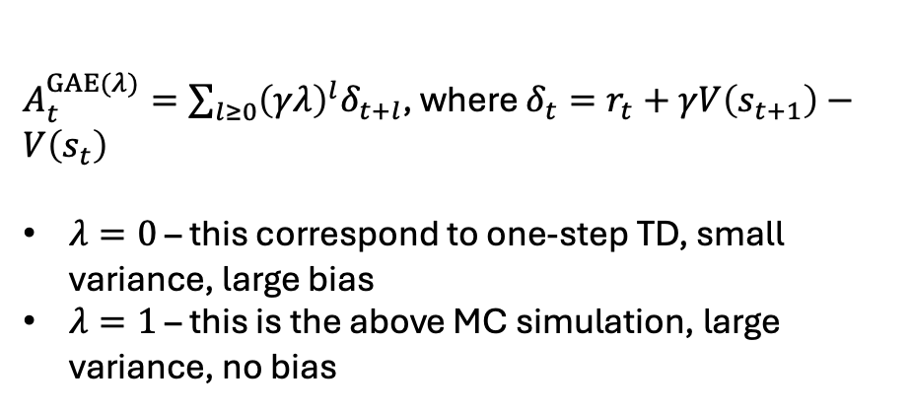
Step 4: Generalized Advantage Estimation
$A_{t}^{GAE(λ)}=\sum_{l≥0}{{\left(γλ\right)}^{l}δ_{t+l}}$, where $δ_{t}=r_{t}+γV\left(s_{t+1}\right)−V\left(s_{t}\right)$
$λ=0$ – this correspond to one-step TD, small variance, large bias
$λ=1$ – this is the above MC simulation, large variance, no bias

Slide 14
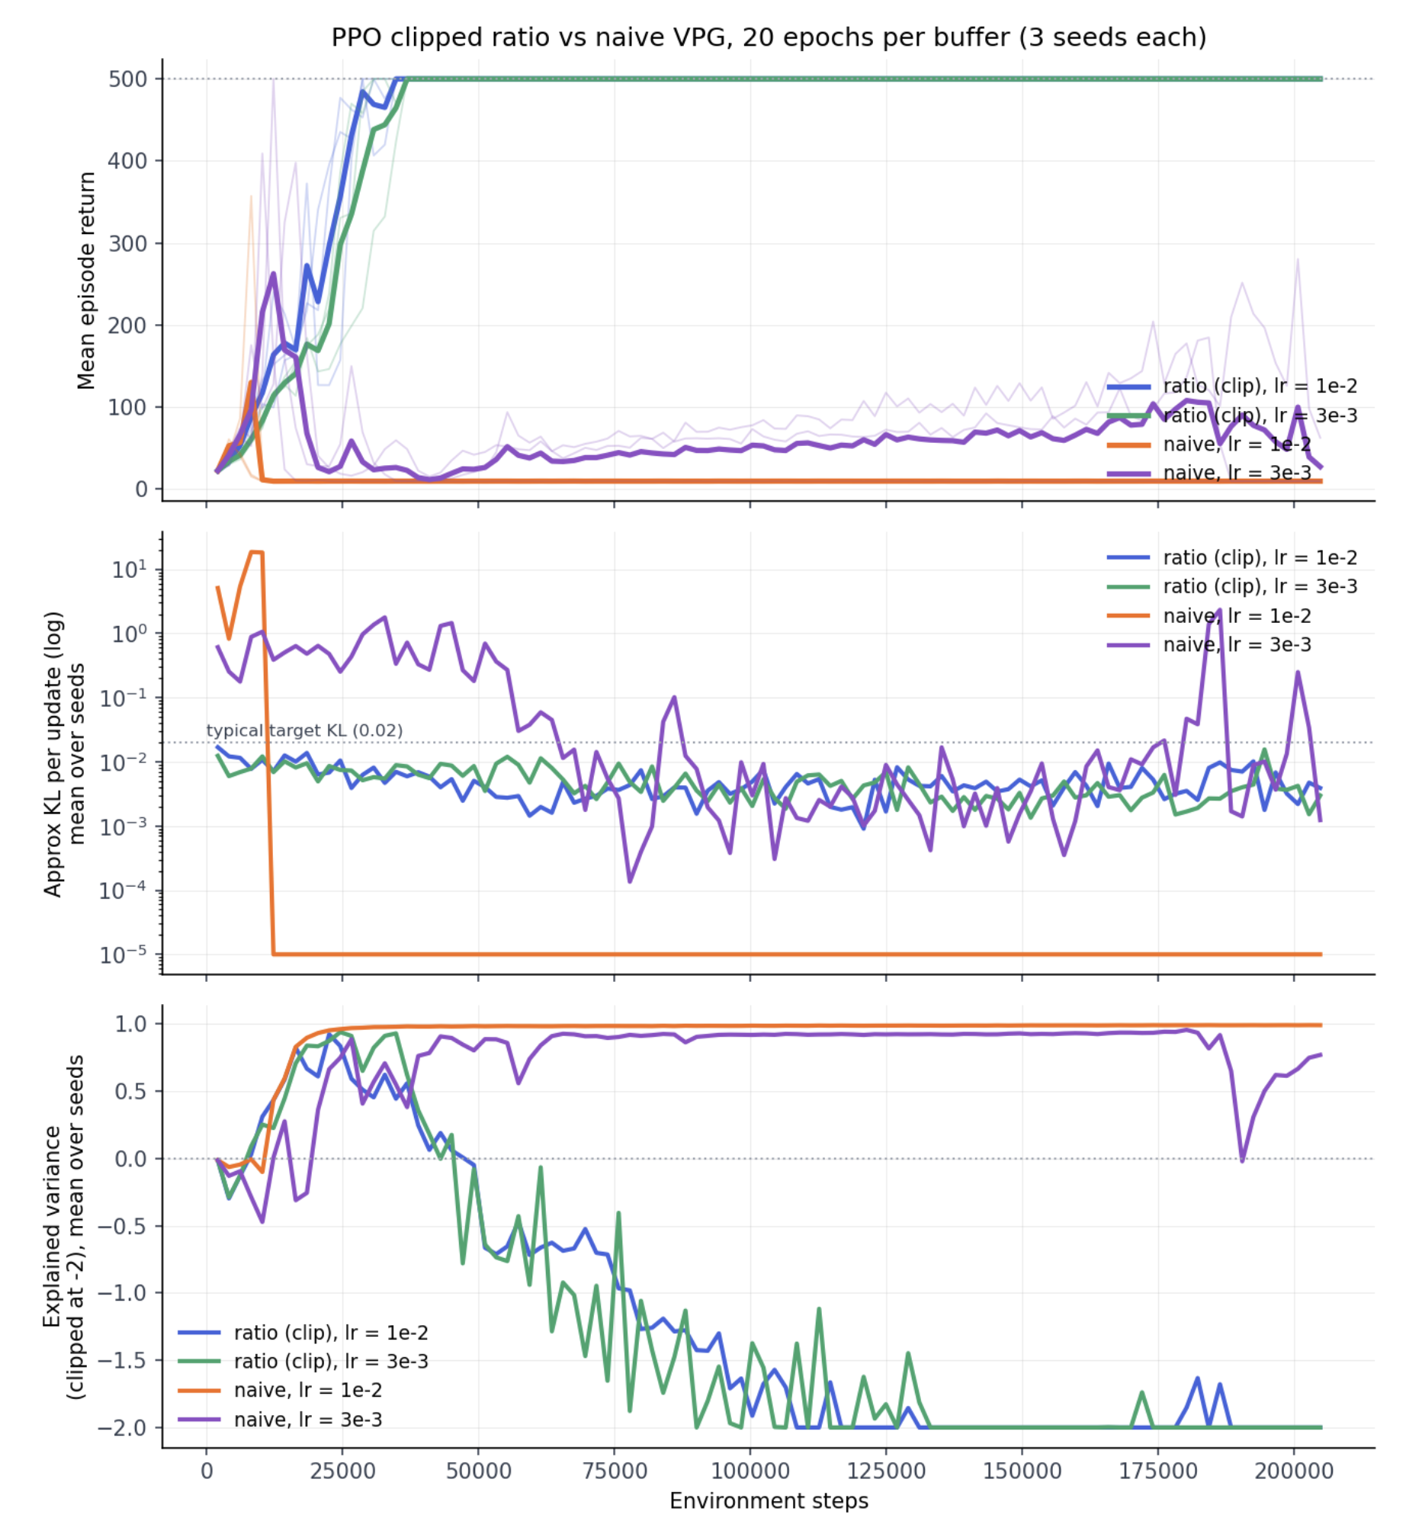
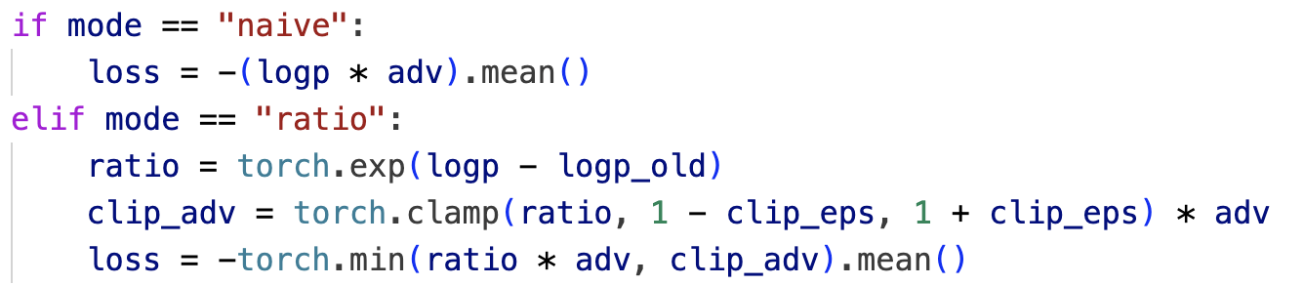
Steps 5: PPO
In PPO, the policy is not allowed to change much:
Things to note:
How stable is learning, seed independent
KL is below 0.02, meaning new policy is close the policy it started from
Also need ~30-40K steps for PPO convergence, compare this to ~200K of the previous GAE step

