Slide 1
Optical RL
Pavel E. Dolgirev

Slide 2
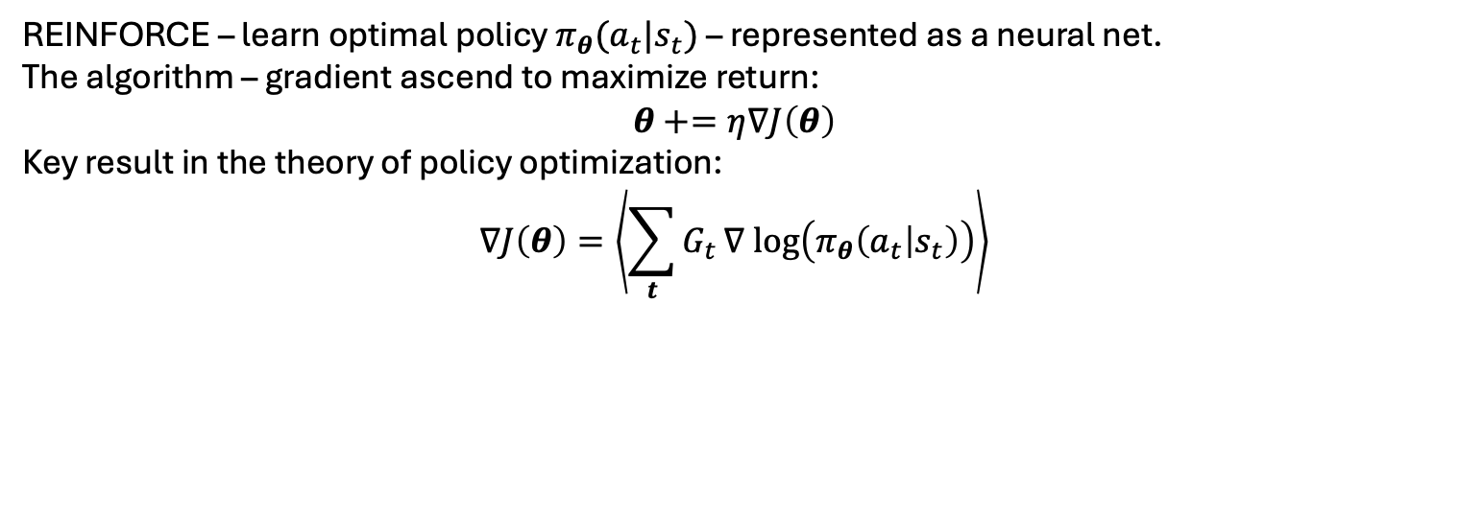
CartPole with REINFORCE
This is our baseline to beat
Max_num_steps = 500
REINFORCE – learn optimal policy $π_{θ}(a_{t}|s_{t})$ – represented as a neural net.
The algorithm – gradient ascend to maximize return:
$$θ+=η∇J\left(θ\right)$$
Key result in the theory of policy optimization:
$$∇J\left(θ\right)=\left\langle \sum_{t}{G_{t}}∇ log\left(π_{θ}\left(a_{t} | s_{t}\right)\right)\right\rangle$$

Slide 3
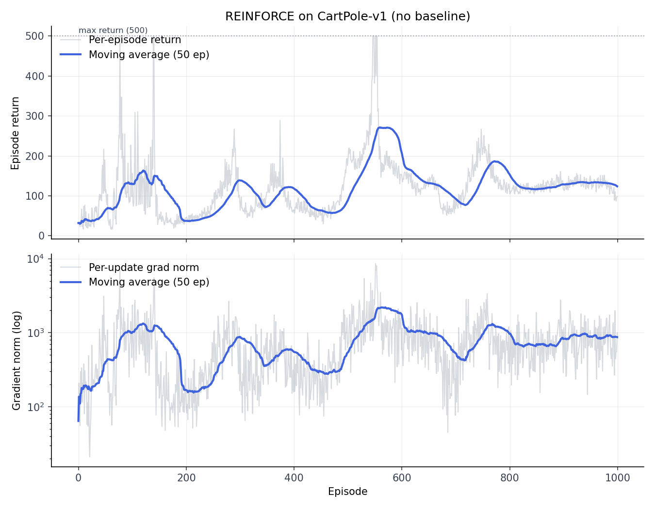
CartPole with REINFORCE, lr=1e-2
Typical result with REINFORCE, no baseline
Trained policy, a NN, one hidden layer, 128 neurons
Learning rate is such that when we have a good policy, it results in a large return, which implies large gradient. Large gradient then moves away from a good policy. Instability of convergence.

Slide 4
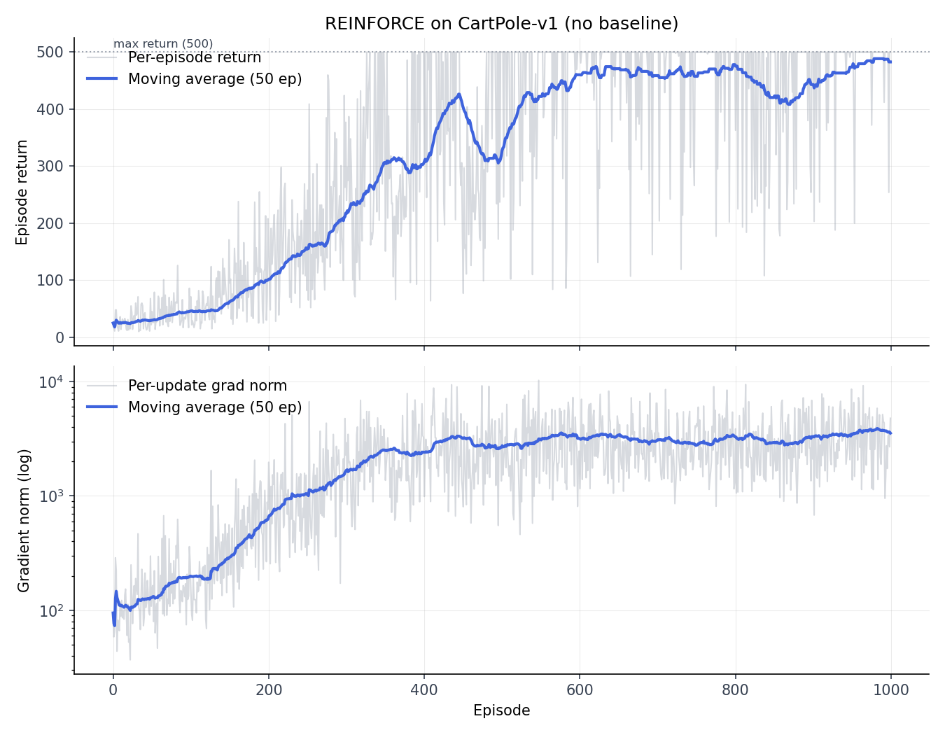
CartPole with REINFORCE, lr=1e-3
Typical result with REINFORCE, no baseline
Trained policy, a NN, one hidden layer, 128 neurons
Small LR helped a lot but we still sometimes get instability and lose a good policy

Slide 5
Six steps toward PPO
Batch episodes – simplest baseline
Value baseline (VPG) – actor-critic
Fixed-horizon rollout and bootstrapping
GAE
Break it on purpose
PPO

Slide 6
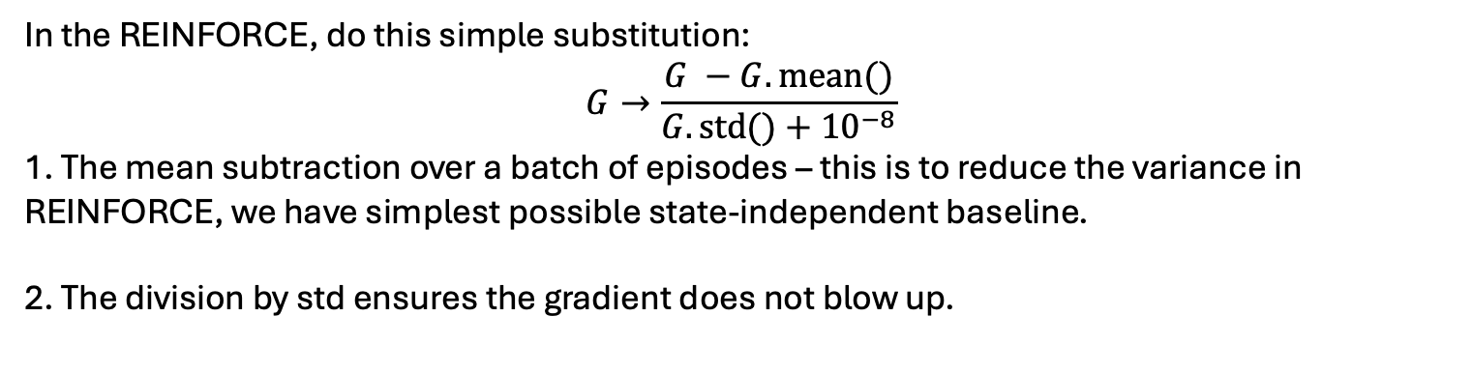
Step 1: batch-normalized returns
In the REINFORCE, do this simple substitution:
$$G→\frac{G −G.mean()}{G.std()+{10}^{−8}}$$
1. The mean subtraction over a batch of episodes – this is to reduce the variance in REINFORCE, we have simplest possible state-independent baseline.
2. The division by std ensures the gradient does not blow up.

Slide 7
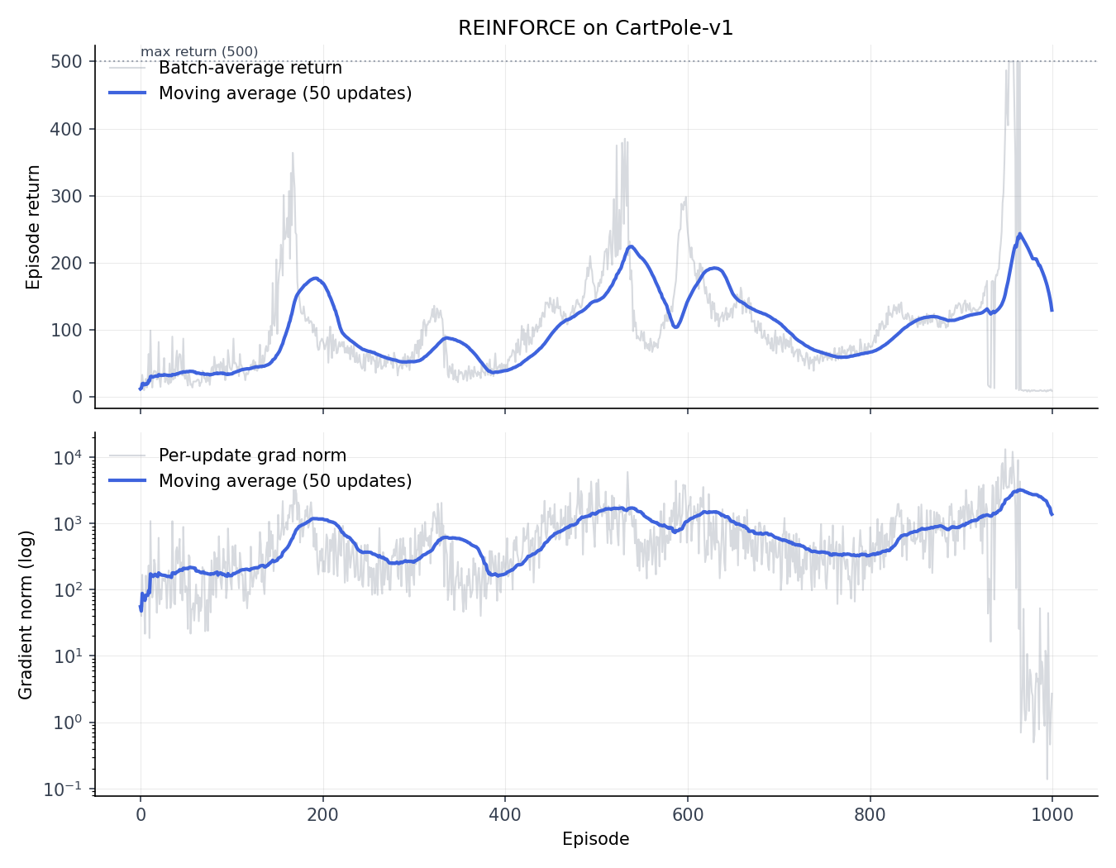
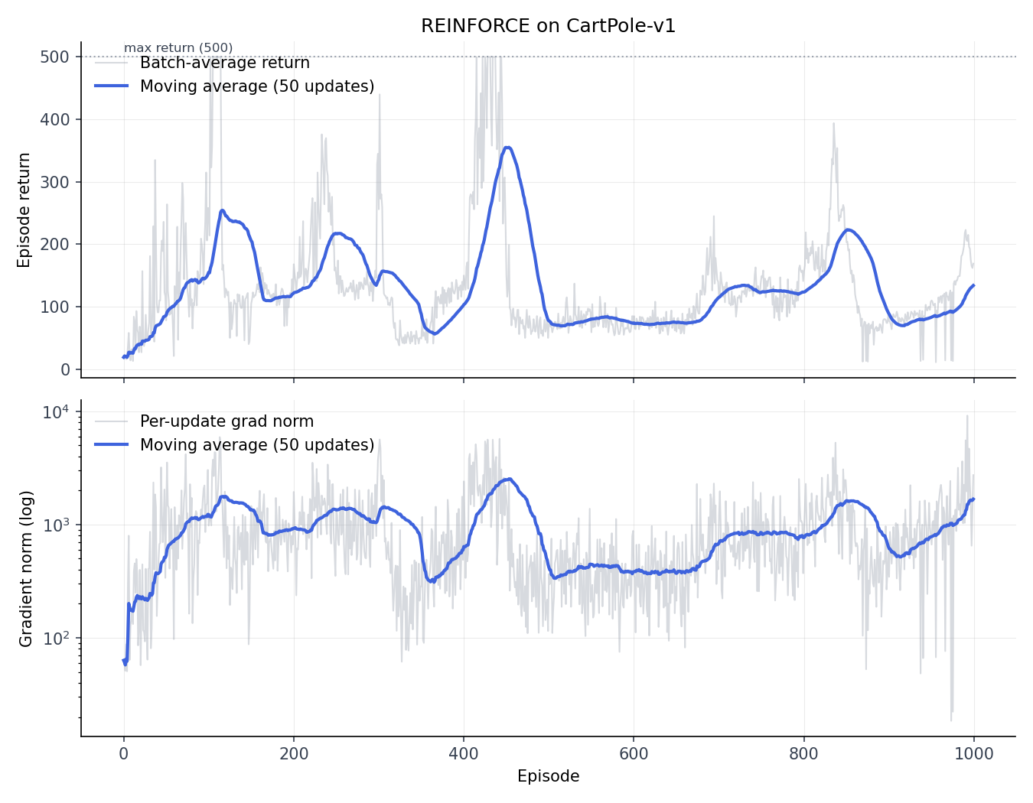
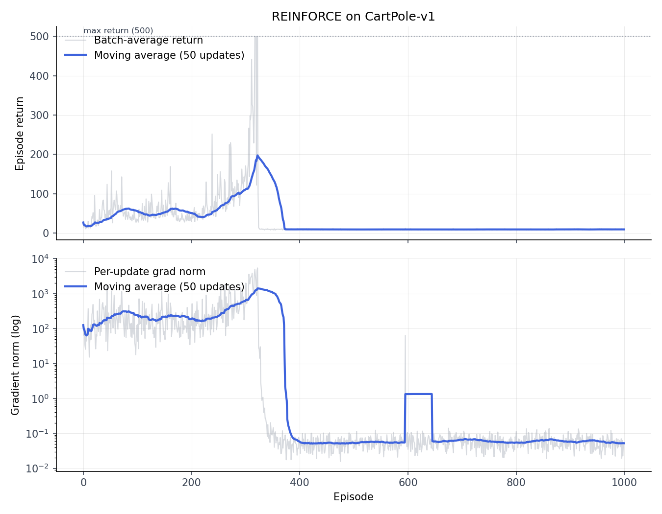
Seed-to-seed variation
Here N_batch = 1, lr = 1e-2
Note strong seed dependence
Note fluctuations
Note instability of the trajectories

Slide 8
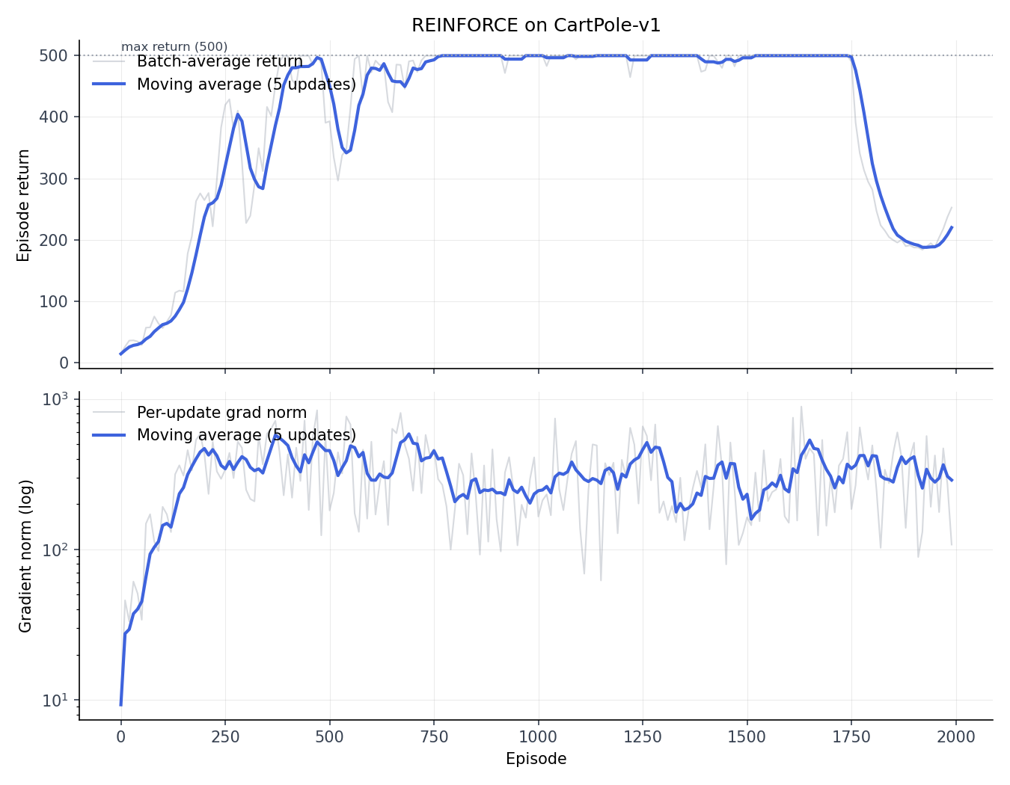
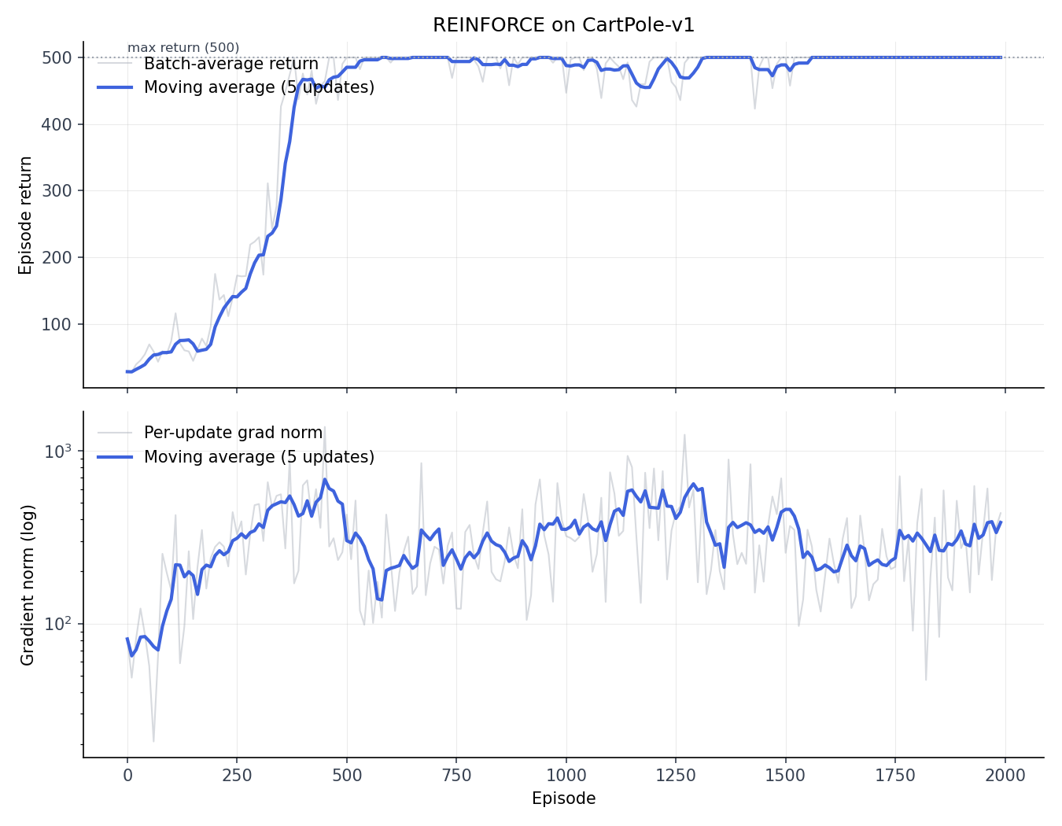
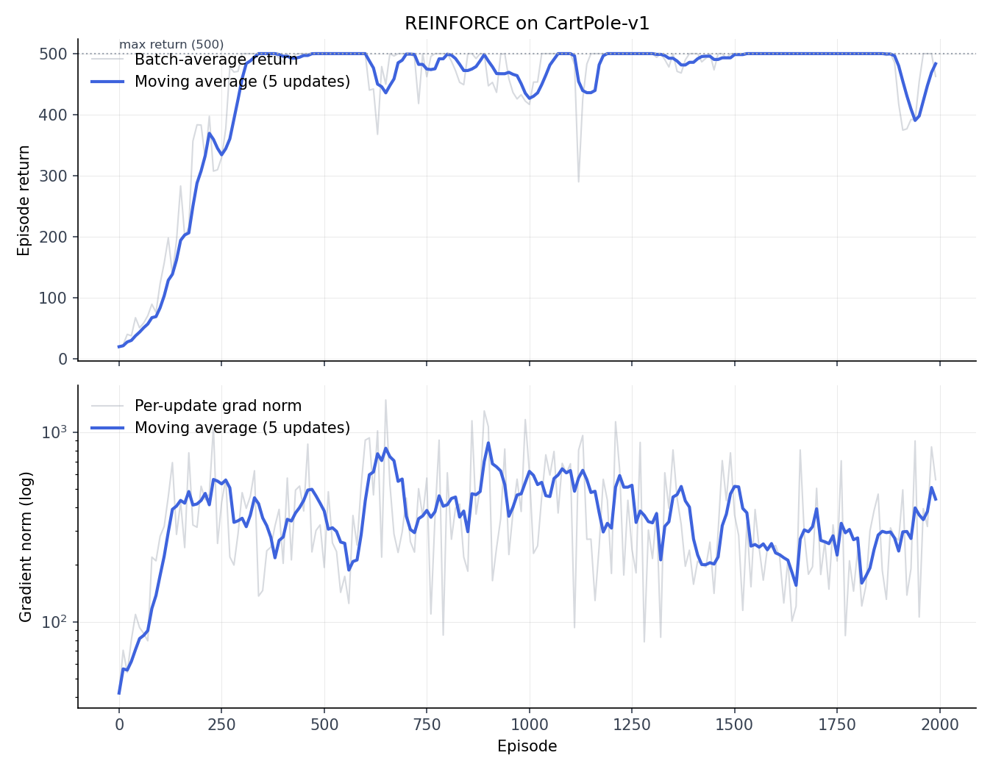
Subtract mean baseline
Here N_batch = 10, lr = 1e-2
Note significantly reduced noise
Node reduced seed dependence
Note reduced gradients

Slide 9
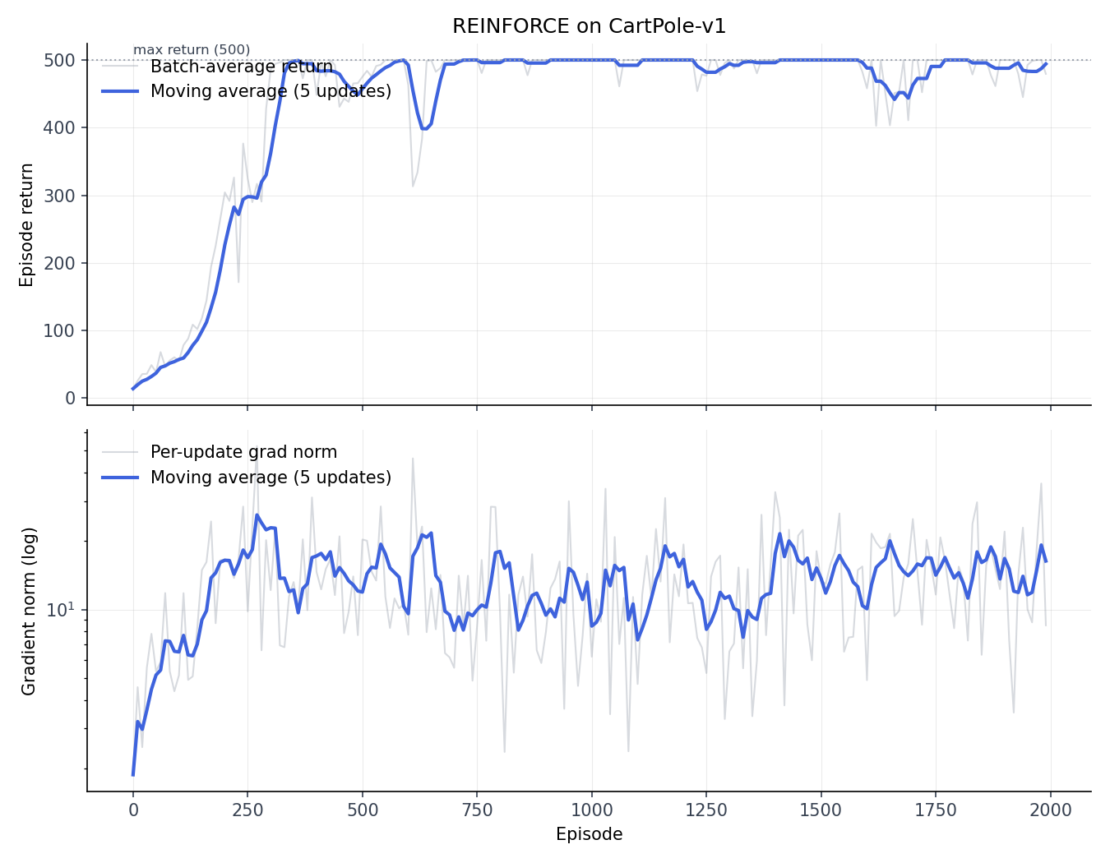
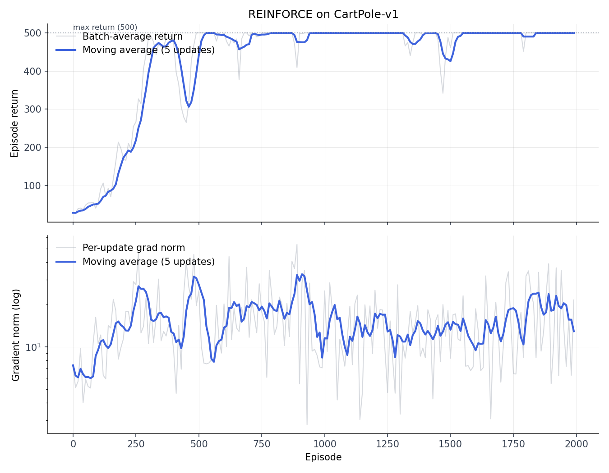
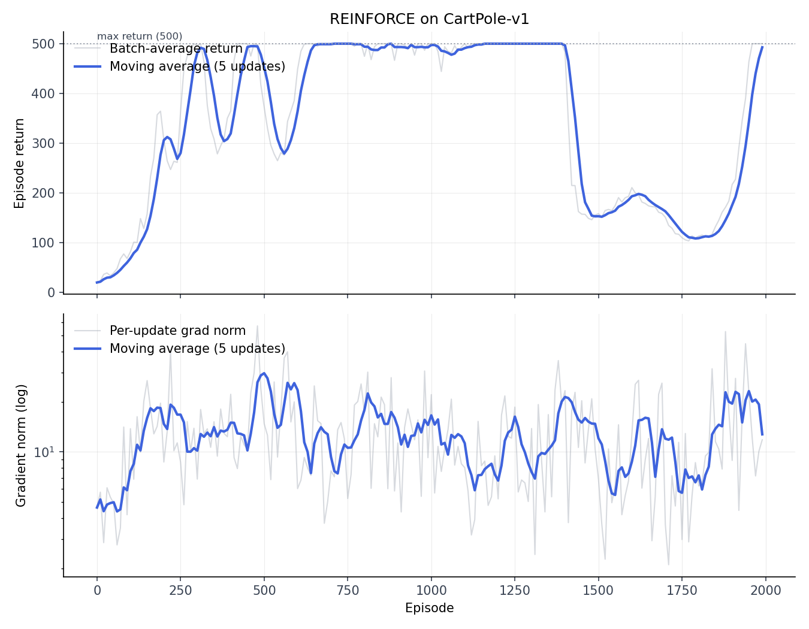
Subtract and normalize
Here N_batch = 10, lr = 1e-2
Note further reduction and stability of gradients

