Slide 1
Welcome!
Notes:
© Copyright Showeet.com – Creative & Free PowerPoint Templates

Slide 2
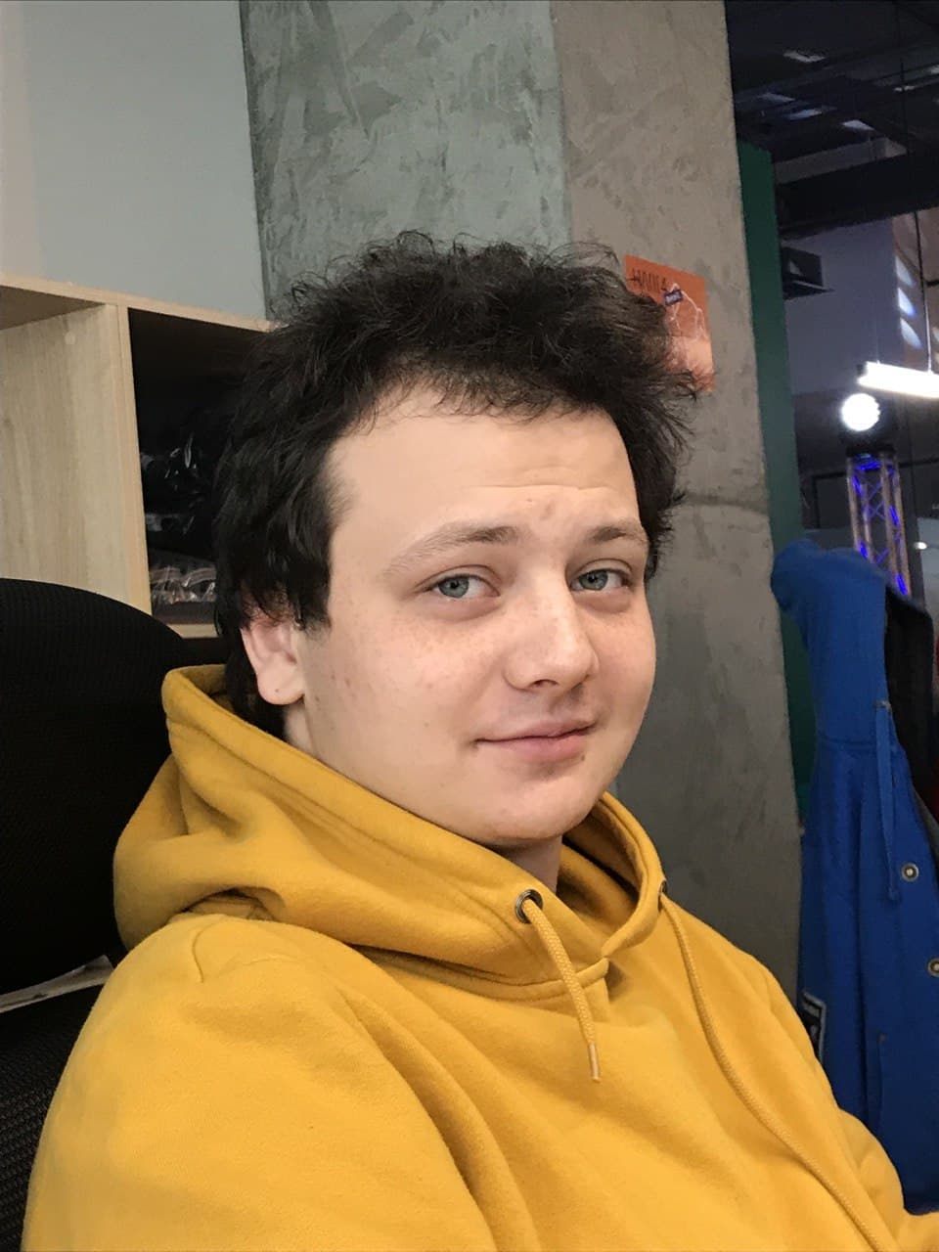
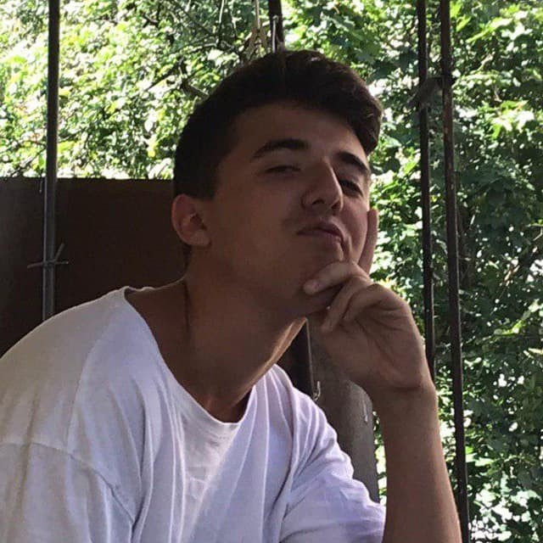
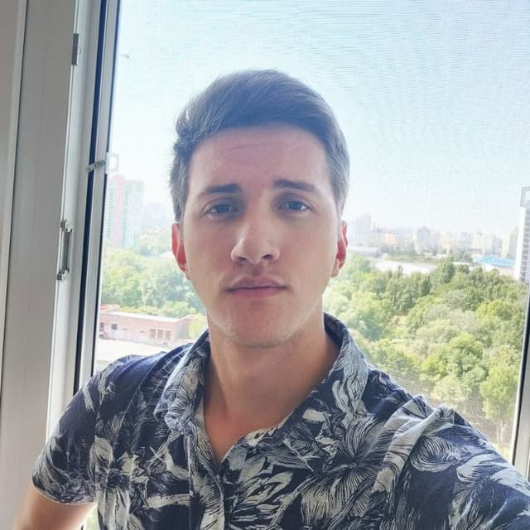
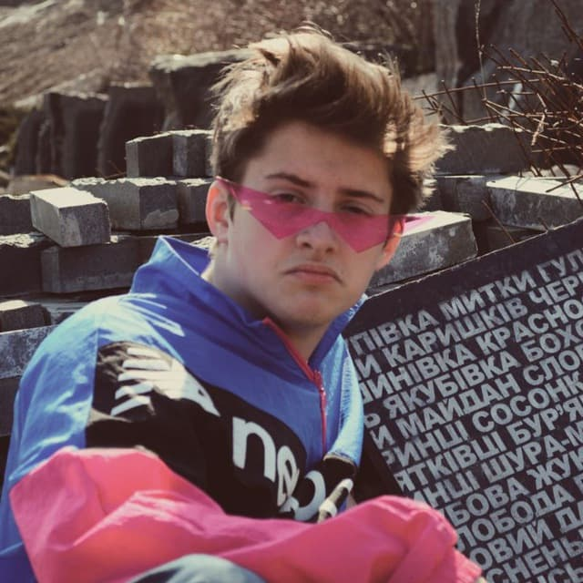
Let my introduce my team
4nn
Bogdan Tkatchuk
Pasha Lysyi
Sasha Bondarchuk
Kostya Ganaga
Notes:
© Copyright Showeet.com – Creative & Free PowerPoint Templates

Slide 3
4nn team
Approach
Notes:
© Copyright Showeet.com – Creative & Free PowerPoint Templates

Slide 4
Our Approach is…
Notes:
© Copyright Showeet.com – Creative & Free PowerPoint Templates

Slide 5
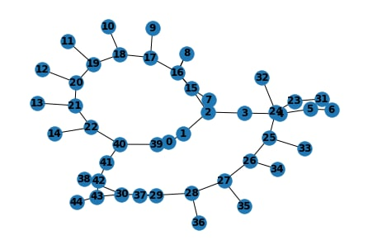
Create Graph
Conducted Analytics
What products are bought the most?
What products are bought in pairs?)
IDD CLOUD
Run and run……
Genetic Algorithm
Notes:
© Copyright Showeet.com – Creative & Free PowerPoint Templates

Slide 6
2 Stage
Optimal darkstore
constuction
Notes:
© Copyright Showeet.com – Creative & Free PowerPoint Templates

Slide 7
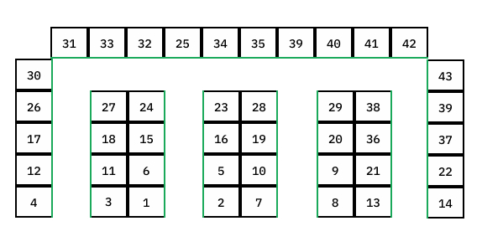
Possible implementation
* Enter
This storage perform on 7% better than baseline

Slide 8
Time is what we want most, but what we use worst.
Notes:
© Copyright Showeet.com – Creative & Free PowerPoint Templates

Slide 9

Thank You!
4NN
Presentation Expert
4nn
1234 Lorem St, Ipsum, 56789, Country
+380505612764
Lysyi.pavlos@email.com
Do you have any questions?
Notes:
© Copyright Showeet.com – Creative & Free PowerPoint Templates

