Slide 1
Welcome!
Thanks for joining us
Notes:
© Copyright Showeet.com – Creative & Free PowerPoint Templates

Slide 2
4nn team
ЕТА prediction
Notes:
© Copyright Showeet.com – Creative & Free PowerPoint Templates

Slide 3




Let my introduce my team
4nn
Pasha Lysyi
Alim Bektimirov
Sasha Bondarchuk
Dima Agafonov
Notes:
© Copyright Showeet.com – Creative & Free PowerPoint Templates

Slide 4

Data sources
01
Kaggle input data
https://www.kaggle.com/competitions/int20h-2023-hackathon/data
02
OpenStreetMap
https://www.openstreetmap.org/
03
Weather
https://www.wunderground.com/
Notes:
© Copyright Showeet.com – Creative & Free PowerPoint Templates

Slide 5
Feature Engineering
Kaggle
Weather
seconds - time of a day
distance – sum of the lengths of the nodes
mean_speed - average time of speed in the city for every 30 minutes in a day (peak hour // traffic jams)
mean_time - the average travel time on each interval
speed - average speed across all nodes for a specific order

Slide 6
Feature Engineering
Weather
'Temperature',
'Dew Point',
'Humidity',
'Wind Speed',
'Wind Gust',
'Pressure',
'Precip.',
'isWindy',
'N',
'NNE',
'NNW',
' Windy',
'Fair',
'Fog',
'Heavy Snow Shower',
'Light Snow',
'Light Snow Shower',
'Snow Shower',

Slide 7
Feature Engineering
Open
Street
map
Weather
'crossing:light_yes',
'public_transport_platform',
'public_transport_stop_position',
'parking_underground',
'crossing:island_yes',
'covered_yes',
'bicycle_permissive',
'bicycle_yes',
'traffic_signals:countdown_yes',
'moped_yes',
'supervised_yes',
'button_operated_yes',
'lift_gate:type_double',
'bus_yes',
'traffic_signals:direction_both',
'traffic_signals:direction_forward',
'entrance_staircase',
'entrance_yes',
'crossing_marked',
'crossing_traffic_signals',
'crossing_uncontrolled',
'crossing_unmarked',
'crossing_zebra',
'tactile_paving_yes',
'trolleybus_yes',
'foot_yes',
'wheelchair_yes',
'bollard_fixed',
'bollard_rising',
'noexit_yes',
'shelter_yes',
'informal_yes',
'crossing_ref_zebra',
'motor_vehicle_destination',
'motor_vehicle_private',
'motor_vehicle_yes',
'shop_travel_agency',
'shop_yes',
'locked_yes',
'railway_level_crossing',
'railway_tram_level_crossing',
'railway_tram_stop',
'railway_tram_stop;tram_level_crossing',
'disused:public_transport_stop_position',
'material_metal',
'material_plastic',
'material_steel',
'tram_yes',
'highway_bus_stop',
'highway_crossing',
'highway_give_way',
'highway_motorway_junction',
'highway_traffic_signals',
'traffic_signals_crossing',
'traffic_signals_signal',
'traffic_signals_traffic_lights',
'traffic_signals_tram_priority',
'direction_backward',
'direction_forward',
'emergency_fire_hydrant',
'barrier_block',
'barrier_bollard',
'barrier_chain',
'barrier_entrance',
'barrier_gate',
'barrier_height_restrictor',
'barrier_kerb',
'barrier_lift_gate',
'barrier_swing_gate',
'crossing:barrier_double_half',
'crossing:barrier_half',
'access_permissive',
'access_permit',
'access_private',
'access_yes',
'crossing:bell_yes',
'disused:bus_yes',
'traffic_signals:sound_yes',
'traffic_signals:vibration_yes',
'amenity_parking',
'amenity_restaurant',
'amenity_taxi',
'kerb_flush',
'kerb_lowered',
'kerb_raised',
'kerb_yes',
'bench_yes',
'mofa_yes',
'disused:trolleybus_yes',
'fire_hydrant:type_pillar',
'fire_hydrant:type_underground',
'traffic_calming_bump',
'traffic_calming_yes',
'flashing_lights_yes',
'traffic_sign_UK:5.35.2'

Slide 8
Model
TabNet vs XGboost
Notes:
© Copyright Showeet.com – Creative & Free PowerPoint Templates

Slide 9
Train and Test score
Train
Score: 120.497353
Test
Score: (?)

Slide 10
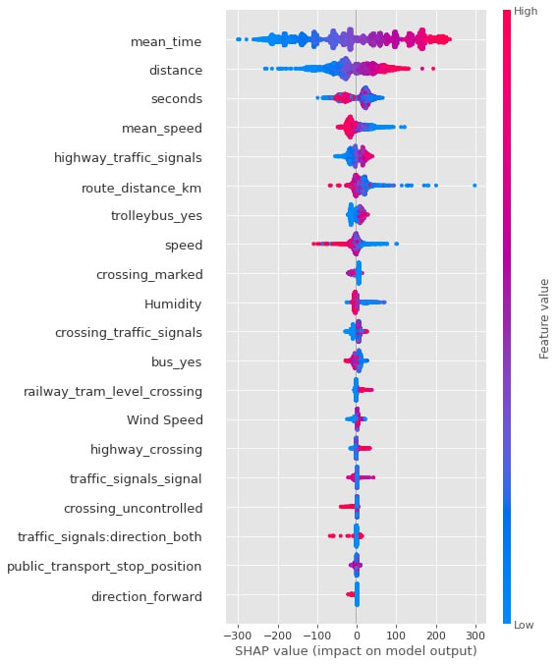
Analysis of model results

Slide 11

Thank You!
4NN
PRESENTATION EXPERT
+380959417580
lysyi.pavlos@email.com
Notes:
© Copyright Showeet.com – Creative & Free PowerPoint Templates

