Slide 1
Toward the Design of a Low Cost, Adaptive Hearing Aid
Kayla-Jade Butkow*, Kelvin da Silva* and David M. Rubin
Biomedical Engineering Research Group
School of Electrical and Information Engineering
University of the Witwatersrand, Johannesburg
Braamfontein, South Africa
*Joint first authors

Slide 2
Hearing Loss
Affects 5% of the global population [1, 2]
Causes [1, 2]
Age
Disease
Trauma
Decreased quality of life [2]
Social isolation
Stigmatization

Slide 3
The Solution – Hearing Aid
Compensatory amplification [4 - 6]
To correct an individual’s hearing deficits
Amplifying specific frequency bands according to a person’s audiogram
Directionality [9 - 11]
Amplifying sounds in particular directions – currently direction of highest SNR
Attenuating sounds in other directions
Cost of commercial hearing aid ~2000$ [3]

Slide 4
Objectives
Development of a low cost hearing aid
Functionality:
Compensatory amplification
Directionality - user tuneable (novelty)
Done in the form of:
Software simulation
Hardware proof of concept

Slide 5
System Block Diagram

Slide 6
Simulated vs Hardware Hearing Aid
Property | Simulation | Hardware
Number of microphones | 10 | 4
Device Bandwidth | 0.25–8 kHz | 2.8-3.5 kHz and 5.6-7 kHz
Filter Order | 14 | 2
Filter Bandwidth | 1/3 Octave | 1/3 Octave
Types of filters | Butterworth FIR bandpass | Butterworth bandpass
Number of filters | 16 per microphone | 2 per microphone
Number of steerable angles | 19 (10° increments) | 5 (0°, 60°, 90°, 120°, 180°)
Real time data acquisition | No | Yes

Slide 7
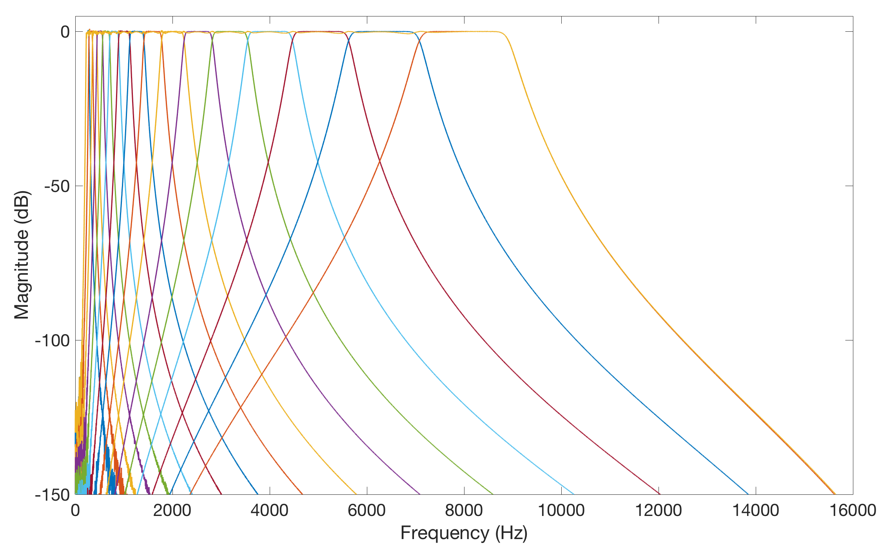
Compensatory Amplification
Audiogram matching: requires amplification of individual frequency bands [12]
Notes:
Independent amplification
Band-by-band basis
Audiogram matching
Requires interpolation of audiogram
Unique for an individual

Slide 8
Directionality
Amplification in a user specified direction
Delay-and-sum beamforming [13 - 15]
Source

Slide 9
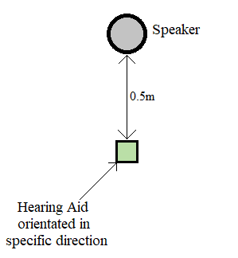
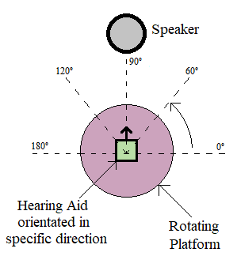
Testing
Compensatory gain
Directionality

Slide 10
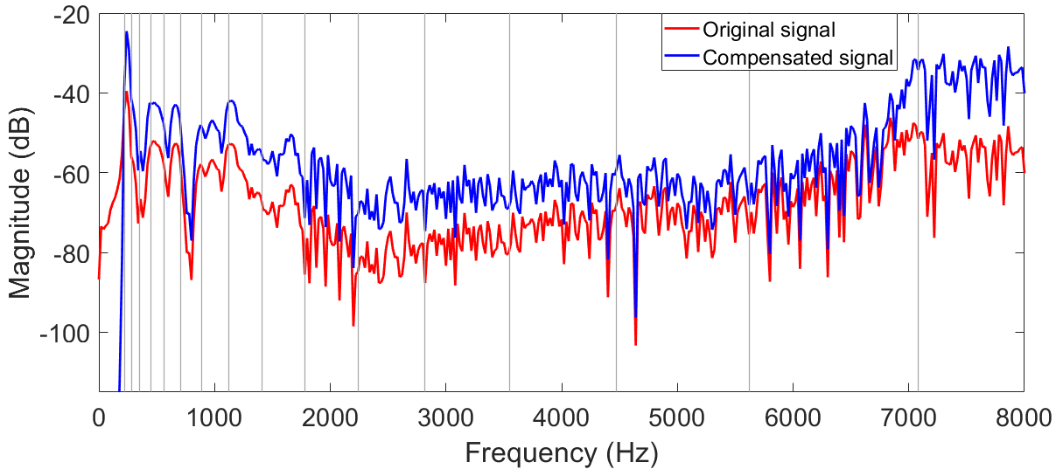
Simulation Results: Amplification
Matched to an audiogram
Average error per frequency band: 1.41%

Slide 11
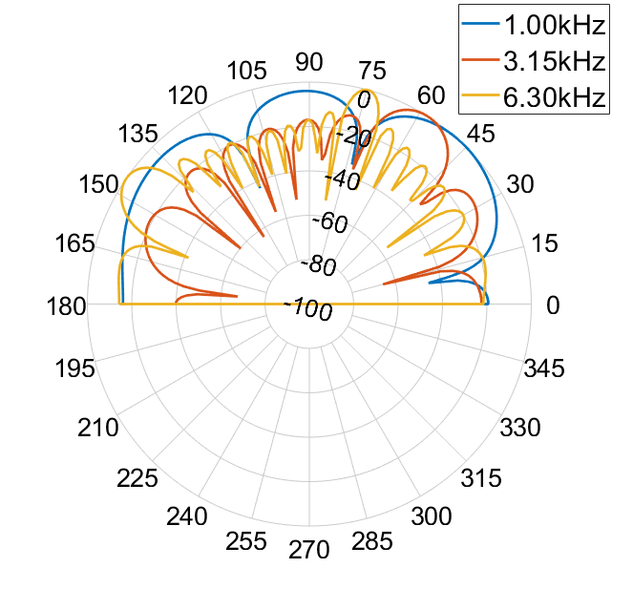
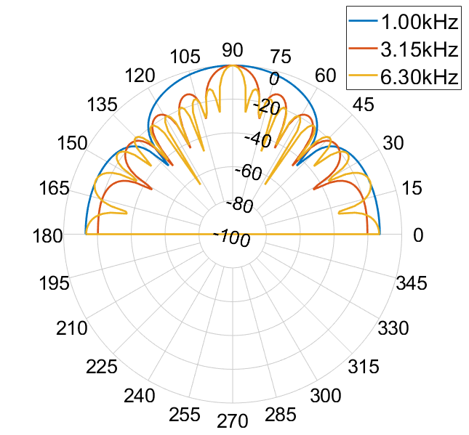
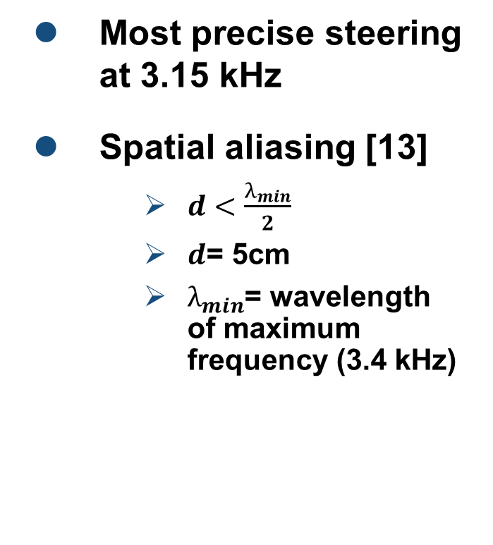
Simulation Results: Directionality
Most precise steering at 3.15 kHz
Spatial aliasing [13]
$d<\frac{λ_{min}}{2}$
$d$= 5cm
$λ_{min}$= wavelength of maximum frequency (3.4 kHz)
60°
90°

Slide 12
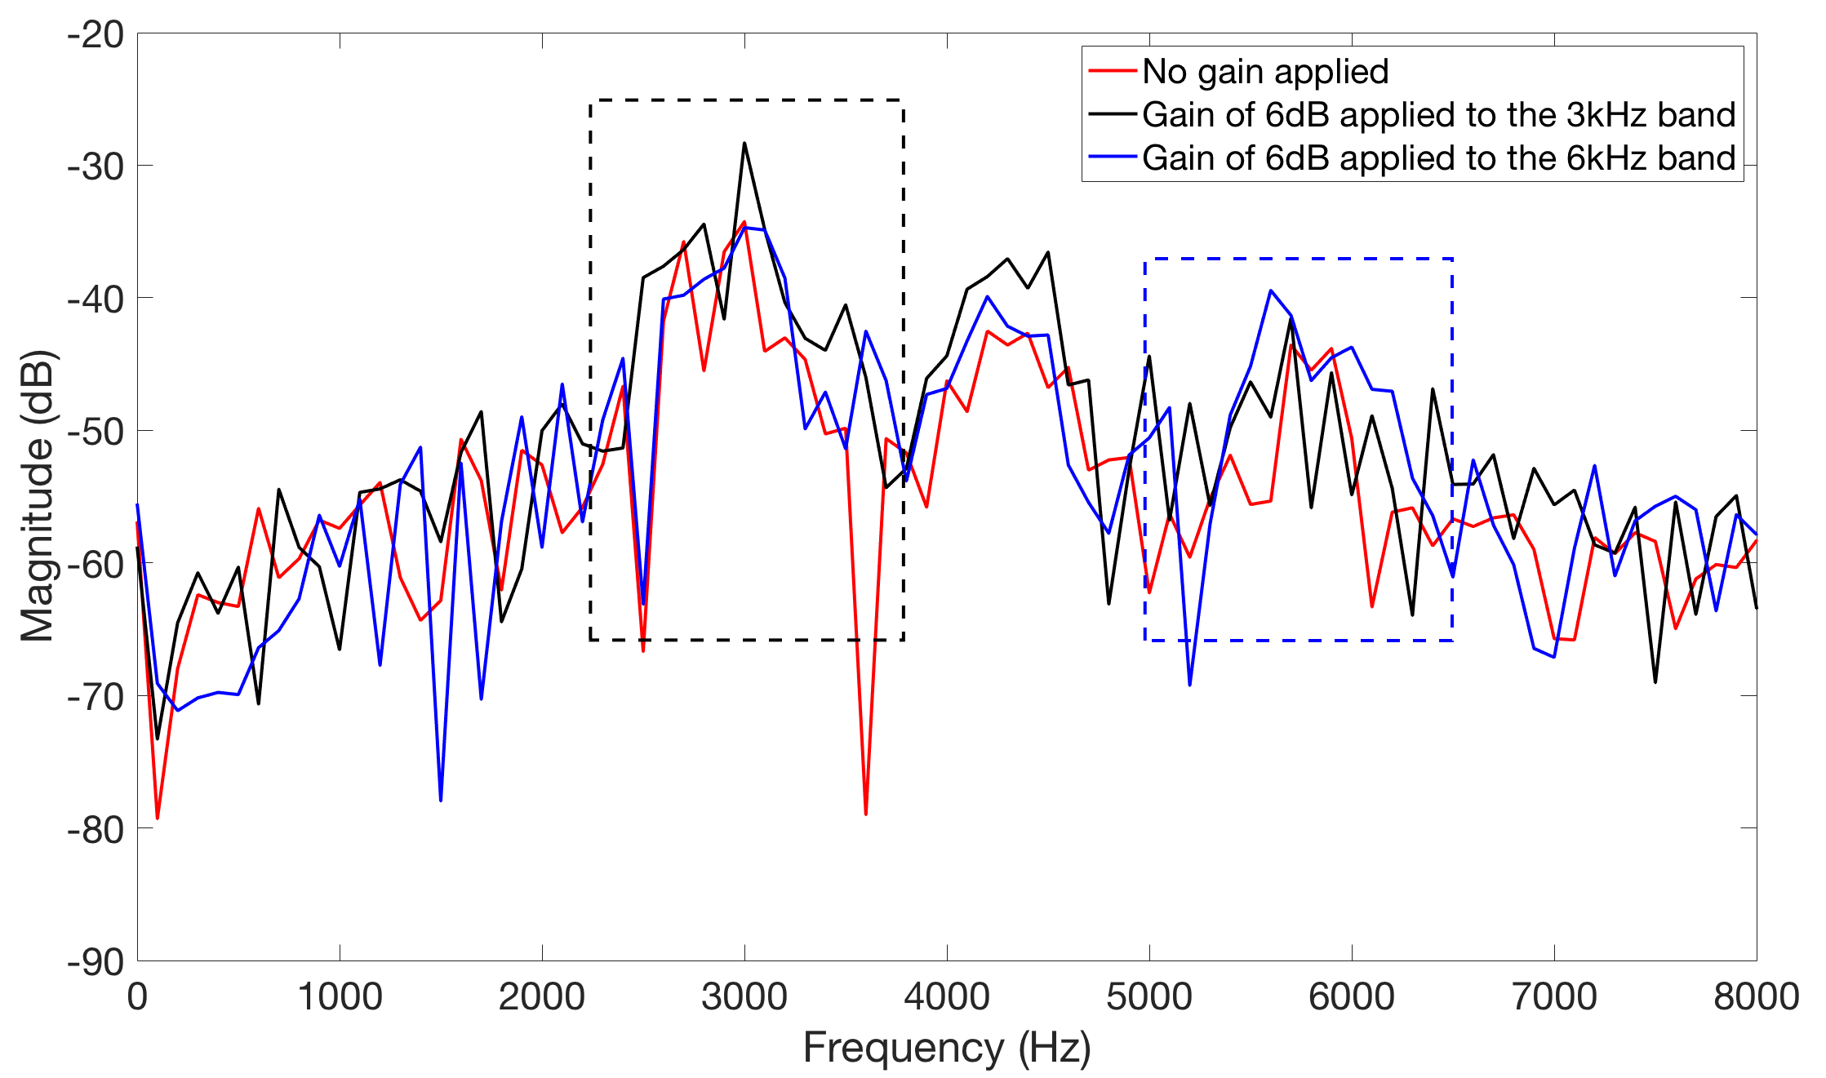
Hardware Results: Amplification
Total cost: $100
Input sound frequency: 3.15 kHz
Error caused by interaction of stop-bands
Notes:
Effect of amplifying one band is seen across the frequency spectrum- due to the order of the filter

Slide 13
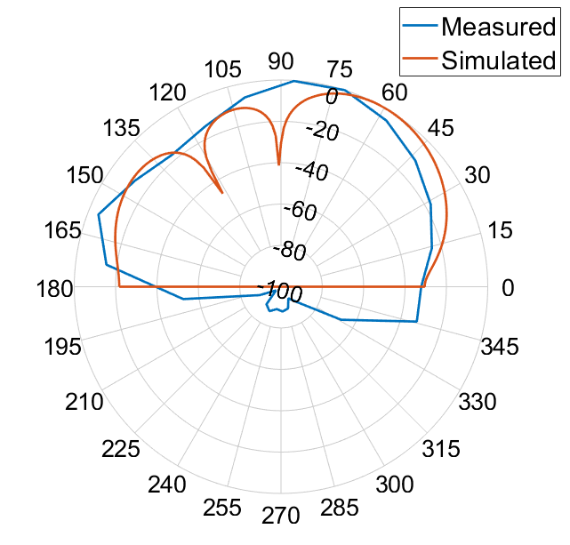
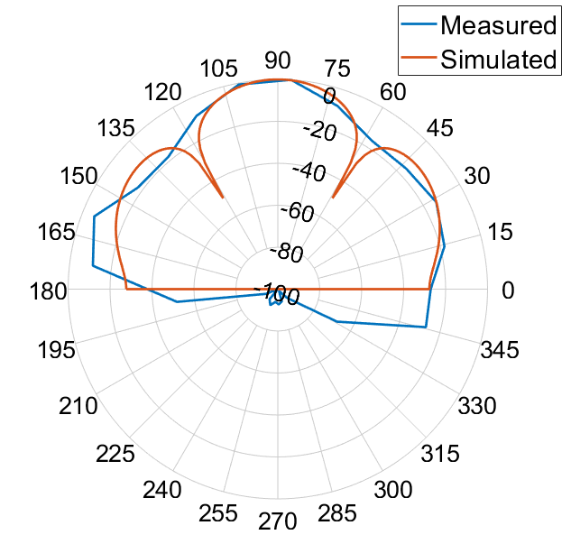
Hardware Results: Directionality
Most accurate at 90°
No time delay
Increased error in other directions
Integer number of sample shifts
60°
90°

Slide 14
System Error Analysis
Compensatory Amplification | Applied Frequency (kHz) | Frequency Band (kHz) | Error (%)
 | 3.15 | 2.82 - 3.55 | 0.81
 | 6.30 | 2.82 - 3.55 | 15.34
 | 3.15 | 5.62 - 7.08 | 19.56
 | 6.30 | 5.62 - 7.08 | 3.67
Directionality | Dial Angle (°) | Average Error (%)
 | 0 | 46.6
 | 60 | 30.7
 | 90 | 12.7
 | 120 | 22.7
 | 180 | 51.7
 | Omni-directional | 42.7
Notes:
Large omni error due to mics

Slide 15
Future Work
Higher quality omni-directional microphones
Integrated circuit chip
Pre-processing of the audio signals
Embedding circuitry into headphones
Reduce the size of the device
Make the device more user friendly

Slide 16
Conclusion
Objectives and specifications have been met
Low cost – $100
Full hearing aid simulation
Compensatory amplification
Steerable directionality
Concepts proven in hardware

Slide 17
References
[1] D. V. Anderson, R. W. Harris, and D. M. Chabries, “Evaluation of a hearing compensation algorithm,” 1995 International Conference on Acoustics, Speech, and Signal Processing, vol. 5, pp. 3531–
[2] Y.-T. Kuo et al., “Complexity-effective auditory compensation for digital hearing aids,” 2008 IEEE International Symposium on Circuits and Systems, pp. 1472–1475, 2008.
[3] earinstitute. Range of hearing aid prices in South Africa. Last accessed: 31/08/2018. [Online]. Available: https://www.earinstitute.co.za/range-of-hearing-aid-prices-in-south/-africa/
[4] J. T. George and E. Elias, “A 16-band reconfigurable hearing aid using variable bandwidth filters,” Global Journal of Researches in Engineering: Electrical and Electronics Engineering, vol. 14, 2014.
[5] N. Subbulakshmi and R. Manimegalai, “A survey of filter bank algorithms for biomedical applications,” 2014 International Conference on Computer Communication and Informatics, 2014.
[6] C. Yang, C. Liu, and S. Jou, “An efficient 18-band quasi-ansi 1/3-octave filter bank using re-sampling method for digital hearing aids,” in 2014 IEEE International Conference on Acoustics, Speech and
[7] A. Sebastian and T. G. James, “Digital filter bank for hearing aid application using FRM technique,” 2015 IEEE International Conference on Signal Processing, Informatics, Communication and Energy
[8] Y.-T. Chang et al., “Complexity-effective auditory compensation with a controllable filter for digital hearing aids,” 17th Asia and South Pacific Design Automation Conference, pp. 557–558, 2012.
[9] T. Ricketts, “Directional hearing aids,” Trends in Amplification, vol. 5, no. 4, pp. 139–176, 2001.
[10] P. Corbishley et al., “An ultra-low power analogue directionality system for digital hearing aids,” 2004 IEEE International Symposium on Circuits and Systems, pp. 233–236, 2004.
[11] J. Tiete et al., “Soundcompass: A distributed mems microphone array-based sensor for sound source localization,” Sensors (Basel, Switzerland), vol. 14, pp. 1918–49, 02 2014.
[12] S. L. Bell, “Filtering to match hearing aid insertion gain to individual ear acoustics.” Trends in amplification, vol. 13, no. 3, pp. 181–189, 2009.
[13] J. Carroll et al., “Fundamental frequency is critical to speech perception in noise in combined acoustic and electric hearing,” The Journal of the Acoustical of America, 2011.
[14] V. Berisha et al., Bandwidth Extension of Speech Using Perceptual Criteria. Morgan & Claypool Publishers, 2013.
[15] J. D. Kraus, Electromagnetics, 3rd ed. McGraw-Hill Book Company, 1985.
3533, 1995.
Signal Processing (ICASSP), 2014, pp. 2639–2643.
Systems, pp. 1–5, 2015.

Slide 18
Questions?

