Slide 1


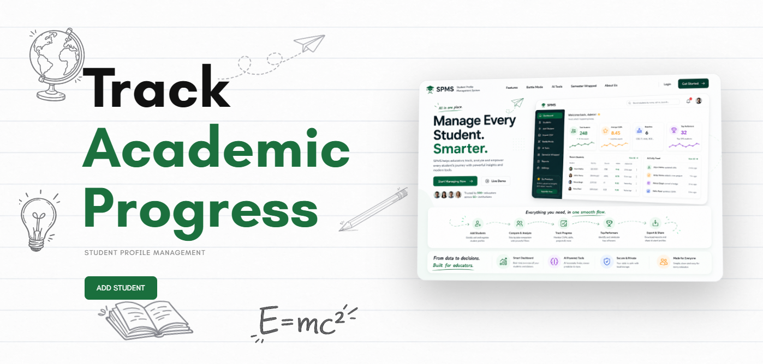
Nodus
Student Profile Management System
Frontend Engineering II (25CSE020)
Presented By:
-Pashvinder(Team Leader)
-Anushka Sahrawat
-Kartavya Garg
-Kartik

Slide 2


The Problem with Student Data Tools
Most student data platforms are dry, form-heavy CRUD systems — built to store data, not to tell a story. Colleges lack a unified, engaging way to view, manage, and explore student journeys.
Colleges deserve more than a spreadsheet with a login screen.
Fragmented Data
Zero Engagement
No Insight
Raw records don't surface trends or career signals.
No single view connects academics, skills, and milestones.
Static tables don't motivate students or faculty.

Slide 3
Introducing Nodus
A student data platform that actually feels like a product — intuitive, visual, and purpose-built for the modern campus.
Frontend-Only
localStorage Persistence
Right-Scoped
Built entirely with HTML, CSS, and vanilla JavaScript — no backend required, fully self-contained.
All student data lives in the browser via localStorage, surviving refreshes and restarts with zero server dependency.
A frontend-only approach is the ideal scope for this assessment — demonstrating mastery of DOM, state, and UX without backend complexity.

Slide 4
Tech Stack
HTML5 & CSS3
Vanilla JavaScript ES6+
localStorage
Semantic markup and modern styling form the structural and visual foundation.
Modules, arrow functions, destructuring — modern JS without any framework overhead.
JSON.stringify / JSON.parse power a lightweight, browser-native data persistence layer.
GROQ API
Drives AI-powered features — career prediction and smart teammate matching.

Slide 5

System Architecture
Career Analysis analyze careers
Index Page
Overview after login
Manage Student
View all students
Login Routing
Role-based checks on every load
Student Profile
Individual student page
Battle Mode
Compare student data
Authentication state is read from localStorage on every page load. Unauthorized roles are redirected immediately — enforcing access control without a server.

Slide 6
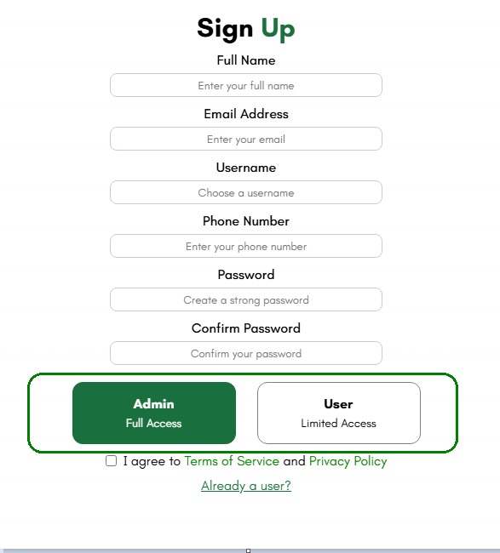
Core & Profile Features
Student Management
Add / Edit students with client-side form validation
Search Student
Admin and Client Authentication
Rich Profile View
🪪 Exportable Profile PDF — shareable student summary

Slide 7
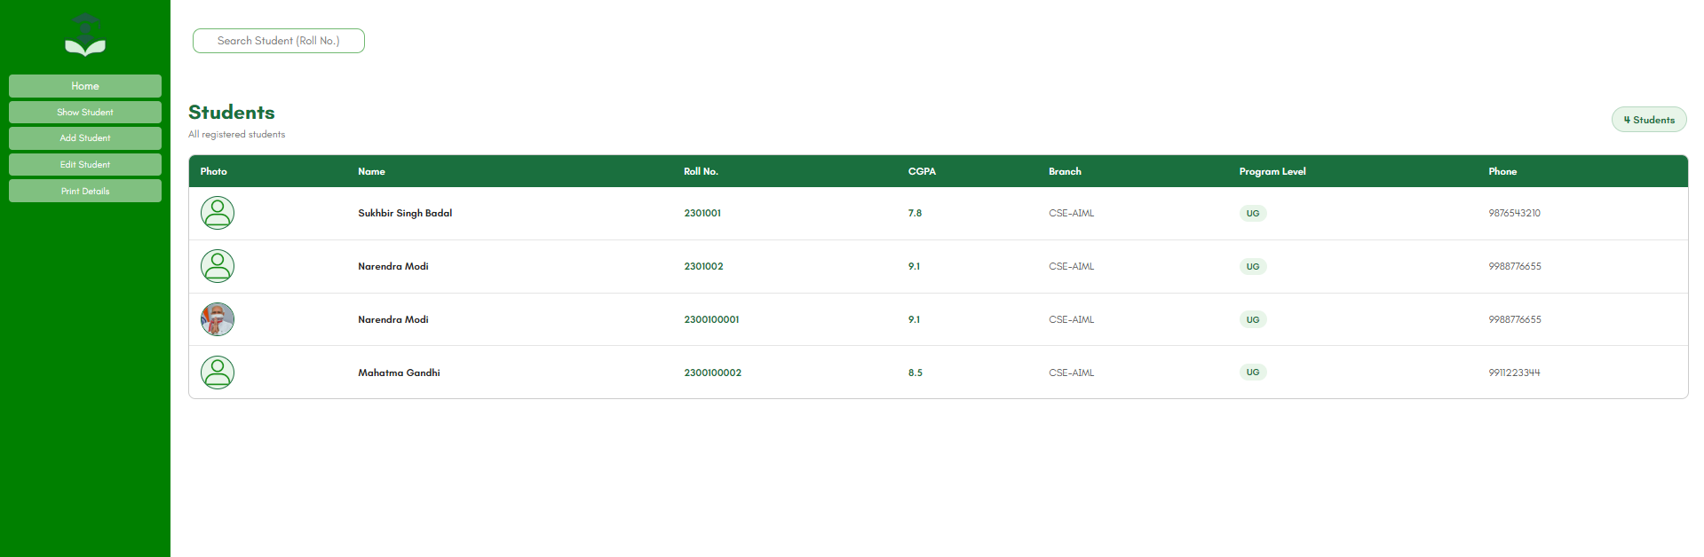
Manage All Students
Manage Profiles of all students

Slide 8
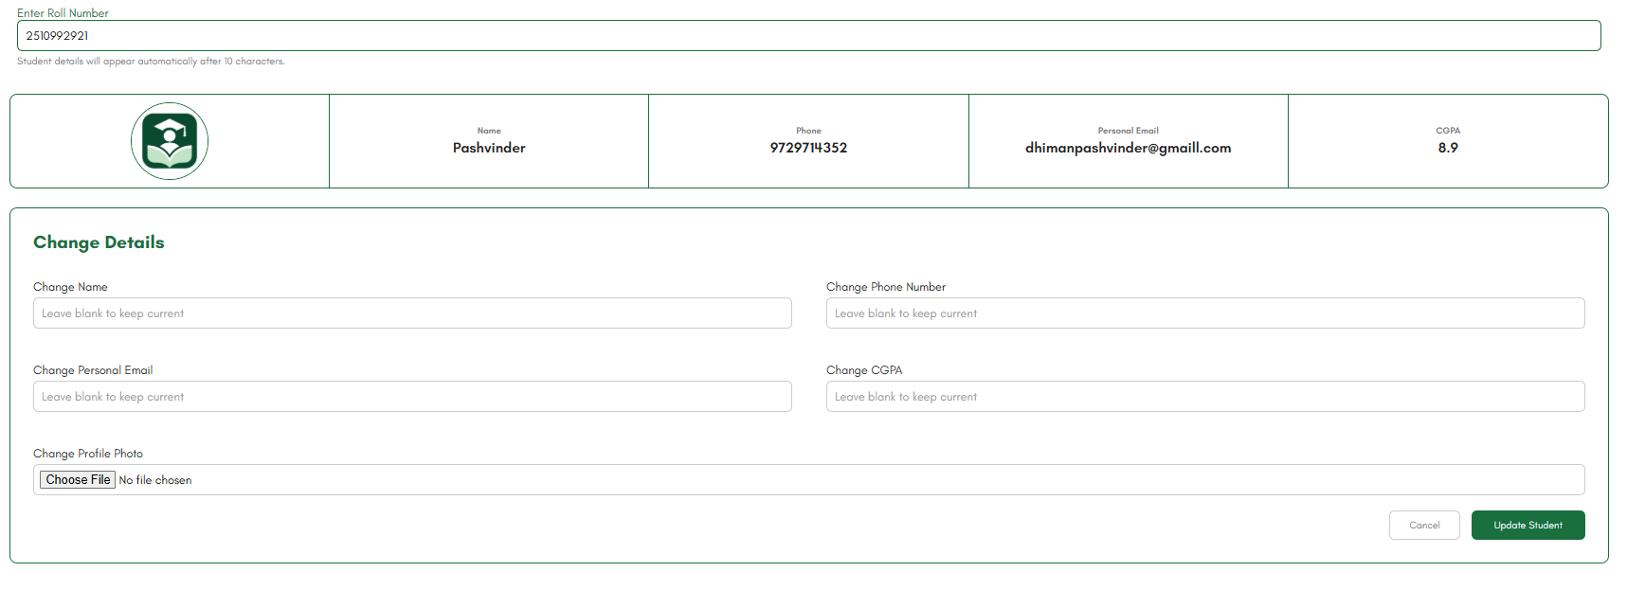
Edit Student Details
Change the pre-existing details of student

Slide 9
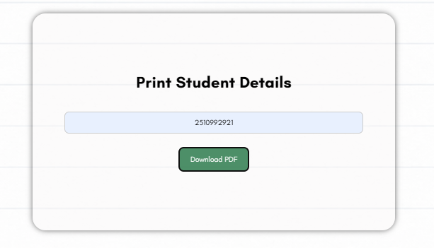
Print Student Details
Get details of a student in PDF format

Slide 10
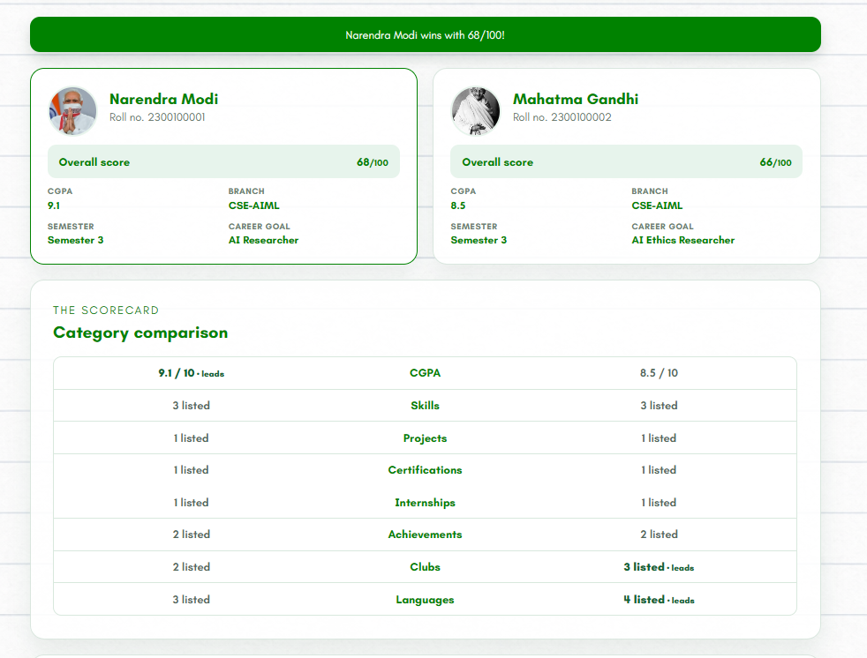
1
Standout Features
Battle Mode
Compete with your friends and collegemates

Slide 11
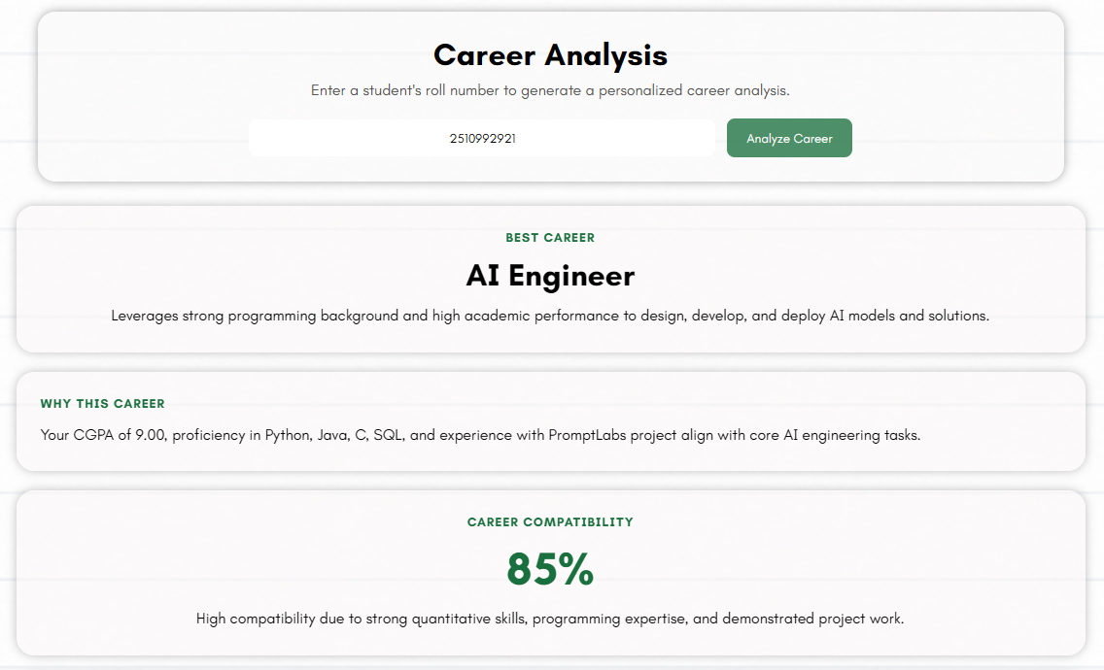
2
Career Path Predictor
GROQ AI reads a student's full profile and recommends career roles plus personalized skill gap analysis.
1

Slide 12



Responsive Page
Desktop View
Mobile View
Tablet View

Slide 13
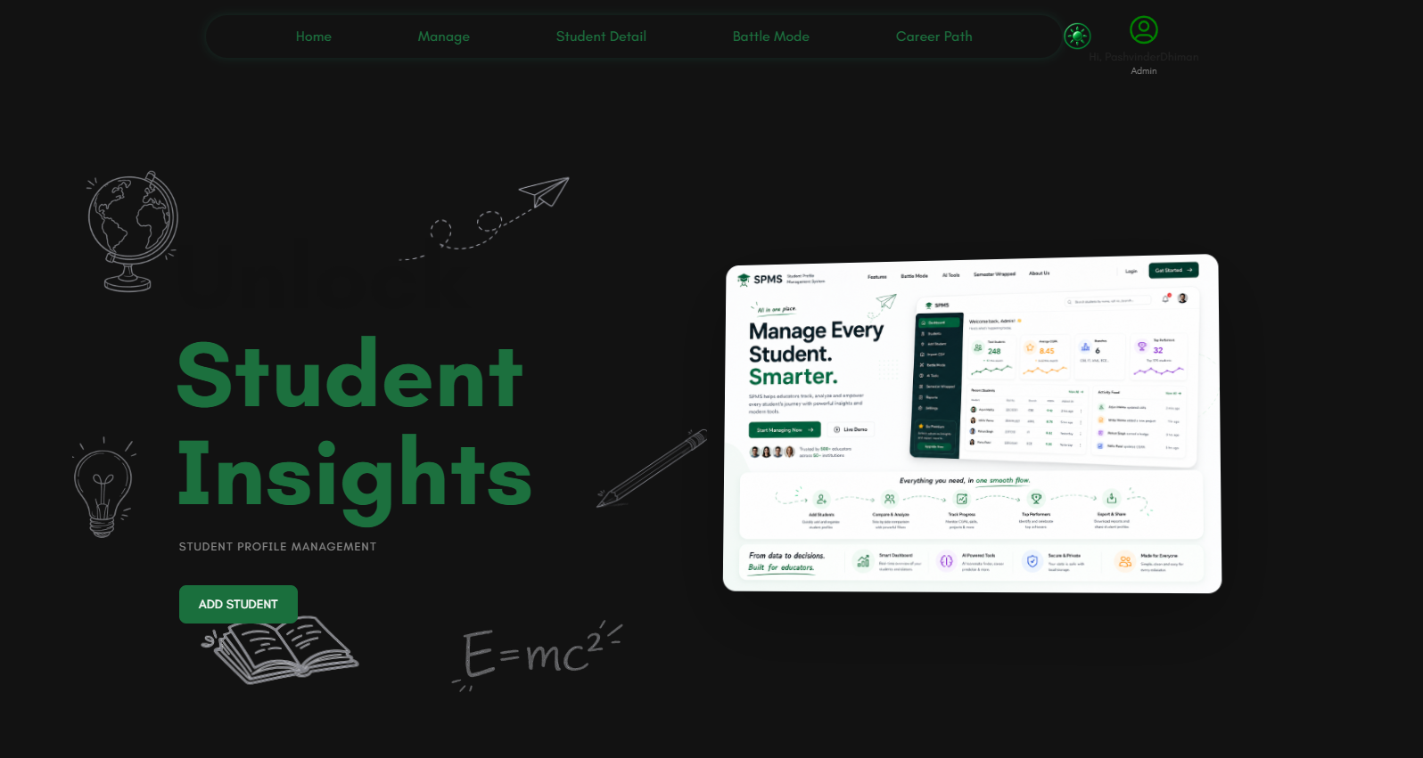
Dark Mode

Slide 14
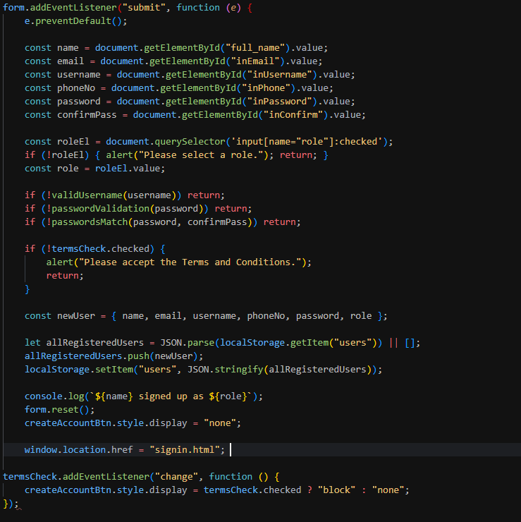
Code Walkthrough — Sign Up & Validation
Sign Up Form Fields
01
01
Full Name, Email, Username, Phone
02
02
Password + Confirm Password (strength-checked)
03
03
Role selection — Admin or Viewer
04
04
Terms & Conditions checkbox — required to submit
05
05
On success: user object saved to localStorage as JSON → redirect to sign-in
No backend required — client-side validation + localStorage replaces a traditional auth server entirely.
No backend required — client-side validation + localStorage replaces a traditional auth server entirely.

Slide 15
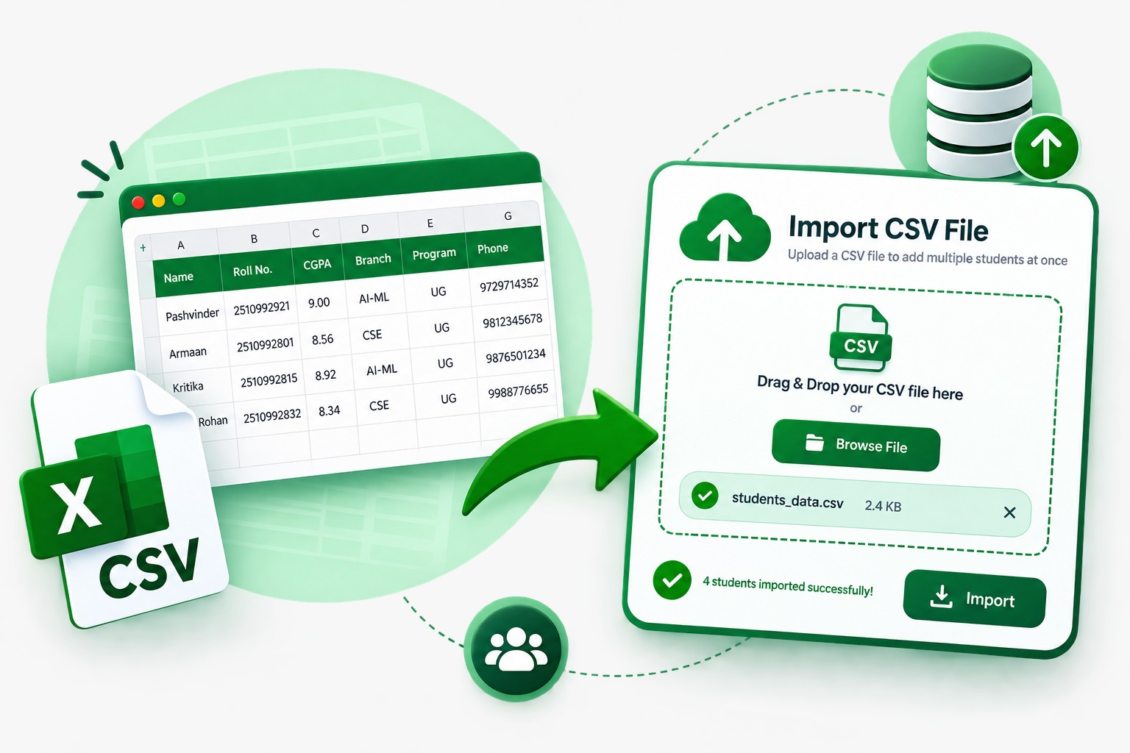
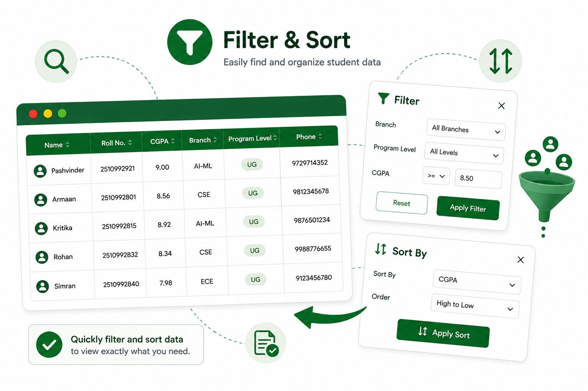
Future Improvisations
1
Advanced Filter & Sort
Multi-field filtering — combine branch + CGPA + semester together, with saved filter presets for quick reuse.
2
Smarter CSV Import
Schema validation, duplicate detection, and an error preview before committing bulk data.
3
Enhanced Semester Wrapped
Shareable social-card export plus year-over-year comparison to track growth across semesters.
4
Battle Mode 2.0
Group battles (3+ students at once) with leaderboard integration for class-wide comparisons.

Slide 16
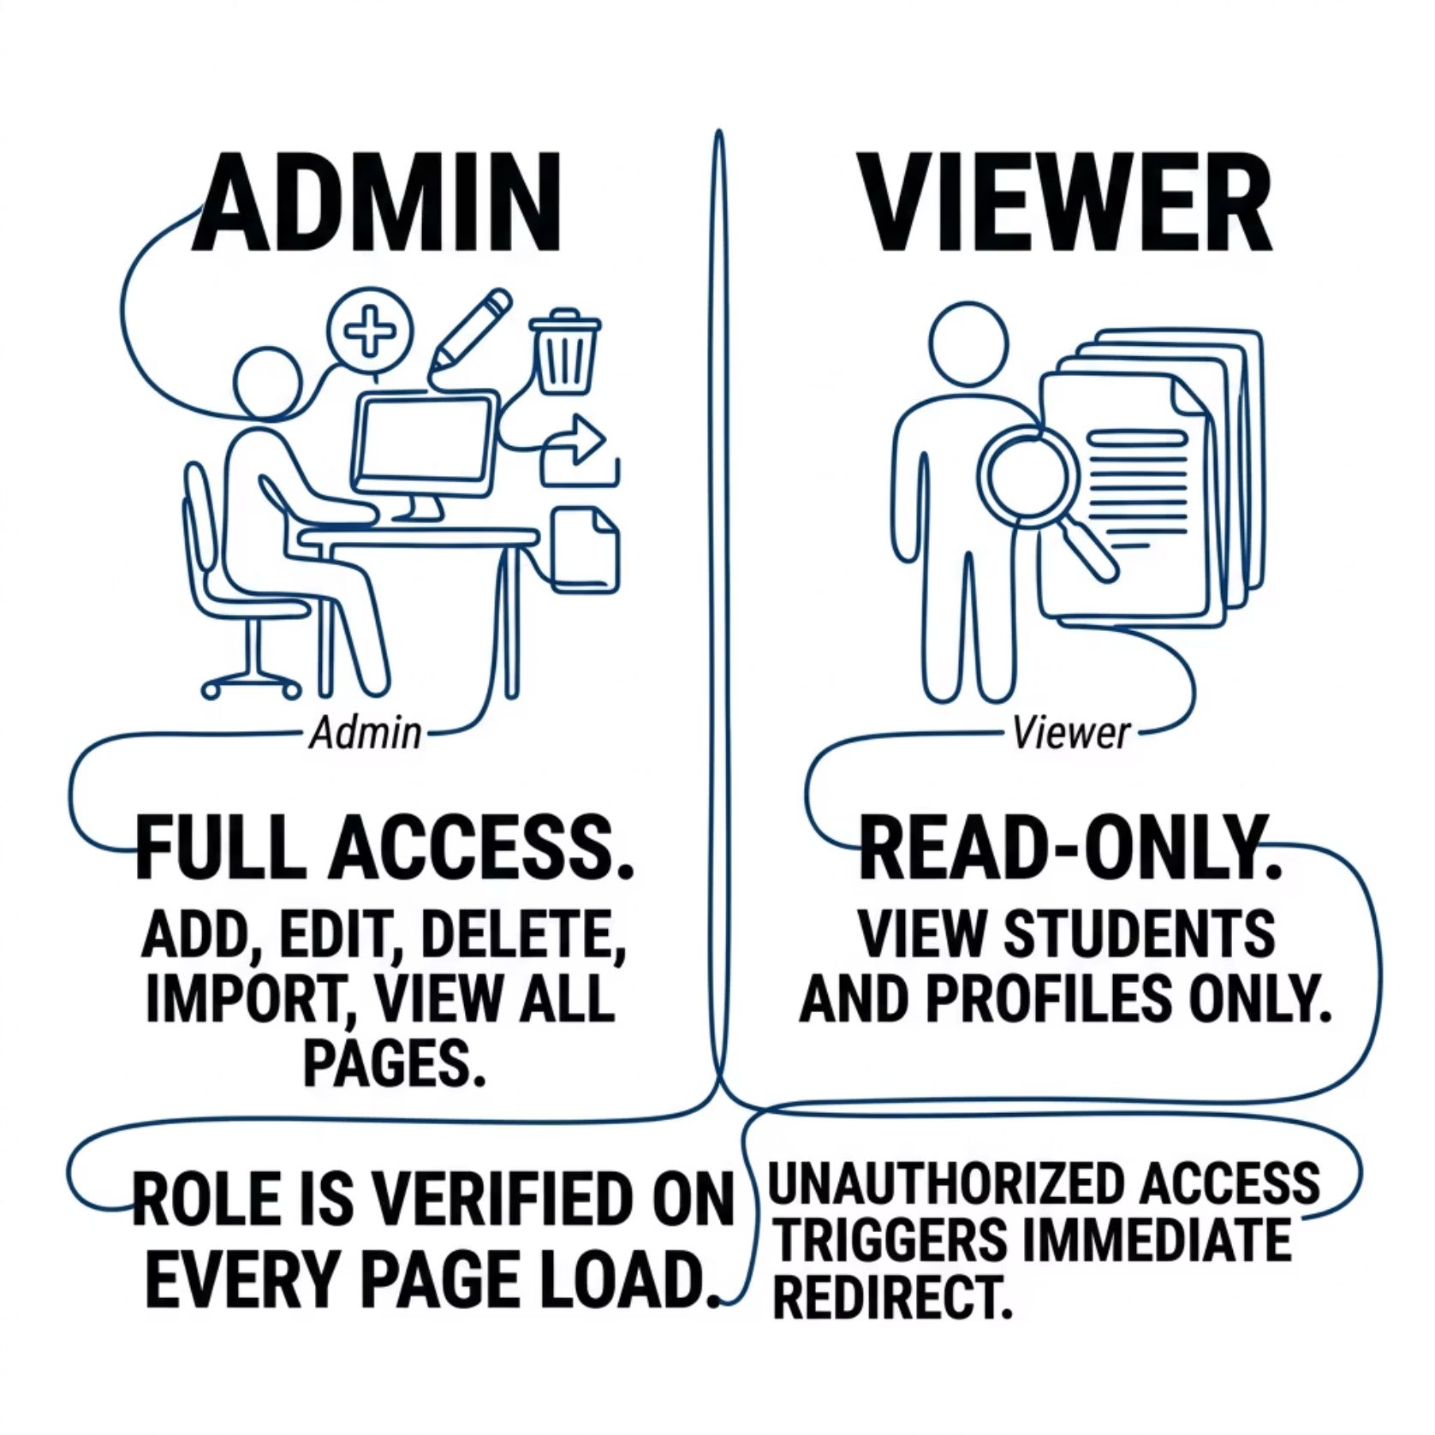

Role-Based Access & Data Persistence
localStorage as a Database
All student records are serialized with JSON.stringify and restored with JSON.parse. Data survives page refreshes, tab closures, and browser restarts — no server, no sync required.
Role enforcement runs on every page load — there is no unprotected route
in Nodus.

Slide 17
Challenges & Learnings
1
Simulating Auth Without a Backend
2
Cross-Page State Consistency
3
Client-Side Data Integrity
Validating, structuring, and sanitizing data without any server-side layer meant building robust validation logic entirely in vanilla JS.
Implementing login flow and session management purely via localStorage required careful state design to prevent spoofing and unauthorized access.
Keeping student data consistent across five separate HTML pages — without a framework's global store — demanded a disciplined read/write contract with localStorage.

Slide 18

“Thank You”
-Team Nodus
GitHub Repository

