Slide 1


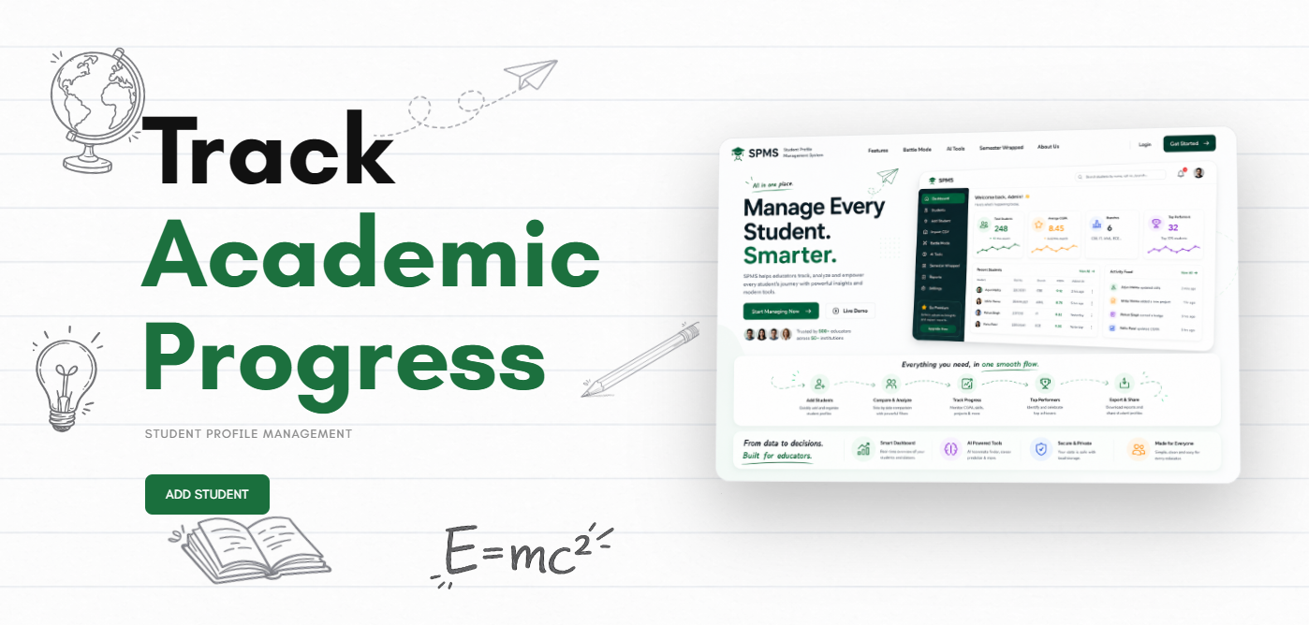
Nodus
Student Profile Management System
Frontend Engineering II (25CSE020)
Presented By:
-Pashvinder(Team Leader)
-Anushka Sahrawat
-Kartavya Garg
-Kartik

Slide 2


The Problem with Student Data Tools
Most student data platforms are dry, form-heavy CRUD systems — built to store data, not to tell a story. Colleges lack a unified, engaging way to view, manage, and explore student journeys.
Colleges deserve more than a spreadsheet with a login screen.
Fragmented Data
Zero Engagement
No Insight
Raw records don't surface trends or career signals.
No single view connects academics, skills, and milestones.
Static tables don't motivate students or faculty.

Slide 3
Introducing Nodus
A student data platform that actually feels like a product — intuitive, visual, and purpose-built for the modern campus.
Frontend-Only
localStorage Persistence
Right-Scoped
Built entirely with HTML, CSS, and vanilla JavaScript — no backend required, fully self-contained.
All student data lives in the browser via localStorage, surviving refreshes and restarts with zero server dependency.
A frontend-only approach is the ideal scope for this assessment — demonstrating mastery of DOM, state, and UX without backend complexity.

Slide 4
Tech Stack
HTML5 & CSS3
Vanilla JavaScript ES6+
localStorage
Semantic markup and modern styling form the structural and visual foundation.
Modules, arrow functions, destructuring — modern JS without any framework overhead.
JSON.stringify / JSON.parse power a lightweight, browser-native data persistence layer.
GROQ API
Drives AI-powered features — career prediction and smart teammate matching.

Slide 5

System Architecture
Dashboard
Overview after login
Students List
View all students
Login Routing
Role-based checks on every load
Student Profile
Individual student page
Battle Mode
Compare student data
Authentication state is read from localStorage on every page load. Unauthorized roles are redirected immediately — enforcing access control without a server.

Slide 6
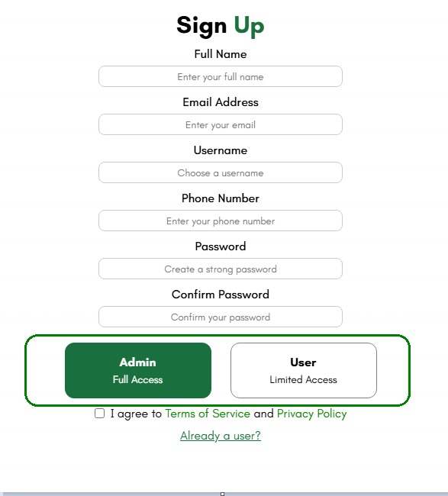
Core & Profile Features
Student Management
Add / Edit students with client-side form validation
Search Student
Admin and Client Authentication
Rich Profile View
🪪 Exportable Profile PDF — shareable student summary

Slide 7
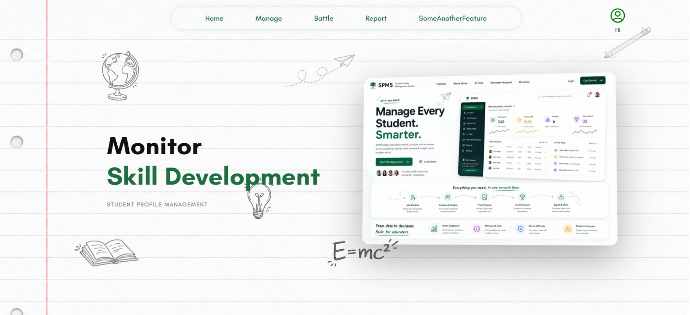

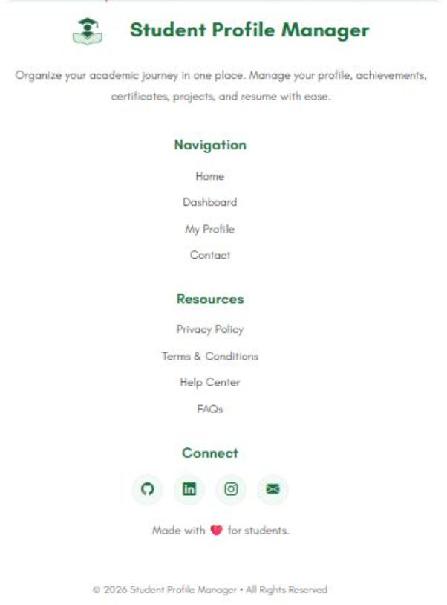
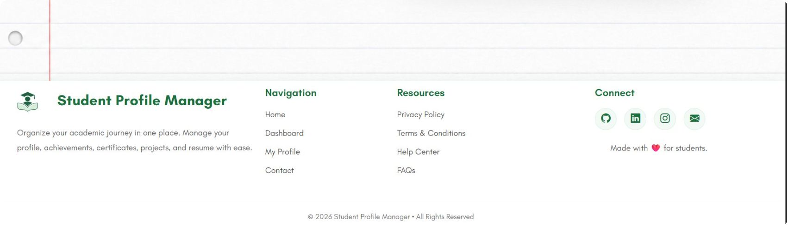
Home Page
Laptop View
Mobile View

Slide 8
Responsive Home Page — Desktop & Mobile
The landing page ("Manage Every Student. Smarter.") is fully responsive — built with Flexbox, CSS Grid, and media queries, zero frameworks.
Desktop View
Mobile View
Full nav bar: Home, Manage, Battle, Report & more
How-It-Works strip: Add Students → Compare & Analyze → Track Progress → Top Performers → Export & Share
Nav links stack vertically at top
Headline adapts to "Compare Student Growth"
Dashboard preview reflows below the fold
Same green-and-white design language — fully adapted to narrow viewports

Slide 9
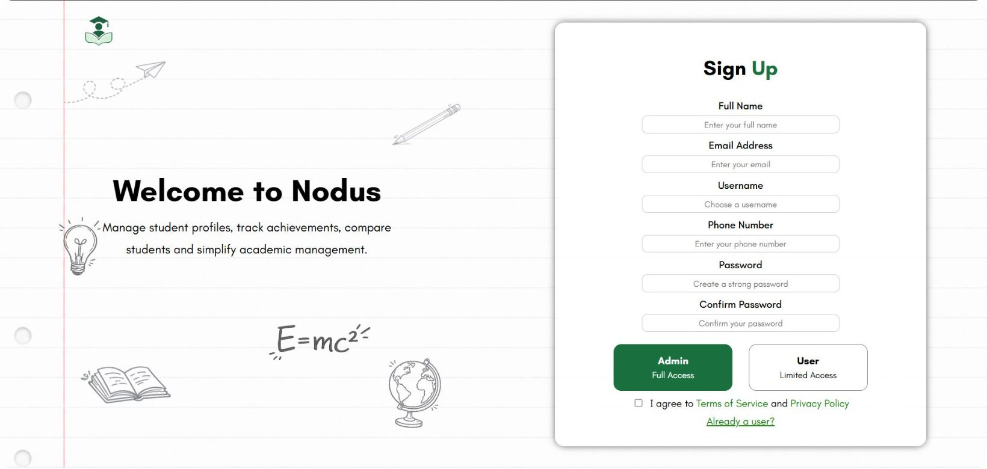
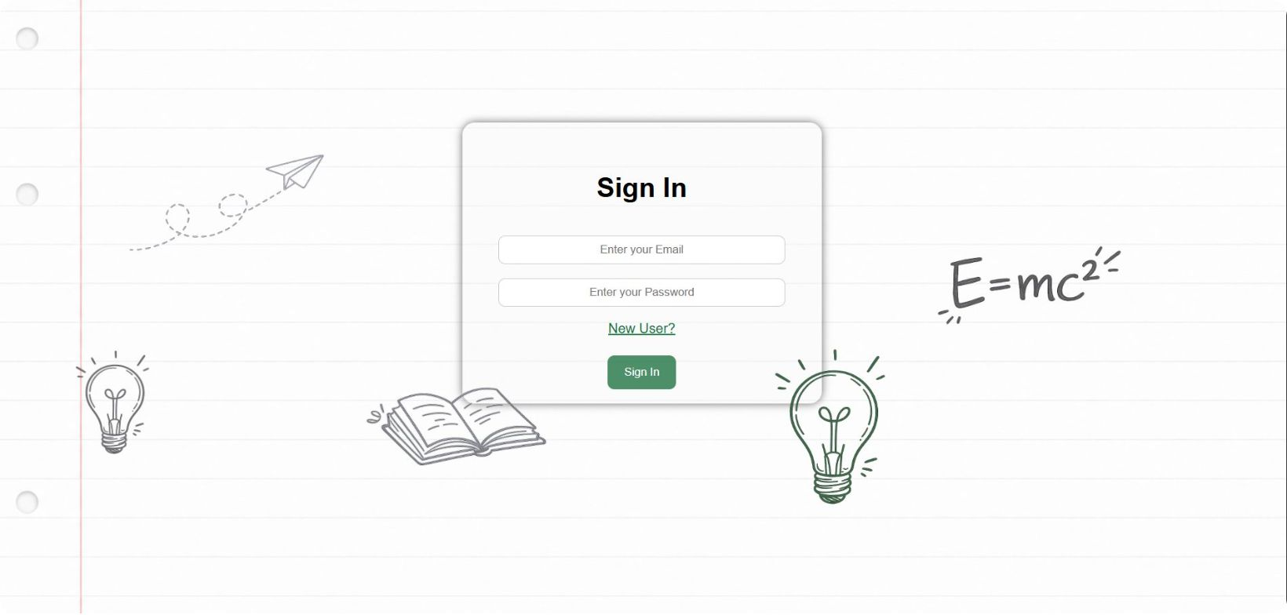
SignUp/In

Slide 10
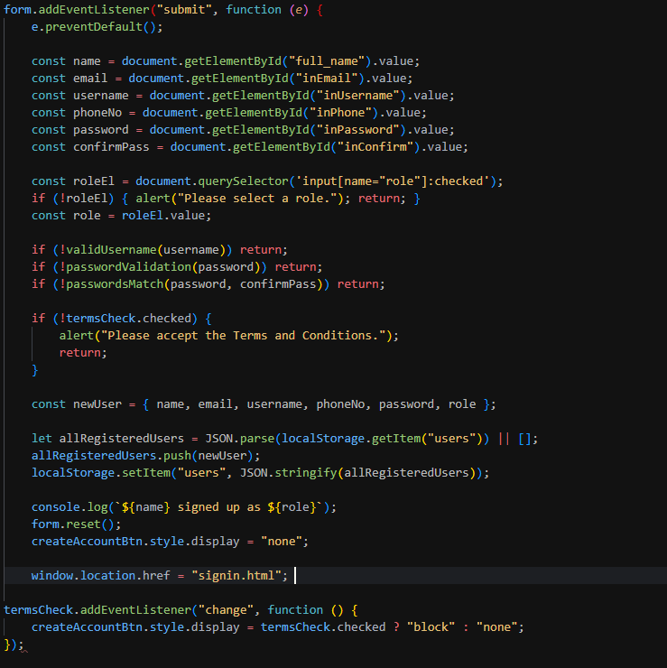
Code Walkthrough — Sign Up & Validation
Sign Up Form Fields
01
01
Full Name, Email, Username, Phone
02
02
Password + Confirm Password (strength-checked)
03
03
Role selection — Admin or Viewer
04
04
Terms & Conditions checkbox — required to submit
05
05
On success: user object saved to localStorage as JSON → redirect to sign-in
No backend required — client-side validation + localStorage replaces a traditional auth server entirely.
No backend required — client-side validation + localStorage replaces a traditional auth server entirely.

Slide 11
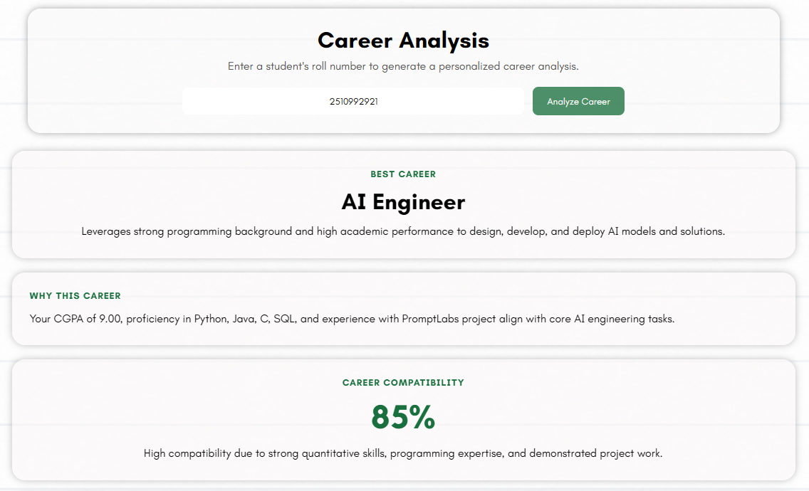
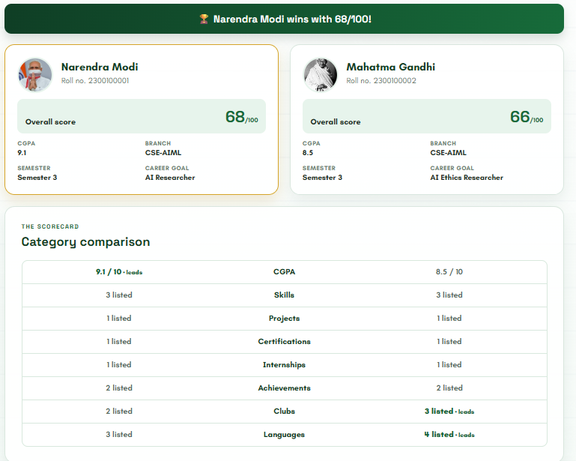
Standout Features
1
Career Path Predictor
GROQ AI reads a student's full profile and recommends career roles plus personalized skill gap analysis.
2
Battle Mode
Compete with your friends and collegemates

Slide 12
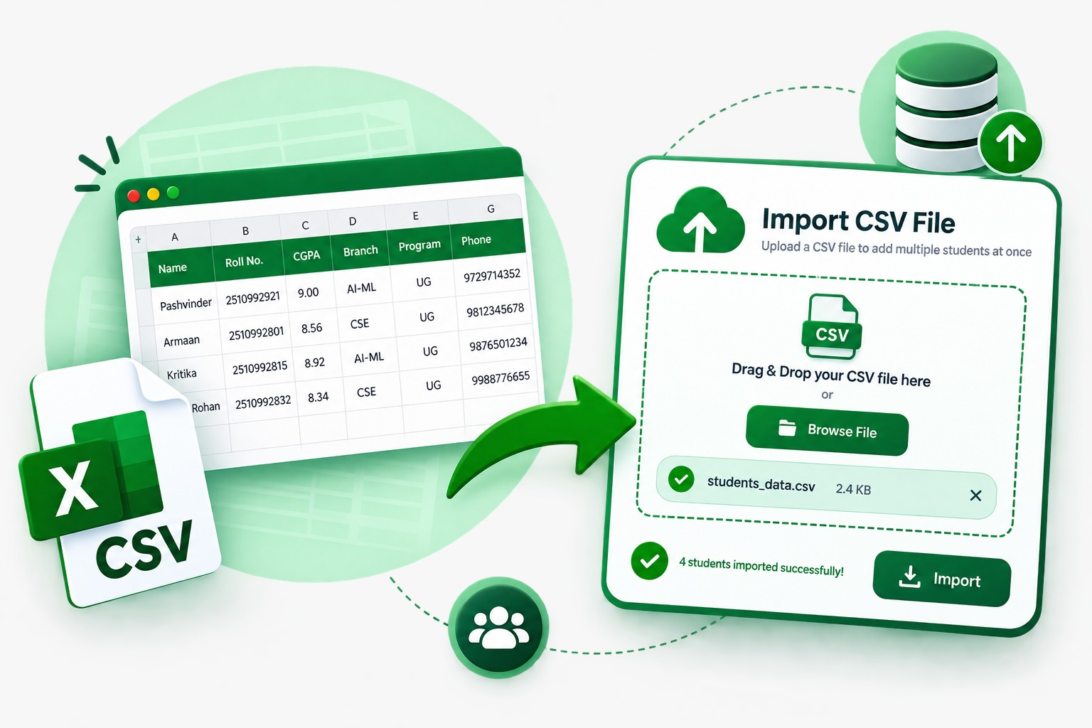
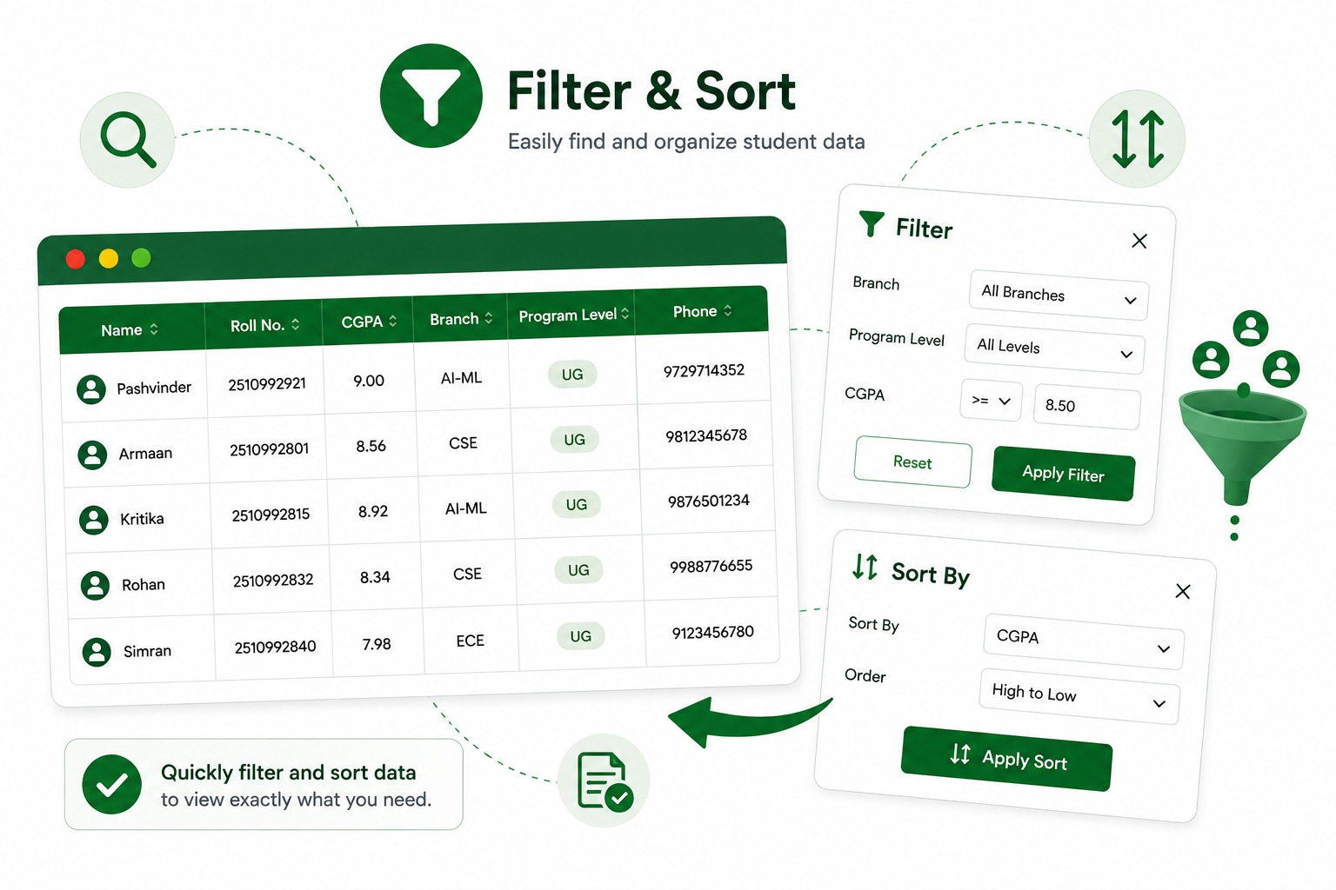
Future Improvisations
1
Advanced Filter & Sort
Multi-field filtering — combine branch + CGPA + semester together, with saved filter presets for quick reuse.
2
Smarter CSV Import
Schema validation, duplicate detection, and an error preview before committing bulk data.
3
Enhanced Semester Wrapped
Shareable social-card export plus year-over-year comparison to track growth across semesters.
4
Battle Mode 2.0
Group battles (3+ students at once) with leaderboard integration for class-wide comparisons.

Slide 13
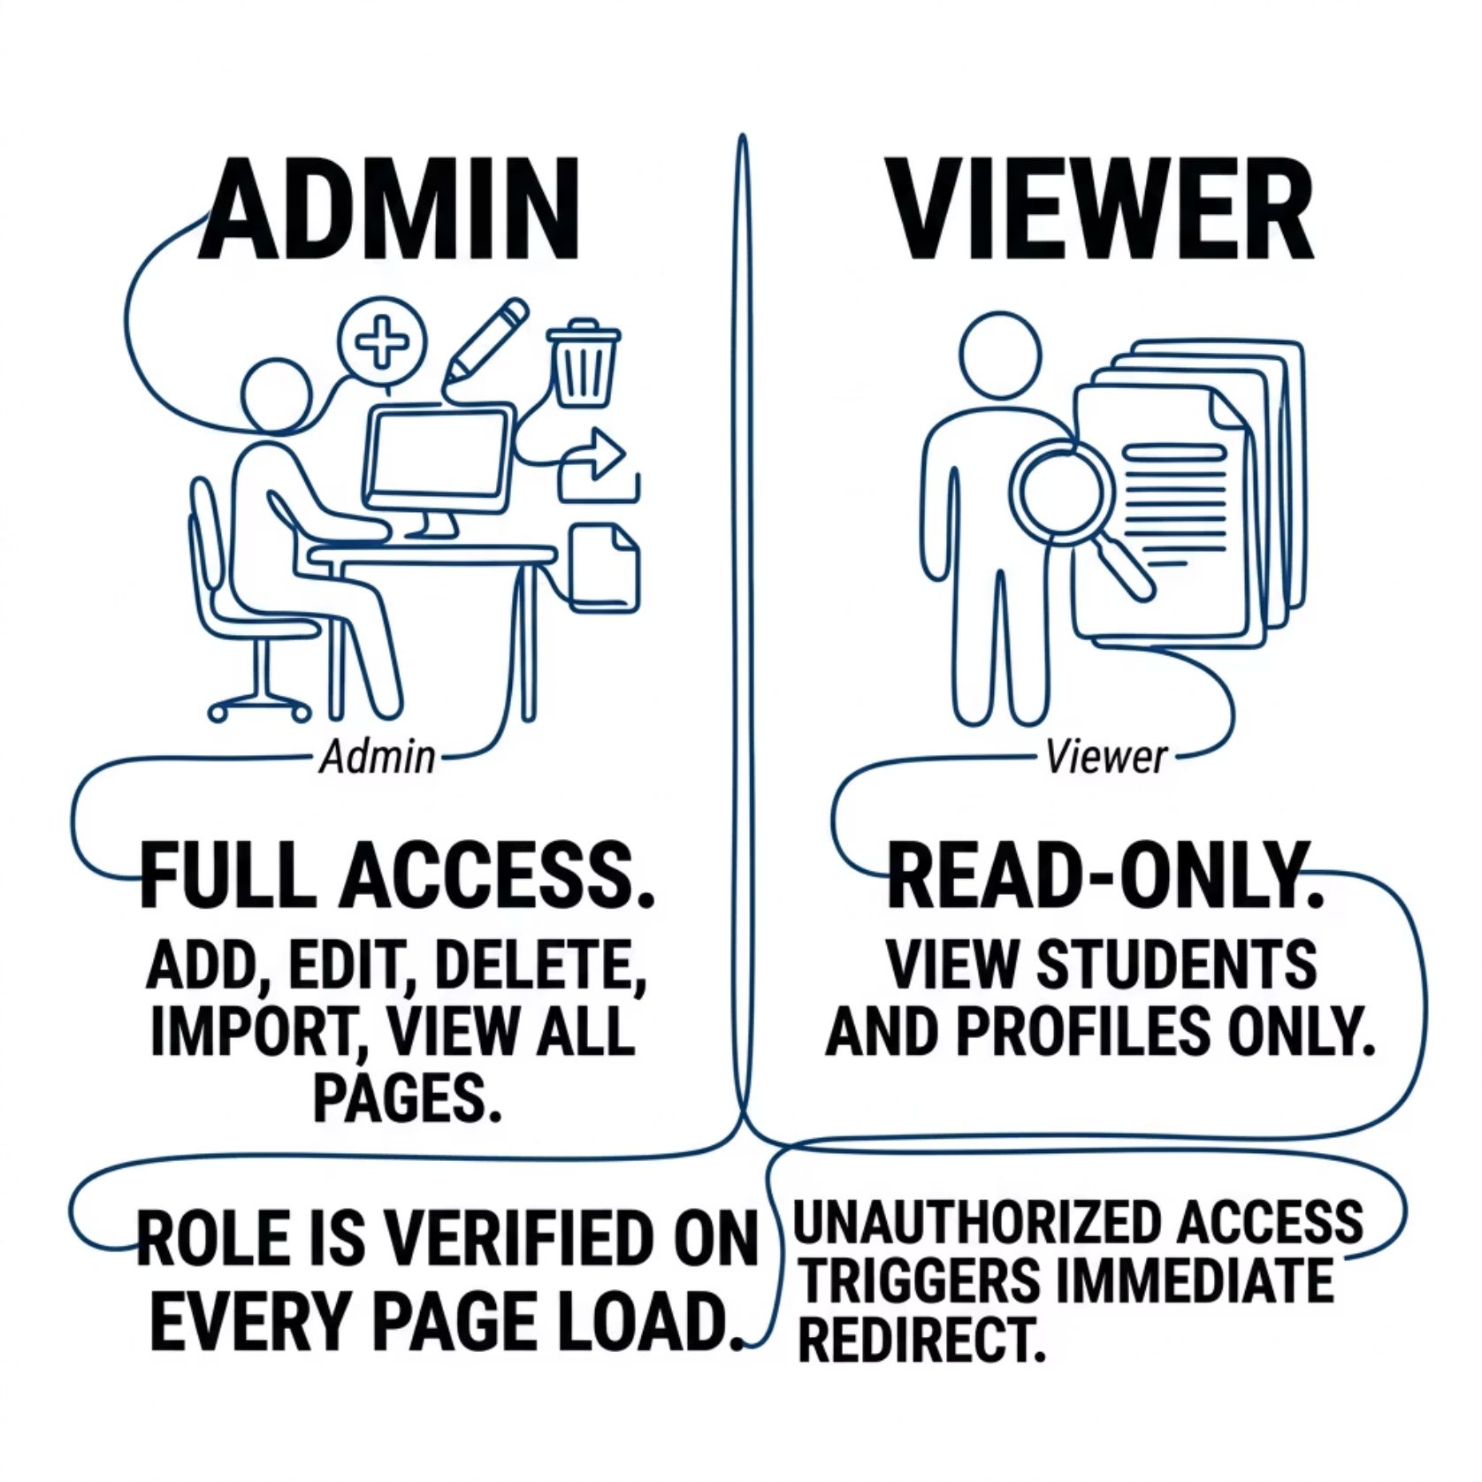

Role-Based Access & Data Persistence
localStorage as a Database
All student records are serialized with JSON.stringify and restored with JSON.parse. Data survives page refreshes, tab closures, and browser restarts — no server, no sync required.
Role enforcement runs on every page load — there is no unprotected route
in Nodus.

Slide 14
Challenges & Learnings
1
Simulating Auth Without a Backend
2
Cross-Page State Consistency
3
Client-Side Data Integrity
Validating, structuring, and sanitizing data without any server-side layer meant building robust validation logic entirely in vanilla JS.
Implementing login flow and session management purely via localStorage required careful state design to prevent spoofing and unauthorized access.
Keeping student data consistent across five separate HTML pages — without a framework's global store — demanded a disciplined read/write contract with localStorage.

Slide 15

“Thank You”
-Team Nodus
GitHub Repository

