Slide 1

ENHANCING AUTOMATIC METADATA GENERATION FOR YOUTUBE VIDEOS THROUGH MULTIMODAL CONTEXTUAL ANALYSIS
Supervisor - Dr. Anantharajah Kaneswaran
Co-supervisor - Mr. Y. Pirunthapan
Semester 07
AUGUST 2025
Presented by : 2021/E/078 , 2021/E/108
1

Slide 2
CONTENT
Aim & objectives ………………………………………………………………………...……………………………………….. 03
Research gap ………………………………………………………………………………………………………………………… 04
Literature survey summery……………………………………………………………………………………………. 05
Data collection, architecture selection and quality checking ……………..... 07
Research methodology and justification …………………..……………………………………….. 08
Progress so far …..……………………………………………………………………………………………………………….... 09
Finding so far and limitation ……………………………………………………………………………………..... 10
Image 1 of metadata generation via RAG + pinecone ……………………………….. 11
Image 2 of metadata generation via RAG + pinecone ………………………………. 12
Next steps ………………………………………………………………………………………………………………………………… 13
Reference ……………………………………………………………………………………………………………………….………… 14
2

Slide 3
AIM AND OBJECTIVES
AIM
Develop a system to automatically generate accurate, contextually relevant metadata (titles, tags, descriptions) for YouTube videos uploaded by content creators, improving discoverability and engagement
OBJECTIVES
Define key metadata types: title, tags, description tailored to video content.
Create a custom multimodal dataset combining video, audio, text features from MSR-VTT annotations.
Integrate LLaMA3:7b via Ollama for metadata generation.
Transition from T5-based fine-tuning to Retrieval-Augmented Generation (RAG) architecture.
Develop a Chrome extension to automate metadata insertion during video upload.
Evaluate model performance with quantitative metrics (Content F1, BLEU, ROUGE).
3

Slide 4
RESEARCH GAP
Existing YouTube metadata generation methods often rely on keyword-based or shallow semantic techniques, lacking deep multimodal contextual understanding.
Prior state of the art models like VATMAN use hierarchical multi-head attention but involve complex architectures not yet fully exploited.
Current fine-tuning approaches such as with T5 or LLaMA3:7b show limitations in fluency, effectivity, or require high resources, limiting scalability and adaptability.
There is a gap in practical, scalable methods combining large LLMs like LLaMA3:7b with vector-based retrieval (RAG) architectures for dynamic and accurate video metadata generation.
Existing datasets (MSR-VTT) provide a solid base but integrating and aligning multimodal features practically with LLMs for this task remains underexplored.
Chrome extension automation of metadata insertion during upload is novel but has not been fully realized or integrated with advanced retrieval-based models.
4

Slide 5
LITERATURE SURVEY SUMMARY
VATMAN Model: State-of-the-art trimodal hierarchical crossmodal attention for video, audio, and text fusion [1] :
Uses ResNeXt-101 (video), Kaldi MFCC (audio), BERT (text).
BART for abstractive summarization.
Our adaptation :
Use of Librosa MFCC instead of Kaldi for audio feature extraction for public reproducibility.
Recognizing that hierarchical crossmodal attention is key to stronger fusion, we identified implementing this as a critical next step in our project.
Relevance to Current Research :
VATMAN and our modifications lay the foundation for rigorous, context-aware metadata generation.
Highlights need for practical, scalable solutions—driving our focus on adaptable architectures for real-world deployment on platforms like YouTube.
5

Slide 6
LITERATURE SURVEY SUMMARY
LLaMA3 [7]: Advanced LLM with multilingual, code reasoning & multimodal support; strong fine-tuning/alignment capabilities.
Ollama : Local deployment framework ensuring privacy & offline inference.
RAG [9]: Enhances LLM output with real-time external context (via vector DBs) for freshness, scalability & adaptability.
Pinecone [6] [8] [10]: High-performance vector DB for fast, scalable, metadata-aware retrieval.
Findings :
Strong LLMs, dynamic context updates, privacy (Ollama), scalable retrieval (Pinecone).
High resource use; retrieval/generation balance needed; cloud cost/latency concerns.
Hierarchical/graph-based retrieval and chain-of-thought fusion enhance reasoning and contextual accuracy.
Relevance to Our Work :
Migration from fine-tuning to RAG + LLaMA3 + Pinecone boosts scalability, adaptability & accuracy for YouTube metadata generation, matching the latest research trends.
6

Slide 7
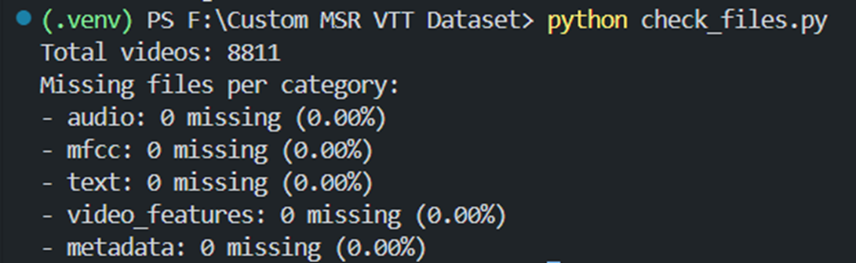
DATA COLLECTION, ARCHITECTURE SELECTION AND QUALITY CHECKING
Custom dataset from MSR-VTT : 8,811 videos selected with video, audio, text modalities.
Metadata created using original MSR-VTT annotations (2 human-annotated sentence pairs per video).
Multimodal features : ResNeXt-101 (video), Librosa MFCC (audio), Whisper transcripts (text).
Quality checks ensured completeness and valid feature shapes.
From T5 encoder-decoder to LLaMA3:7b for improved language modeling.
Local deployment via Ollama for control.
Final shift to RAG architecture with Pinecone vector database for dynamic retrieval and generation.
7

Slide 8
RESEARCH METHODOLOGY AND JUSTIFICATION
Method choice :
Fine-tuning LLaMA3:7b on Google Colab was resource-intensive and impractical for dynamic YouTube metadata, so Retrieval-Augmented Generation (RAG) with Pinecone vector database was adopted for scalable, flexible, and real-time metadata updates without modifying model weights.
Metadata Generation Pipeline:
Extract video, audio, and text features
Fuse multimodal embeddings
Retrieve relevant context via Pinecone RAG
Generate metadata (titles, tags, descriptions) with LLaMA3:7b
Alternative Methods Considered:
T5 Fine-tuning – BLEU 0.21, repetition, corrupted info → excluded.
LLaMA3:7b Fine-tuning – Better quality but static & costly to update.
RAG Chosen – Proven in literature for knowledge-intensive tasks; dynamic integration of context.
8

Slide 9
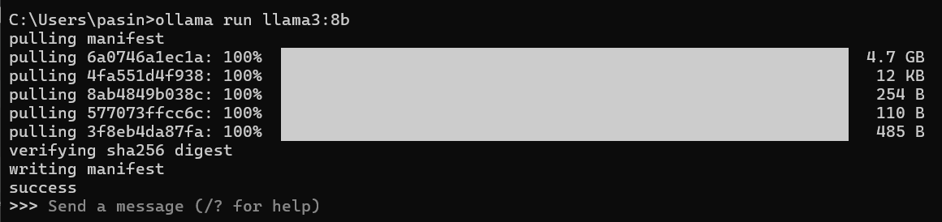
PROGRESS SO FAR
Custom multimodal dataset (metadata via LLaMA3:7b) created, validated, and complete.
No missing data after quality checks.
Tested all alternatives (T5, LLaMA3:7b fine-tuning) and T5 rejected due to low quality.
Chrome extension + FastAPI backend built for seamless metadata generation and YouTube upload integration.
Transitioned to Retrieval-Augmented Generation (RAG) architecture, decision based on experimental findings and quality benchmarks
Generated and evaluated metadata for 2 sample videos using RAG (see following slides for screenshots)
9

Slide 10
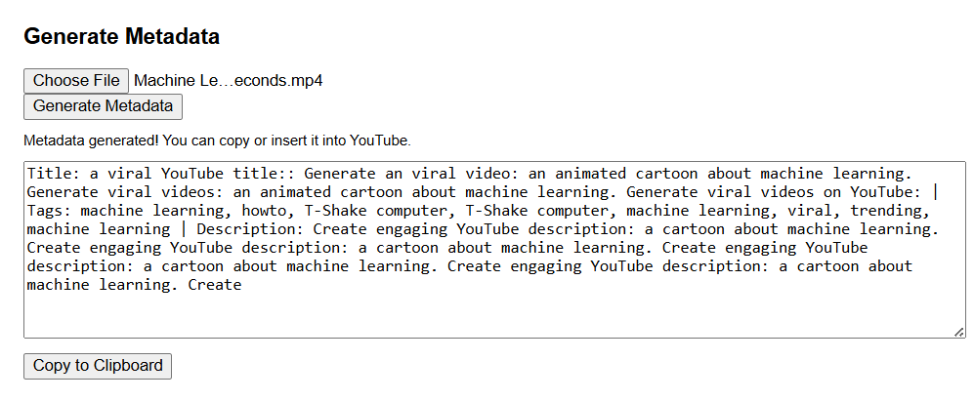
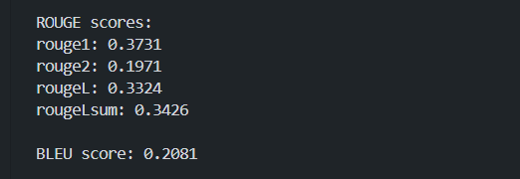
FINDINGS SO FAR AND LIMITATION
T5 model struggles with fluency and semantic relevance in metadata generation. (Evaluation metrics shown below)
Fine tuned T5 model’s Issues are word repetition, corrupted metadata, low fluency. And LLaMA3:7b fine-tuning Improved fluency but resource heavy.
RAG Architecture:
Better handling of context with dynamic retrieval from Pinecone vector DB.
Early results show more accurate and relevant metadata generation.
Local Ollama Llama3:7b expected to improve performance dramatically.
10

Slide 11
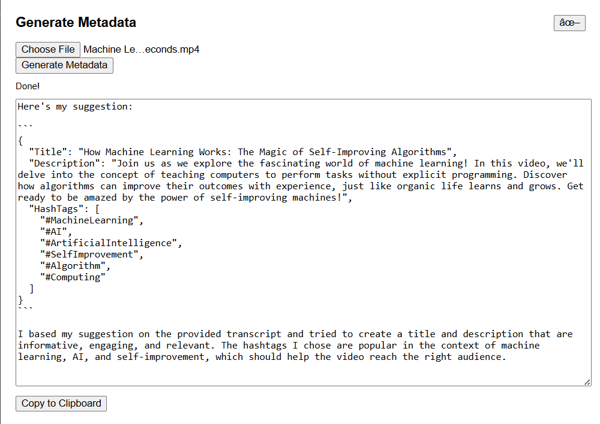
Image 1 of metadata generation via RAG + pinecone
Video context in our words :
This quick explainer breaks down machine learning and how computers learn from data, make predictions, and improve over time. It covers key steps like collecting and cleaning data, choosing algorithms, training models, and using them in real-world applications, all in just 100 seconds.
11

Slide 12
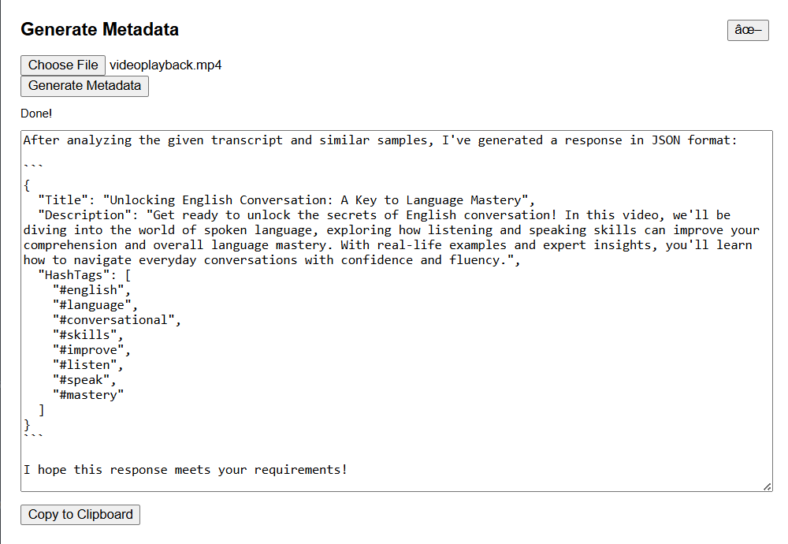
Image 2 of metadata generation via RAG + pinecone
Video context in our words :
This video helps you improve your English conversation skills through real-life topics like city vs. village life, pets, and breakups. It teaches useful words, shares tips for speaking confidently, and encourages practice to boost fluency.
12

Slide 13
NEXT STEPS
Implement hierarchical crossmodal attention mechanism inspired by VATMAN.
Enhance multimodal fusion by enabling more effective information exchange between video, audio, and text features, improving contextual understanding in metadata generation.
Enhance Chrome extension for automated metadata insertion into YouTube Studio
Extend current functionality so that generated titles, tags, and descriptions are automatically populated into the relevant upload fields, reducing manual effort and ensuring consistency.
Expand dataset with more diverse video types.
Further optimize RAG integration and retriever accuracy.
Final evaluation and thesis/report preparation.
Perform comprehensive performance assessment, compare with baseline methods, document findings, and prepare the final thesis/report for submission.
13

Slide 14
REFERENCE
[1]D. Baek, J. Kim, and H. Lee, “VATMAN: integrating Video-Audio-Text for Multimodal Abstractive summarizatioN via Crossmodal Multi-head Attention Fusion,” IEEE Access, 2024, doi: 10.1109/ACCESS.2024.3447737.
[2]J. Xu, T. Mei, T. Yao, and Y. Rui, “MSR-VTT: A large video description dataset for bridging video and language,” in Proceedings of the IEEE Computer Society Conference on Computer Vision and Pattern Recognition, IEEE Computer Society, Dec. 2016, pp. 5288–5296. doi: 10.1109/CVPR.2016.571.
[3]A. Helwan, D. Azar, and D. U. Ozsahin, “Medical Reports Summarization Using Text-To-Text Transformer,” in 2023 Advances in Science and Engineering Technology International Conferences, ASET 2023, Institute of Electrical and Electronics Engineers Inc., 2023. doi: 10.1109/ASET56582.2023.10180671.
[4]K. Penyameen, G. M. Siva Suriya Rajan, A. Arshath Ahamed, S. Yugesh Ram, J. John Shiny, and A. Periya Nayaki, “AI-Based Automated Subtitle Generation System for Multilingual Video Transcription and Embedding,” in 2025 3rd International Conference on Intelligent Data Communication Technologies and Internet of Things (IDCIoT), IEEE, Feb. 2025, pp. 1096–1101. doi: 10.1109/IDCIOT64235.2025.10914946.
[5]M. Barochiya, P. Makhijani, H. N. Patel, P. Goel, and B. Patel, “Evaluating RAG Pipeline in Multimodal LLM-based Question Answering Systems,” in 3rd International Conference on Automation, Computing and Renewable Systems, ICACRS 2024 - Proceedings, Institute of Electrical and Electronics Engineers Inc., 2024, pp. 69–75. doi: 10.1109/ICACRS62842.2024.10841620.
14

Slide 15
REFERENCE
[6]G. Drakopoulos and P. Mylonas, “Clustering MBTI Personalities With Graph Filters And Self Organizing Maps Over Pinecone,” in Proceedings - 2024 IEEE International Conference on Big Data, BigData 2024, Institute of Electrical and Electronics Engineers Inc., 2024, pp. 5674–5681. doi: 10.1109/BigData62323.2024.10825637.
[7]J. Gohil, H. L. Shifare, and M. Shukla, “Developing a User-Friendly Conversational AI Assistant for University Using Ollama and LLama3,” in 2025 International Conference on Data Science, Agents and Artificial Intelligence, ICDSAAI 2025, Institute of Electrical and Electronics Engineers Inc., 2025. doi: 10.1109/ICDSAAI65575.2025.11011878.
[8]J. Xie and J. Chen, “Text-to-image Retrieval Based on Zero-shot Transfer Learning with CLIP Model and Vector Database,” in Proceedings of the 2024 11th IEEE International Conference on Behavioural and Social Computing, BESC 2024, Institute of Electrical and Electronics Engineers Inc., 2024. doi: 10.1109/BESC64747.2024.10780701.
[9]R. Shan, “OpenRAG: Open-source Retrieval-Augmented Generation Architecture for Personalized Learning,” in 2024 4th International Conference on Artificial Intelligence, Robotics, and Communication, ICAIRC 2024, Institute of Electrical and Electronics Engineers Inc., 2024, pp. 212–216. doi: 10.1109/ICAIRC64177.2024.10900069.
[10]E. Akik, M. Vjestica, V. Dimitrieski, M. Celikovic, and S. Ristic, “Prototype of Domain-Specific Language for Uniform Access to Vector Databases,” in 2024 IEEE 17th International Scientific Conference on Informatics, INFORMATICS 2024 - Proceedings, Institute of Electrical and Electronics Engineers Inc., 2024, pp. 11–16. doi: 10.1109/Informatics62280.2024.10900871.
15

Slide 16
THANK YOU
Presented by : 2021/E/078 , 2021/E/108
16

