Slide 1

Professionalism of IT Teams
Conflict, Performance & Stakeholder Management
COURSE TITLE
PREPARED BY
DATE & PERIOD
TECH1100 – Professional Practice
Your Name (Student ID)
Trimester 1, 2026

Slide 2










Table of Contents
Case Context & Introduction
Causes of Underperformance (Q1)
Escalating Risks & Mitigation (Q2)
Structured Conflict Resolution (Q3)
Stakeholder Salience & Repair (Q4)
Prevention & Agile Learning (Q5)
TECH1100 - Professional Practice
E-Commerce Study
Slide 2 of 16

Slide 3
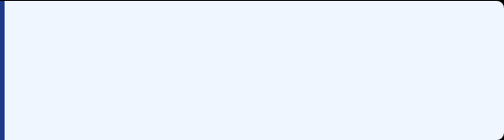
Introduction & Case Overview
Context Analysis
Core Issue Statement
Environment: Rapidly growing e-commerce organization with dynamic scale demands.
"Unmanaged interpersonal friction has ruptured team alignment, reduced psychological safety, and compromised external customer relationships, putting contract renewals at risk."
Symptoms: Declining team engagement, critical campaign delays, and a direct slide in sales.
Core Obstacle: Unmanaged confrontational behavior by Samuel (Social Media Specialist).
Immediate leadership intervention is required by Isabella to stabilize the unit.
Stakeholder Friction: A major brand partner expresses extreme dissatisfaction.
TECH1100 - Professional Practice
E-Commerce Study
Slide 3 of 16

Slide 4

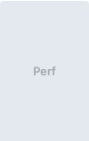
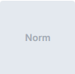


Causes of Underperformance
Interpersonal Conflict: High assertive/low cooperative "Competing" behaviors stall cross-functional work.Thomas & Kilmann, 1974
Psychological Safety Drop: Team members withdraw from creative sharing to avoid open hostility.Edmondson, 1999
Tuckman Regression: Unresolved disputes regress the team into a hostile "Storming" cycle.Tuckman, 1965
Storming (Current)
Forming
Norming
Performing
TECH1100 - Assessed Slide (Q1.1)
E-Commerce Study
Slide 4 of 16

Slide 5
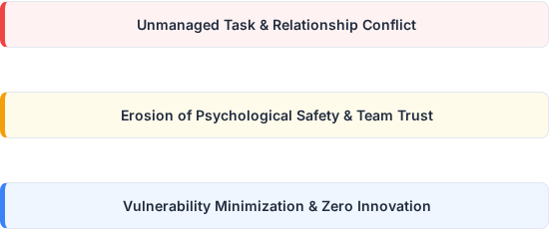
Impact of Reduced Safety
Samuel's Destructive Impact
Morale Deterioration: Destructive feedback creates an unsafe professional forum.
Vulnerability Banished: Team hides errors to escape public humiliation.Edmondson, 1999
Campaign Stagnation: Social media output loses innovation as collaboration stalls.
Outcome: Severe drops in marketing campaign efficiency and final sales conversions.
TECH1100 - Assessed Slide (Q1.2)
E-Commerce Study
Slide 5 of 16

Slide 6

Escalating Risks if Unresolved
Risk Class | Critical Consequences & Impacts | Risk Level | Strategic Citations
Operational | Extended revenue decay, missing strategic deadlines, uncoordinated campaigns. | High | ISO 31000 (2018)
Stakeholder | Definitive brand partner exit, severe B2B reputation erosion. | Critical | Freeman (1984)
Human Capital | Talent departures, expensive HR investigations, workspace grievances. | Medium | Tuckman (1965)
TECH1100 - Assessed Slide (Q2.1)
E-Commerce Study
Slide 6 of 16

Slide 7
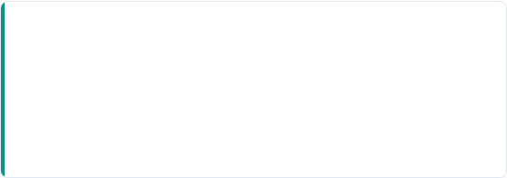
Risk Mitigation Framework
ISO 31000 Alignment: Direct risk identification, mitigation treatment, and governance controls.ISO 31000, 2018
ISO 31000 Loop
Continuous Oversight: Risk controls must translate directly to active project boards.
Urgent Conflict Resolution: Initiate formal individual behavioral check-ins.
"Isabella must transition from reactive damage control to active strategic risk mitigation."
Execution Dashboards: Set public KPIs to track individual delivery.
Stakeholder Communications: Build transparent engagement channels.
TECH1100 - Assessed Slide (Q2.2)
E-Commerce Study
Slide 7 of 16

Slide 8
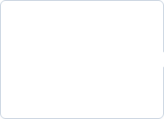
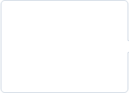
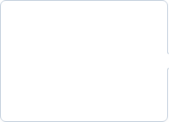


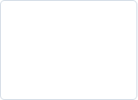
Conflict Resolution Plan
Gather Evidence
1-on-1 Meet
Active Listen
Set Bounds
Commit to PIP
Review
Collect specific instances of Samuel's outbursts.
Initiate direct private dialogue to bypass defensiveness.
Uncover root issues behind his confrontational behavior.
Outline strict code of team communication norms.
Establish a Performance Improvement Plan with timelines.
Audit behavioral trends weekly.
REFERENCE MODEL: THOMAS & KILMANN (1974) & GOLEMAN (1995)
TECH1100 - Assessed Slide (Q3.1)
E-Commerce Study
Slide 8 of 16

Slide 9


Critical Intervention Steps
SBI Feedback Model
Psychological Safety Norms
Structure feedback cleanly to de-escalate tension:
Build a reliable team dynamic through rules:
1. Situation: Target a specific timeframe/incident.
Team Charter: Co-create core collaboration values.
2. Behaviour: Describe observed actions objectively.
Respect Frame: Zero tolerance for personal attacks.
3. Impact: Detail consequence on team outcomes.
Feedback Protocols: Shift focus to task, not character.
EDMONDSON, 1999
TECH1100 - Assessed Slide (Q3.2)
E-Commerce Study
Slide 9 of 16

Slide 10

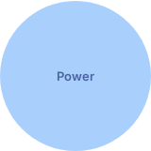
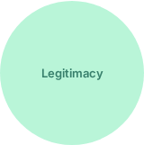
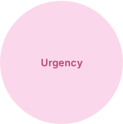
Stakeholder Prioritisation
Stakeholder Salience Model
Power: Partner possesses immense financial clout over e-commerce revenue streams.
Legitimacy: Clear contractual ties establish formal priority status.
Urgency: Impending contract renewal cycle demands instant executive repair work.
Category: Classified as a "Definitive" high-priority stakeholder.Mitchell et al., 1997
TECH1100 - Assessed Slide (Q4.1)
E-Commerce Study
Slide 10 of 16

Slide 11


Relationship Repair Strategy
Phase 1: Transparency
Phase 2: Collaboration
Schedule immediate alignment meetings with partner executives.
Co-design performance goals to secure strategic buy-in.
Acknowledge execution drops without laying blame.
Provide access to regular campaign performance metrics.
Present concrete evidence of newly active internal controls.Dirks et al., 2009
Adopt modern client relations communication loops.
TECH1100 - Assessed Slide (Q4.2)
E-Commerce Study
Slide 11 of 16

Slide 12
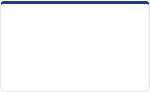
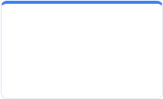
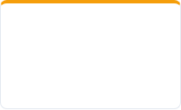
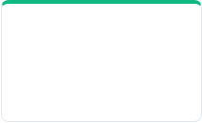
Preventing Recurrence
Professional Code: Introduce clean, modern behavioral standards.
Agile Retrospectives: Evaluate delivery pipelines and internal team trust weekly.
P
D
Plan
Do
Defined Roles: Clarify boundaries to prevent task overlap friction.
Code & Team Charter
Daily Sync & Feedback
Feedback Loops: Detect early warning signals of team distress.
DEMING, 1986
C
A
Check
Act
Sprint Retrospectives
System Correctives
TECH1100 - Assessed Slide (Q5.1)
E-Commerce Study
Slide 12 of 16

Slide 13


Embedding Team Learning
Dynamic Safety Culture
Continuous Improvement
Build system learning mechanisms to support individual expression:
Move past point-in-time solutions into operational habits:
Reframe errors as system-level teaching assets.
Implement ongoing professional development workshops.
Equip leaders with proactive active-listening toolkits.
Encourage regular peer-led operational sessions.
Reward team members who flag procedural bottlenecks.
Establish formal metrics to link team trust to delivery milestones.
EDMONDSON, 2018
TECH1100 - Assessed Slide (Q5.2)
E-Commerce Study
Slide 13 of 16

Slide 14

Strategic Conclusion
Key Strategic Takeaways
Direct Impact: Unchecked personal friction leads to decreased psychological safety, team underperformance, and critical drops in B2B trust.
Intervention: Applying clear academic frameworks (SBI, Tuckman, Mitchell Venn Model) provides structured tools to solve team gridlock.
Operational Success: Consistent systemic updates (Deming PDCA loop) protect ongoing campaign output and rebuild partner trust.
Growth: Professional leadership transforms conflict from a project liability into a driver for mature team collaboration.
TECH1100 - Professional Practice
E-Commerce Study
Slide 14 of 16

Slide 15
Academic References
Deming, W.E. (1986) Out of the Crisis. Cambridge, MA: MIT Press.
Dirks, K.T., Lewicki, R.J. and Zaheer, A. (2009) 'Repairing relationships within and between organizations', Academy of Management Review, 34(1), pp. 68-84.
Edmondson, A. (1999) 'Psychological safety and learning behavior in work teams', Administrative Science Quarterly, 44(2), pp. 350-383.
Edmondson, A.C. (2018) The Fearless Organization: Creating Psychological Safety in the Workplace for Learning, Innovation, and Growth. Hoboken, NJ: John Wiley & Sons.
Freeman, R.E. (1984) Strategic Management: A Stakeholder Approach. Boston, MA: Pitman.
ISO (2018) ISO 31000:2018 Risk Management – Guidelines. Geneva: International Organization for Standardization.
Mitchell, R.K., Agle, B.R. and Wood, D.J. (1997) 'Toward a theory of stakeholder identification and salience: Defining the principle of who and what really counts', Academy of Management Review, 22(4), pp. 853-886.
Thomas, K.W. and Kilmann, R.H. (1974) Thomas-Kilmann Conflict Mode Instrument. Tuxedo, NY: Xicom.
Tuckman, B.W. (1965) 'Developmental sequence in small groups', Psychological Bulletin, 63(6), pp. 384-399.
TECH1100 - Professional Practice
E-Commerce Study
Slide 15 of 16

Slide 16
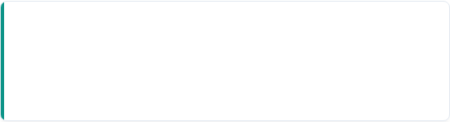
Appendix – AI Declaration
AI Tool Integration
Assurance Declaration
Application Used: ChatGPT / Gemini Engine.
Compliance Category: Level 2 Compliance.
"I hereby confirm that all AI-generated suggestions, structures, and copy elements were rigorously reviewed, critiqued, and revised to maintain high standards of academic integrity and contextual accuracy."
Purpose of Use: Structural design guidance and drafting of comparative layouts.
TECH1100 - Professional Practice
E-Commerce Study
Slide 16 of 16

