Slide 1
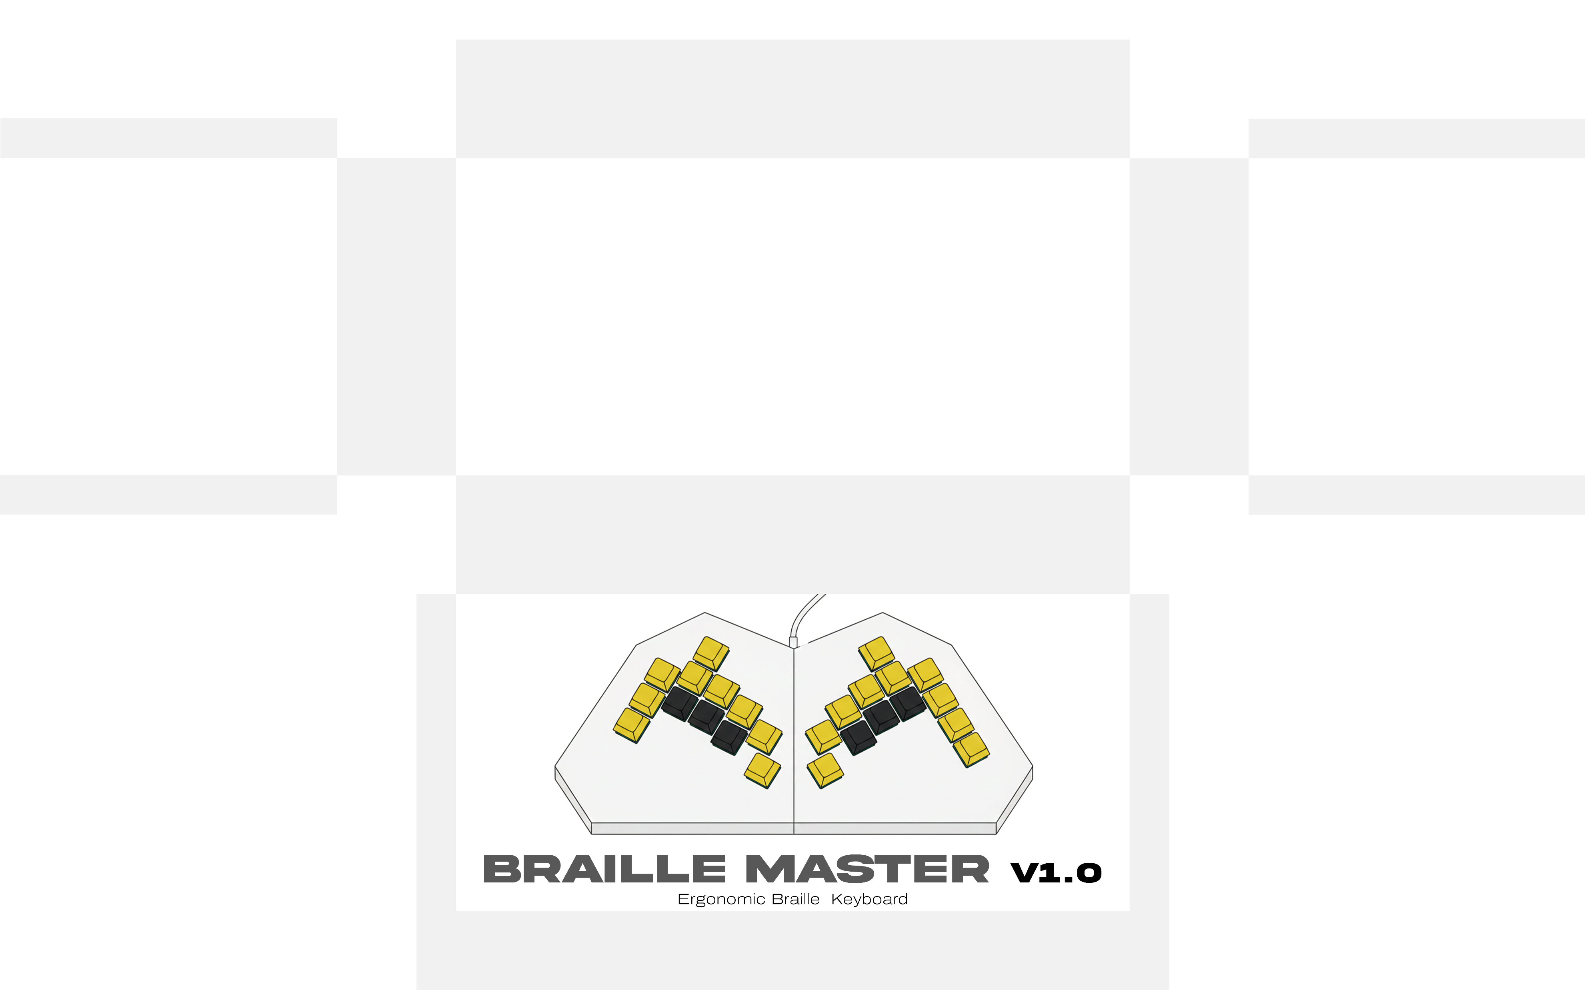

Slide 2
Group 09
Ekanayake E.M.M.
Gamage N.N.J.
Nipun P.G.D.
Wickramanayake P.M.
E/20/097
E/20/111
E/20/269
E/20/436

Slide 3
Content
Introduction
Problem
Solution
Design and Layout
Features
Use Cases
The Future
Conclusion

Slide 4
Introduction
43 Million
According to WHO and IAPB:
Completely blind
2.2 Billion
295 Million
Moderate to severe vision impairment
People have a near or distance vision impairment
258 Million
Mild vision impairment

Slide 5
The leading causes of visual impairment are age related (cataracts, muscle degeneration, etc.)
As the global population ages, the number of visually impaired people is projected to triple by 2050.
In the UK alone, 23% of visually impaired people say they never use the internet because of accessibility barriers.

Slide 6

Problem
Standard interfaces create a digital barrier, effectively locking visually impaired individuals out of the modern world.
Standard QWERT keyboards are hard to navigate and lack feedback.
Touchscreens are even harder to navigate with the limited senses.
While some accessible products have their own unique challenges.

Slide 7
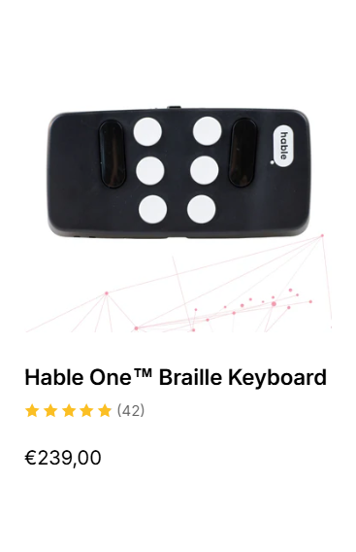
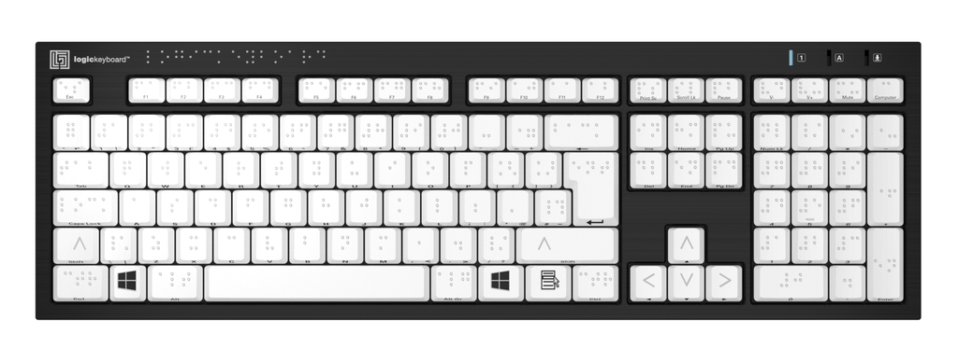
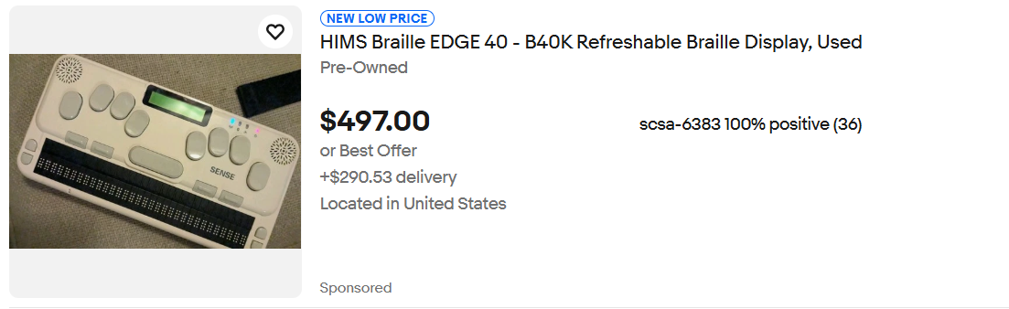
87 000 LKR
154 000 LKR

Slide 8




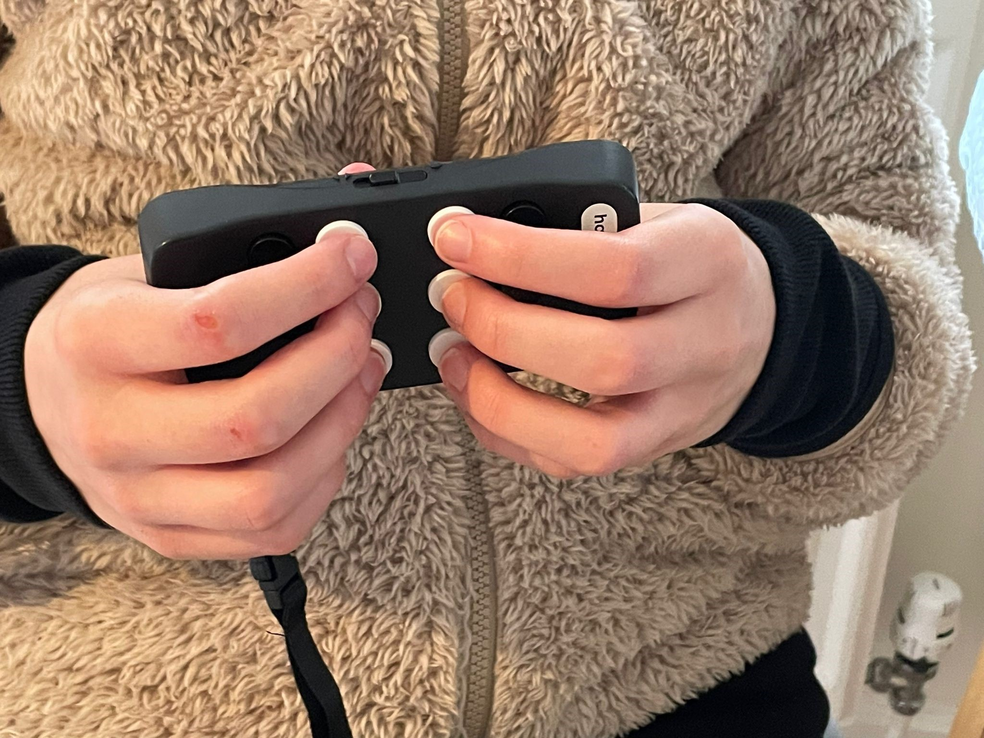

Gathered from user reviews, Reddit and Quora conversations,
Existing keyboards for visually impaired individuals are,
Expensive
Too Heavy
Too Slow
Uncomfortable
Unnecessarily complex

Slide 9
Solution
Braille Master
A simple, accessible, affordable, ergonomic keyboard with many features and customizability.

Slide 10
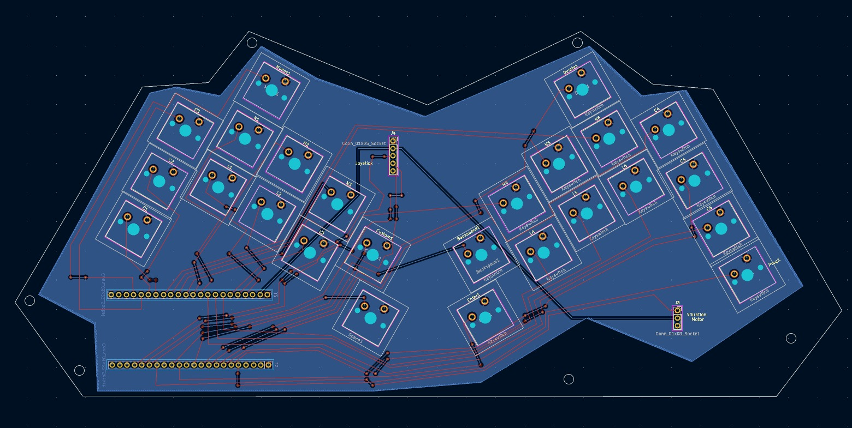
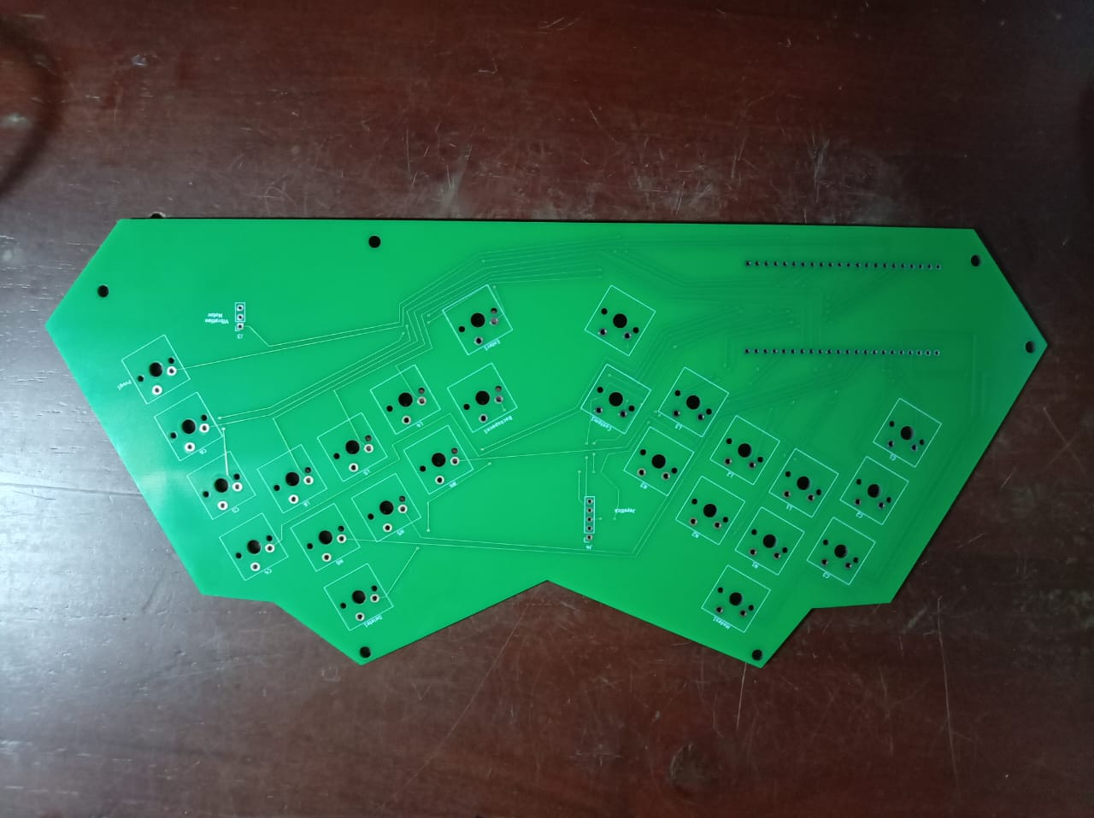
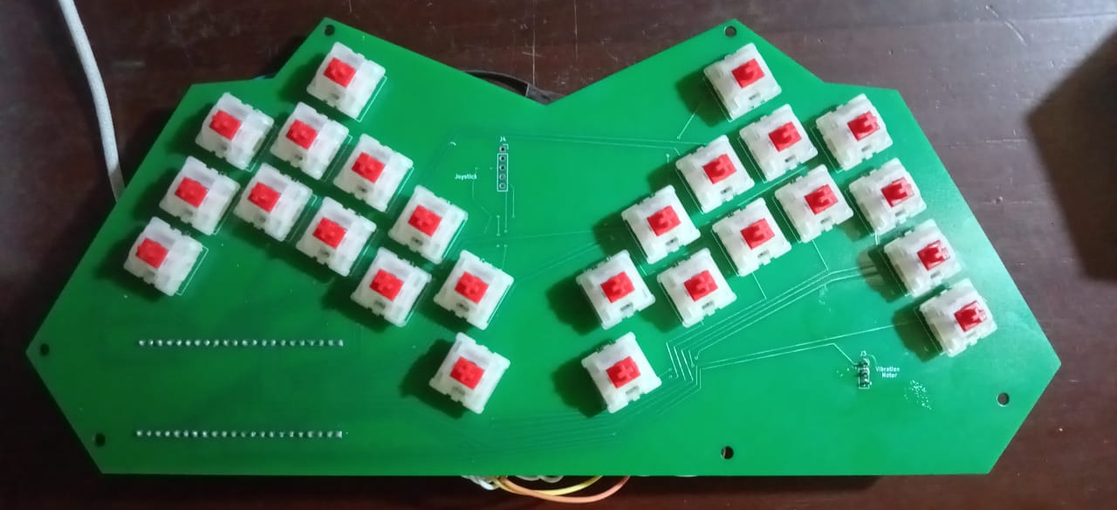
Design and Layout
KiCad
Fusion 360

Slide 11
Cost of a Unit
Item | Prices (LKR)
PCB | 3,614
Components | 2,500
Encloser | 3,825
Custom Key Caps | 1,100
Mechanical Keys | 3,100
Printing and Packaging | 1,800
Total | 15,939
*One fifth of a price of a existing braille keyboard!

Slide 12
Mode Key
Number Keys
Delete
Custom Keys
Feature Keys
Program Key
Enter
Braille Keys
Backspace
Caps Lock
Space

Slide 13
Features
USB-C Compatible – Plug and play, no additional drivers are required.
25 Mechanical keys for smooth and satisfying feel.
Ergonomic design for comfortability.
Custom printed concave and flat keycaps for easy identification.
Windows and Linux Support.
Optimized for NVDA and JAWS screen readers
Splash-resistant chassis for durability

Slide 14
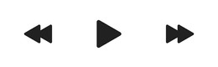
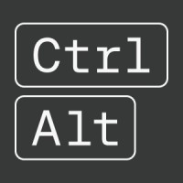
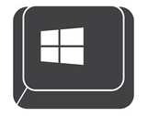
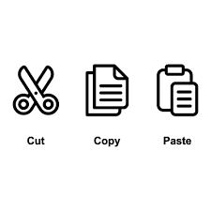
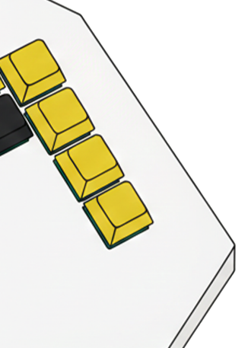
Modes:
Mode 1: Media Control (Default)
Top Key: Next Track
Middle Key: Play/Pause
Bottom Key: Previous Track
Mode 2: System Modifiers (One Press)
Top Key: Control (Ctrl)
Middle Key: Alt
Bottom Key: Windows Key
Mode 3: Clipboard (Two Presses)
Top Key: Paste
Middle Key: Cut
Bottom Key: Copy
Custom Keys
Customizable Keys
can use to add characters to these keys using the program key.
Program Key

Slide 15




Use Cases
For students to take notes in class quietly.
For programmers to write code easily and save custom characters.
For musicians to use media controls while listening to audio tracks.

Slide 16
The Future
Joystick for easy navigation. (make the keyboard all in one product).
Introduce Bluetooth accessibility for tabs and smart phone use.
Integrate refreshable braille display.
Introduce a software for specific customizations.

Slide 17
Conclusion
We have taken the durability of mechanical switches, the speed of Perkins-style input, and the intelligence of modern macros—and combined them into one affordable, easy to use and accessible device.

Slide 18
THANK YOU

