Slide 1

Three-tier architecture used by ChromeOS for mobile devices and its performance and security
Date: 2022-05-08
Group ID : SE3030_WE_22
Student ID | Name with initials
IT20243258 | Ekanayake E. M. U. Y
IT20214784 | Jayasena R. C. P
IT20004118 | Bandara G. K. A. H
IT20152864 | Perera K. A. P. M
System : ChromeOS
Architecture : Three-tier architecture
Key Qualities: Performance and security

Slide 2
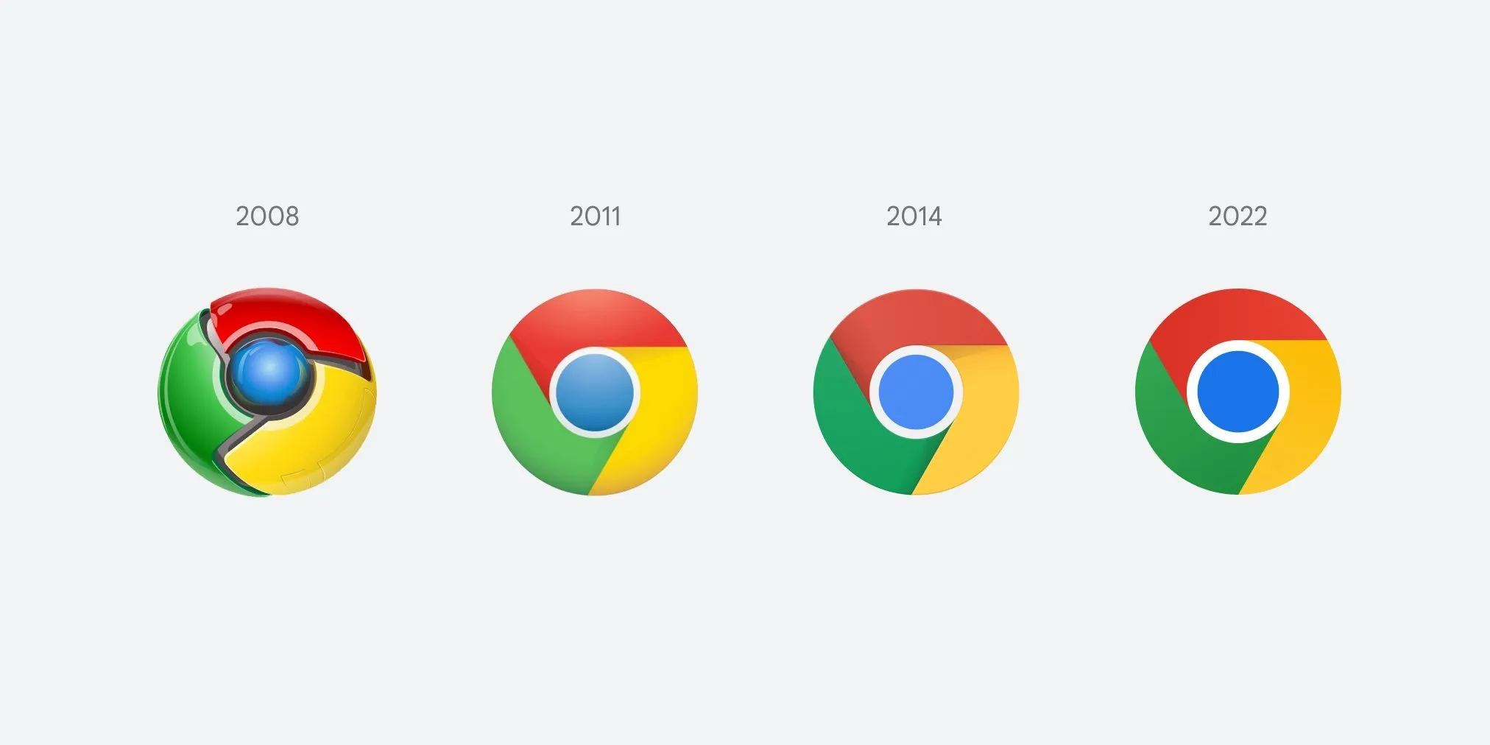
Abstract
IT20214784
What is ChromeOS?
What is Three-Tier Architecture?
Three-Tier Architecture in ChromeOS
Security of ChromeOS
Performance of ChromeOS
Impact of Three-Tier Architecture on ChromeOS
Pros and cons of ChromeOS
Recommendations and Conclusion
References

Slide 3

What is ChromeOS?
IT20214784
ChromeOS is a lightweight, Linux based operating system designed by Google
ChromeOS in its core is the Google Chrome browser
Developed from the open-source Chromium project
Designed around web applications
Web applications in Google ecosystem are available
Primary devices are Chromebooks(laptops), Chromeboxes and Tablets
Built on the Three-Tier Architecture

Slide 4
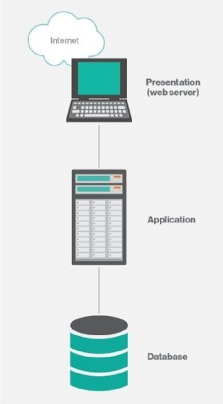
What is Three-Tier Architecture?
IT20214784
A client-server architecture which is modular
Composed of three logical tiers
Presentation tier
Application tier
Data tier
A client-server architecture which is modular
Presentation tier- User interface
Application tier- Handles logic
Data tier- Handles data
3 layers can be present in the same or different physical servers

Slide 5
Why is Three-Tier Architecture used for ChromeOS?
IT20214784
Three Tier-Architecture allows separation of layers for security
Makes the development easier by allowing to develop layers separately and concurrently
Allows to change and update one tier without affecting others
Provides scalability by separating the data tier
Separation of layers makes load balancing easier and improves performance
Makes the system lightweight

Slide 6
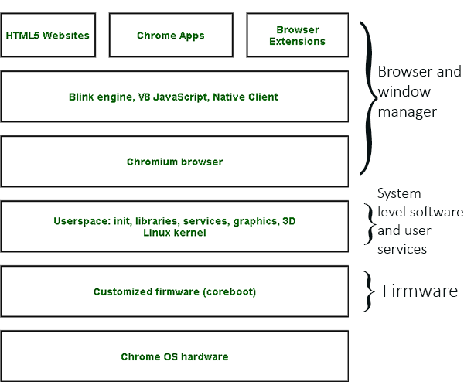
Three-Tier Architecture in ChromeOS
IT20004118
Architecture of ChromeOS
Built on Three-Tier Architecture
Tiers
Firmware
System level software and user land services
Browser and window manager
Custom firmware based on ‘coreboot’ and ‘u-boot’ is used
System level software and user services are minimum. Only essentials.
Window manager handles user interface and user interactions

Slide 7
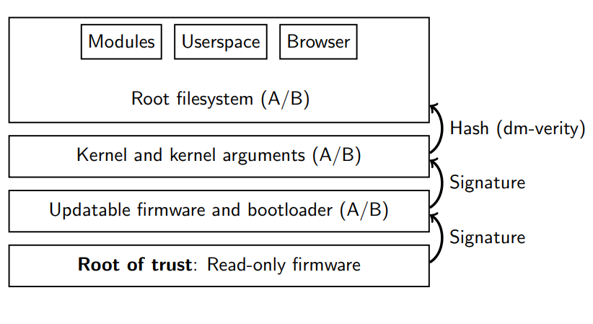
ChromeOS Security
IT20004118
Read-only firmware for root of trust
A/B read-write firmware- allows to keep two copies of the OS and update one OS while other is working
Therefore, update failures can be minimized
Verified boot- Self check the OS when booting to detect tampering, if detected reverts to a trusted version
Sandbox- All third-party code runs in a sandbox
Verified boot and read-only firmware

Slide 8
ChromeOS Security Contd.
IT20004118
ChromeOS downloads and installs only signed updates from Google
It flags un-booted versions and falls back to previous successful version if newer version fails
These updates happen through A/B partitions in firmware layer and therefore creates redundancy and does not affect other layers
Kernel is wrapped in a verified boot container
Chrome browser supports JavaScript sandboxing
Different tabs run in separate locked down processes
Per-user and per-system encrypted partitions (uses TPM, eCryptFS encryption protocols)

Slide 9
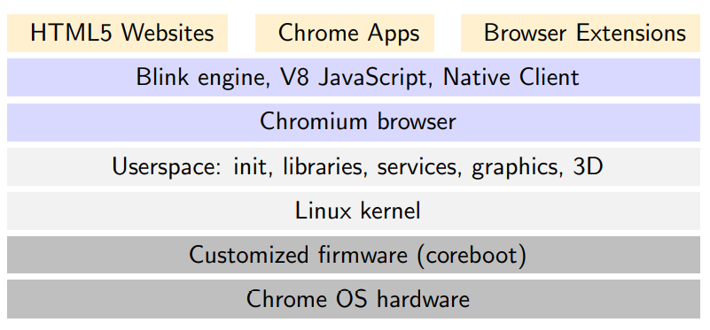
Performance of ChromeOS
IT20243258
ChromeOS uses an extensively patched Linux kernel
User space layer is also based on a Linux distribution (Gentoo)
Therefore, it is lightweight and fast. Linux kernel improves the performance of the system
Google advertises a boot time of only 8 seconds in ChromeOS
Coreboot and U-boot customized firmware speeds up the booting process

Slide 10
Performance of ChromeOS Contd.
IT20243258
Userland software is trimmed to a minimum
Additional apps can be downloaded from the store
This helps to keep the system snappy and fast
User interface is handled by the Chrome browser which is very fast
Chrome browser windows are main UI components
Supports HTML5 and JavaScript with additional APIs
Google services are optimized to run faster on Chrome browser
Web interface is much faster than traditional window managers

Slide 11
Impact of Three-Tier Architecture on ChromeOS-Security
IT20243258
Considering the performance and security it seems that Three-Tier architecture has impacted very positively on ChromeOS
Layer-wise separation has provided layers to hide complexity and separate concerns
Firmware layer can handle system security using verified boot, read-only firmware and A/B read write firmware without affecting other layers
If any update error occurs in the firmware layer it does not propagate to other layers. Revert to a trusted version quickly.
Sandboxing in Chrome Browser and User Land Software layer allows to keep the other layers secure from third party apps

Slide 12
Impact of Three-Tier Architecture on ChromeOS-Performance
IT20243258
ChromeOS performance is increased by optimizing each layer individually
Layer-wise separation has allowed to configure each layer to be faster without affecting the performance of other layers
A loosely coupled system – Improves fault tolerance and performance
Minimizing the software in User Land Software Layer has improved performance
Linux kernel and Linux distro-based User Land Software layer increases performance
Customized firmware in Firmware layer boots ChromeOS faster
Chrome browser in the Browser and Window Manager layer make the UI faster

Slide 13
Impact of Three-Tier Architecture on ChromeOS
IT20152864
Improvements in Security and Performance with the use of layer wise separation shows the effect of 3 Tier Architecture
Developers have been able to optimize each layer individually
Security mostly handled in Firmware layer – Fault tolerance
Optimized Kernel improves performance in the Userland Software Layer
Chrome Browser in the window manager layer makes the UI faster
Each layer is working individually to make the whole system faster and secure collectively
3 Tier Architecture has supported for a well-structured system
Principle of separation of concern has been used

Slide 14
Pros and cons of ChromeOS
IT20152864
Pros
Faster boot time – 8 Seconds
Faster UI – Chrome Browser
Sync user data through email
High security
Lightweight and fast
Cons
Limited apps – Chrome web store
Not suited for performance intensive tasks
Needs an internet connection for most tasks

Slide 15
Recommendations and Conclusion
IT20152864
It can be concluded that the use of 3-Tier Architecture has many advantages on ChromeOS
It can be observed that there is further separation of layers inside the main 3 layers
Different layers are optimized individually without affecting other layers
Security and performance of ChromeOS has been increased with the use of 3 Tier Architecture
Support for Android apps can be increased further to have a large pool of apps
N-Tier architecture can be used to further separate the layers
ChromeOS hardware can be improved to support performance intensive tasks

Slide 16
References
IT20152864
https://www.chromium.org/chromium-os/chromiumos-design-docs/boot-design/
https://www.google.com/amp/s/slideplayer.com/amp/3827326/
https://www.google.com/amp/s/www.geeksforgeeks.org/what-is-google-chrome-operating-system/amp/
https://www.chromium.org/chromium-os/chromiumos-design-docs/software-architecture/#:~:text=Chromium%20OS%20consists%20of%20three,Firmware
https://developer.android.com/topic/arc
http://sufianalogy.blogspot.com/2012/12/chrome-os-and-system-architecture.html?m=1
Google Chrome Operating System Gunjan Bansal, Madhulika Sharma, Sarita Yadav, Usha Yadav MCA final year, AIM&ACT Banasthali Vidyapeeth, Tonk Rajasthan -304022
Security Evaluation of Google Chrome Operating System, Ogbuabor Godwin Okechukwu Department Of Computer Science, Michael Okpara University of Agriculture, Umudike, IOSR Journal of Computer Engineering (IOSR-JCE
Chrome OS Internals, Josh Triplett, josh@joshtriplett.org, LinuxCon Europe 2014

Slide 17
Thank you

