Slide 1

“Motorbike Defect Checker and Predictor”
Android App to identify vehicle auto parts altered and their usage prediction
Project ID: TMP 23 - 383

Slide 2
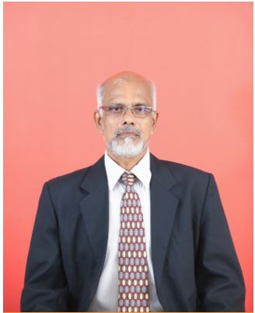

Supervision Personalities
MOTORBIKE DEFECT CHECKER AND PREDICTOR
Supervisor :
Co - Supervisor :
Dr. Amithalal Caldera
Senior Lecturer (Higher Grade)
Faculty of Computing | Information Technology
Ms. Supipi Karunathilaka
Instructor
Faculty of Computing | Information Technology

Slide 3

Team Members
MOTORBIKE DEFECT CHECKER AND PREDICTOR
IT20219598 - S.L.D.P Pramodya
IT20257040 - A.M.K.A.P Amarasingha
IT20261764 - D.M.D.H Dissanayake
IT20156206 - Rathnasooriya P.U.

Slide 4
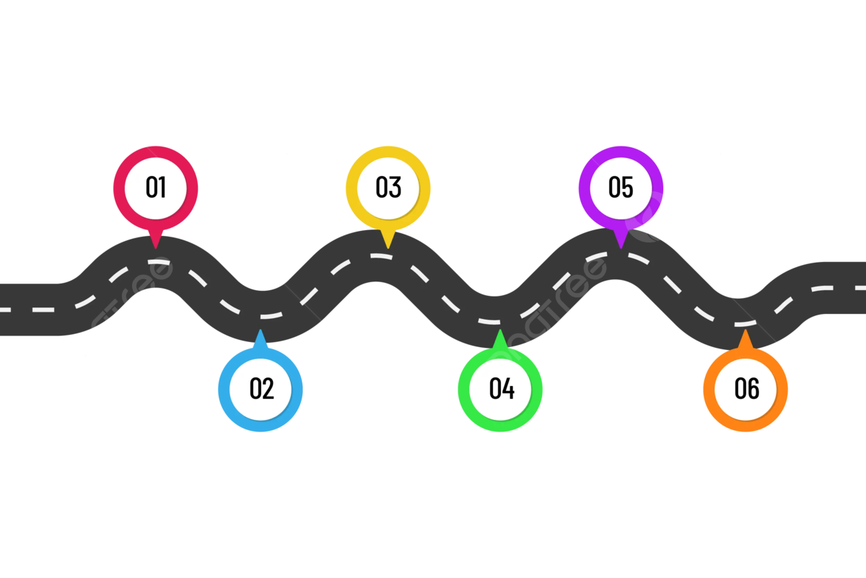
Roadmap
MOTORBIKE DEFECT CHECKER AND PREDICTOR
Progress of the proposed system
Introduction
Main objectives
Research Problem & Solution
Overall System Diagram
Individual Components

Slide 5
Introduction
MOTORBIKE DEFECT CHECKER AND PREDICTOR
Research problem
How to purchase a motor bike with minimum defects and alternations ?
How to purchase a motor bike without getting tricked ?
2. Solution
3. Main objectives
4. Overall System Diagram

Slide 6
01. Research Problem
MOTORBIKE DEFECT CHECKER AND PREDICTOR
The problem that we have identified is that when an individual tries to purchase a vehicle (Motorbike) he will not be able to identify the defects, auto parts fixed as an alternative to original parts, engine defects, usage of the current tyres, vehicle details and the registration paper details comparison.

Slide 7

02. Solution
MOTORBIKE DEFECT CHECKER AND PREDICTOR
As a solution, our team has come up with a Mobile Application which is based on the sub-section of Machine Learning (ML) which is called Image Processing and a vast database with all the necessary data regarding auto parts to solve this issue.

Slide 8
03. Main Objectives
MOTORBIKE DEFECT CHECKER AND PREDICTOR
Capture images of the auto parts in the vehicle and compare them with the original parts and provide a summary regarding the altered parts.
Capture the sound of the engine and provide a summary of the engine’s current condition and a prediction of future fault occurrences.
Capture an image of the Registration paper and compare it to the bike’s original details.
Capture the images of tyres and predict the usage and possible life expectation.

Slide 9
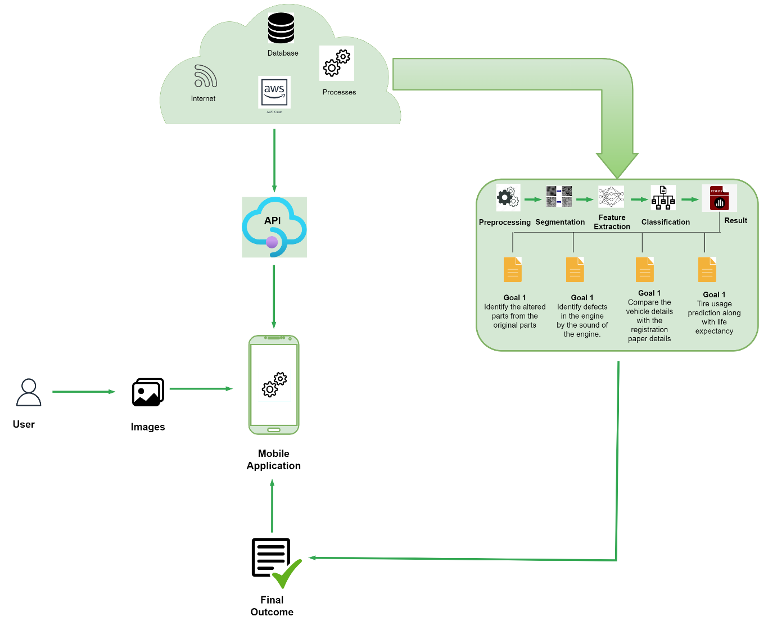
04. Overall System Diagram
MOTORBIKE DEFECT CHECKER AND PREDICTOR

Slide 10

Progress of the proposed system
MOTORBIKE DEFECT CHECKER AND PREDICTOR

Slide 11
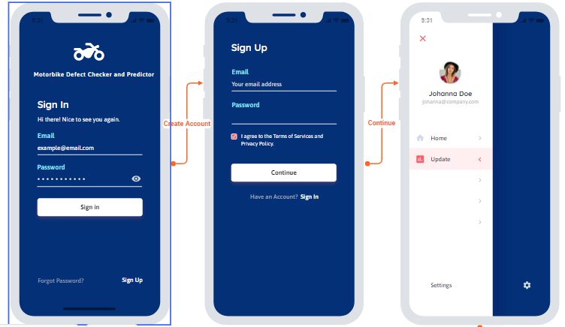
MOTORBIKE DEFECT CHECKER AND PREDICTOR
Wireframes

Slide 12
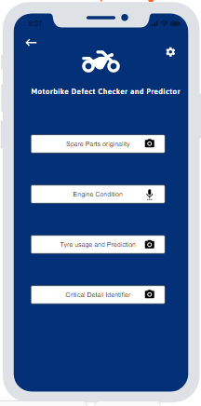
MOTORBIKE DEFECT CHECKER AND PREDICTOR
Wireframes

Slide 13
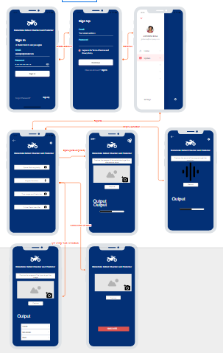
MOTORBIKE DEFECT CHECKER AND PREDICTOR
Wireframes

Slide 14
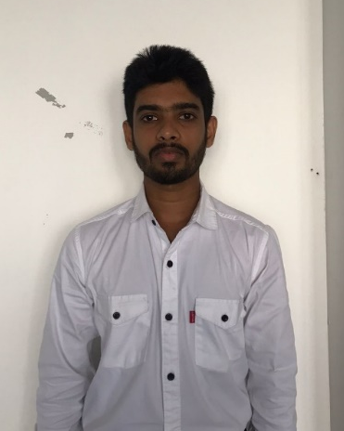
IT20219598 |Information Technology
MOTORBIKE DEFECT CHECKER AND PREDICTOR
S.L.D.P Pramodya

Slide 15

Research Question
MOTORBIKE DEFECT CHECKER AND PREDICTOR
How to identify altered parts in a motorbike fixed except original parts?
IT20219598 | S.L.D.P Pramodya | TMP-23-383

Slide 16

Research Methodology
MOTORBIKE DEFECT CHECKER AND PREDICTOR
Capture images of the original parts and altered versions.
Train the ML model using the data set
Compare the images captured with the images in our trained models.
Color pre-processing
Conversion to binary image
Provide an output regarding the alternation
IT20219598 | S.L.D.P Pramodya | TMP-23-383

Slide 17
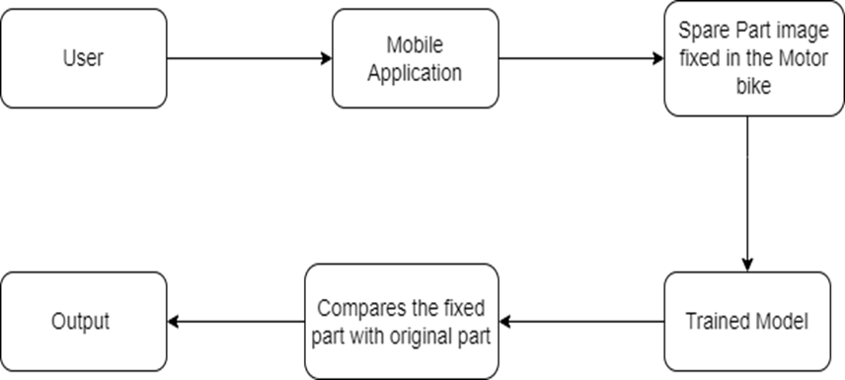
Research Methodology
MOTORBIKE DEFECT CHECKER AND PREDICTOR
IT20219598 | S.L.D.P Pramodya | TMP-23-383

Slide 18

MOTORBIKE DEFECT CHECKER AND PREDICTOR
Completion of the System
Component | Status of Completion
Object Recognition Models | In Progress
Image Processing | In Progress
Feature Extraction | In Progress
IT20219598 | S.L.D.P Pramodya | TMP-23-383

Slide 19

Progress up to now
MOTORBIKE DEFECT CHECKER AND PREDICTOR
Completion of the System
IT20219598 | S.L.D.P Pramodya | TMP-23-383

Slide 20
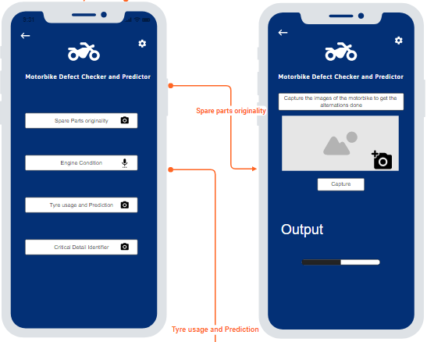
MOTORBIKE DEFECT CHECKER AND PREDICTOR
Wireframes for the component
Completion of the System
IT20219598 | S.L.D.P Pramodya | TMP-23-383

Slide 21
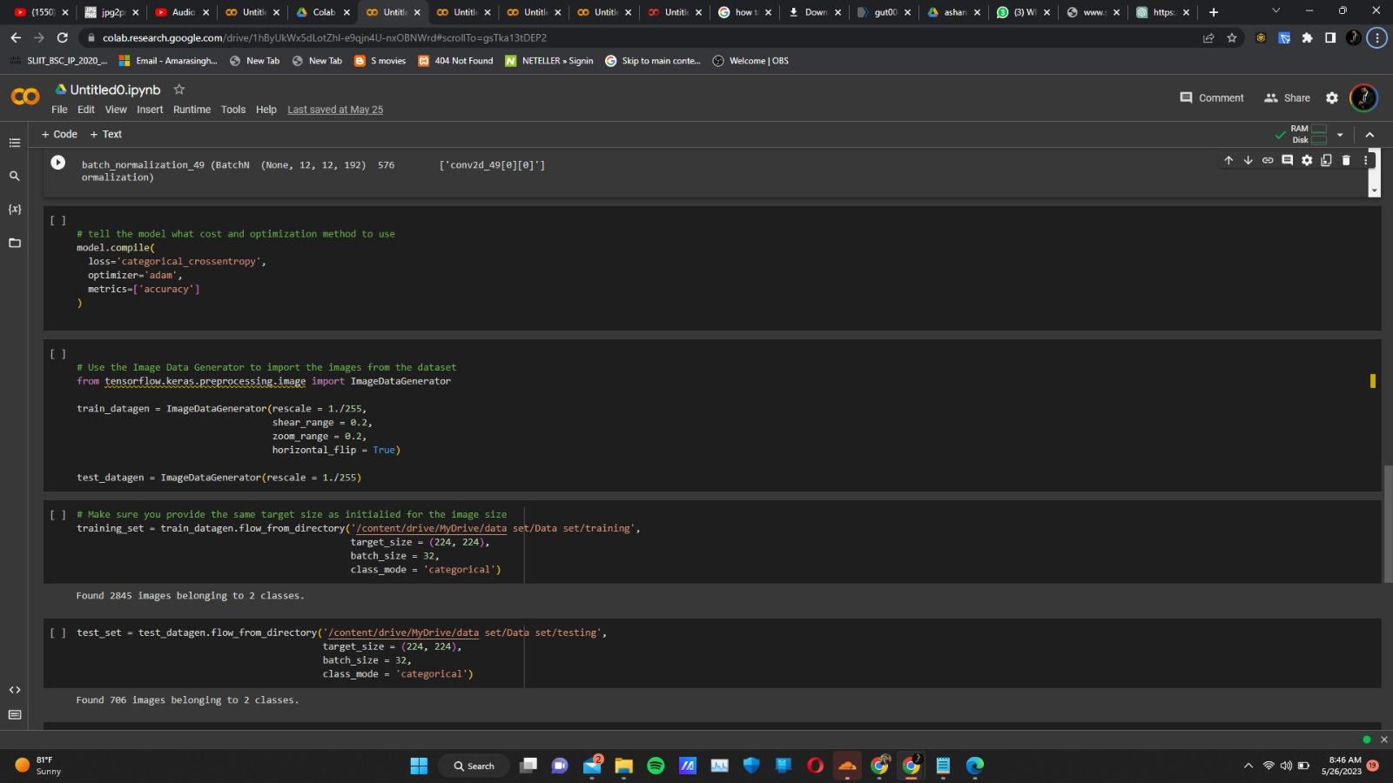
MOTORBIKE DEFECT CHECKER AND PREDICTOR
Completion of the System
IT20219598 | S.L.D.P Pramodya | TMP-23-383

Slide 22
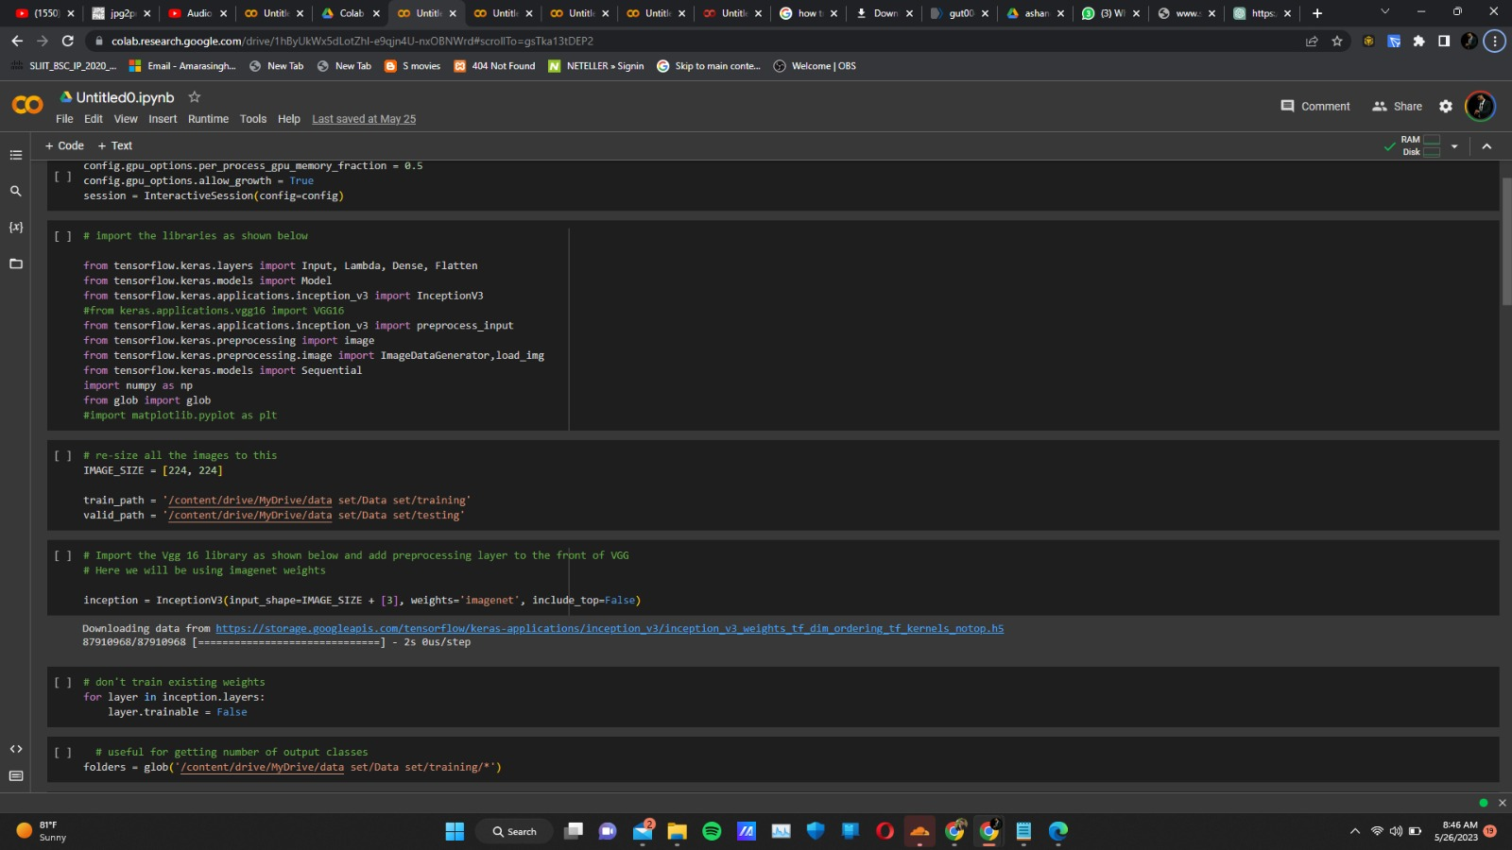
MOTORBIKE DEFECT CHECKER AND PREDICTOR
Completion of the System
IT20219598 | S.L.D.P Pramodya | TMP-23-383

Slide 23

MOTORBIKE DEFECT CHECKER AND PREDICTOR
Progress at the moment
The needed image data sets have been found to train the models.
The needed requirements and wireframes have been gathered to implement the mobile application.
Completion of the System
What’s to be done
The implementation of frontend and backend of the mobile application has to be completed.
IT20219598 | S.L.D.P Pramodya | TMP-23-383

Slide 24
References
MOTORBIKE DEFECT CHECKER AND PREDICTOR
[1]
https://www.researchgate.net/profile/Ashfaq
Shafin/publication/344519283_Automatic _Environmental_Sound_Recognition_AES R_Using_Convolutional_Neural_Network/l inks/5f7de369458515b7cf6f22d7/Automa tic-Environmental-Sound-RecognitionAESR-Using-Convolutional-NeuralNetwork.pdf
Completion of the System
[2]
https://www.autopartspro.co.uk/
[3]
“Toyota Accessories Augmented Reality [TAAR] App. (2021, November 17). Groove Jones. https://www.groovejones.com/toyota-accessories-augmented-reality-taar-app/
In-Text Citation: (Toyota Accessories Augmented Reality [TAAR] App, 2021)
IT20219598 | S.L.D.P Pramodya | TMP-23-383

Slide 25

IT20257040 |Information Technology
MOTORBIKE DEFECT CHECKER AND PREDICTOR
A.M.K.A.P Amarasingha

Slide 26
Research Question
MOTORBIKE DEFECT CHECKER AND PREDICTOR
How to identify defects of an engine by the sound of the engine heard?
IT20257040 | A.M.K.A.P Amarasingha| TMP-23-383

Slide 27

Research Methodology
MOTORBIKE DEFECT CHECKER AND PREDICTOR
Capture Voice of engine.
We are going to train a voice-recognition model with sound clips of healthy motorbike engines and unhealthy ones and for the processing
Analyze the sound
The user will have to record a few voice clips of the sound of the engine to identify whether the strange noise is of these 1. Tick, tick tick, 2. Bump & grind, 3. Creepy krink, 4. Boo hiss, 6. Snap, crackle, pop.
IT20257040 | A.M.K.A.P Amarasingha| TMP-23-383

Slide 28
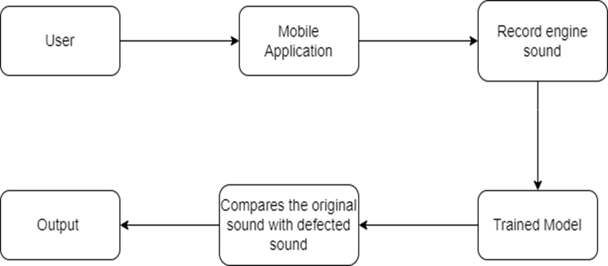
Research Methodology
MOTORBIKE DEFECT CHECKER AND PREDICTOR
IT20257040 | A.M.K.A.P Amarasingha| TMP-23-383

Slide 29

MOTORBIKE DEFECT CHECKER AND PREDICTOR
Completion of the System
Component | Status of Completion
 | In Progress
Sound Processing | In Progress
Feature Extraction | In Progress
Sound Recognition Models

Slide 30
Progress up to now
MOTORBIKE DEFECT CHECKER AND PREDICTOR
Completion of the System
IT20257040 | A.M.K.A.P Amarasingha| TMP-23-383

Slide 31
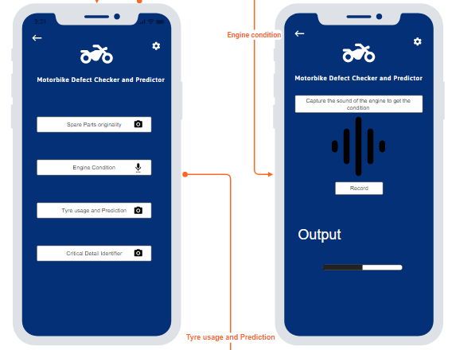
MOTORBIKE DEFECT CHECKER AND PREDICTOR
Wireframes for the component
Completion of the System
IT20257040 | A.M.K.A.P Amarasingha| TMP-23-383

Slide 32
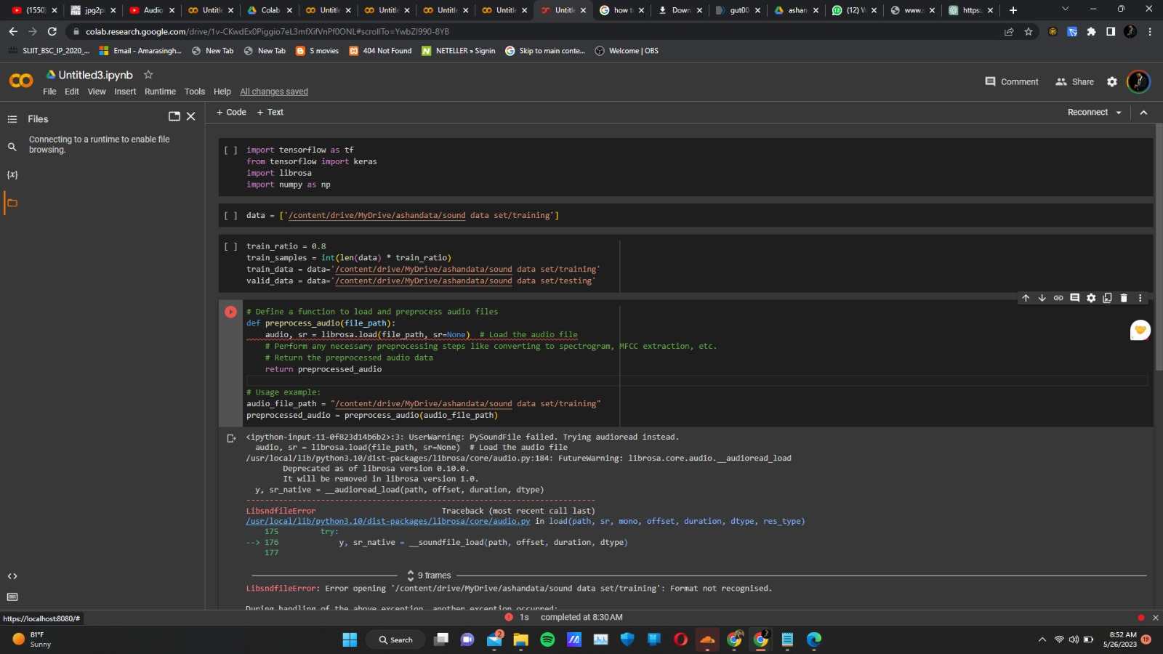
MOTORBIKE DEFECT CHECKER AND PREDICTOR
Completion of the System
IT20257040 | A.M.K.A.P Amarasingha| TMP-23-383

Slide 33
MOTORBIKE DEFECT CHECKER AND PREDICTOR
Progress at the moment
The needed image data sets have been found to train the models.
The needed requirements and wireframes have been gathered to implement the mobile application.
Completion of the System
What’s to be done
The implementation of frontend and backend of the mobile application has to be completed.
IT20257040 | A.M.K.A.P Amarasingha| TMP-23-383

Slide 34
References
MOTORBIKE DEFECT CHECKER AND PREDICTOR
[1]
Ilminen, Gary. “Top 6 Strange Motorcycle Noises | What They May Mean.” Ultimate Motorcycling, 29 Mar. 2016, ultimatemotorcycling.com/2016/03/29/to p-6-strange-motorcycle-noises-what-theymay-mean.
[2]
https://www.researchgate.net/profile/Ashfaq
Shafin/publication/344519283_Automatic _Environmental_Sound_Recognition_AES R_Using_Convolutional_Neural_Network/l inks/5f7de369458515b7cf6f22d7/Automa tic-Environmental-Sound-RecognitionAESR-Using-Convolutional-NeuralNetwork.pdf
Completion of the System
[3]
Upadhyay, A., Li, J., King, S., & Addepalli, S. (2023, February 1). A Deep-Learning-Based Approach for Aircraft Engine Defect Detection. MDPI. https://doi.org/10.3390/machines11020192
In-Text Citation: (Upadhyay et al., 2023)
IT20257040 | A.M.K.A.P Amarasingha| TMP-23-383

Slide 35

IT20261764 |Information Systems Engineering
MOTORBIKE DEFECT CHECKER AND PREDICTOR
D.M.D.H Dissanayake

Slide 36
Research Question
MOTORBIKE DEFECT CHECKER AND PREDICTOR
How to identify major details of a motorbike if the details on the motor bike are worn out, rusted, not clear ?
IT20261764 | D.M.D.H Dissanayake | TMP-23-383

Slide 37
Research Methodology
MOTORBIKE DEFECT CHECKER AND PREDICTOR
Capture images of the registration paper and vehicle details
Here user can capture the images of the registration paper, engine number, chassis number, color, and number plate.
Compare the images of captured
Color pre-processing
Conversion to binary image
Output the accuracy of the details.
IT20261764 | D.M.D.H Dissanayake | TMP-23-383

Slide 38
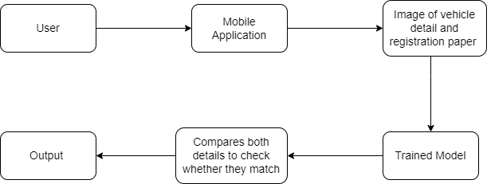
Research Methodology
MOTORBIKE DEFECT CHECKER AND PREDICTOR
IT20261764 | D.M.D.H Dissanayake | TMP-23-383

Slide 39

MOTORBIKE DEFECT CHECKER AND PREDICTOR
Completion of the System
Component | Status of Completion
Object Recognition Models | In Progress
Image Processing | In Progress
Feature Extraction | In Progress
IT20261764 | D.M.D.H Dissanayake | TMP-23-383

Slide 40
Progress up to now
MOTORBIKE DEFECT CHECKER AND PREDICTOR
Completion of the System
IT20261764 | D.M.D.H Dissanayake | TMP-23-383

Slide 41
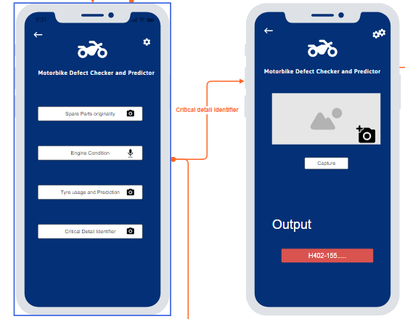
MOTORBIKE DEFECT CHECKER AND PREDICTOR
Wireframes for the component
Completion of the System
IT20261764 | D.M.D.H Dissanayake | TMP-23-383

Slide 42
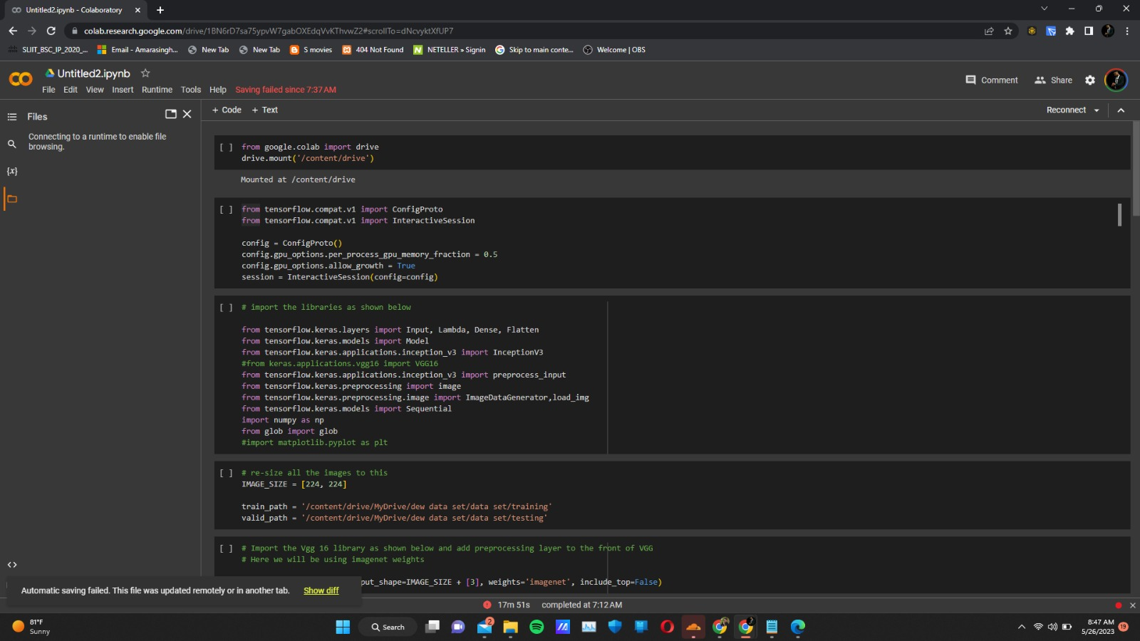
MOTORBIKE DEFECT CHECKER AND PREDICTOR
Completion of the System
IT20261764 | D.M.D.H Dissanayake | TMP-23-383

Slide 43
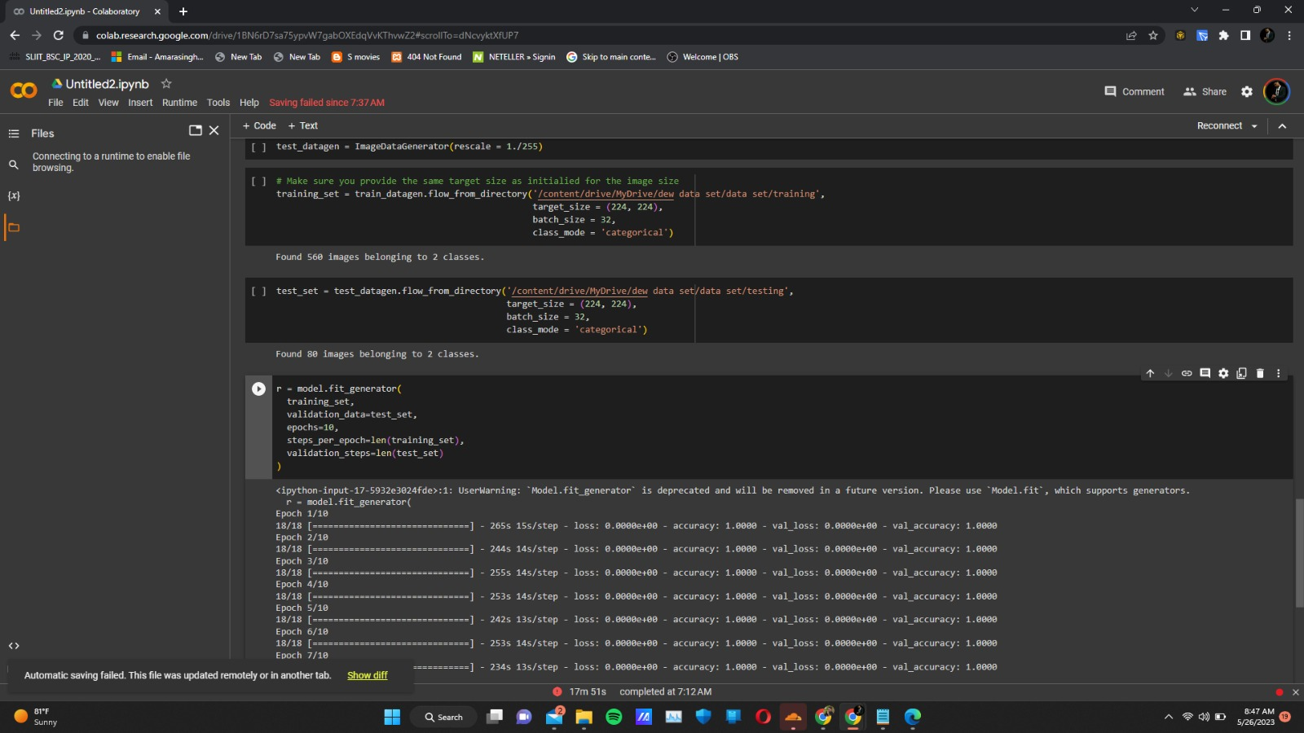
MOTORBIKE DEFECT CHECKER AND PREDICTOR
Completion of the System
IT20261764 | D.M.D.H Dissanayake | TMP-23-383

Slide 44
MOTORBIKE DEFECT CHECKER AND PREDICTOR
Progress at the moment
The needed image data sets have been found to train the models.
The needed requirements and wireframes have been gathered to implement the mobile application.
Completion of the System
What’s to be done
The implementation of frontend and backend of the mobile application has to be completed.
IT20261764 | D.M.D.H Dissanayake | TMP-23-383

Slide 45
References
MOTORBIKE DEFECT CHECKER AND PREDICTOR
[1]
Department of Motor Traffic. (n.d.). Department of Motor Traffic. https://dmt.gov.lk/
In-Text Citation: (Department of Motor Traffic, n.d.)
[2]
“How Optical Character Recognition Algorithms Redefine Business Processes &Mdash; ITRex.” ITRex, 6 Apr. 2022, itrexgroup.com/blog/how-ocr-algorithmsredefine-business-processes.
Completion of the System
[3]
https://www.researchgate.net/profile/Ashfaq
Shafin/publication/344519283_Automatic _Environmental_Sound_Recognition_AES R_Using_Convolutional_Neural_Network/l inks/5f7de369458515b7cf6f22d7/Automa tic-Environmental-Sound-RecognitionAESR-Using-Convolutional-NeuralNetwork.pdf
IT20261764 | D.M.D.H Dissanayake | TMP-23-383

Slide 46
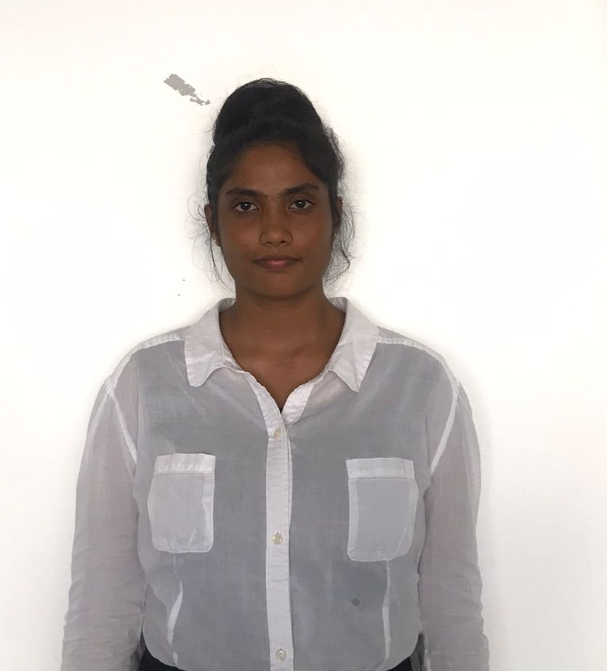
IT20156206 | Data Science
MOTORBIKE DEFECT CHECKER AND PREDICTOR
Rathnasooriya P.U.

Slide 47
Research Question
MOTORBIKE TYER USAGE AND LIFE EXPECTANCY PREDICTOR
How to identify Motorbike tyer usage and Life expectancy prediction system with computer vision and a machine learning model.

Slide 48
Research Methodology
MOTORBIKE TYER USAGE AND LIFE EXPECTANCY PREDICTOR
Capture images of tyres.
Here user can capture or upload an image of a tyre and predict usage and life expectancy.
Output the usage details and Life expectancy.
IT20156206 | Rathnasooriya P. U | TMP-23-383

Slide 49
MOTORBIKE TYER USAGE AND LIFE EXPECTANCY PREDICTOR
Completion of the System
Component | Status of Completion
Gathering datasets | 95%
Vision transformer model to predict the usage | 80%
Output the predicted life expectancy of the tyre | 10%

Slide 50
Progress up to now
MOTORBIKE TYER USAGE AND LIFE EXPECTANCY PREDICTOR
Completion of the System
IT20156206 | Rathnasooriya P. U | TMP-23-383

Slide 51
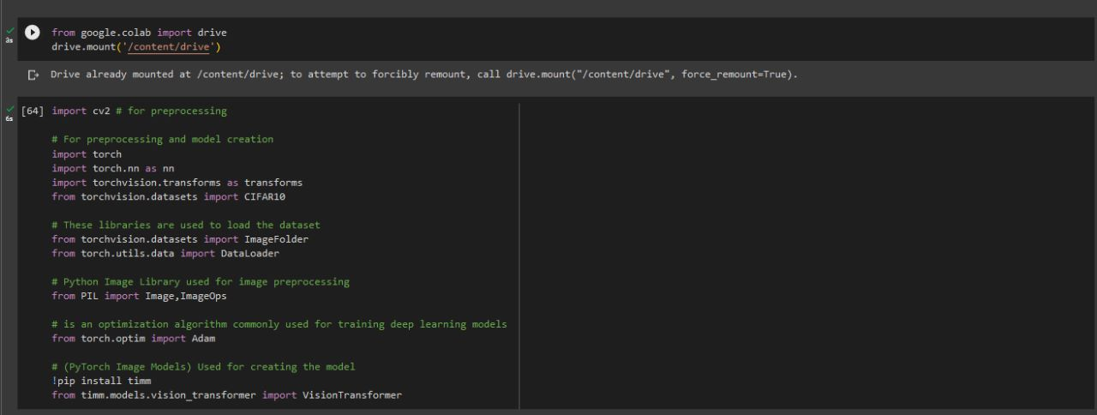
Completion of the System
IT20156206 | Rathnasooriya P. U | TMP-23-383

Slide 52
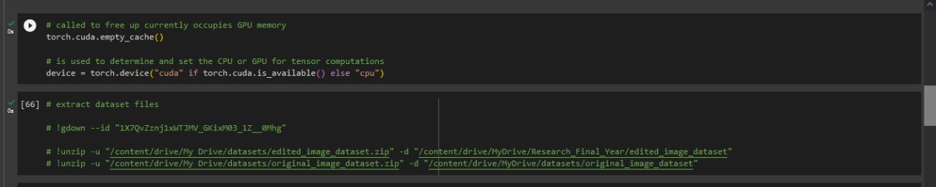
Completion of the System
IT20156206 | Rathnasooriya P. U | TMP-23-383

Slide 53
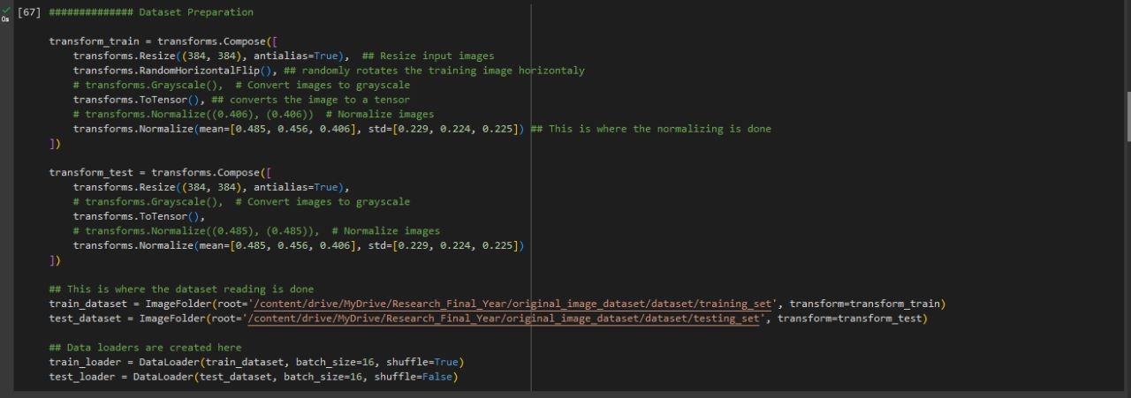
Completion of the System
IT20156206 | Rathnasooriya P. U | TMP-23-383

Slide 54
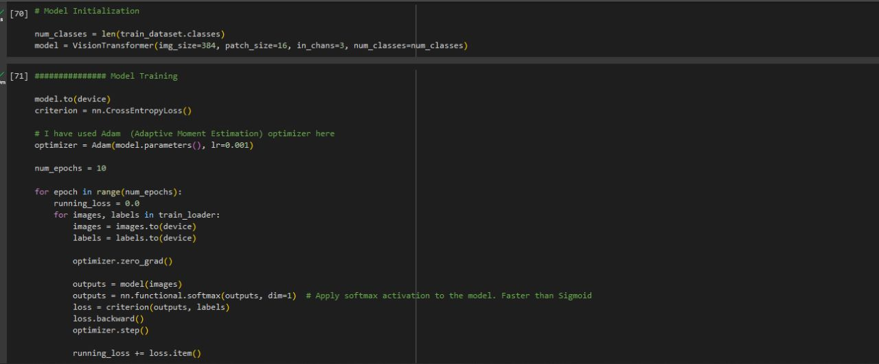
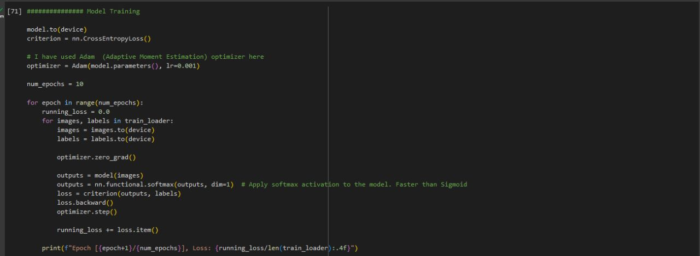
Completion of the System
IT20156206 | Rathnasooriya P. U | TMP-23-383

Slide 55
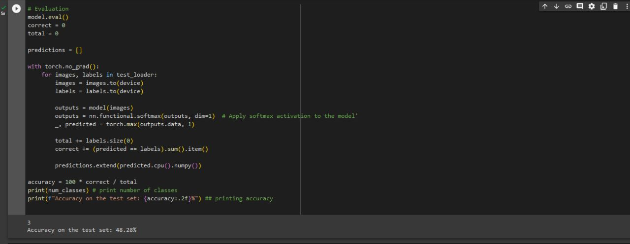
Completion of the System
IT20156206 | Rathnasooriya P. U | TMP-23-383

Slide 56
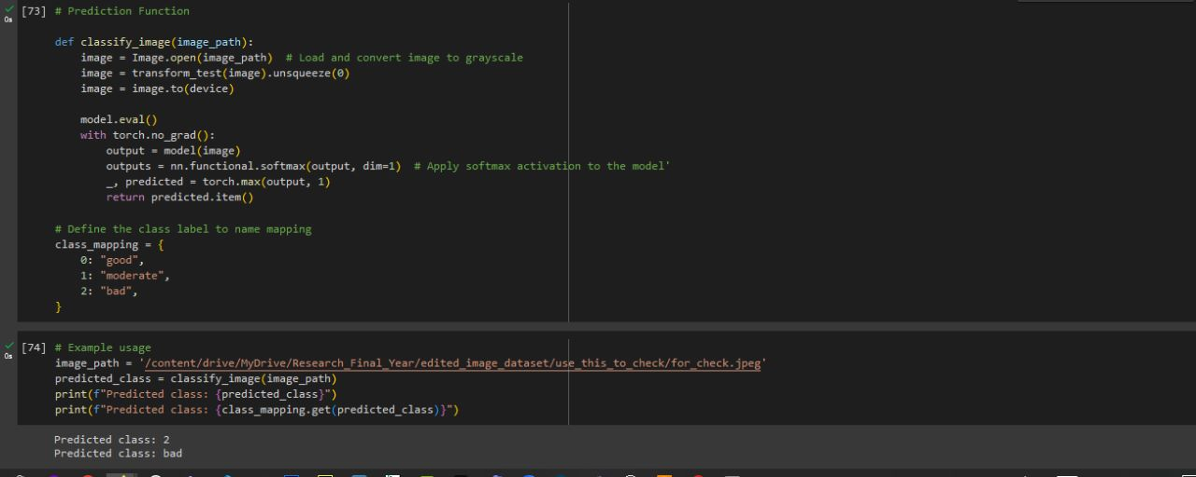
Completion of the System
IT20156206 | Rathnasooriya P. U | TMP-23-383

Slide 57
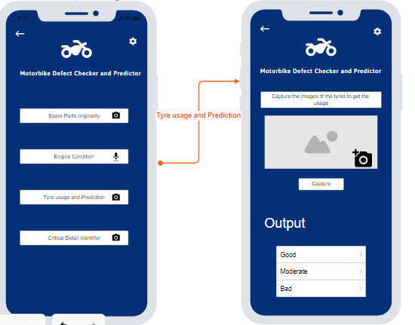
MOTORBIKE TYER USAGE AND LIFE EXPECTANCY PREDICTOR
Wireframes for the component
Completion of the System
IT20156206 | Rathnasooriya P. U | TMP-23-383

Slide 58
MOTORBIKE TYER USAGE AND LIFE EXPECTANCY PREDICTOR
Progress at the moment
Collected the required dataset having 200 images for each class.
Created the model for tyre usage prediction.

Slide 59
MOTORBIKE TYER USAGE AND LIFE EXPECTANCY PREDICTOR
What’s to be done
Model have to be fine tuned to get a better accuracy.
Dataset has to be expanded further.
Model has to be extended to give the life expectancy of the tyre.

Slide 60
References
MOTORBIKE TYER USAGE AND LIFE EXPECTANCY PREDICTOR
[1] J. Zhu, K. Han, and S. Wang, “Automobile tire life prediction based on image processing and machine learning technology,” Advances in Mechanical Engineering, vol. 13, no. 3, p. 168781402110027, Mar. 2021, doi: https://journals.sagepub.com/doi/10.1177/16878140211002727
[2] V. Pagliarulo et al., “Combining ESPI with laser scanning for 3D characterization of racing tyres sections,” Optics and Lasers in Engineering, vol. 104, pp. 71–77, May 2018, Available: https://doi.org/10.1016/j.optlaseng.2017.07.004. [Accessed Mar. 20, 2023].
Completion of the System

Slide 61
Thank You !
MOTORBIKE TYER USAGE AND LIFE EXPECTANCY PREDICTOR
Completion of the System

