Slide 1
7BUIS025W
Web and social media analytics
Reddit - Shoestring
Pasindu ekanayake – w1742110
Presentation by

Slide 2
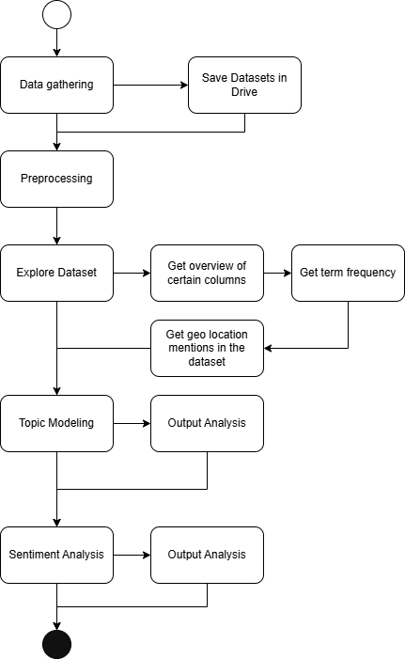
Methodological steps

Slide 3
Key Insights

Slide 4
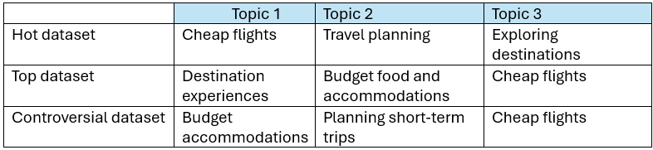
three themes, each for three different datasets
1

Slide 5
The most talked about trending destinations are Japan Italy London Spain
2

Slide 6
The most talked about all-time destinations are Japan Mexico City Paris Vietnam
3

Slide 7
The most talked about controversial destinations are Japan Paris London Italy
4

Slide 8
The most popular method of travel is air travel flights
5

Slide 9
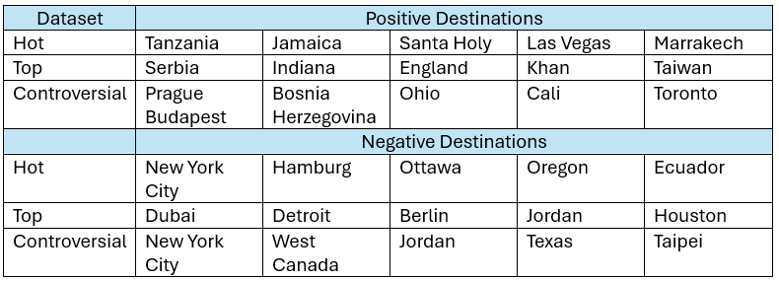
The most positive and negative travel destinations
6

Slide 10
Walkthrough of the code

Slide 11
THANK YOU
Pasindu Ekanayake​
pasinduekanayake123@gmail.com
w1742110@westminster.ac.uk

