Slide 1
Data bases 2
Database project: Gamified marketing application

Slide 2
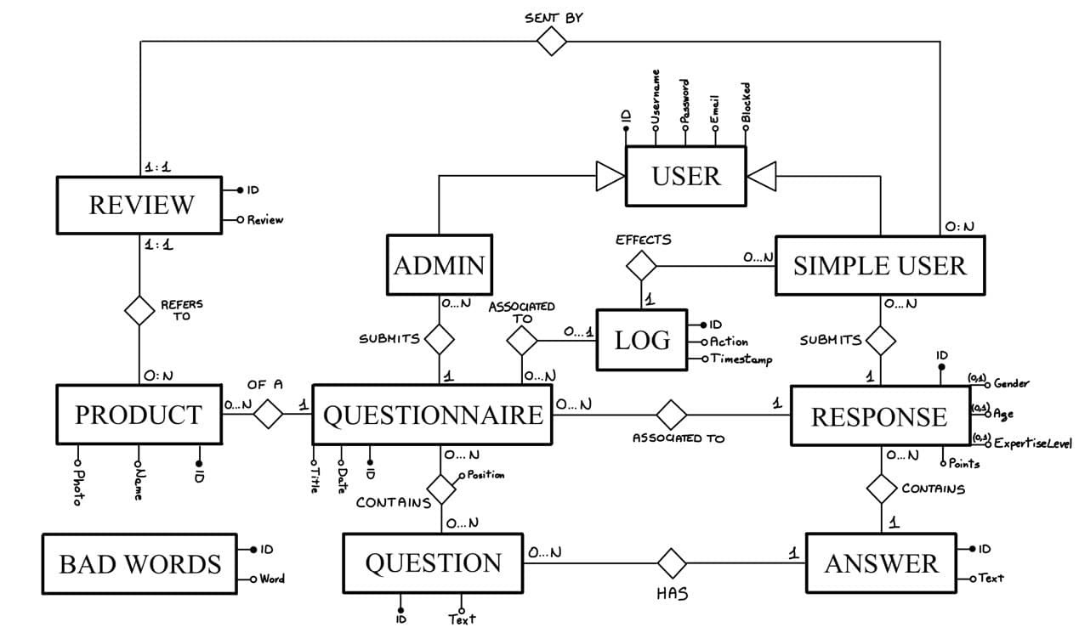
Entity Relationship

Slide 3
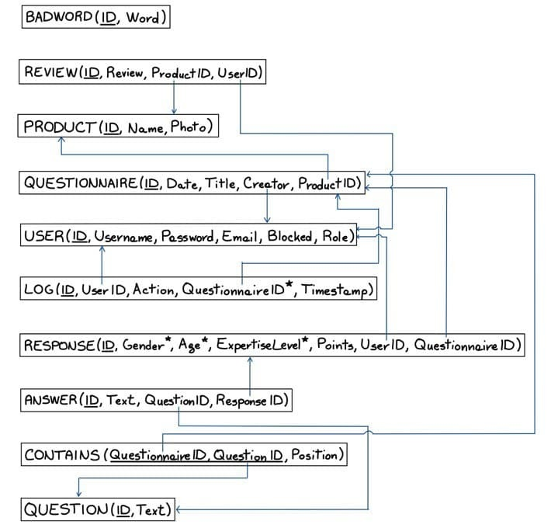
Relational model

Slide 4
Motivation
Answer represents a single answer to a specific question, while response is the “package” of all the answer related to a questionnaire

Slide 5
Relationship “of a”
Of a
PRODUCT
QUESTIONNAIRE
PRODUCT → QUESTIONNAIRE
OneToMany
Fetch Lazy
Cascade all
Orphan Removal
QUESTIONNAIRE → PRODUCT
ManyToOne
Fetch Eager
No cascading
0:N
1:1
PRODUCT
*
QUESTIONNAIRE
1
PRODUCT
QUESTIONNAIRE

Slide 6
Relationship “contains”
contains
QUESTION
QUESTIONNAIRE
QUESTION → QUESTIONNAIRE
ManyToMany
Fetch Lazy
No cascading
QUESTIONNAIRE → QUESTION
ManyToMany
Fetch Lazy
No cascading
0:N
0:N
QUESTION
*
QUESTIONNAIRE
*
QUESTION
QUESTIONNAIRE

Slide 7
Relationship “creates”
creates
USER
QUESTIONNAIRE
USER → QUESTIONNAIRE
OneToMany
Fetch Lazy
Cascade persist, merge
QUESTIONNAIRE → USER
ManyToOne
Fetch Lazy
No cascading
0:N
1:1
USER
*
QUESTIONNAIRE
1
USER
QUESTIONNAIRE

Slide 8
Relationship “has”
has
QUESTION
ANSWER
QUESTION → ANSWER
OneToMany
Fetch Lazy
No cascading
This relationship is not so important
ANSWER → QUESTION
ManyToOne
Fetch Eager
No cascading
0:N
1:1
QUESTION
*
ANSWER
1
QUESTION
ANSWER

Slide 9
Relationship “associated to”
associated to
QUESTIONNAIRE
RESPONSE
QUESTIONNAIRE → RESPONSE
OneToMany
Fetch Lazy
Cascading all
Orphan removal
RESPONSE → QUESTIONNAIRE
ManyToOne
Fetch Eager
No cascading
0:N
1:1
QUESTIONNAIRE
*
RESPONSE
1
QUESTIONNAIRE
RESPONSE

Slide 10
Relationship “submits”
submits
RESPONSE
ANSWER
RESPONSE → ANSWER
OneToMany
Fetch Lazy
Cascading all
Orphan removal
ANSWER → RESPONSE
ManyToOne
Fetch Eager
No cascading
0:N
1:1
RESPONSE
*
ANSWER
1
RESPONSE
ANSWER

Slide 11
Relationship “associated to”
Associated to
QUESTIONNAIRE
LOG
QUESTIONNAIRE → LOG
OneToMany
Fetch Lazy
Cascading all
LOG → QUESTIONNAIRE
ManyToOne
Fetch Eager
No cascading
0:N
0:1
QUESTIONNAIRE
*
LOG
1
QUESTIONNAIRE
LOG

Slide 12
Relationship “effects”
effects
USER
LOG
USER → LOG
OneToMany
Fetch Lazy
No cascading
LOG → USER
ManyToOne
Fetch Eager
No cascading
0:N
1:1
USER
*
LOG
1
USER
LOG

Slide 13
Relationship “sent by”
sent by
USER
REVIEW
USER → REVIEW
OneToMany
Fetch Lazy
No cascading
REVIEW→ USER
ManyToOne
Fetch Eager
No cascading
0:N
1:1
USER
*
REVIEW
1
USER
REVIEW

Slide 14
Relationship “refers to”
refers to
PRODUCT
REVIEW
PRODUCT → REVIEW
OneToMany
Fetch Eager
Cascade all
Orphan removal
PRODUCT → USER
ManyToOne
Fetch Eager
No cascading
0:N
1:1
PRODUCT
*
REVIEW
1
PRODUCT
REVIEW

Slide 15
Motivation
We assume that a question could be eliminated only if there is no questionnaire that contains it (this implies there are no answer for that question)

Slide 16
Entity Answer
@Entity
public class Answer implements Serializable{
private static final long serialVersionUID = 1L;
@Id
@GeneratedValue(strategy=IDENTITY)
private Long id;
@Lob//it could be heavy!
@Column(nullable = false)
private String text;
@ManyToOne(optional=false)
private Question question;
@ManyToOne(optional=false)
private Response response;
}

Slide 17
Entity BadWord
@Entity
public class BadWord implements Serializable{
private static final long serialVersionUID = 1L;
@Id
@GeneratedValue(strategy=IDENTITY)
private Long id;
@Column(nullable=false, unique = true)
private String word;
}

Slide 18
Entity Log
@Entity
public class Log implements Serializable{
private static final long serialVersionUID = 1L;
@Id
@GeneratedValue(strategy=IDENTITY)
private Long id;
@Column(nullable=false)
@Enumerated(EnumType.STRING)
private Action action;
@ManyToOne(optional=true)
private Questionnaire questionnaire;
@ManyToOne(optional=false)
private User user;
@CreationTimestamp
@Column(name="timestamp", nullable = false, updatable = false, insertable = false, columnDefinition="TIMESTAMP DEFAULT CURRENT_TIMESTAMP")
private LocalDateTime timestamp;
}

Slide 19
Entity Product
@Entity
public class Product implements Serializable{
private static final long serialVersionUID = 1L;
@Id
@GeneratedValue(strategy=IDENTITY)
private Long id;
@Column(nullable=false)
private String name;
@Basic(fetch=FetchType.EAGER)
@Lob
@Column(name = "photo", columnDefinition="MEDIUMBLOB", nullable=false)
private byte[] photo;
@OneToMany(mappedBy="product", fetch = FetchType.LAZY, cascade = CascadeType.ALL, orphanRemoval = true)
@Builder.Default
private List<Questionnaire> questionnaires= new ArrayList<Questionnaire>();
@OneToMany(mappedBy="product", fetch = FetchType.EAGER, cascade = CascadeType.ALL, orphanRemoval = true)
@Builder.Default
private List<Review> reviews= new ArrayList<Review>();
}

Slide 20
Entity Question
@Entity
public class Question implements Serializable{
private static final long serialVersionUID = 1L;
@Id
@GeneratedValue(strategy=IDENTITY)
private Long id;
@Column(nullable = false)
private String text;
@ManyToMany(mappedBy="questions")
@Builder.Default
private List<Questionnaire> questionnaires = new ArrayList<Questionnaire>();
@OneToMany(mappedBy="question")
@Builder.Default
private List<Answer> answers = new ArrayList<Answer>();
}

Slide 21
Entity Questionnaire 1/2
@Entity
public class Questionnaire implements Serializable{
private static final long serialVersionUID = 1L;
@Id
@GeneratedValue(strategy=IDENTITY)
private Long id;
@Column(unique=true, nullable = false)
private LocalDate date;
@Column(nullable = false)
private String title;
@ManyToOne(optional=false)
@JoinColumn(name = "productId", referencedColumnName = "id")
private Product product;
}

Slide 22
Entity Questionnaire 2/2
@ManyToMany
@JoinTable(
name="contains",
joinColumns = @JoinColumn(name = "questionnaireId"),
inverseJoinColumns = @JoinColumn(name = "questionId"))
@OrderColumn(name = "position")
@Builder.Default
private List<Question> questions=new ArrayList<Question>();
@OneToMany(mappedBy="questionnaire", cascade = CascadeType.ALL, orphanRemoval = true)
@Builder.Default
private List<Response> responses=new ArrayList<Response>();
@ManyToOne(optional=false, fetch=FetchType.LAZY)
private User creator;
@OneToMany(mappedBy="questionnaire", cascade=CascadeType.ALL)
@Builder.Default
private List<Log> logs=new ArrayList<Log>();

Slide 23
Entity method for adding a Question
// in entity Questionnaire
public void addQuestion(Question question) {
this.questions.add(question);
question.getQuestionnaires().add(this);
}

Slide 24
Entity Response
@Entity
@EqualsAndHashCode(exclude= "answers")
@ToString(exclude="answers")
@Table(uniqueConstraints=@UniqueConstraint(columnNames={"questionnaire_id", "user_id"}))
public class Response implements Serializable{
private static final long serialVersionUID = 1L;
@Id
@GeneratedValue(strategy=IDENTITY)
private Long id;
private Integer age;
@Enumerated(EnumType.STRING)
private Gender gender;
@Enumerated(EnumType.STRING)
private ExpertiseLevel expertiseLevel;
private Integer points;
@ManyToOne(optional=false)
private Questionnaire questionnaire;
@ManyToOne(optional=false, fetch=FetchType.LAZY)
private User user;
@OneToMany(mappedBy="response", cascade = CascadeType.ALL, orphanRemoval = true)
@Builder.Default
private List <Answer> answers = new ArrayList<Answer>();
}

Slide 25
Entity method for adding an Answer
// in entity Response
public void addAnswer(Answer answer) {
this.answers.add(answer);
answer.setResponse(this);
}

Slide 26
Points Handling
// in entity Response
@PostPersist
public void calculatePoints() {
Integer points = 0;
if(age!=null) points+=2;
if(gender!=null) points+=2;
if(expertiseLevel!=null) points+=2;
points+=answers.size();
this.points=points;
}

Slide 27
Trigger handling in JPA. Why?
Easier to test
The trigger refers to the logic of the application, so it is more natural to handle it in the application tier
The database remains «dumb» with respect to the application logic

Slide 28
Entity Review
@Entity
public class Review implements Serializable{
private static final long serialVersionUID = 1L;
@Id
@GeneratedValue(strategy=IDENTITY)
private Long id;
@Lob //it could be heavy!
@Column(nullable=false)
private String review;
@ManyToOne(optional=false)
private Product product;
@ManyToOne(optional=false)
private User user;
}

Slide 29
Entity User 1/2
@Entity
public class User {
@Id
@GeneratedValue(strategy=IDENTITY)
private Long id;
@Column(unique=true, nullable=false)
private String username;
@Column(nullable=false)
private String password;
@Column(unique=true, nullable=false)
private String email;
@Column(nullable=false)
private Boolean blocked;

Slide 30
Entity User 2/2
@Column(nullable=false)
private String roles;
@OneToMany(mappedBy="creator", cascade = {CascadeType.PERSIST, CascadeType.MERGE})
@Builder.Default
private List<Questionnaire> questionnairesCreated = new ArrayList<Questionnaire>();
@OneToMany(mappedBy="user")
@Builder.Default
private List<Response> responses = new ArrayList<Response>();
@OneToMany(mappedBy="user")
@Builder.Default
private List<Log> logs = new ArrayList<Log>();
@OneToMany(mappedBy="user")
@Builder.Default
private List<Review> reviews = new ArrayList<Review>();
}

Slide 31
Entity Method for retrieving all points of a User
// in entity User
public Integer getPoints() {
return responses.stream()
.map(Response::getPoints)
.reduce(0, Integer::sum);
}

Slide 32
Server Side Components
Repositories
Mappers
Services
Controllers

Slide 33
Repositories
AnswerRepository
BadWordRepository
LogRepository
ProductRepository
QuestionnaireRepository
QuestionRepository
ResponseRepository
ReviewRepository
UserRepository

Slide 34
Repository Methods
Basic CRUD operations are automatically implemented (findAll, findById…)
Different ways to handle custom methods

Slide 35
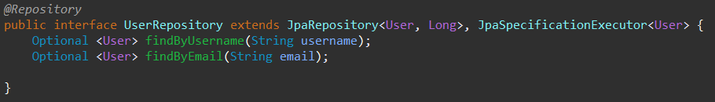
Semantic interpretation
Repositories can interpret the purpose of a method by its name
Useful for simple queries

Slide 36
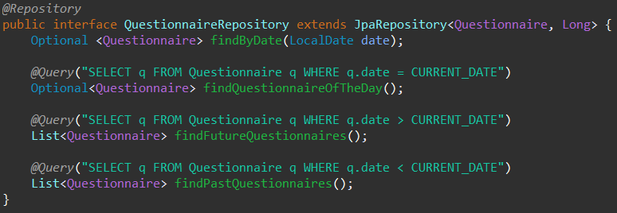
JPQL
@Query annotation specifying a JPQL query

Slide 37
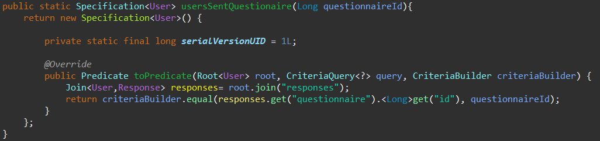
Specification
Criteria builder approach

Slide 38
Spring Data JPA Testing
Data JPA Test Annotations
TestEntityManager to help for persistence operations
TestContainers to run tests in a virtual instance of a database

Slide 39
Mappers and DTO pattern
JPA models don’t represent correctly the exchanged data between client and server
The Data Transfer Object pattern allows to model this data as Java Objects with the addition of applying constraints to the attributes of the requests
Mappers are necessary to translate DTO to JPA models and viceversa
Implemented using MapStruct Library

Slide 40
Services
Handle all the business logic
Leave to the controllers only the task of handling requests and sending responses
They are interfaced with Mappers, Repositories and other Services

Slide 41
Bad Word Service
@Service
public class BadWordService {
private final BadWordRepository badWordRepository;
@Transactional
public boolean containtsBadWord(List<String> words)
}

Slide 42
Log Service
@Service
@AllArgsConstructor
public class LogService {
@Transactional
public void logLogin(User user)
@Transactional
public void logCancellation(User user, Questionnaire questionnaire)
@Transactional
public void logSubmission(User user, Questionnaire questionnaire)
}

Slide 43
Product Service
@Service
public class ProductService {
private final ProductRepository productRepository;
private final ProductMapper productMapper;
@Transactional
public void addProduct(ProductRequest productRequest)
@Transactional(readOnly = true)
public Optional<Product> getProduct(Long id)
@Transactional(readOnly = true)
public List<ProductResponse> getAllProducts()
@Transactional(readOnly = true)
public ProductOfTheDayResponse getProductOfTheDay()
}

Slide 44
Questionnaire Service 1/2
@Service
public class QuestionnaireService {
private final UserService userService;
private final ProductService productService;
private final QuestionService questionService;
private final LogService logService;
private final QuestionnaireRepository questionnaireRepository;
private final QuestionnaireMapper questionnaireMapper;
private final QuestionMapper questionMapper;
@Transactional
public void addQuestionnaire(QuestionnaireRequest questionnaireRequest)
@Transactional
public void updateQuestionnaire(QuestionnaireRequest questionnaireRequest, Long id)
@Transactional(readOnly = true)
public QuestionnaireOfTheDayResponse getQuestionnaireOfTheDay()

Slide 45
Questionnaire Service 2/2
@Transactional(readOnly = true)
public List<QuestionnaireResponse> getPastQuestionnaires()
@Transactional(readOnly = true)
public List<QuestionnaireResponse> getFutureQuestionnaires()
@Transactional
public void deleteQuestionnaire(Long id)
@Transactional(readOnly = true)
public Optional<Questionnaire> getQuestionnaire(Long id)
@Transactional(readOnly = true)
public List<QuestionResponse> getQuestionsOfQuestionnaire(Long id)
@Transactional
public void cancelQuestionnaireSubmission()
}

Slide 46
Question Service
@Service
public class QuestionService {
private final QuestionRepository questionRepository;
private final QuestionMapper questionMapper;
@Transactional
public void addQuestion(QuestionRequest questionRequest)
@Transactional(readOnly = true)
public List<QuestionResponse> getAllQuestions()
@Transactional(readOnly = true)
public Optional<Question> getQuestion(Long id)
}

Slide 47
Response Service
@Service
public class ResponseService {
private final ResponseRepository responseRepository;
private final BadWordService badWordService;
private final QuestionnaireService questionnaireService;
private final UserService userService;
private final QuestionService questionService;
private final LogService logService;
private final ResponseMapper responseMapper;
private final UserMapper userMapper;
@Transactional
public void addReponse(ResponseRequest request)
@Transactional(readOnly = true)
public ResponseResponse getUserResponse(Long userId, Long questionnaireId)
@Transactional(readOnly = true)
public List<LeaderboardUserResponse> getLeaderboard()
}

Slide 48
Review Service
@Service
@AllArgsConstructor
public class ReviewService {
private final BadWordService badWordService;
private final ProductService productService;
private final UserService userService;
private final ReviewMapper reviewMapper;
private final ReviewRepository reviewRepository;
@Transactional
public void addReview(ReviewRequest reviewRequest)
}

Slide 49
User Service
@Service
@AllArgsConstructor
public class UserService {
private final UserRepository userRepository;
private final UserMapper userMapper;
@Transactional
public void blockLogged()
@Transactional
public void signup(UserRequest userRequest)
@Transactional(readOnly = true)
public Optional<User> getLoggedUser()
@Transactional(readOnly = true)
public List<UserResponse> getUsersSent(Long questionnaireId)
@Transactional(readOnly = true)
public List<UserResponse> getUsersCancelled(Long questionnaireId)
}

Slide 50
@Transactional annotation
Spring boot offers the @Transactional annotation for wrapping methods in a transaction
Repository methods are also transactional
With nested transactional methods, the first called is the one which commits (pay attention to implicit detachment and exception handling)
Some methods are flagged as readOnly: this is used to give a hint to the transaction subsystem that the operation will not write on the database

Slide 51
Controllers
Implemented as Spring Rest Controllers
Handle all HTTP requests and responses
Every controller method is mapped with an URI pattern and an HTTP method
The DTO parameters represent the body of the request, while the return type represents the JSON format of the response
Path variables represent parameters in the URL of the request

Slide 52
Controllers & DTO design 1/2
OPERATION | URI | METHOD | PARAMETER | RETURN TYPE
PRODUCT CONTROLLER
add product | /admin/products | POST | image, name | void
get all products | /admin/products | GET | - | List [id, name, photo]
get product of the day | /user/products | GET | - | id, name, image, List [username, review]
REVIEW CONTROLLER
add review | /user/products/reviews | POST | productId, review | void
QUESTIONNAIRE CONTROLLER
add questionnaire | /admin/questionnaires | POST | date, productId, List[questionId] | void
get past questionnaires | /admin/questionnaires/past | GET | - | List [id, date, title, product]
get future questionnaires | /admin/questionnaires/future | GET | - | List [id, date, title, product]
delete past questionnaire | /admin/questionnaires/{id} | DELETE | - | void
get questionnaire of the day | /user/questionnaires | GET | - | id, title, product(id, name, photo), List[question(id, text)]
update questionnaire | /admin/questionnaires/{id} | PUT | date, productId, List[questionId] | void
cancel questionnaire (for logs) | /user/questionnaires/cancel | POST | - | -
get questions of questionnaire | /admin/questionnaires/{id}/questions | GET | - | List[question(id, text)]

Slide 53
Controllers & DTO design 2/2
OPERATION | URI | METHOD | PARAMETER | RETURN
RESPONSE CONTROLLER
submit response | /user/responses | POST | questionnaireId, age, gender, expertise, List[answer(questionid, text)] | void
get all responses for questionnaire | /admin/questionnaires/{questionnaireId}/ users/{userId} | GET | - | age, gender, expertise, List[answer(questionid, text)]
get leaderboard | /user/questionnaires/leaderboard | GET | - | List [userId, username, dailyPoints, totalPoints]
QUESTION CONTROLLER
add question | /admin/questions | POST | text | void
get all questions | /admin/questions | GET | - | List[question(id, text)]
USER CONTROLLER
Authentication methods are omitted from this table
get users who cancelled the questionnaire | /admin/questionnaires/{id}/users/cancelled | GET | - | List[userId, username, email]
get users who submitted the questionnaire | /admin/questionnaires/{id}/users/sent | GET | - | List[userId, username, email]

Slide 54
Role-Based Access Control \w Spring Security
Authorization and roles are managed with JWT
Authentication & authorization methods are configured by extending an highly customizable class supplied by Spring Security
Tokens are generated and validated by filters

Slide 55
Exception Handling
Exeptions are handled by a dedicated class annotated with @RestControllerAdvice, to which all exeptions are automatically routed to when thrown inside the application

