Slide 1
Data bases 2
Database project: Gamified marketing application

Slide 2
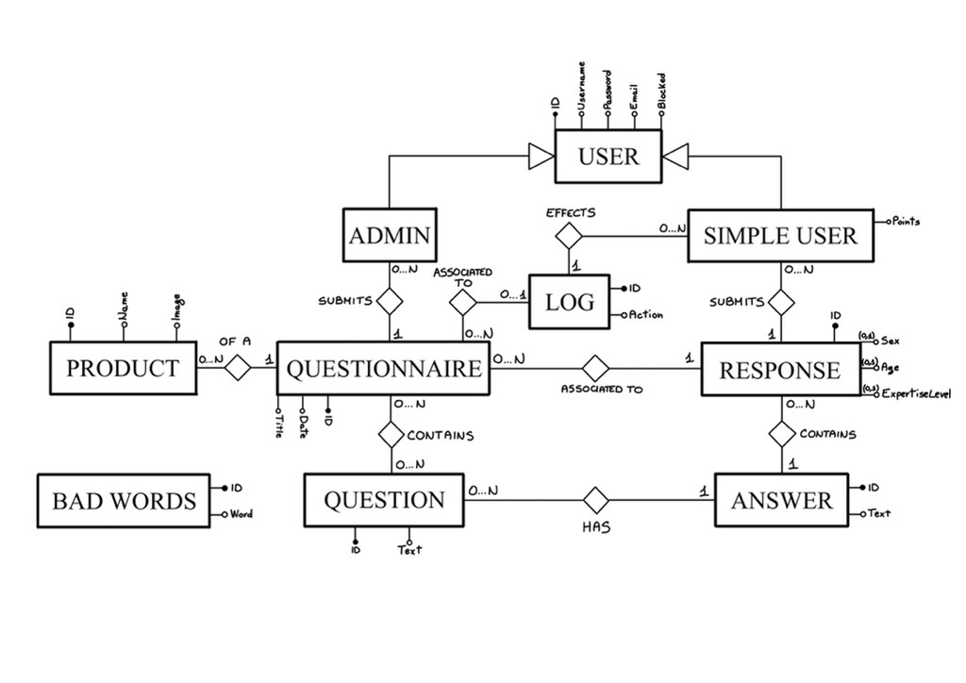
Entity Relationship

Slide 3
Relational model
BadWord(id, word)
Product(id, name, image)
Questionnaire(id, date, title, creator, productId)
User(id, username, password, email, blocked, roles)
Log(id, userId, action, questionnaireId*, date, time)
Response(id, sex*, age*, expertiseLevel*, userId, questionnaireId, points)
Answer(id, text, questionId, responseId)
Contains(questionnaireId, questionId)
Question(id, text)

Slide 4
Motivation
Answer represents a single answer to a specific question, while response is the “package” of all the answer related to a questionnaire

Slide 5
Relationship “of a”
Of a
PRODUCT
QUESTIONNAIRE
PRODUCT → QUESTIONNAIRE
OneToMany
Fetch Lazy
Cascade all
Orphan Removal
QUESTIONNAIRE → PRODUCT
ManyToOne
Fetch Eager
No cascading
0:N
1:1
PRODUCT
*
QUESTIONNAIRE
1
PRODUCT
QUESTIONNAIRE

Slide 6
Relationship “contains”
contains
QUESTION
QUESTIONNAIRE
QUESTION → QUESTIONNAIRE
ManyToMany
Fetch Lazy
No cascading
QUESTIONNAIRE → QUESTION
ManyToMany
Fetch Lazy
No cascading
0:N
0:N
QUESTION
*
QUESTIONNAIRE
*
QUESTION
QUESTIONNAIRE

Slide 7
Relationship “creates”
creates
USER
QUESTIONNAIRE
USER → QUESTIONNAIRE
OneToMany
Fetch Lazy
Cascade persist, merge
QUESTIONNAIRE → USER
ManyToOne
Fetch Eager
No cascading
0:N
1:1
USER
*
QUESTIONNAIRE
1
USER
QUESTIONNAIRE

Slide 8
Relationship “has”
has
QUESTION
ANSWER
QUESTION → ANSWER
OneToMany
Fetch Lazy
No cascading
This relationship is not so important
ANSWER → QUESTION
ManyToOne
Fetch Eager
No cascading
0:N
1:1
QUESTION
*
ANSWER
1
QUESTION
ANSWER

Slide 9
Relationship “associated to”
associated to
QUESTIONNAIRE
RESPONSE
QUESTIONNAIRE → RESPONSE
OneToMany
Fetch Lazy
Cascading all
Orphan removal
RESPONSE → QUESTIONNAIRE
ManyToOne
Fetch Eager
No cascading
0:N
1:1
QUESTIONNAIRE
*
RESPONSE
1
QUESTIONNAIRE
RESPONSE

Slide 10
Relationship “submits”
submits
RESPONSE
ANSWER
RESPONSE → ANSWER
OneToMany
Fetch Lazy
Cascading all
Orphan removal
ANSWER → RESPONSE
ManyToOne
Fetch Eager
No cascading
0:N
1:1
RESPONSE
*
ANSWER
1
RESPONSE
ANSWER

Slide 11
Relationship “associated to”
Associated to
QUESTIONNAIRE
LOG
QUESTIONNAIRE → LOG
OneToMany
Fetch Lazy
No cascading
LOG → QUESTIONNAIRE
ManyToOne
Fetch Eager
No cascading
0:N
0:1
QUESTIONNAIRE
*
LOG
1
QUESTIONNAIRE
LOG

Slide 12
Relationship “effects”
effects
USER
LOG
USER → LOG
OneToMany
Fetch Lazy
No cascading
LOG → USER
ManyToOne
Fetch Eager
No cascading
0:N
0:1
USER
*
LOG
1
USER
LOG

Slide 13
Motivation
We assume that a question could be eliminated only if there is no questionnaire that contains it (this implies there are no answer for that question)

Slide 14
Entity Answer
@Entity
public class Answer implements Serializable{
private static final long serialVersionUID = 1L;
@Id
@GeneratedValue(strategy=IDENTITY)
private Long id;
@Lob//it could be heavy!
@Column(nullable = false)
private String text;
@ManyToOne(optional=false, fetch=FetchType.EAGER)
@JoinColumn(name = "questionId", referencedColumnName = "id")
private Question question;
@ManyToOne(optional=false)
@JoinColumn(name = "responseId", referencedColumnName = "id")
private Response response;
}

Slide 15
Entity BadWord
@Entity
public class BadWord implements Serializable{
private static final long serialVersionUID = 1L;
@Id
@GeneratedValue(strategy=IDENTITY)
private Long id;
@Column(nullable=false, unique = true)
private String word;
}

Slide 16
Entity Log
@Entity
public class Log implements Serializable{
private static final long serialVersionUID = 1L;
@Id
@GeneratedValue(strategy=IDENTITY)
private Long id;
@Column(nullable=false)
private String action;
@ManyToOne(optional=true, fetch=FetchType.EAGER)
@JoinColumn(name = "questionnaireId", referencedColumnName = "id")
private Questionnaire questionnaire;
@ManyToOne(optional=false, fetch=FetchType.EAGER)
@JoinColumn(name = "userId", referencedColumnName = "id")
private User user;
}

Slide 17
Entity Product
@Entity
public class Product implements Serializable{
private static final long serialVersionUID = 1L;
@Id
@GeneratedValue(strategy=IDENTITY)
private Long id;
@Column(nullable=false)
private String name;
@Basic(fetch=FetchType.EAGER)
@Lob
@Column(name = "photo", columnDefinition="MEDIUMBLOB", nullable=false)
private byte[] photo;
@OneToMany(mappedBy="product", fetch = FetchType.LAZY, cascade = CascadeType.ALL, orphanRemoval = true)
private List<Questionnaire> questionnaires;
}

Slide 18
Entity Question
@Entity
public class Question implements Serializable{
private static final long serialVersionUID = 1L;
@Id
@GeneratedValue(strategy=IDENTITY)
private Long id;
@Column(nullable = false)
private String text;
@ManyToMany(mappedBy="questions")
private List<Questionnaire> questionnaires;
@OneToMany(mappedBy="question")
private List<Answer> answers;
}

Slide 19
Entity Questionnaire
@Entity
public class Questionnaire implements Serializable{
private static final long serialVersionUID = 1L;
@Id @GeneratedValue(strategy=IDENTITY)
private Long id;
@Column(unique=true, nullable = false)
private LocalDate date;
@Column(nullable = false)
private String title;
@aanyToOne(optional=false)
@JoinColumn(name = "productId", referencedColumnName = "id")
private Product product;
@ManyToMany
@JoinTable(
name="contains",
joinColumns = @JoinColumn(name = "questionnaireId"),
inverseJoinColumns = @JoinColumn(name = "questionId"))
private List<Question> questions;
@OneToMany(mappedBy="questionnaire", cascade = CascadeType.ALL, orphanRemoval = true)
private List<Response> responses;
@ManyToOne(optional=false, fetch=FetchType.LAZY)
@JoinColumn(name = "creator", referencedColumnName = "id")
private User user;
@OneToMany(mappedBy="questionnaire")
private List<Log> logs;}

Slide 20
Entity Response
@Entity
public class Response implements Serializable{
private static final long serialVersionUID = 1L;
@Id
@GeneratedValue(strategy=IDENTITY)
private Long id;
private Integer age;
private String gender;
private String expertiseLevel;
private Integer points;
@ManyToOne(optional=false, fetch=FetchType.EAGER)
@JoinColumn(name = "questionnaireId", referencedColumnName = "id")
private Questionnaire questionnaire;
@ManyToOne(optional=false, fetch=FetchType.LAZY)
@JoinColumn(name = "submitter", referencedColumnName = "id")
private User user;
@OneToMany(mappedBy="response", cascade = CascadeType.ALL, orphanRemoval = true)
private List <Answer> answers;
}

Slide 21
Entity User
@Entity
public class User {
@Id
@GeneratedValue(strategy=IDENTITY)
private Long id;
@Column(unique=true, nullable=false)
private String username;
@Column(nullable=false)
private String password;
@Column(unique=true, nullable=false)
private String email;
@Column(nullable=false)
private Boolean blocked;
@Column(nullable=false)
private String roles;
@OneToMany(mappedBy="creator", cascade = {CascadeType.PERSIST, CascadeType.MERGE})
private List<Questionnaire> questionnairesCreated;
@OneToMany(mappedBy="user")
private List<Response> responses;
@OneToMany(mappedBy="user")
private List<Log> logs;
}

Slide 22
Entity method for doing something
// in entity A
public void method(Class arg, . . .) {
// code
}
// use if requested

Slide 23
Components
Repositories
Services
Controllers

Slide 24
Repositories
AnswerRepository
BadWordRepository
LogRepository
ProductRepository
QuestionnaireRepository
ResponseRepository
UserRepository

Slide 25
Business method for doing something
public void method(Class arg, . . .) {
// code
}
// use if requested
/*
clone this slide as many tie as there are requested business methods
*/

