Slide 1
Data bases 2
Database project: Gamified marketing application

Slide 2
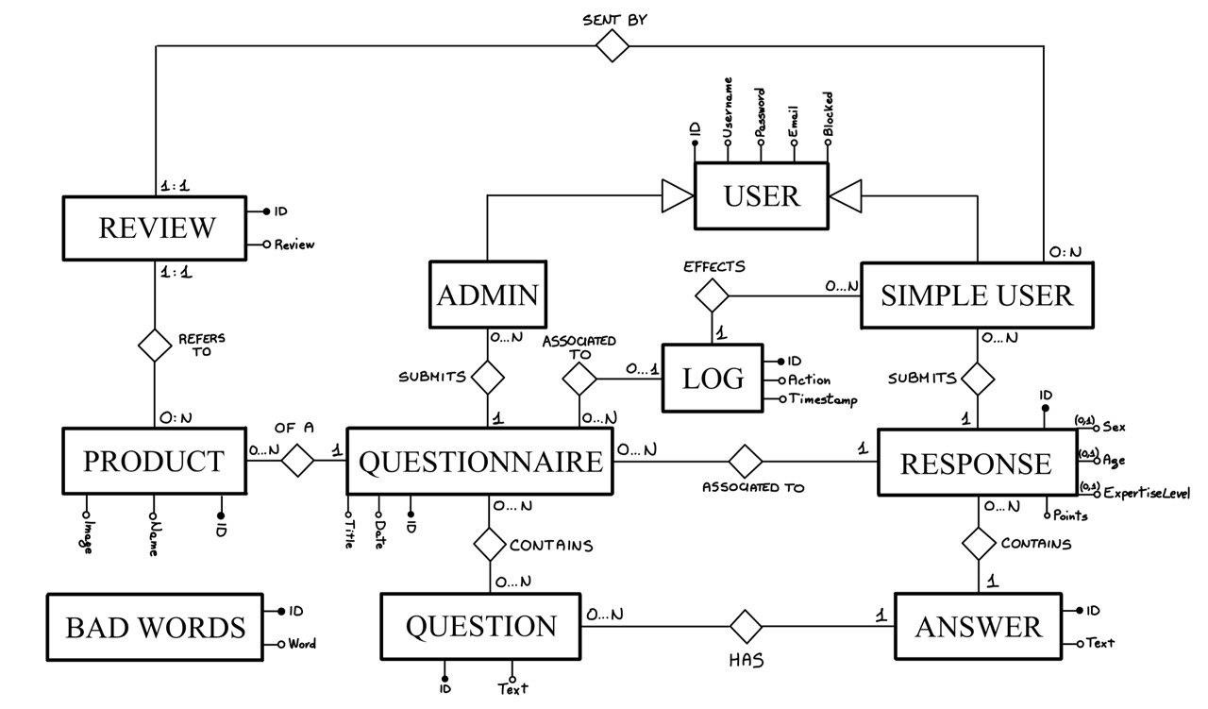
Entity Relationship

Slide 3
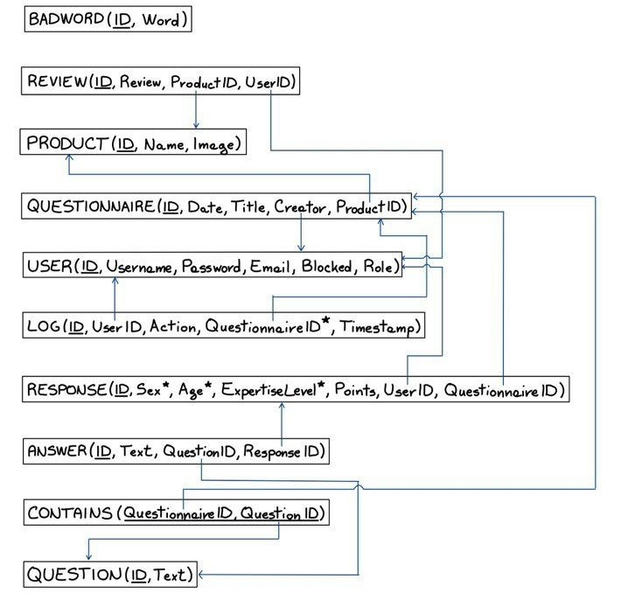
Relational model

Slide 4
Motivation
Answer represents a single answer to a specific question, while response is the “package” of all the answer related to a questionnaire

Slide 5
Relationship “of a”
Of a
PRODUCT
QUESTIONNAIRE
PRODUCT → QUESTIONNAIRE
OneToMany
Fetch Lazy
Cascade all
Orphan Removal
QUESTIONNAIRE → PRODUCT
ManyToOne
Fetch Eager
No cascading
0:N
1:1
PRODUCT
*
QUESTIONNAIRE
1
PRODUCT
QUESTIONNAIRE

Slide 6
Relationship “contains”
contains
QUESTION
QUESTIONNAIRE
QUESTION → QUESTIONNAIRE
ManyToMany
Fetch Lazy
No cascading
QUESTIONNAIRE → QUESTION
ManyToMany
Fetch Lazy
No cascading
0:N
0:N
QUESTION
*
QUESTIONNAIRE
*
QUESTION
QUESTIONNAIRE

Slide 7
Relationship “creates”
creates
USER
QUESTIONNAIRE
USER → QUESTIONNAIRE
OneToMany
Fetch Lazy
Cascade persist, merge
QUESTIONNAIRE → USER
ManyToOne
Fetch Eager
No cascading
0:N
1:1
USER
*
QUESTIONNAIRE
1
USER
QUESTIONNAIRE

Slide 8
Relationship “has”
has
QUESTION
ANSWER
QUESTION → ANSWER
OneToMany
Fetch Lazy
No cascading
This relationship is not so important
ANSWER → QUESTION
ManyToOne
Fetch Eager
No cascading
0:N
1:1
QUESTION
*
ANSWER
1
QUESTION
ANSWER

Slide 9
Relationship “associated to”
associated to
QUESTIONNAIRE
RESPONSE
QUESTIONNAIRE → RESPONSE
OneToMany
Fetch Lazy
Cascading all
Orphan removal
RESPONSE → QUESTIONNAIRE
ManyToOne
Fetch Eager
No cascading
0:N
1:1
QUESTIONNAIRE
*
RESPONSE
1
QUESTIONNAIRE
RESPONSE

Slide 10
Relationship “submits”
submits
RESPONSE
ANSWER
RESPONSE → ANSWER
OneToMany
Fetch Lazy
Cascading all
Orphan removal
ANSWER → RESPONSE
ManyToOne
Fetch Eager
No cascading
0:N
1:1
RESPONSE
*
ANSWER
1
RESPONSE
ANSWER

Slide 11
Relationship “associated to”
Associated to
QUESTIONNAIRE
LOG
QUESTIONNAIRE → LOG
OneToMany
Fetch Lazy
No cascading
LOG → QUESTIONNAIRE
ManyToOne
Fetch Eager
No cascading
0:N
0:1
QUESTIONNAIRE
*
LOG
1
QUESTIONNAIRE
LOG

Slide 12
Relationship “effects”
effects
USER
LOG
USER → LOG
OneToMany
Fetch Lazy
No cascading
LOG → USER
ManyToOne
Fetch Eager
No cascading
0:N
0:1
USER
*
LOG
1
USER
LOG

Slide 13
Relationship “sent by”
sent by
USER
REVIEW
USER → REVIEW
OneToMany
Fetch Lazy
No cascading
REVIEW→ USER
ManyToOne
Fetch Eager
No cascading
0:N
1:1
USER
*
REVIEW
1
USER
REVIEW

Slide 14
Relationship “refers to”
refers to
PRODUCT
REVIEW
PRODUCT → REVIEW
OneToMany
Fetch Lazy
Cascade all
Orphan removal
PRODUCT → USER
ManyToOne
Fetch Eager
No cascading
0:N
1:1
PRODUCT
*
REVIEW
1
PRODUCT
REVIEW

Slide 15
Motivation
We assume that a question could be eliminated only if there is no questionnaire that contains it (this implies there are no answer for that question)

Slide 16
Entity Answer
@Entity
public class Answer implements Serializable{
private static final long serialVersionUID = 1L;
@Id
@GeneratedValue(strategy=IDENTITY)
private Long id;
@Lob //it could be heavy!
@Column(nullable = false)
private String text;
@ManyToOne(optional=false, fetch=FetchType.EAGER)
private Question question;
@ManyToOne(optional=false)
private Response response;
}

Slide 17
Entity method for adding an Answer
// in entity Response
public void addAnswer(Answer answer) {
this.answers.add(answer);
answer.setResponse(this);
}

Slide 18
Points Handling
// in entity Response
@PostPersist
public void calculatePoints() {
Integer points = 0;
if(age!=null) {
points+=2;
}
if(gender!=null) {
points+=2;
}
if(expertiseLevel!=null) {
points+=2;
}
points+=answers.size();
this.points=points;
}

Slide 19
Trigger handling in JPA. Why?
Easier to test
The trigger refers to the logic of the application, so it is more natural to handle it in the application tier
The database remains «dumb» with respect to the application logic

Slide 20
Entity BadWord
@Entity
public class BadWord implements Serializable{
private static final long serialVersionUID = 1L;
@Id
@GeneratedValue(strategy=IDENTITY)
private Long id;
@Column(nullable=false, unique = true)
private String word;
}

Slide 21
Entity Log
@Entity
public class Log implements Serializable{
private static final long serialVersionUID = 1L;
@Id
@GeneratedValue(strategy=IDENTITY)
private Long id;
@Column(nullable=false)
@Enumerated(EnumType.STRING)
private Action action;
@ManyToOne(optional=true, fetch=FetchType.EAGER)
private Questionnaire questionnaire;
@ManyToOne(optional=false, fetch=FetchType.EAGER)
private User user;
@CreationTimestamp
@Column(name="timestamp", nullable = false, updatable = false, insertable = false, columnDefinition="TIMESTAMP DEFAULT CURRENT_TIMESTAMP")
private LocalDateTime timestamp;
}

Slide 22
Entity Product
@Entity
public class Product implements Serializable{
private static final long serialVersionUID = 1L;
@Id
@GeneratedValue(strategy=IDENTITY)
private Long id;
@Column(nullable=false)
private String name;
@Basic(fetch=FetchType.EAGER)
@Lob
@Column(name = "photo", columnDefinition="MEDIUMBLOB", nullable=false)
private byte[] photo;
@OneToMany(mappedBy="product", fetch = FetchType.LAZY, cascade = CascadeType.ALL, orphanRemoval = true)
private List<Questionnaire> questionnaires;
@OneToMany(mappedBy="product", fetch = FetchType.EAGER)
private List<Review> reviews;
}

Slide 23
Entity Question
@Entity
public class Question implements Serializable{
private static final long serialVersionUID = 1L;
@Id
@GeneratedValue(strategy=IDENTITY)
private Long id;
@Column(nullable = false)
private String text;
@ManyToMany(mappedBy="questions")
private List<Questionnaire> questionnaires;
@OneToMany(mappedBy="question")
private List<Answer> answers;
}

Slide 24
Entity method for adding a Question
// in entity Question
public void addQuestion(Question question) {
this.questions.add(question);
question.getQuestionnaires().add(this);
}

Slide 25
Entity Questionnaire
@Entity
public class Questionnaire implements Serializable{
private static final long serialVersionUID = 1L;
@Id
@GeneratedValue(strategy=IDENTITY)
private Long id;
@Column(unique=true, nullable = false)
private LocalDate date;
@Column(nullable = false)
private String title;
@ManyToOne(optional=false)
@JoinColumn(name = "productId", referencedColumnName = "id")
private Product product;
@ManyToMany
@JoinTable(name="contains", joinColumns = @JoinColumn(name = "questionnaireId"),inverseJoinColumns = @JoinColumn(name = "questionId"))
private List<Question> questions;
@OneToMany(mappedBy="questionnaire", cascade = CascadeType.ALL, orphanRemoval = true)
private List<Response> responses;
@ManyToOne(optional=false, fetch=FetchType.LAZY)
private User creator;
@OneToMany(mappedBy="questionnaire")
private List<Log> logs;
}

Slide 26
Entity Response
@Entity
@Table(uniqueConstraints= @UniqueConstraint(columnNames={"questionnaire_id", "user_id"}))
public class Response implements Serializable{
private static final long serialVersionUID = 1L;
@Id
@GeneratedValue(strategy=IDENTITY)
private Long id;
private Integer age;
@Enumerated(EnumType.STRING)
private Gender gender;
@Enumerated(EnumType.STRING)
private ExpertiseLevel expertiseLevel;
private Integer points;
@ManyToOne(optional=false, fetch=FetchType.EAGER)
private Questionnaire questionnaire;
@ManyToOne(optional=false, fetch=FetchType.LAZY)
private User user;
@OneToMany(mappedBy="response", cascade = CascadeType.ALL, orphanRemoval = true)
private List <Answer> answers;
}

Slide 27
Entity Review
@Entity
public class Review implements Serializable{
private static final long serialVersionUID = 1L;
@Id
@GeneratedValue(strategy=IDENTITY)
private Long id;
@Lob //it could be heavy!
@Column(nullable=false)
private String review;
@ManyToOne(optional=false, fetch = FetchType.EAGER)
private Product product;
@ManyToOne(optional=false, fetch = FetchType.EAGER)
private User user;
}

Slide 28
Entity User
@Entity
public class User {
@Id
@GeneratedValue(strategy=IDENTITY)
private Long id;
@Column(unique=true, nullable=false)
private String username;
@Column(nullable=false)
private String password;
@Column(unique=true, nullable=false)
private String email;
@Column(nullable=false)
private Boolean blocked;
@Column(nullable=false)
private String roles;
@OneToMany(mappedBy="creator", cascade = {CascadeType.PERSIST, CascadeType.MERGE})
private List<Questionnaire> questionnairesCreated;
@OneToMany(mappedBy="user")
private List<Response> responses;
@OneToMany(mappedBy="user")
private List<Log> logs;
@OneToMany(mappedBy="user")
private List<Review> reviews;
}

Slide 29
Entity Method for retrieving all points of a User
// in entity User
public Integer getPoints() {
return responses.stream()
.map(Response::getPoints)
.reduce(0, Integer::sum);
}

Slide 30
Components
Repositories
Services
Controllers

Slide 31
Repositories
AnswerRepository
BadWordRepository
LogRepository
ProductRepository
QuestionnaireRepository
ResponseRepository
UserRepository

Slide 32
Repository Methods
Basic CRUD operations are automatically implemented (findAll, findById…)
Different ways to handle custom methods

Slide 33
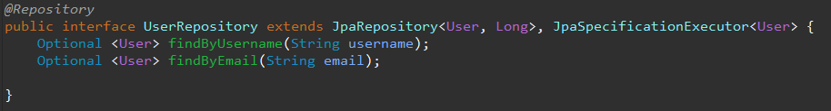
Semantic interpretation
Repositories can interpret the purpose of a method by its name
Useful for simple queries

Slide 34
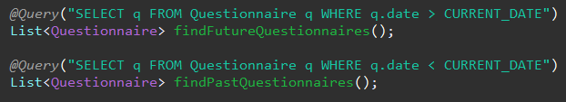
JPQL
@Query annotation specifying a JPQL query

Slide 35
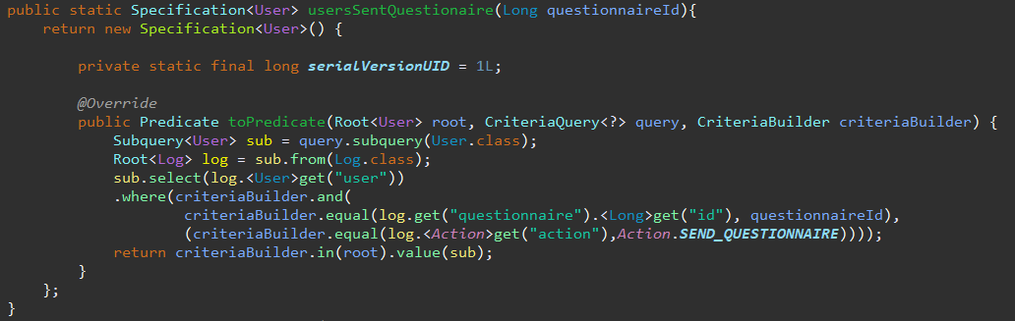
Specification
Criteria builder approach

Slide 36
JPA Testing
Data JPA Test Annotations
TestEntityManager to help for persistence operations
TestContainers to run tests in a virtual instance of a database

Slide 37
Business method for doing something
public void method(Class arg, . . .) {
// code
}
// use if requested
/*
clone this slide as many tie as there are requested business methods
*/

