Slide 1
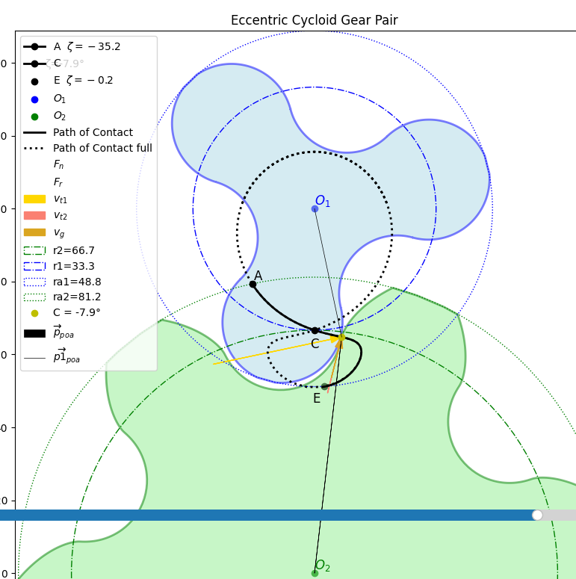
Legend:
A start of mesing
E end of meshing
Path of contact
Maximum path of contact
Sliding evlocity
Parameter:
Hide on click

