Slide 1






STUDIO DEL SENSORE
Processo di
calibrazione
generates
is analysed by
generates
is analysed by
calibrazione.cpp
measurements
analyse.py
measurements/plots
plot_dev_std.py
Rilevazione
alluminio o
carta velina
gives output data
manually stored
is analysed by
generates
twosurfacescheck.cpp
twosurfaces_test/twosurfacescheckresults.txt
twosurfacestest.py
twosurfaces_test/
grid_plot

Slide 2
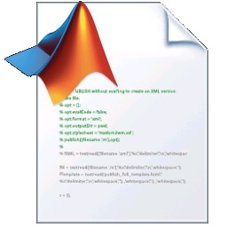
STUDIO RISPOSTA MECA
Acquisizione risposta del Meca
generates
is analysed by
generates
other files in
rispostavelocita.cpp
control
plot_response.py
control
Cerca della fdt
del Meca
is analysed by
output is
used by
find_tf.py
script_matlab/
test_tf.mlx

Slide 3
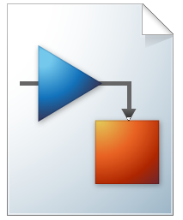
PROGETTAZIONE REGOLATORE
Progetto in luogo
delle radici
some screen captures
script_matlab/
find_R.mlx
script_matlab/
img_project/
rootlocusimages
Test Simulink in anello chiuso
some screen captures
script_matlab/
sistema_finale_ciclo_chiuso.slx
script_matlab/
img_project/
sometestsimages
generates
is analysed by
Realizzazione
R.cpp
data_test.csv
analyse_data_test.py

