Slide 1
July 2026
06_SAST
Presented by Gabriele Pasqualini

Slide 2
OBJECTIVE
In this lab activity Static Code Analysis will be conducted on 2 cases:
Case 1) one with known vulnerabilities
Case 2) one without known vulnerabilities.
*For each case the code will be analyzed with Sonarcloud for the code and with OWASP’s dependency-check tool.

Slide 3
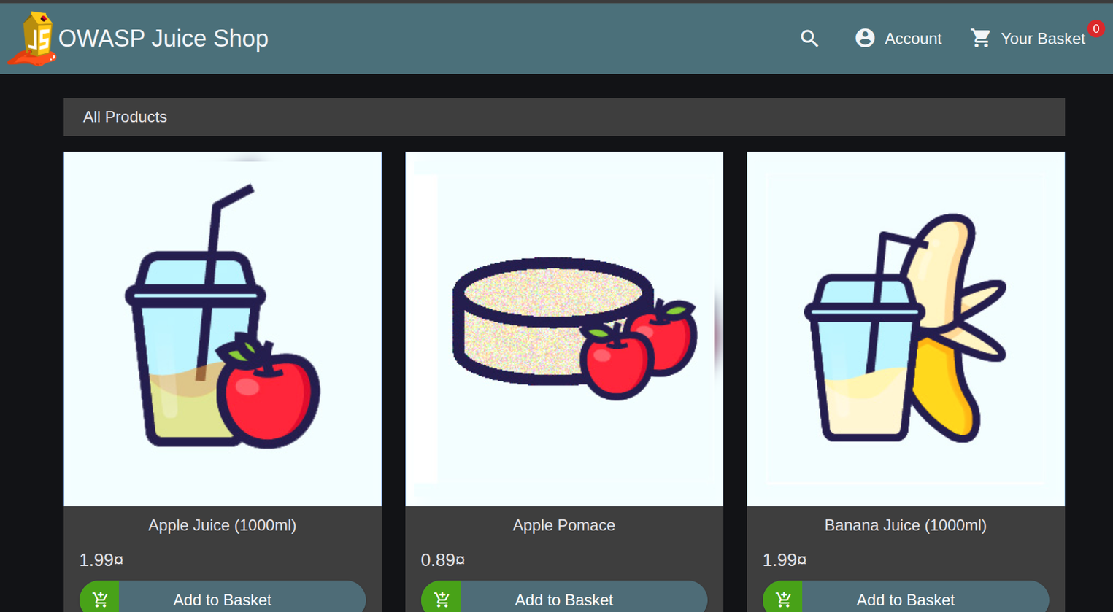
Case 1
As a target application for the security analysis, the intentionally vulnerable repository OWASP Juice Shop was selected.
Since it is a quite big repository with many intentional vulnerabilities i decided to focus only on an SQLi challenge

Slide 4
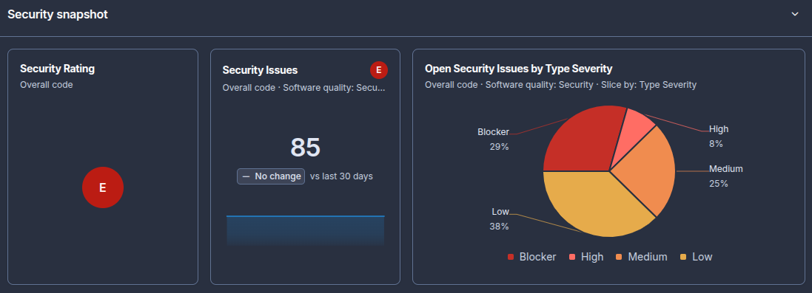
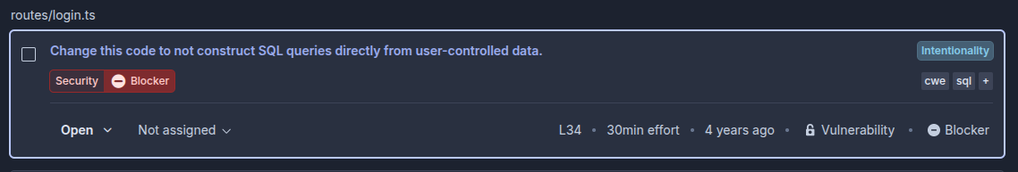
Case 1.1: Sonarcloud Analysis
As expected many Security Issues were found,
Example SQL vulnerability:

Slide 5
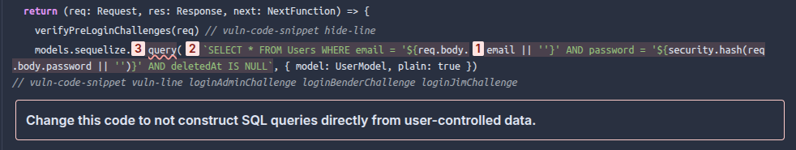
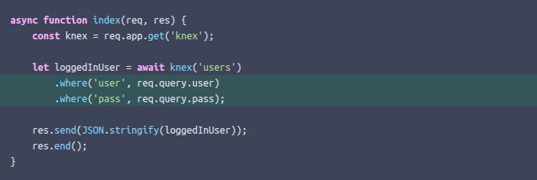
Case 1.2: Vulneravle Code Example
Proposed solution template from sonarcloud:

Slide 6
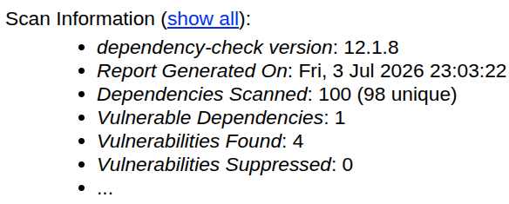
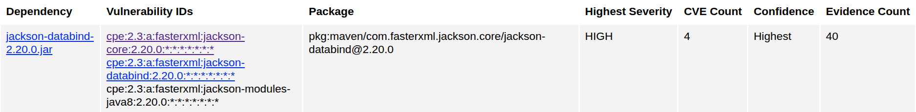
Case 1.3: Dependencies Analysis
HIGH Severity
Dependency analysis identified vulnerable versions of the Jackson Databind library. The detected version (2.20.0) is associated with multiple known CVEs classified with HIGH severity.

Slide 7
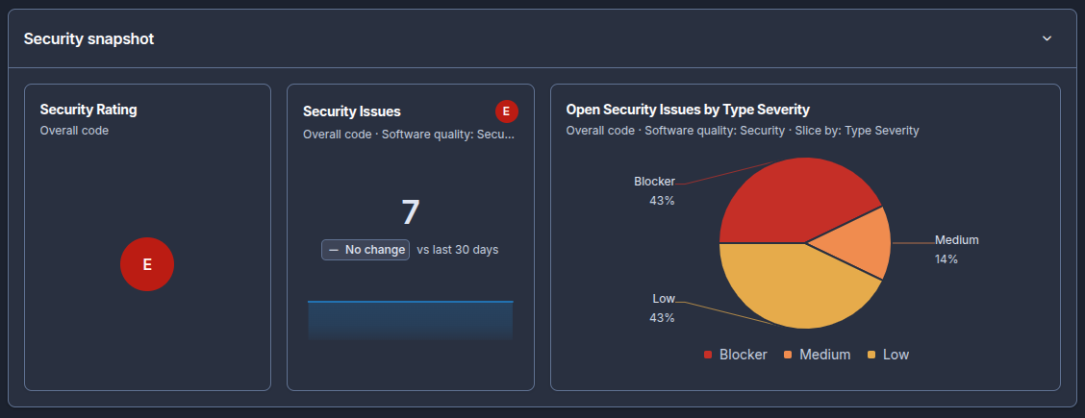
Case 2
As repository without known vulnerabilities my Web Application Programming Project was chosen: https://github.com/PasqualiniGabriele/WebApplicationProgramming-Project.
It is a website for sport fields booking and for tournament organization.
Analysis with sonarcloud:
All 3 vulnerabilities found with “Blocker” severity are associated with user input validation

Slide 8
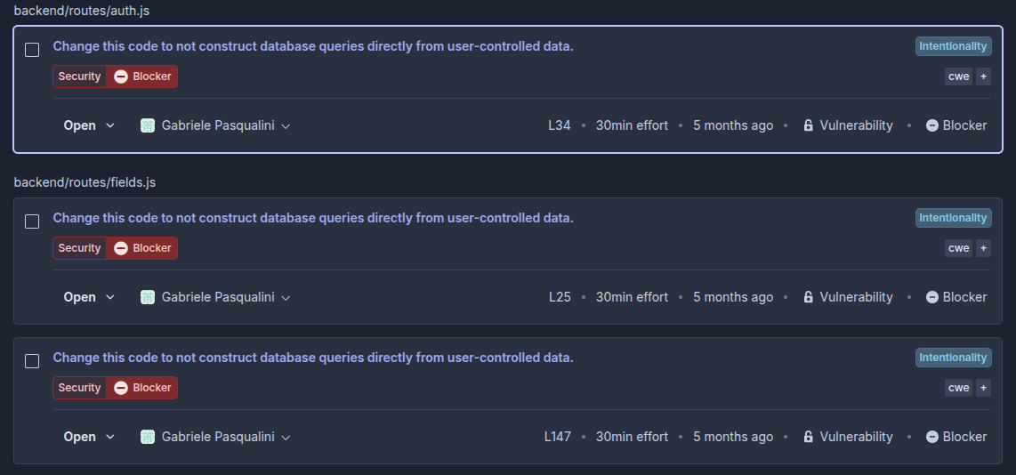
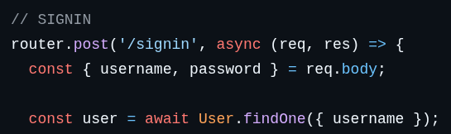
Case 2.1: Code
Responsible code:
This can lead to a NoSQL Injection vulnerability if an attacker sends a crafted object instead of a normal string, for example using MongoDB operators such as $ne or $gt.
Solution:
The vulnerability was mitigated by validating and sanitizing user input before executing the database query, ensuring that username and password are treated only as strings and rejecting invalid or malformed data to prevent NoSQL injection attacks.

Slide 9
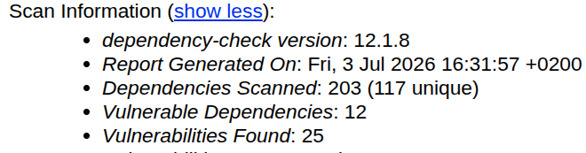
Case 2.2: Dependencies
OWASP dependency-check tool output:
The analysis of the dependencies highlighted multiple outdated libraries, and for each of those it is sufficient to perform an update.

