Slide 1
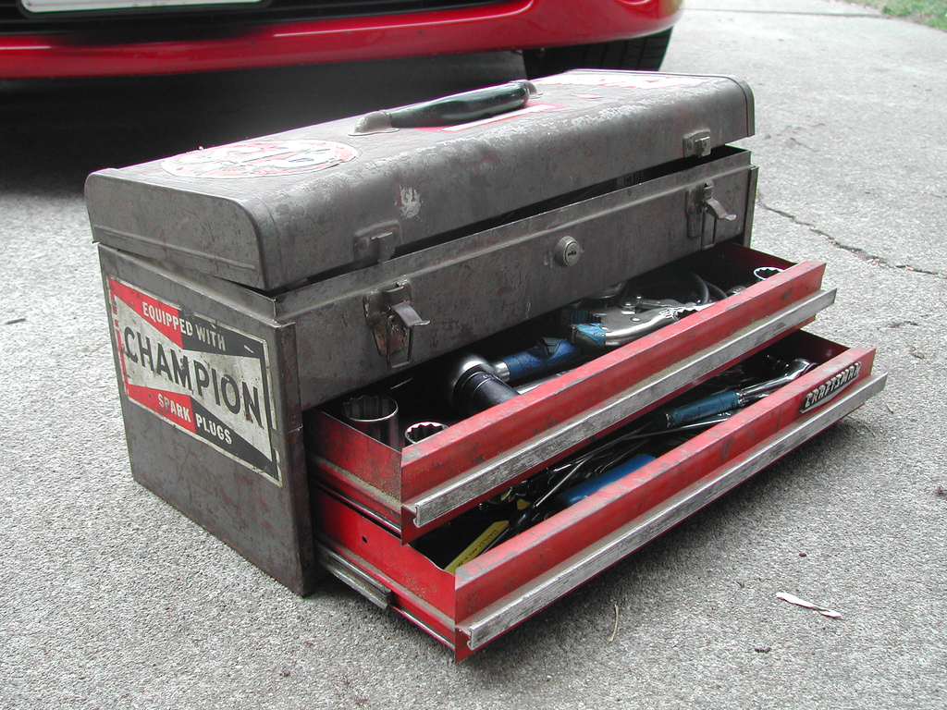
Making Your Emergency Toolkit
Notes:
Main title, let’s do this!

Slide 2
WHO’S THIS?
Rich Benner
SQL Server Performance Specialist
10 Years Experience
richbenner.com/toolkit
rich@richbenner.com
‘SQL Server Community’ Slack Channel - @richbenner

Slide 3
WHY AM I HERE?
You’re the main line of defense against poorly SQL Servers.
You don’t have time to waste.
You may not have a lot of SQL Server knowledge, but it’s your problem now.

Slide 4
LET’S MAKE A TOOLKIT
A set of scripts that you can use to diagnose problems
Keep it up to date
Make sure you know how they work

Slide 5
COMMUNITY TOOLS
Scripts available on Blogs
sp_WhoIsActive
First Responder Kit
Diagnostic Information Queries

Slide 6
PRIORITIES, PRIORITIES
The server is melting and you need to fix it NOW
Major outage or performance issue
Slower than it is usually

Slide 7
DIAGNOSTICS
Database Settings
Hardware
Software
Current Activity
sp_WhoIsActive
sp_BlitzFirst
Wait Stats
Disk Performance

Slide 8
BASICS
Script 1 - Environment.sql
Check what you’re working with
Machine/Instance Name
Product Version/Edition/Patch Level
Is Clustered or in an Availability Group
Server Uptime
CPU
Memory

Slide 9
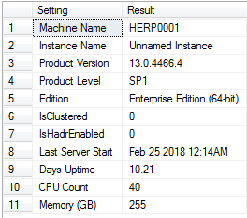
ENVIRONMENT.SQL RESULTS
Anything out of the ordinary?

Slide 10
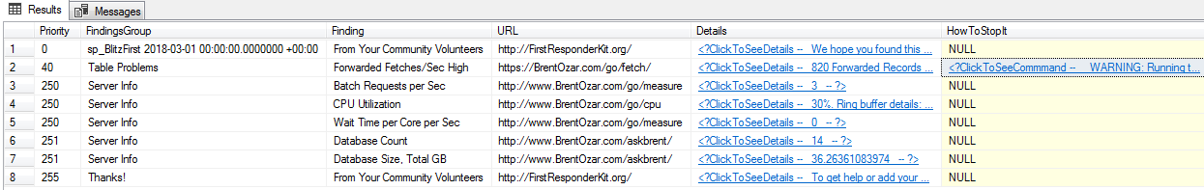
IMMEDIATE PROBLEMS
sp_BlitzFirst (requires sp_BlitzCache)
EXEC dbo.sp_BlitzFirst
Prioritised output, the higher on your list the more urgent it probably is
Notes:
@expertmode = 1 for advanced diagnostics

Slide 11
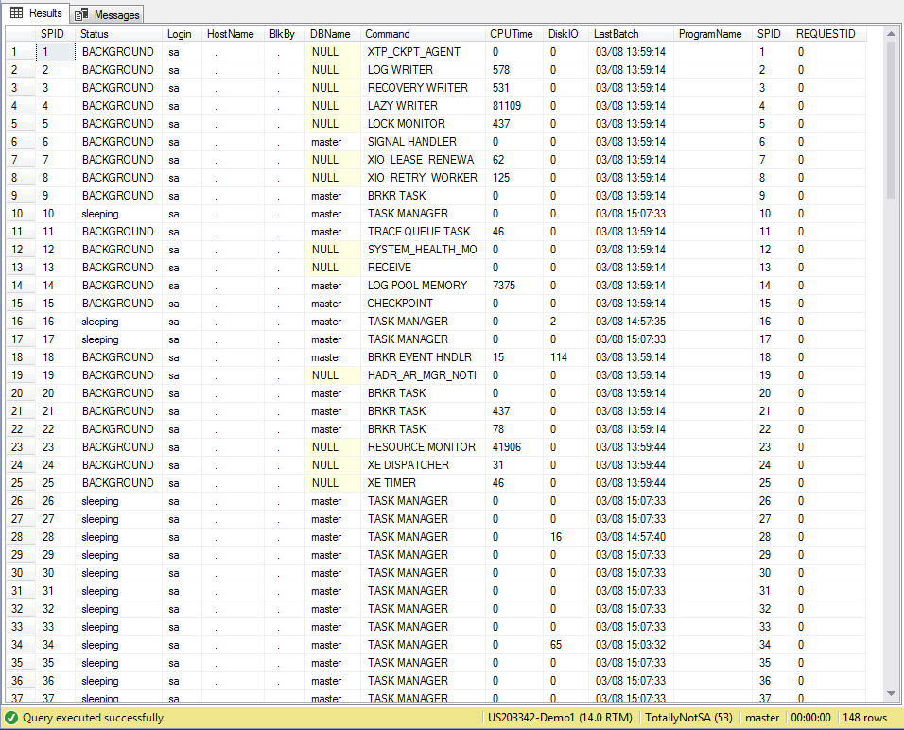
ACTIVE QUERIES – SP_WHO2
sp_who2

Slide 12
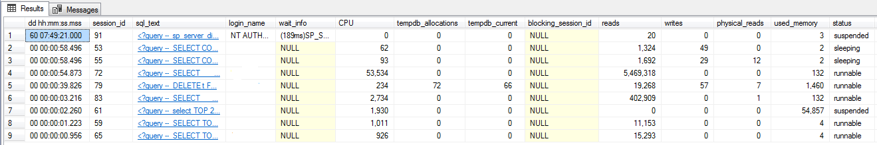
ACTIVE QUERIES
sp_WhoIsActive

Slide 13
WAIT STATS QUERY
Written by Paul S. Randal at SQLSkills.com
https://www.sqlskills.com/blogs/paul/capturing-wait-statistics-period-time/
Default is 30 minutes, for the toolkit change this to 30 seconds.

Slide 14
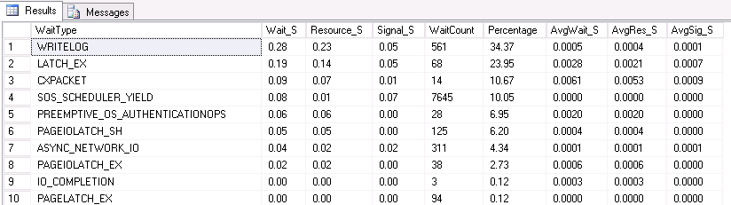
WAIT STAT ANALYSIS
https://www.sqlskills.com/help/waits/

Slide 15
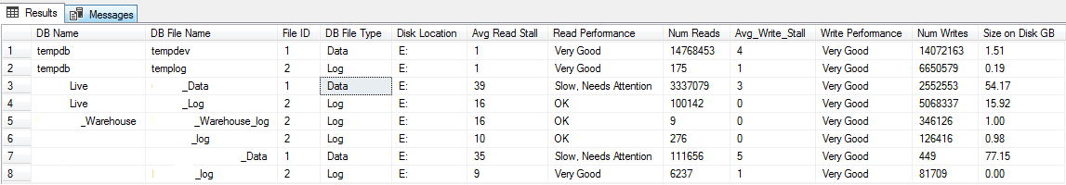
DISK PERFORMANCE
SSD’s are cheap
Spinning Rust is slow
Is network speed an issue?
Disk performance can cause lots of issues
Disk_Speed_Check.sql – Adapted from David Pless
Notes:
Demo?

Slide 16
BINGO!
Browsing the internet on the SQL Server to bypass content filters | “It’s using lots of Memory” | Fiddler left running on the server | Network Guy: “It’s definitely the database’s fault” (spoiler: it wasn’t) | “Why can’t we build this in MS Access?”
Stacked SQL Instances | Spinning Disks | Where’s SSMS? Client running SQL 2000… | Percentage File Growth Stats | “It’s thrown an error” (error not included)
It’s Oracle… | “It was running slow so I rebooted it” | Playing Games on the SQL Server | Mining Bitcoin on the Server | Developer leaves transaction open and locks the database
“It’s just Slow” | Developer Edition in Production | Using server to Torrent | “Can I get sysadmin to production?” | Default MAXDOP/Cost Threshold for Parallelism
Hosting personal website on company server | Auto Shrink on | “It doesn’t need that much memory does it?” | “Why do you keep ignoring my emails?” | “You’re the DBA Right? Well, I’ve got this MySQL database…”

Slide 17
THANK YOU
richbenner.com/toolkit
Any Other Questions

