Slide 1
BIOWEB Site
Names | ID’s
Ahmed Abd El-Samie | 20198005
Yussuf Mahmoud | 20198104
Passant Mohamed | 20198018
Eslam Hossny | 20198010
Ala’a Ahmed | 20198011

Slide 2
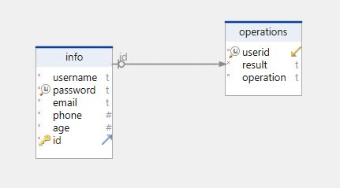
Database Schema 1

Slide 3
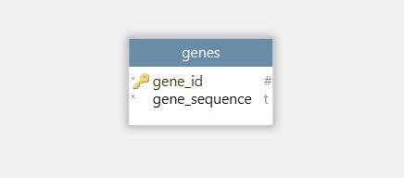
Database Schema 2

Slide 4
Our Biological functions

Slide 5
GC Content
GC-content:
is the percentage of nitrogenous bases in a DNA or RNA molecule that are either guanine (G) or cytosine (C).
It is calculated as : (Count(G + C)/(length of(sequence) – count(nbases))) * 100%.

Slide 6
Complement
Complement:
The complement of a DNA sequence is formed interchanging A and T and interchanging C and G and vise
versa.
Thus the complement of ACTG is TCAC.

Slide 7
Reversed Complement
Reverse Complement:
The complement of a DNA sequence is formed interchanging A and T and interchanging C and G and vise
versa then Reverse it.
Thus the complement of ACTG is TGAC then after reversed CAGT .

Slide 8
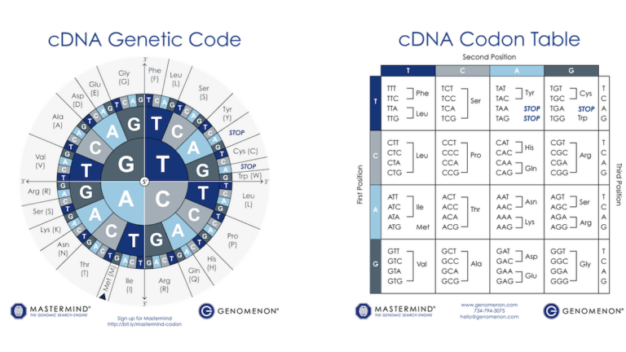
Protein Translation
Protein Translation:
It means translation of RNA string into Amino Acid string but in coding we took DNA so instead of each U
we make T if the user enter RNA string , also when we find a stop codon we break.

Slide 9
Nbases filter
Nbases filter:
It removed all unknown nucleotides in sequence “N”.
Thus Sequence is ANACGTNT it will be AACGTT.

Slide 10
Transcription From DNA TO RNA
Transcription:
It is change of DNA to mRNA by RNA polymerase where Complement of A will be U.
A DNA sequence ACGGGTAAGG will be transcribed into UGCCCAUUCC.

Slide 11
Convert from RNA to DNA
RNA to DNA:
It converts an RNA sequence to a DNA sequence by converting any uracil nucleotides (U) in the RNA
sequence to thymine nucleotides (T).
Thus RNA sequence is ACUGUUA it will be in DNA ACTGTTA.

Slide 12
Our WEBSITE

Slide 13
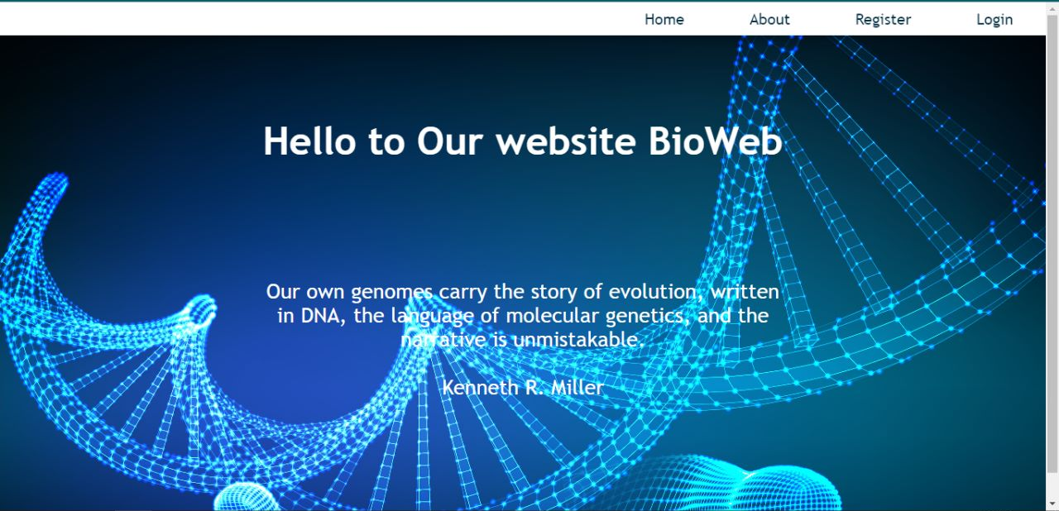
Home

Slide 14
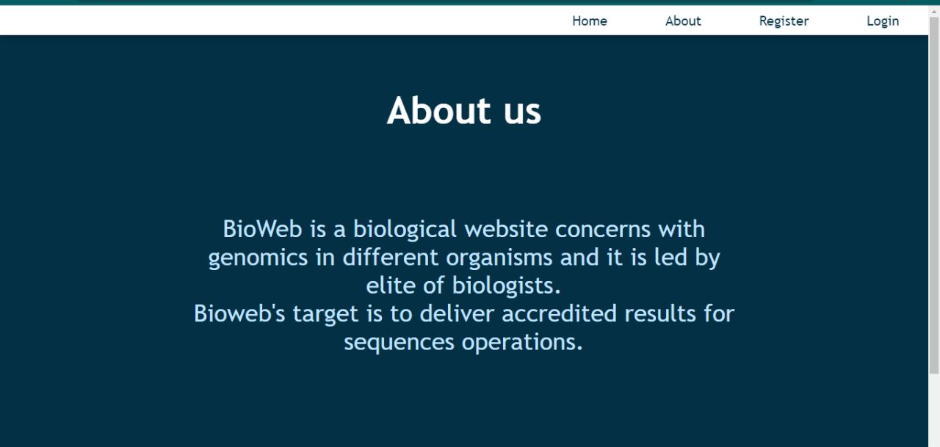
About

Slide 15
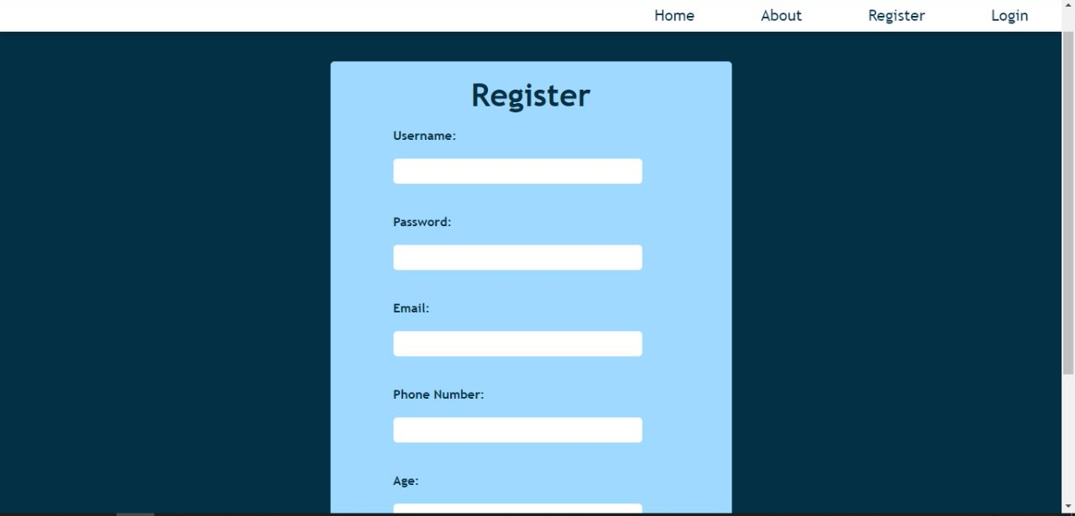
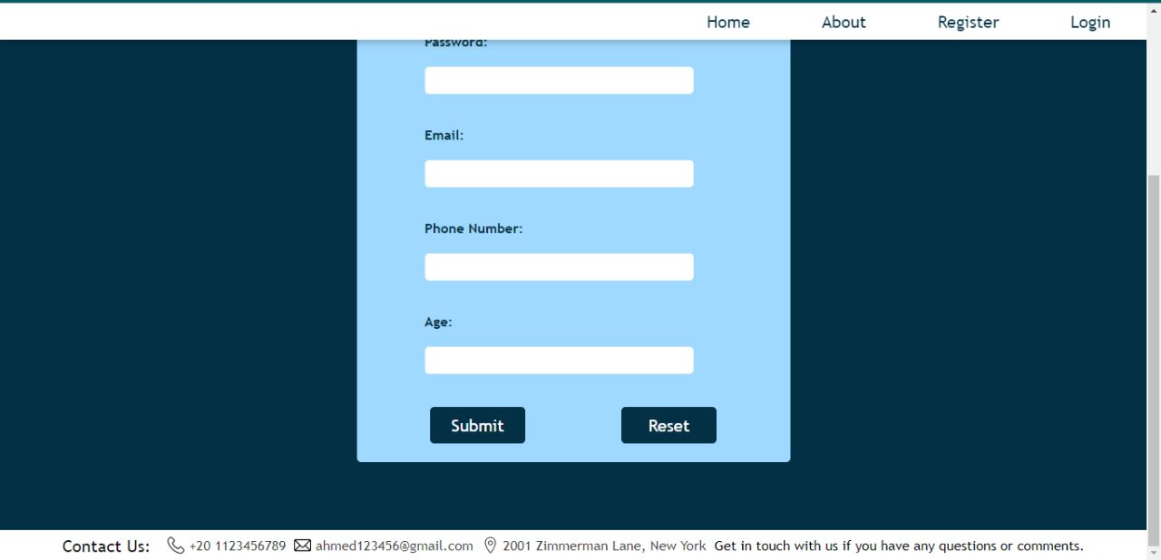
Register Form

Slide 16
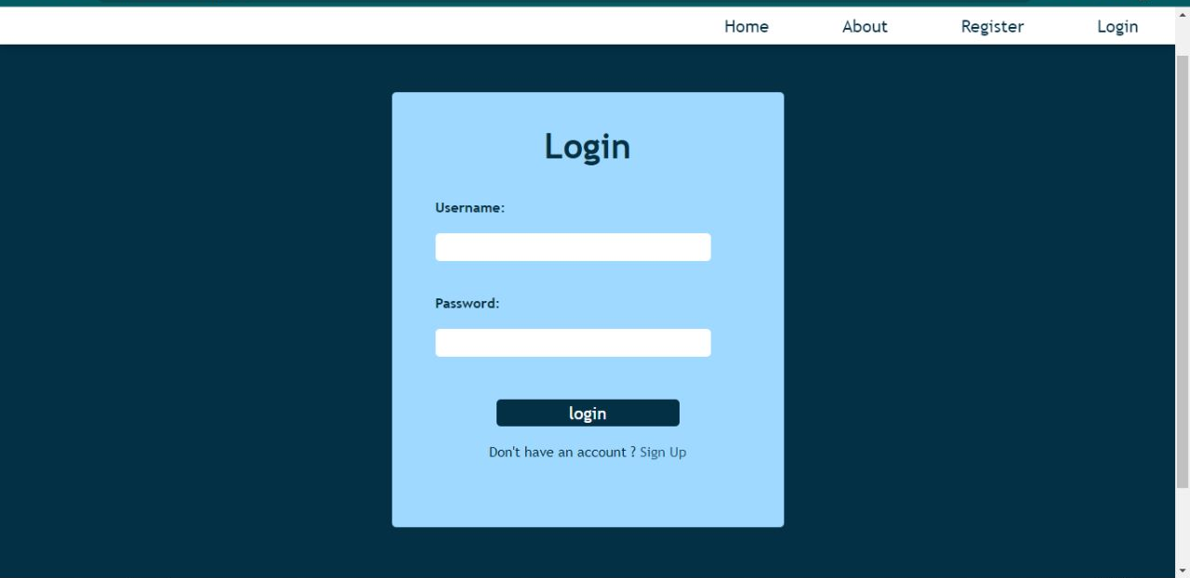
Login Form

Slide 17
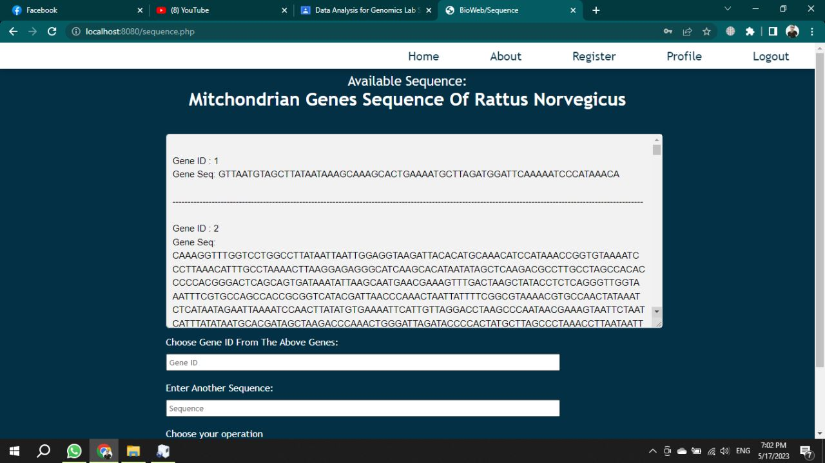
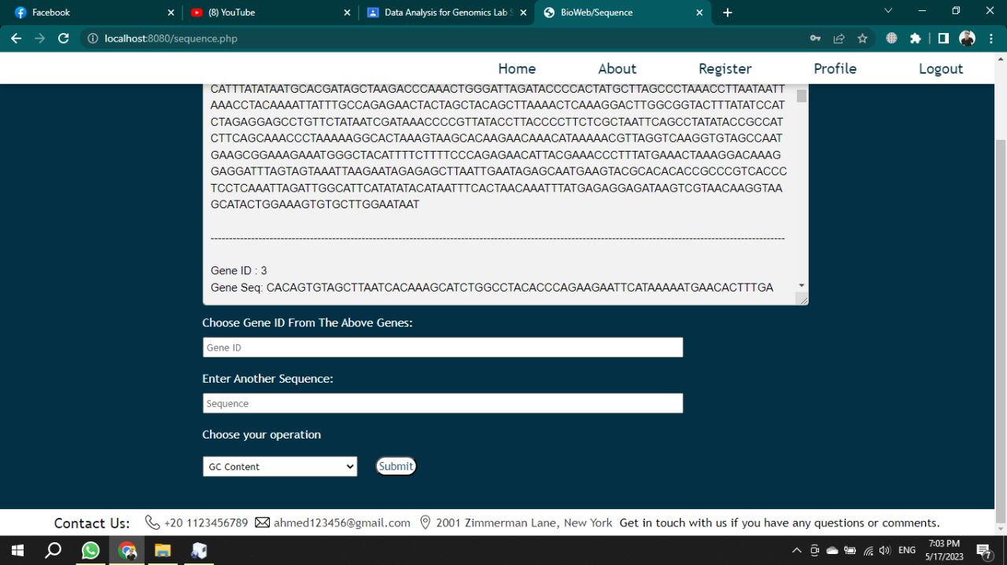
Applying Operations

Slide 18
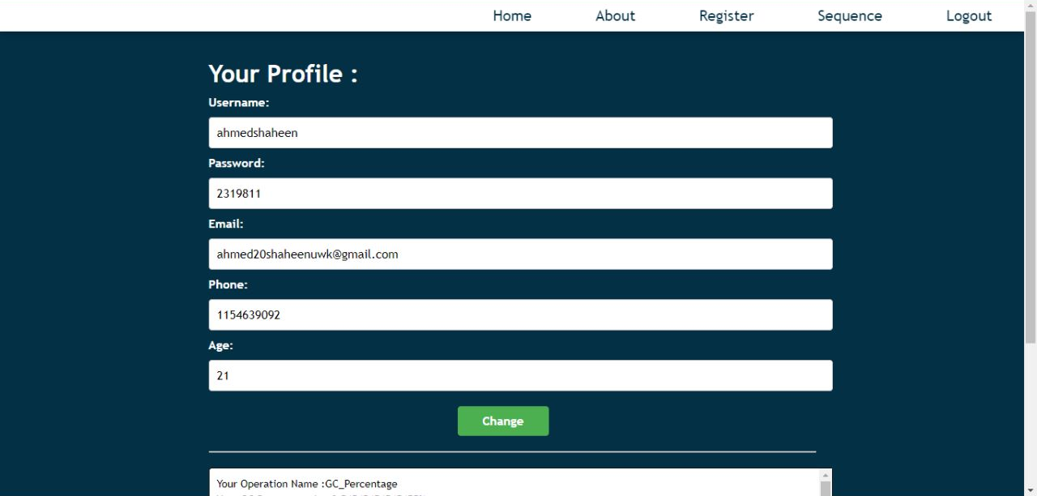
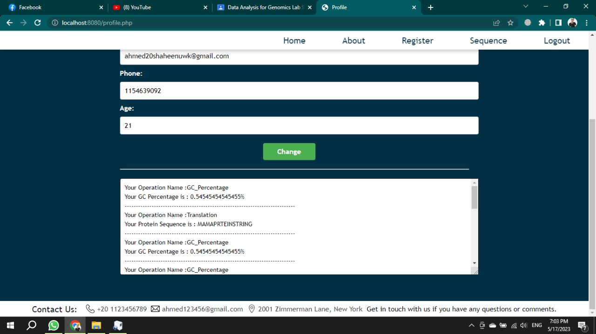
Profile

Slide 19
Thank You

