Slide 1
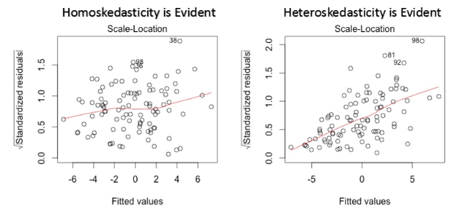
Selecting the Right Features for Your Model
Test 1 2023-04-26
Input data of power plant, and implement a program to test the following three assumptions in regression analysis of the power plant data.
(1) Autocorrelation (Hint: Durbin – Watson statistic)
(2) The error terms must have constant variance.
(3) The error terms must be normally distributed (Hint: by QQ test )
Output
DW value for each factor
The standardized residual values vs fitted values plot
The QQ plot
https://www.statology.org/standardized-residuals/
資料來源：https://www.analyticsvidhya.com/blog/2016/07/deeper-regression-analysis-assumptions-plots-solutions/

