Slide 1
Homework 2

Slide 2
Data visualization
Data visualization is viewed by many disciplines as a modern equivalent of visual communication.
A primary goal of data visualization is to communicate information clearly and efficiently via statistical graphics, plots and information graphics. Numerical data may be encoded using dots, lines, or bars, to visually communicate a quantitative message.
Effective visualization helps users analyze and reason about data and evidence.
In this homework, you should use Shiny and Plotly package to implement it.

Slide 3
Homework 2
Score :
Use Rshiny 20%
Use Plotly 15%
Merge Data 15%
At least 2 datasets
Interactively UI 20%
At least 3 user selection, such as textInput, ButtonInput and so on.
Data visualization 20%
At least 3 charts, such as line chart, pie chart and so on.
Innovative service 30%
Note :
You can’t use the examples or exercises in PPT as the homework.

Slide 4
Deadline
Deadline
2022/05/12 23:59
Submit
Portal
Filename
s+SID_HW2.zip
e.g : s1001234_HW2.zip
included server.r, ui.r, global.r, and others files

Slide 5
Bonus
Bonus 1 : Top 10% submit
Note : Score > 90
Bonus 2 : Real time data visualization or save datasets in your database
Please provide SQL schema
SQL structure
SQL content

Slide 6
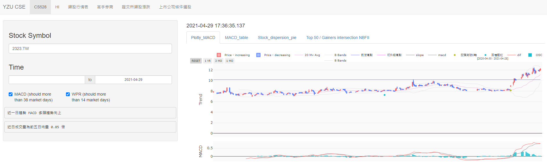
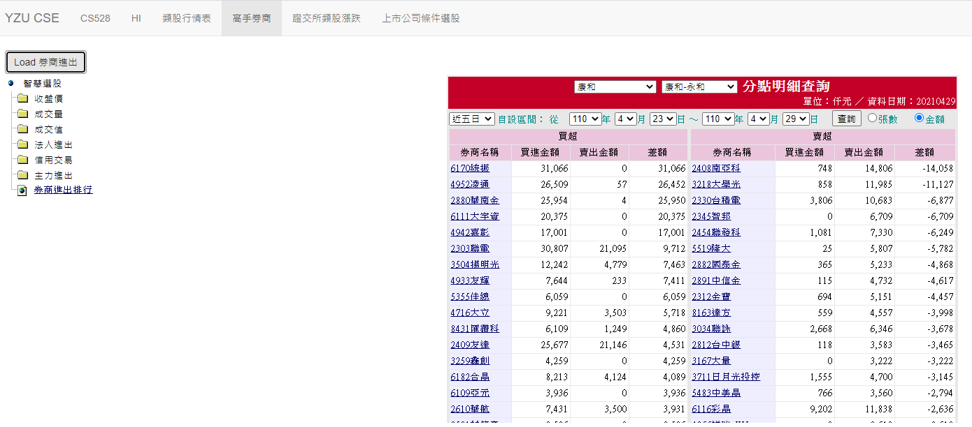
Example

Slide 7
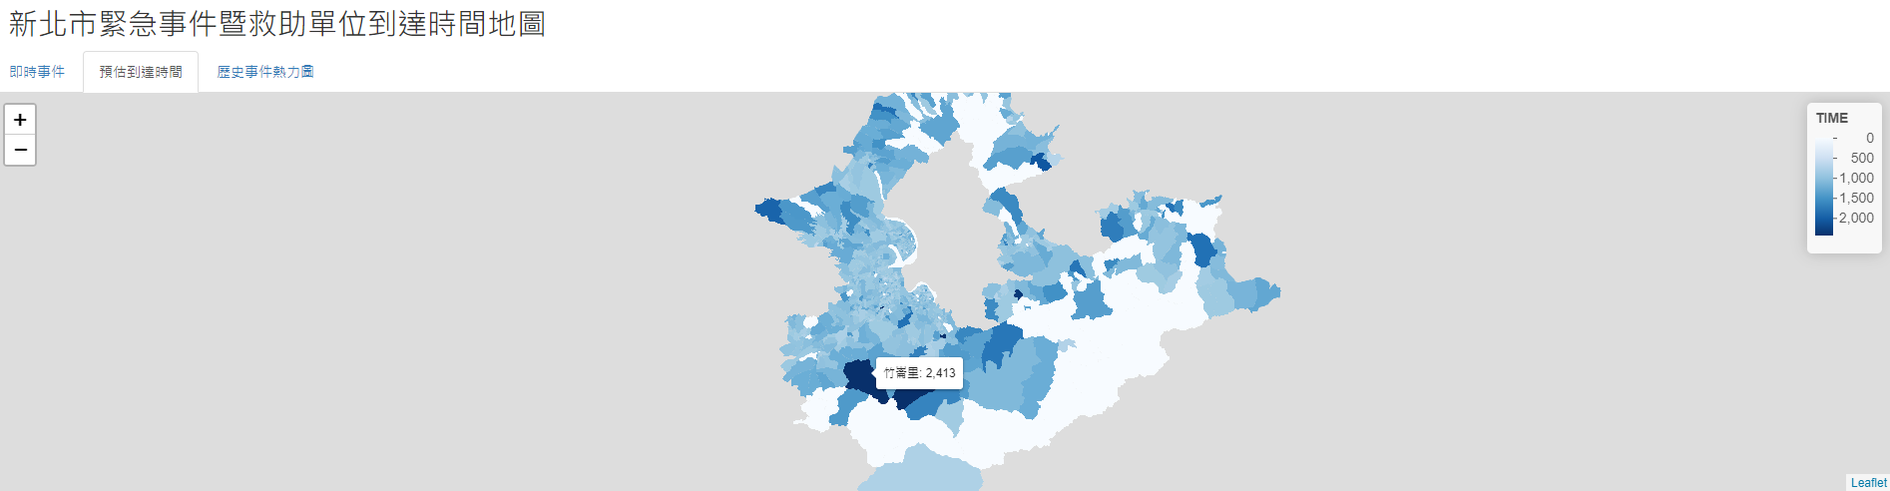
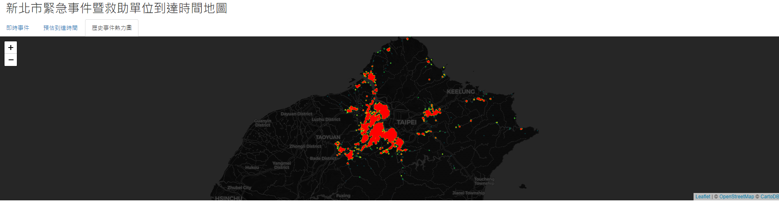
Example

Slide 8
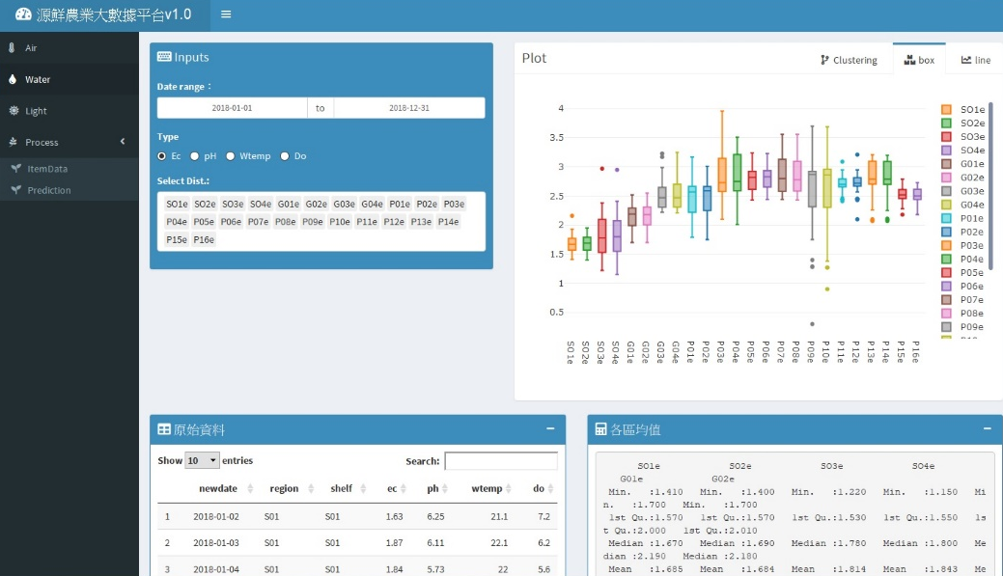
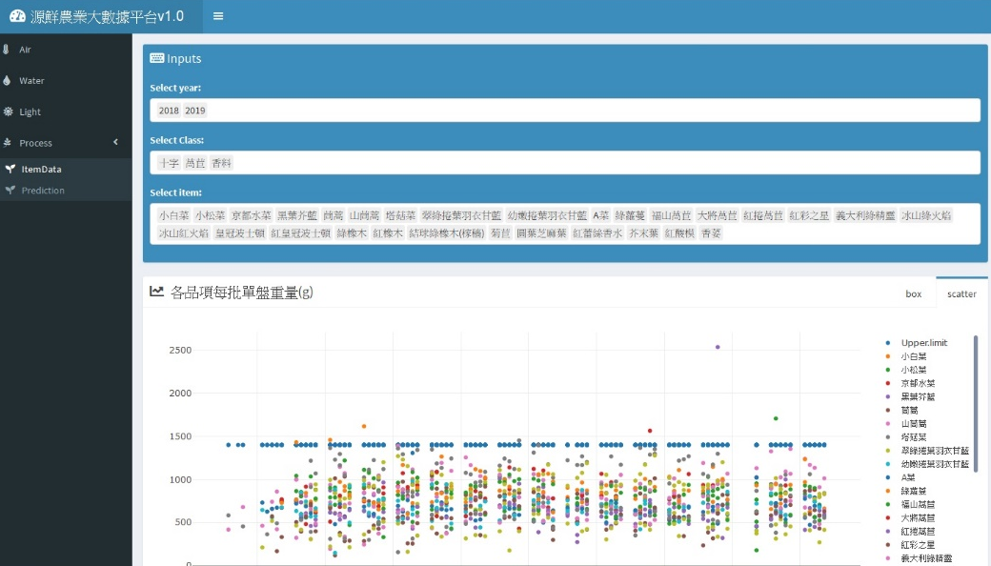
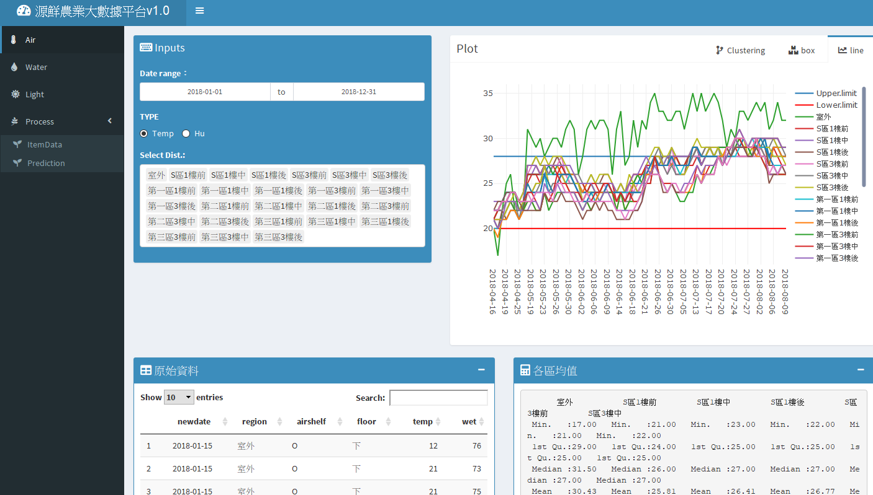
Example

Slide 9
Q&A

