Slide 1
Homework 1

Slide 2
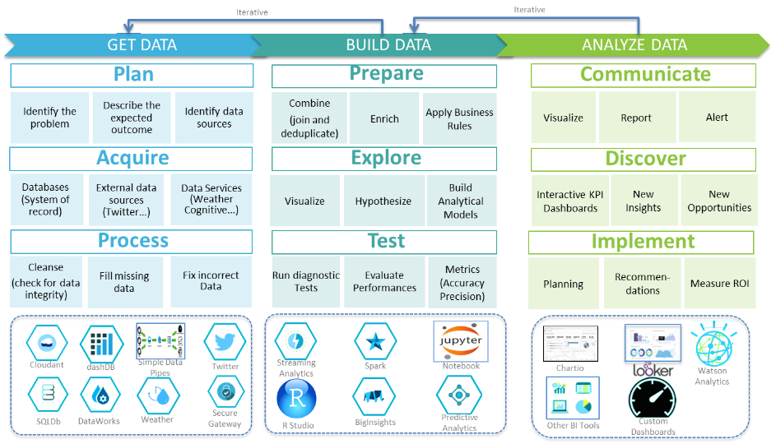
Data Preprocessing

Slide 3
Homework 1
Subject :
Data Preprocessing
Description
The raw data are often loosely controlled, resulting in out-of-range values, missing values, etc. The data preprocessing is an important step in the data mining process to quality of data. In this homework, you need to use R programming language to implement this process.
Data:
HW1.csv
https://drive.google.com/file/d/1WWrDamqW2rrFFJPTrmv1WVi-83hk9bW3/view?usp=sharing

Slide 4
Homework 1
請以論文格式撰寫書面資料
https://www.yzu.edu.tw/admin/aa/index.php/tw/2016-01-14-06-58-46/2017-04-13-06-25-12/98-2016-03-23-06-06-30
內容須包含處理目的、處理流程、處理方法 (方法無限制)
例如：Missing Value、Out-of-Range…

Slide 5
Homework 1
Score
書面資料 60%
程式碼 40%

Slide 6
Deadline
Deadline
2022/04/07 23:59
Submit
Portal
Filename
s+SID_HW1.zip
e.g : s1001234_HW1.zip
包含 pdf, r scrpit

Slide 7
Bonus
Bonus 1 : Top 10% submit
Note : Score > 90

