Slide 1
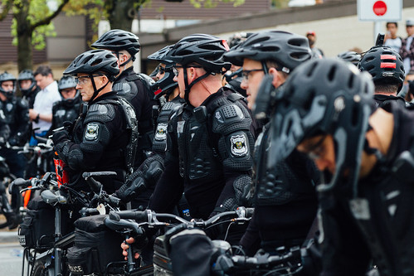
Terry Stops Traffic By Pascalia Maiga
Project Overview
Terry Stops, based on reasonable suspicion, should not use race as the sole justification to avoid discrimination and constitutional rights violations.
Investigative detention, established in Terry v. Ohio, has been widely analyzed and critiqued.
The inclusion of perceived race in these stops has fueled debates on racial profiling and bias. Law enforcement must train officers to base stops on reasonable suspicion, not race alone.

Slide 2
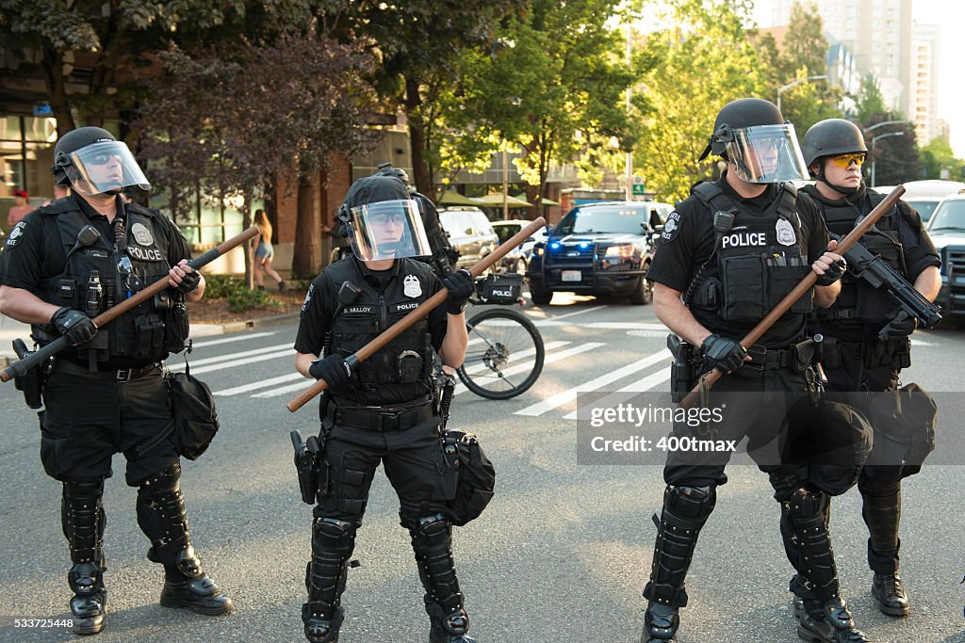
Business Understanding.
The objective of this project is to develop a predictive model that aids law enforcement agencies in making well-informed decisions during Terry Stops.
By leveraging information on various factors such as the presence of weapons, the timing of the stop, and the gender and race of both the officer and the subject, the classifier can assist officers in gauging the likelihood of an arrest.
This initiative aims to enhance the efficiency and impartiality of law enforcement actions, potentially mitigating instances of false arrests and misconduct.

Slide 3


My data represents records of police reported stops under Terry v. Ohio, 392 U.S. 1 (1968). Each row represents a unique stop. Data provided by City of Seattle and Dataset Owner spd2internetData There are 54.9K rows and 23 Columns
Descriptive Exploration
I described the data set in terms of shape and the data types for all the columns present.
Data Cleaning
I Identified and corrected inaccuracies, inconsistencies, and irrelevant data from a dataset. These were the steps; handling missing values, removing duplicates, correcting data format, transforming variables to make the data ready for modelling and predictions.
Exploratory Descriptive Analysis (EDA)
The dataset had an additional columns, during data processing I featured engineered columns to help in better understanding of any underlying patterns that would help make better predictions.
Pre-processing Data
Encoding Categorical Features
Training and Testing Split
Test and train split was on test at 20% of the data. More data given to training data set to ensure the model get all the patterns and perform better
Standardization
Standardizes the features by removing the mean and scaling to unit variance.

Slide 4

Modelling
These are the algorithms that I used in my modelling:
* Logistic Regression - baseline
* Random Forest Classifier
* Support Vector Machine
Logistic Regression - baseline Model
Cross validation scores: 84.7402
The baseline model was correct 84.74 % most of the time in its classification.
Random Forest Classifier
rfc_model Accuracy: 84.5305
The Random Forest classifier was correct 84% in its classification most of the time.
Support Vector Machine
Cross validation scores: [0.8573382 0.84639927 0.83956244 0.83956244 0.83409298]
The SVC model was correct 84.34% most of the time

Slide 5
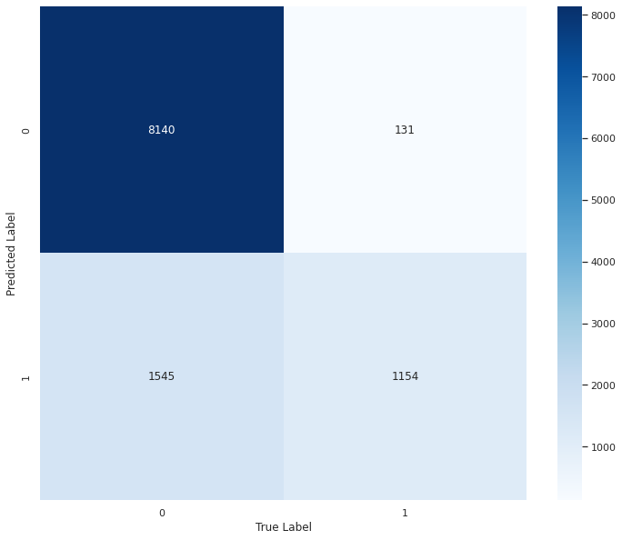
Model Evaluation
I evaluated the model performance using accuracy, precision, recall, and F1-score. The results are stored in a Pandas data frame and returned.
And by the use of confusion matrix these were the results:
* 851 observations were correctly predicted as 0 (True Negatives)
* 358 observations were incorrectly predicted as 1 (False Positives)
* 1142 observations were incorrectly predicted as 0 (False Negatives)
* 1619 observations were correctly predicted as 1 (True Positives)

Slide 6
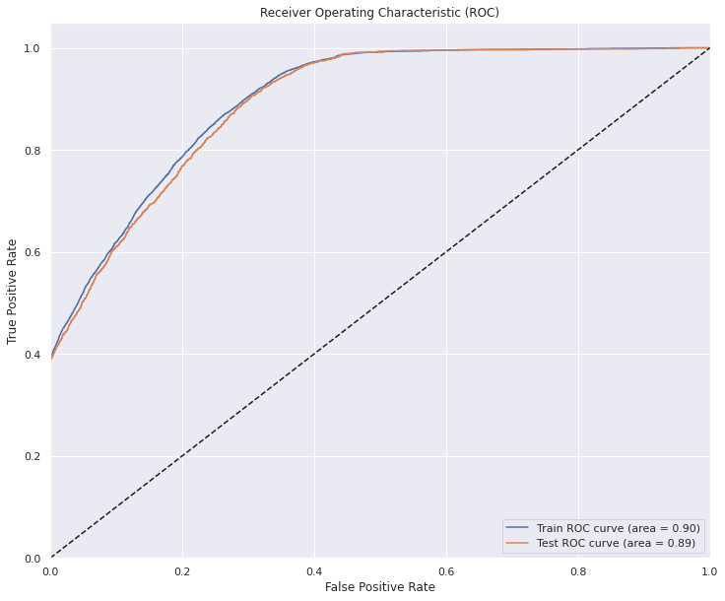
Model Performance
To help improve the model performance, I did introduce the roc_curve which indeed confirmed that
most of the prediction the model made were correct, the true positivity rate was high.

Slide 7
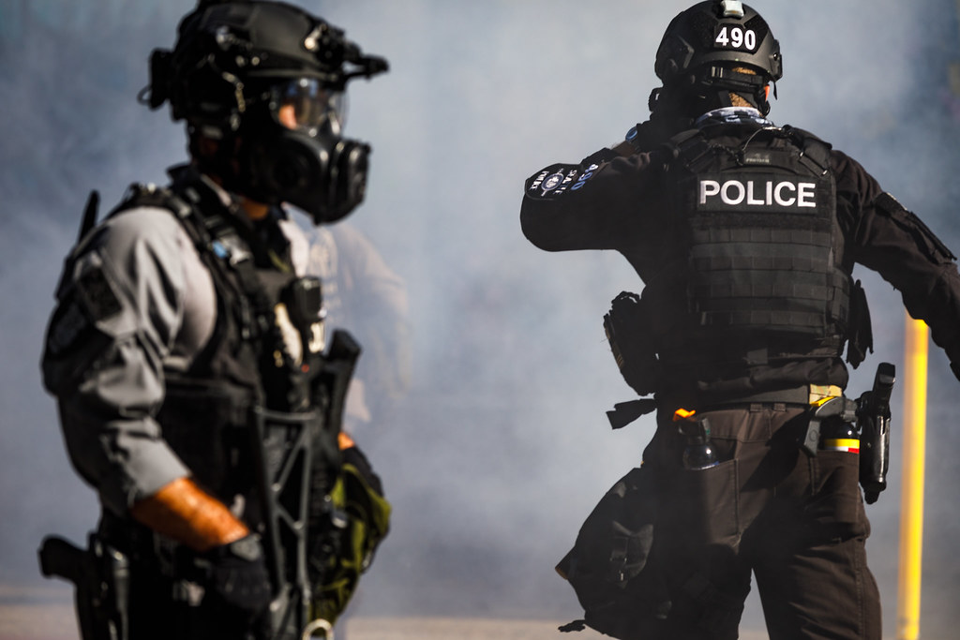
Conclusion
The project results demonstrate that machine learning models can effectively analyze Terry stop data to predict resolution arrests.
The model has successfully identified the key features for making predictions, providing valuable insights for policymakers and law enforcement agencies.
However, it is crucial to recognize that this is just one aspect of the overall analysis, and further investigation may be necessary to gain a more comprehensive understanding of the data.
Recommendation.
Train officers on the appropriate circumstances for making arrests during Terry Stops, as this is a key factor in predicting arrests.
Ensure that the officer's precinct is captured for all Terry Stops to enhance arrest prediction accuracy.
Additionally, train officers on the appropriate situations for conducting frisks, another significant predictor of arrests.

