Slide 1
Recommender System
I160164 – Usman Ali
I170130 – Abubakr Idrees

Slide 2
Contents
Dataset
Sparse Matrix
Item Based Collaboration
Output

Slide 3
Dataset
Movielens 100k
Used u.data, u.item files
Saved headers
user_id', 'item_id', 'rating', 'timestamp’
'item_id', 'title', 'release_date', 'video_release_date', 'imdb_url'
Notes:
User id corresponds to a user
Item id corresponds to a movie id
Title corresponds to a movie title on the id

Slide 4
Edited file
1683|The Dark Knight (2008)|18-Jul-2008||https://www.imdb.com/title/tt0468569/?pf_rd_m=A2FGELUUNOQJNL&pf_rd_p=e31d89dd-322d-4646-8962-327b42fe94b1&pf_rd_r=1D35RE7W25B8DKKY2DJ2&pf_rd_s=center-1&pf_rd_t=15506&pf_rd_i=top&ref_=chttp_tt_4|0|1|0|0|0|0|1|0|1|0|0|0|0|0|0|0|0|0|0
1684|Avengers: Infinity War (2018)|27-Apr-2018||https://www.imdb.com/title/tt4154756/?pf_rd_m=A2FGELUUNOQJNL&pf_rd_p=e31d89dd-322d-4646-8962-327b42fe94b1&pf_rd_r=1D35RE7W25B8DKKY2DJ2&pf_rd_s=center-1&pf_rd_t=15506&pf_rd_i=top&ref_=chttp_tt_64|0|1|1|0|0|0|0|0|0|0|0|0|0|0|0|1|0|0|0
1685|Logan (2017)|03-Mar-2017||https://www.imdb.com/title/tt3315342/?pf_rd_m=A2FGELUUNOQJNL&pf_rd_p=e31d89dd-322d-4646-8962-327b42fe94b1&pf_rd_r=1D35RE7W25B8DKKY2DJ2&pf_rd_s=center-1&pf_rd_t=15506&pf_rd_i=top&ref_=chttp_tt_219|0|1|0|0|0|0|0|0|1|0|0|0|0|0|0|1|0|0|0
1686|Interstellar (2014)|07-Nov-2014||https://www.imdb.com/title/tt0816692/?pf_rd_m=A2FGELUUNOQJNL&pf_rd_p=e31d89dd-322d-4646-8962-327b42fe94b1&pf_rd_r=K2MY6399FNBWCGEN8HM6&pf_rd_s=center-1&pf_rd_t=15506&pf_rd_i=top&ref_=chttp_tt_28|0|0|1|0|0|0|0|0|1|0|0|0|0|0|0|1|0|0|0
1687|The Wolf of Wall Street (2013)|25-Dec-2013||https://www.imdb.com/title/tt0993846/?pf_rd_m=A2FGELUUNOQJNL&pf_rd_p=e31d89dd-322d-4646-8962-327b42fe94b1&pf_rd_r=K2MY6399FNBWCGEN8HM6&pf_rd_s=center-1&pf_rd_t=15506&pf_rd_i=top&ref_=chttp_tt_140|0|0|0|0|0|0|1|0|1|0|0|0|0|0|0|0|0|0|0

Slide 5
Sparse Matrix
Sparse matrices come up in some specific types of data, most notably observations that record the occurrence or count of an activity.
Three common examples include:
One-hot encoding,
Count encoding, used to represent the frequency of words in a vocabulary for a document
TF-IDF encoding, normalized word frequency scores.

Slide 6
Compressed Sparse Row
The sparse matrix is represented using three one-dimensional arrays for the non-zero values, the extents of the rows, and the column indexes

Slide 7
Item Collaboration
KNN
Pros:
Simplistic algorithm — uses only value of K and the distance function

Slide 8
Cosine similarity:
This distance metric is used mainly to calculate similarity between two vectors. When used with KNN this distance gives us a new perspective to a business problem and lets us find some hidden information in the data
Notes:
Used to identify similarity in texts,
Bad ways to do it, Euclidean distance, Manhattan distance hamming distance

Slide 9
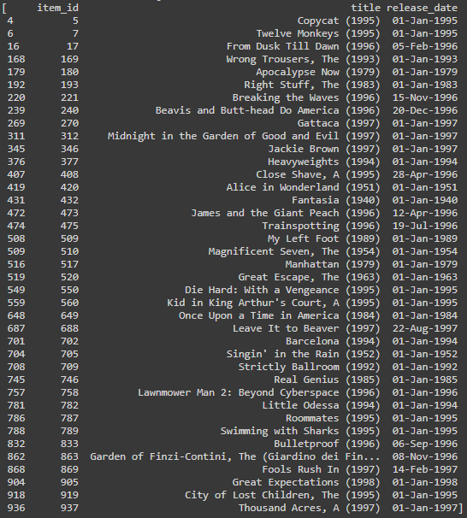
Output
For user 3

Slide 10
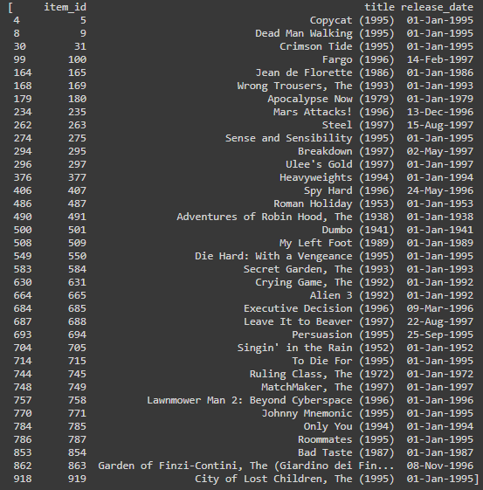
Output
For user 3

