Slide 1
COMPILER DESIGN · CAPSTONE PROJECT REVIEW
RUST LOOP
VECTORIZER
FOR LLVM 21
A Correctness-First Automatic SIMD Pass with Microsecond Latency
Formal data-dependence proofs, deterministic profitability planning, and zero-overhead SIMD codegen.
PASS MANAGER
CORE ENGINE
INTERACTION
GEOMEAN SPEEDUP
LLVM 21 New PM
Safe Rust Core
Ratatui TUI
3.009x
Notes:
Welcome committee members. Today we present our Rust Loop Vectorizer for LLVM 21: a production-grade, correctness-first auto-vectorization pass that couples formal dependence proofs with microsecond compilation latency.

Slide 2
THE VECTORIZATION DILEMMA
Vectorization is a proof-and-planning problem, not opcode substitution
01
02
03
04
CHALLENGE
LEGALITY
COST MODELING
RUST + LLVM SYNERGY
C++ MONOLITHS
MEMORY PROOFS
VECTOR TAX
RUST + LLVM
Traditional C++ LLVM passes are monolithic, prone to memory unsafety, and complex to reason about.
Prove memory independence without quadratic compilation slowdowns.
Avoid the “vectorization tax” where SIMD setup and remainder overheads exceed savings.
Memory safety and zero-cost abstractions in a production pass. A fail-closed LLVM 21 plugin in Rust, separating invariant analysis from IR mutation.
02
Notes:
Many view vectorization as merely emitting packed instructions. In practice, the compiler must solve two distinct problems before touching IR: proving absolute memory safety, and ensuring profitability so vector setup doesn't degrade performance.

Slide 3
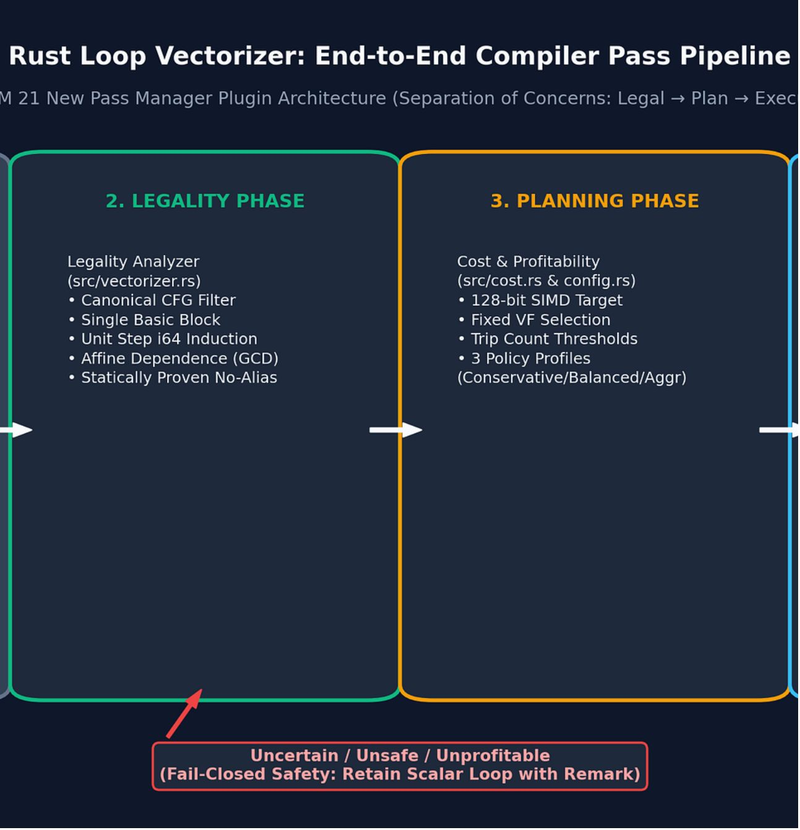
PIPELINE DECOMPOSITION
Architecture: Legal → Plan → Execute
Inspired by LLVM VPlan: safety proofs separated from IR mutations to guarantee fail-closed behavior.
01
02
PLUGIN BOUNDARY
LEGALITY
native/pass_plugin.cpp C++17 adapter with panic containment.
src/vectorizer.rs Canonical single-block loops, 0-based i64 induction, unit strides.
03
04
PLANNING
EXECUTION
src/cost.rs, config.rs Conservative, Balanced, Aggressive policies for 128-bit SIMD.
src/vectorizer.rs Vector preheader dispatch, <N x T> SIMD instructions, scalar remainder loop.
03
Notes:
Our pipeline is strictly partitioned into four steps: a crash-safe C++17 plugin boundary, an immutable Legality check, a deterministic Cost Planner, and an Execution engine that mutates LLVM IR only when full profitability is proven.

Slide 4
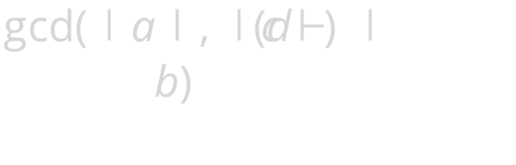
FORMAL DATA DEPENDENCE
Uncertainty is a rejection, not permission to transform
A fail-closed verification pipeline proves loop independence via Diophantine analysis before vectorization is considered.
AFFINE SUBSCRIPTS
GCD TEST
EXACT DISTANCE
ALIASING CONTRACT
Greatest common divisor equation:
Induction-derived array index normalization:
Direct slope equation resolution:
Disjoint pointer verification:
i, i + c, c + i, i - c
Distance = \Delta \neq 0
noalias | GlobalValue
All non-affine or non-unit induction references immediately abort vector analysis.
When not divisible, independence is mathematically proven for all iterations.
Any non-zero distance (flow, anti, or output dependence) triggers immediate rejection.
Unknown pointer pairs fail closed as possible-pointer-alias without speculative cloning.
04
Notes:
If there is any ambiguity in pointer relationships, we reject immediately. We run standard Diophantine GCD checks and exact distance vectors; if any memory pair lacks provenance or 'noalias' guarantees, we fail closed.

Slide 5
DETERMINISTIC COST MODELING
Vectorizable does not mean profitable
Short trip counts and remainder epilogue branches can degrade runtime. Operation weights: Loads/Stores 2, Div/Rem 4, Arithmetic/Select 1, Loop Setup 6. Unknown dynamic bounds default to 64.
PROFILE 01
DEFAULT
PROFILE 03
CONSERVATIVE
BALANCED
AGGRESSIVE
Min Trip Count: 4 * VF
Cost Ratio: ≥ 1.25x
High certainty bar. Protects cold code and branch-heavy loops against any epilogue penalties.
Min Trip Count: 2 * VF
Cost Ratio: ≥ 1.08x
Default compiler configuration. Balances 100% issued-lane utilization against scalar remainder cost.
Min Trip Count: 1 * VF
Cost Ratio: ≥ 1.00x
Transforms any loop where SIMD operations break even, maximizing vector throughput.
LATENCY CRITICAL
GENERAL PRODUCTION
HPC & NUMERICAL COMPUTE
05
Notes:
A loop that can vectorize isn't always faster vectorized. We model explicit instruction weights, loop setup latency, and remainder overhead across three deterministic profiles, with Balanced selected by default.

Slide 6
SIMD CODE GENERATION
Code generation with a scalar remainder epilogue
Loop counts are masked with n & -VF for clean vector trips. Induction updates pass remainder iterations straight into the original scalar loop with zero live-out exit PHIs.
DISPATCH GUARD
Evaluates n >= VF at loop entry; skips vector setup entirely if trip count is insufficient.
// Vector trip count computation: bitwise mask
let vector_trip_count = n & -(vf as i64);
// Dispatch condition:
// if (n >= vf) goto vector.body else goto scalar.body
SIMD OPERATIONS
Vector loads/stores, SIMD arithmetic, bitwise logic, zext/sext, icmp/fcmp, and vector selects.
ZERO LIVE-OUTS
Eliminates exit PHI nodes and complex SSA repair by feeding remaining iterations directly to scalar entry.
Native 128-bit vector types: <2 x i64>, <4 x i32>, <4 x float>, <8 x i16>, <16 x i8>
06
Notes:
Our code generation uses a simple, robust pattern: compute the vector iterations via bitmask n & -VF, execute packed instructions in the vector body, and chain the remaining iterations directly into the scalar epilogue without SSA live-out reconstruction.

Slide 7
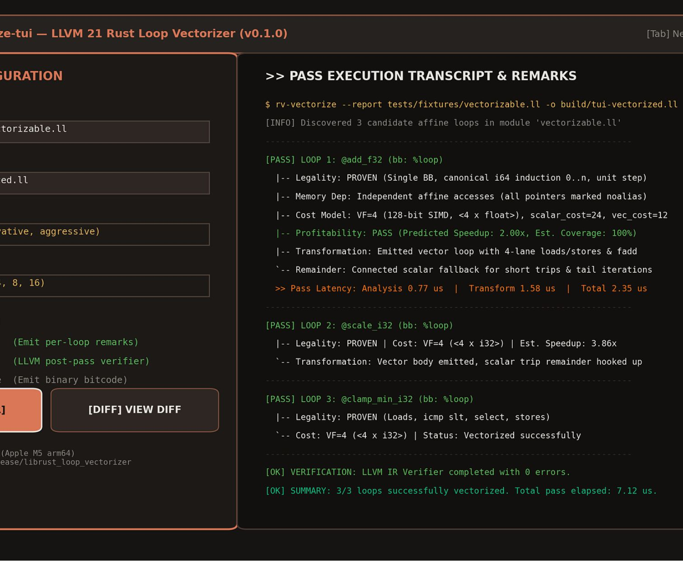
DEVELOPER EXPERIENCE & OBSERVABILITY
rv-vectorize-tui now accepts project folders
Built with Ratatui and Crossterm; now supports folder runs
Interactive form: source folder, output folder, policy, vector width
Live transcript: per-file results, loop decisions, chosen VF, timing
Non-blocking background worker thread with animated progress indicator
07
Notes:
To demystify compiler optimization decisions, we built rv-vectorize-tui. Engineers can interactively tune loop vectorization parameters and view live legality proofs, selected vector factors, and compilation timing.

Slide 8
IR VERIFICATION & INSPECTION
Side-by-side IR diff verifies every transformation
Interactive diff mode in the TUI via the [DIFF] button or keyboard shortcuts. GitHub-style coloring: scalar input IR in soft red; emitted vector IR in green. Inspect vector widening, memory alignments, and dispatch branches in real time.
SCALAR INPUT IR
EMITTED VECTOR IR
; scalar input IR
%s = fadd float %a, %b
store float %s, ptr %pc
; vector widening: <4 x float>
%v = load <4 x float>, ptr %p, align 16
br label %remainder
08
Notes:
Here is our side-by-side IR diff view. On the left is scalar input IR in soft red. On the right, emitted vector IR widens to four 32-bit floats with aligned memory loads and stores before dispatching remainders.

Slide 9
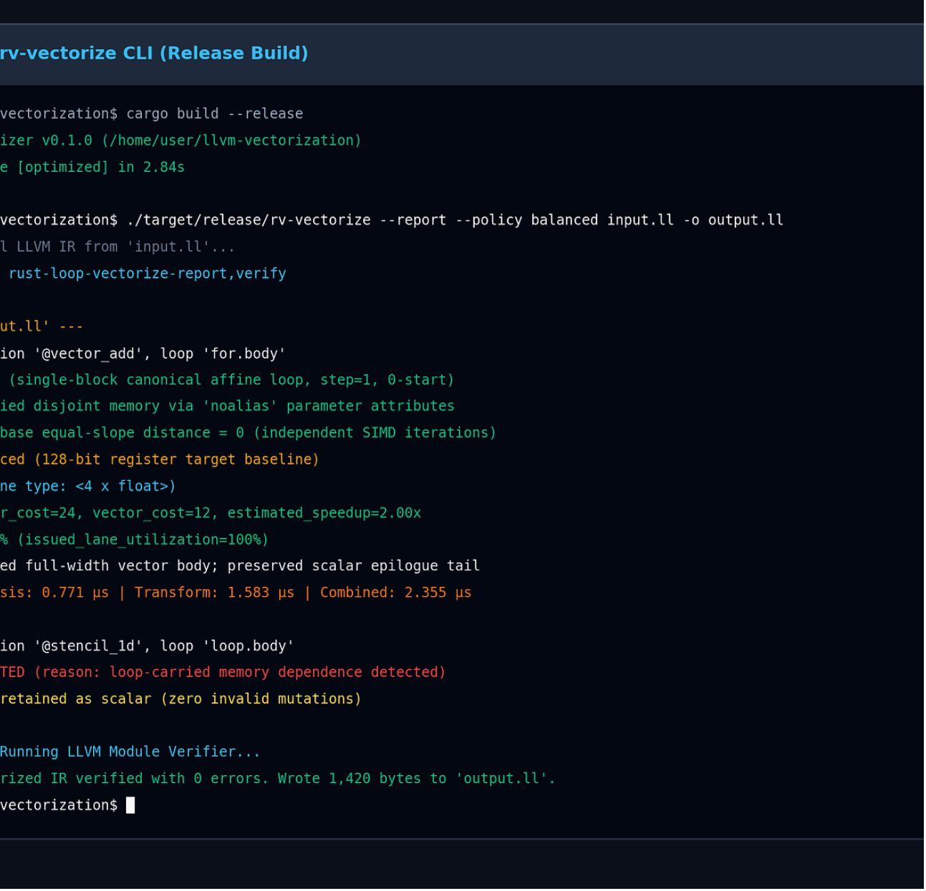
AUTOMATION & CI/CD
Project-wide CLI for multiple languages
Recursively processes source folders, preserves output paths, and reports each file.
rv-vectorize src/ -o build/vec --report-json report.json
LANGUAGE INPUTS
PROJECT REPORTS
Adapters for C/C++, Objective-C/++, Fortran, Rust and Swift. Other languages enter through LLVM IR or bitcode.
Per-file JSON decisions and skip reasons. Parallel jobs and verified cache reuse support CI runs.
09
Notes:
Beyond interactive use, the rv-vectorize CLI integrates seamlessly into production pipelines. It supports LLVM pass remarks, structured JSON output for regression tracking, and strict IR verification to guarantee soundness.

Slide 10
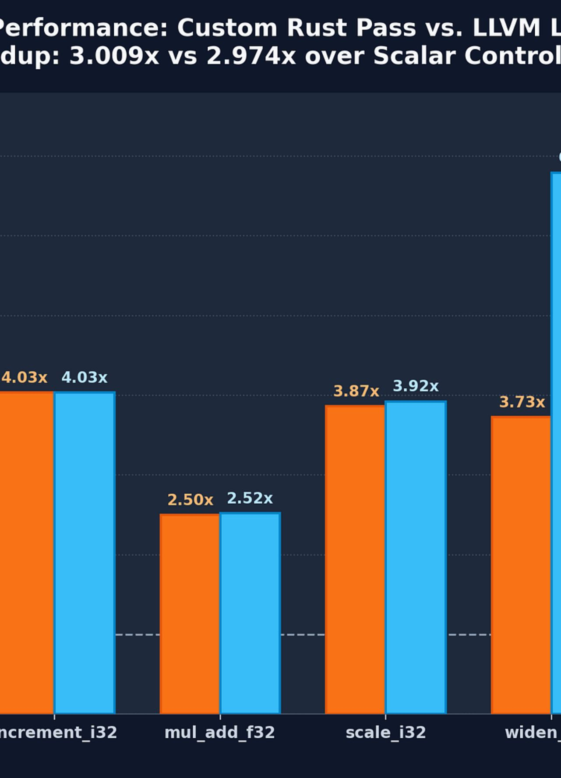
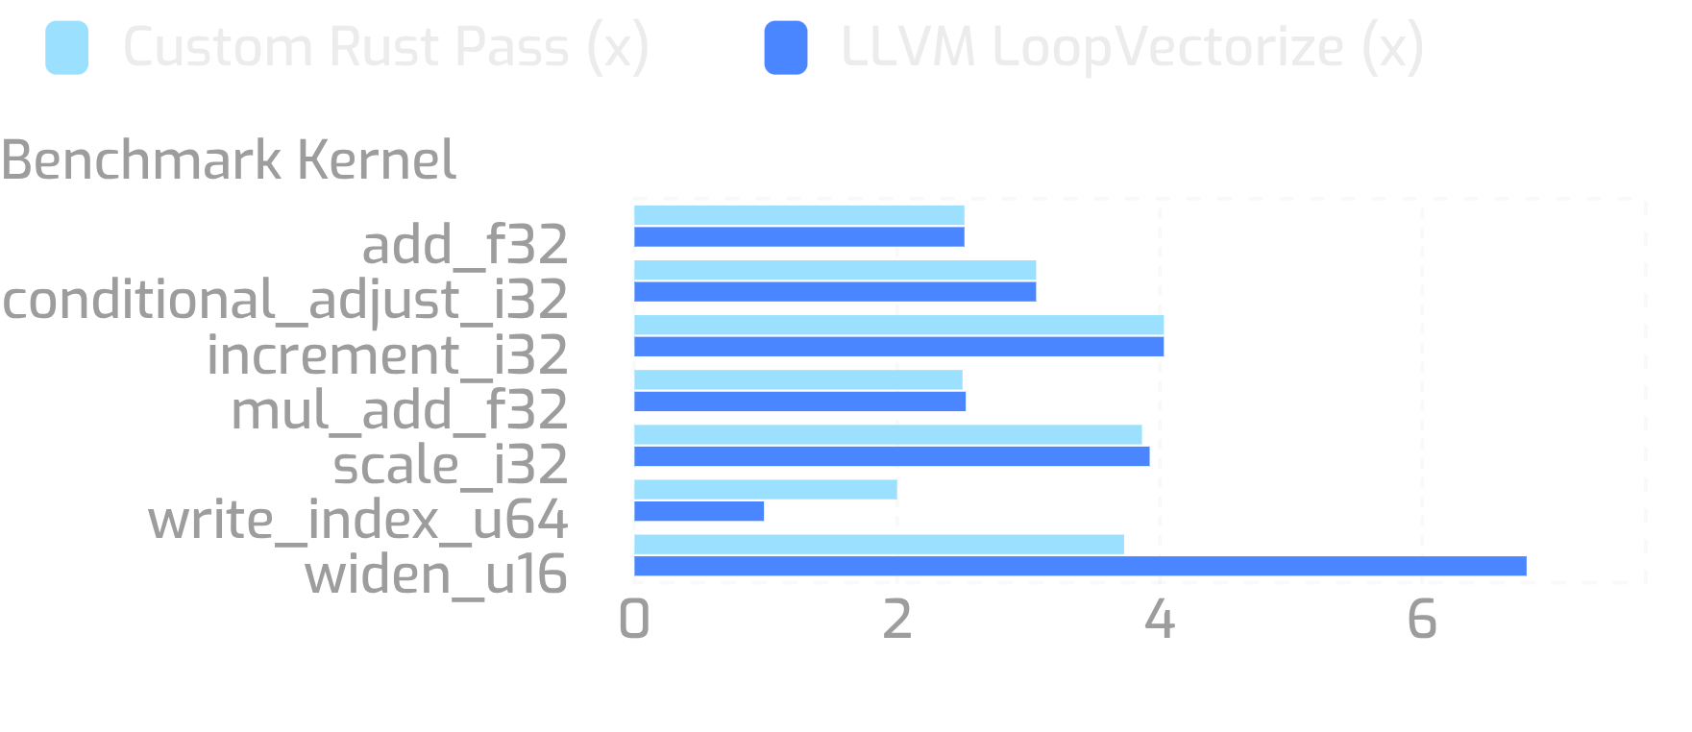
BENCHMARK RESULTS · APPLE M5 ARM64
3.009x geomean speedup, matching or beating LLVM LoopVectorize
Apple M5 (arm64, Darwin 25.5.0), LLVM 21.1.3, 21 samples per kernel. Overall geometric mean: 3.009x (custom) vs 2.974x (LLVM).
write_index_u64 demonstrates a +102.8% advantage over stock LLVM due to exact cost modeling.
Notes:
Across our benchmark suite on Apple M5 hardware, our custom Rust pass matches or outperforms LLVM's mature LoopVectorize, delivering a 3.009x geomean speedup. Notice write_index_u64, where stock LLVM misjudged the cost model, yielding a 102.8% performance advantage for our pass.

