Slide 1
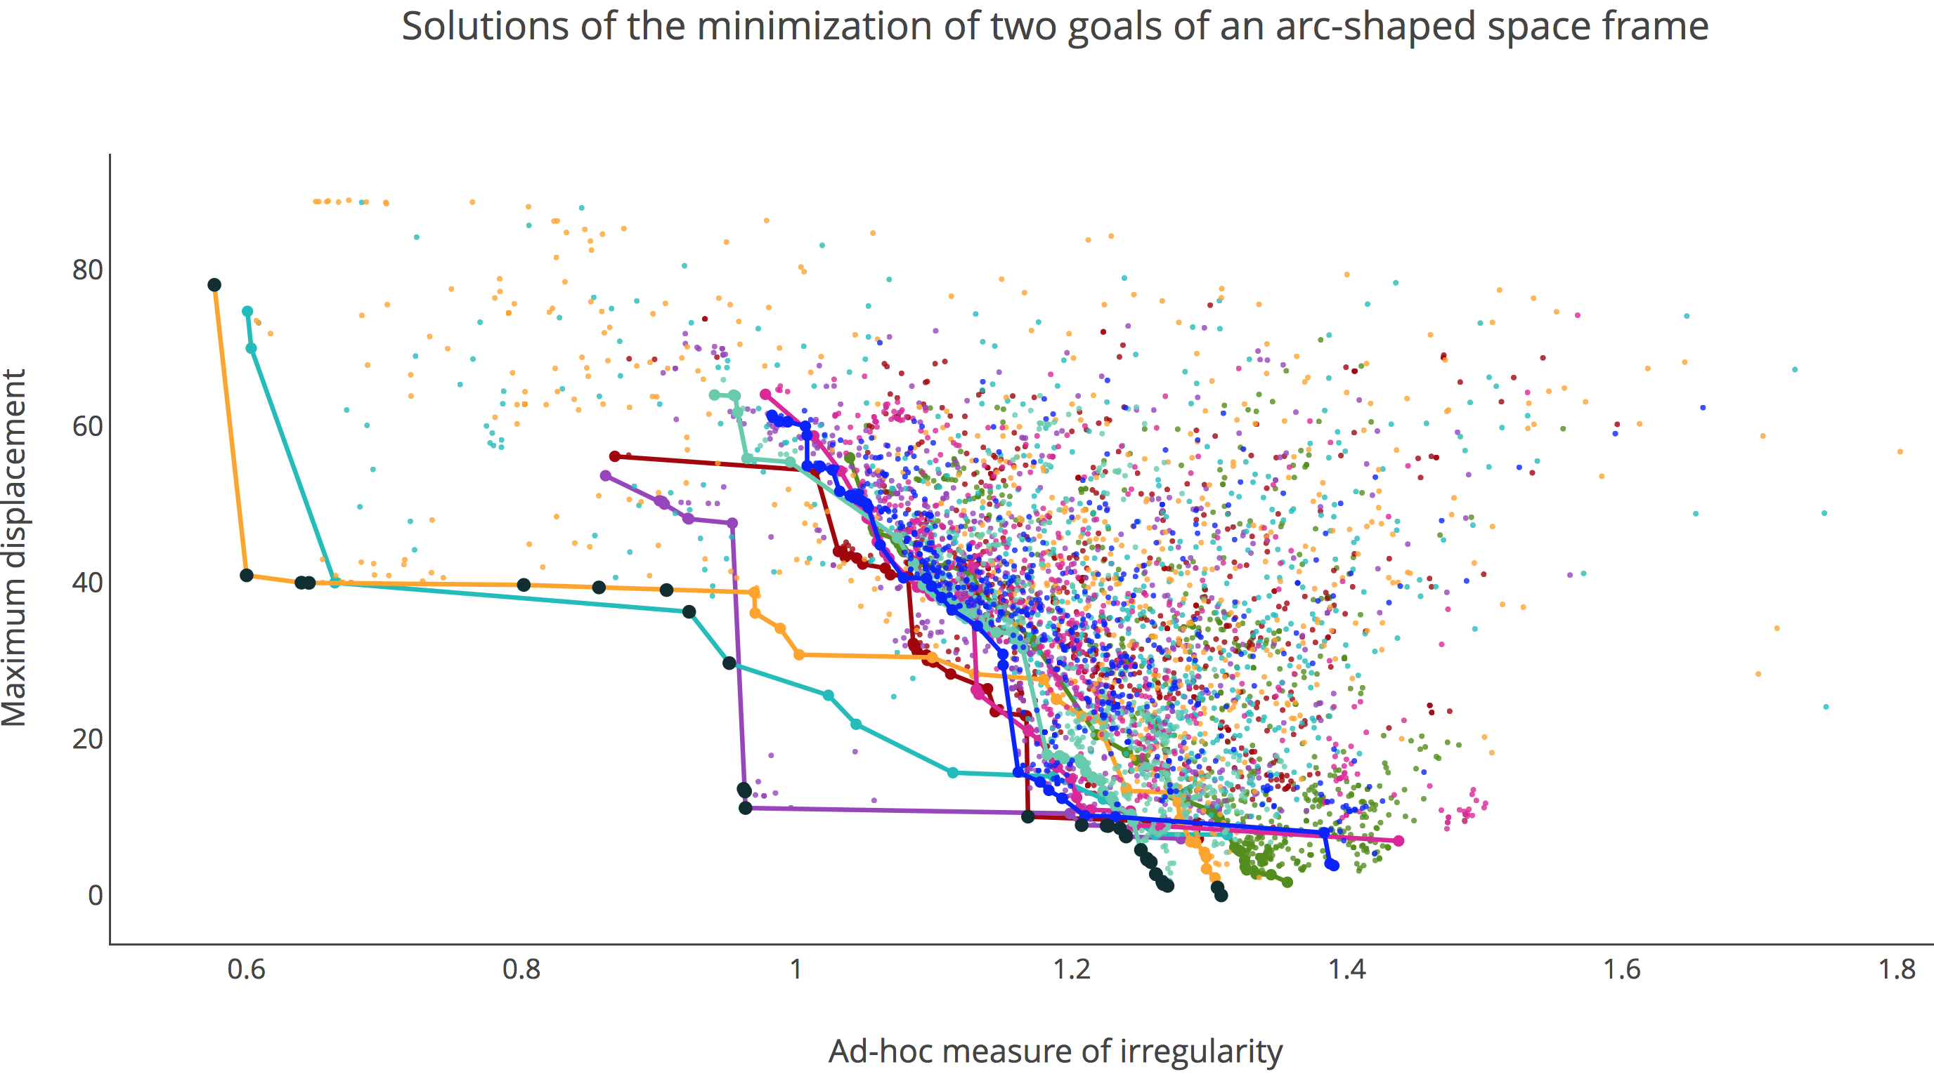

Slide 3
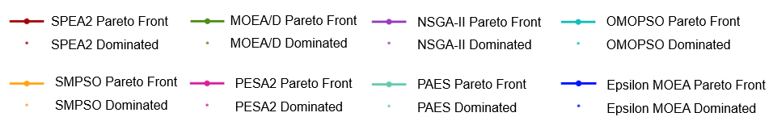

Slide 4
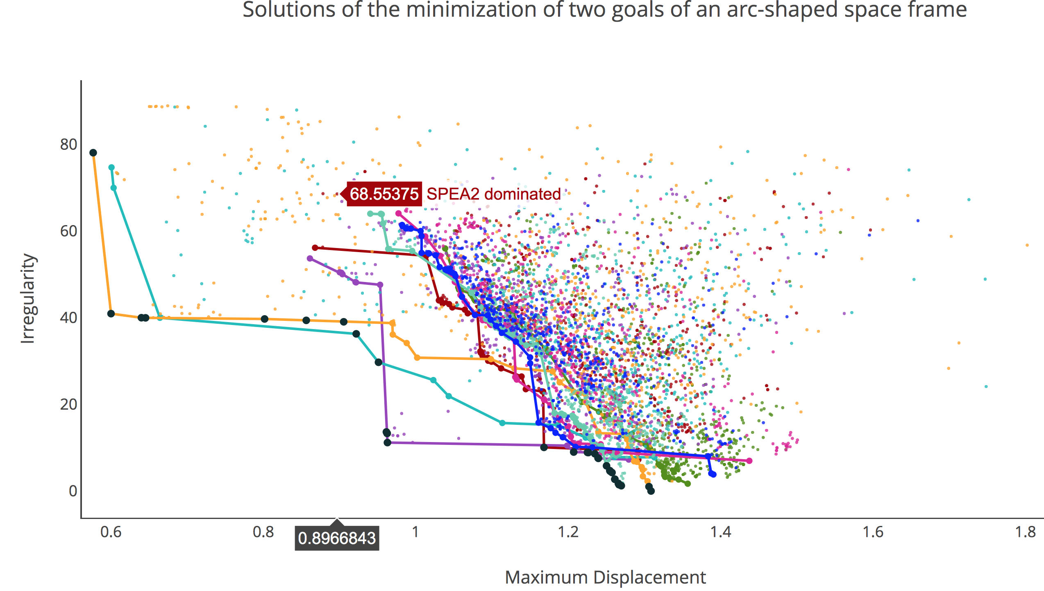

Slide 5
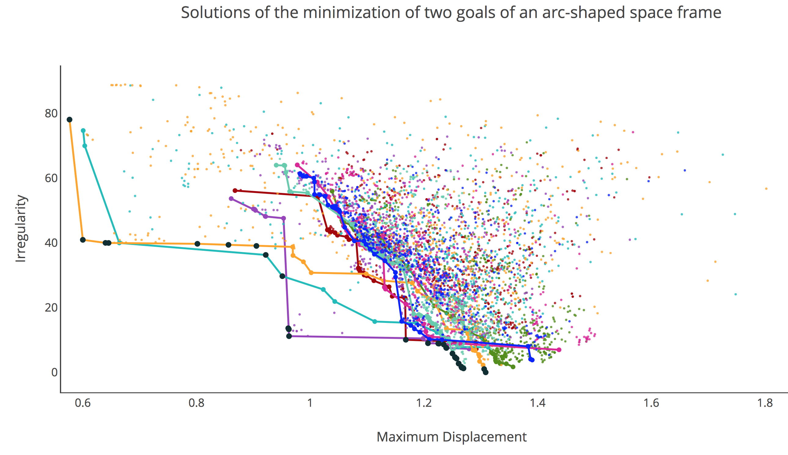
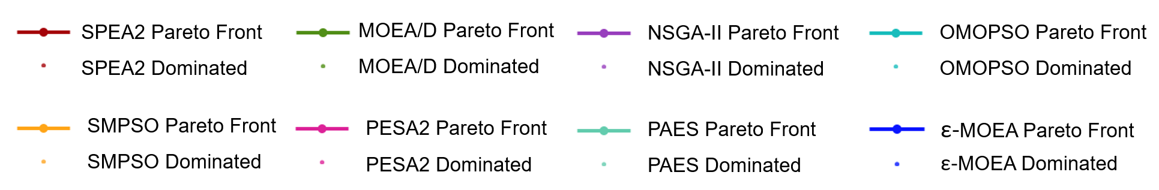

Slide 6
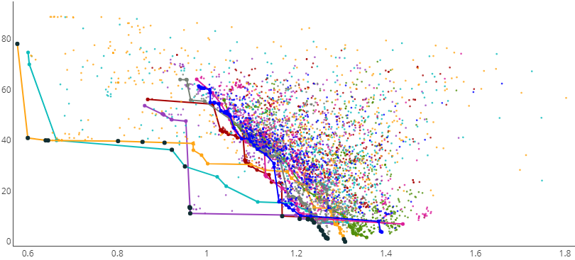
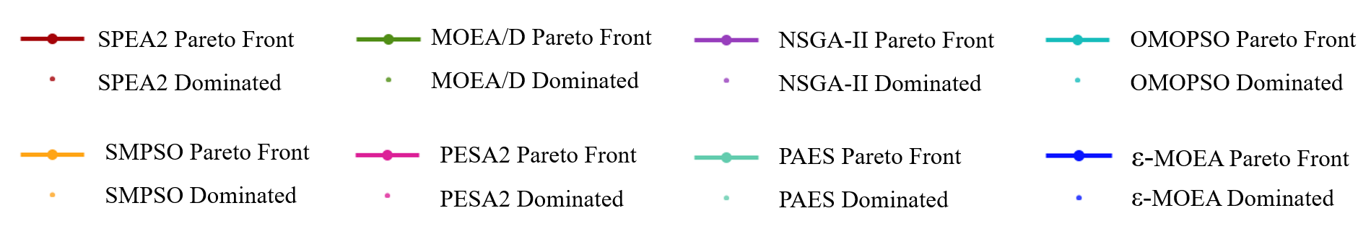


Slide 7
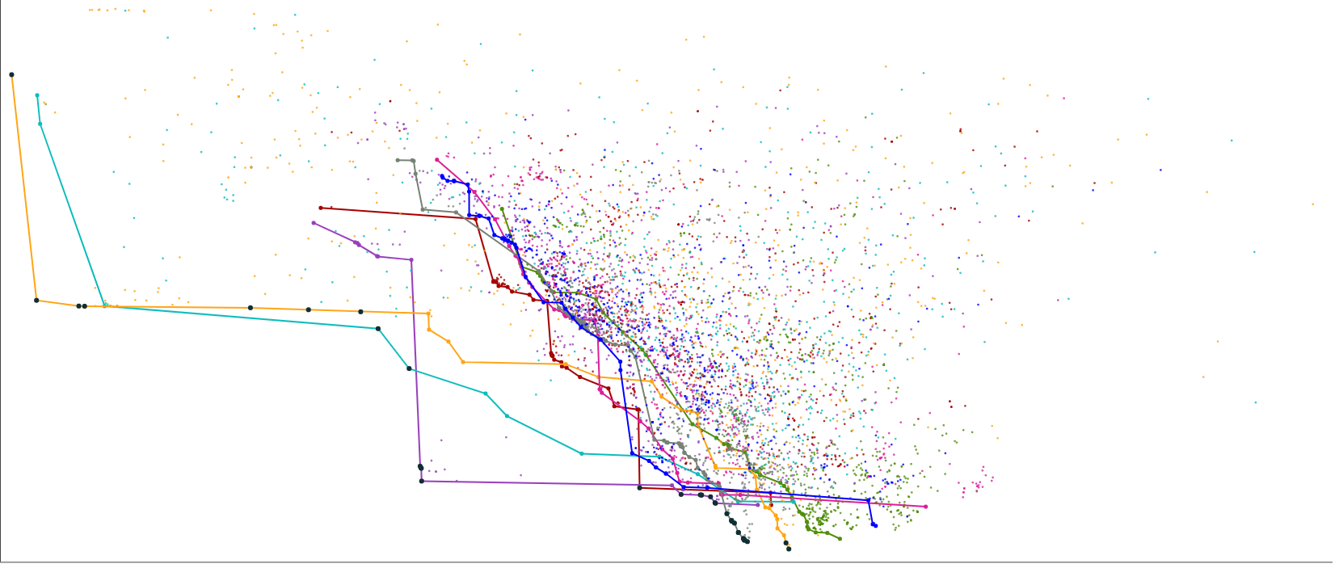
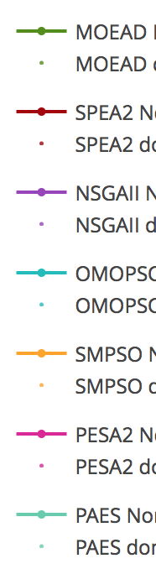
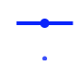
80
60
Irregularity
40
20
0
0.6 0.8 1 1.2 1.4 1.6 1.8
Maximum Displacement
SPEA2 Pareto Front
MOEA/D Pareto Front
NSGA-II Pareto Front
OMOPSO Pareto Front
SPEA2 Dominated
MOEA/D Dominated
NSGA-II Dominated
OMOPSO Dominated
SMPSO Pareto Front
PESA2 Pareto Front
PAES Pareto Front
ε-MOEA Pareto Front
SMPSO Dominated
PESA2 Dominated
PAES Dominated
ε-MOEA Dominated

