Slide 1

3D Modeling Tool
Algorithmic Design Tool
</>
3D Modeling Tool

Slide 2
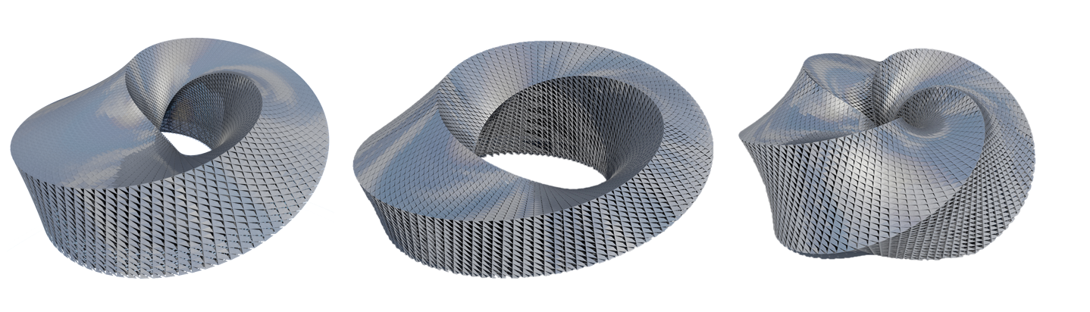

Slide 4
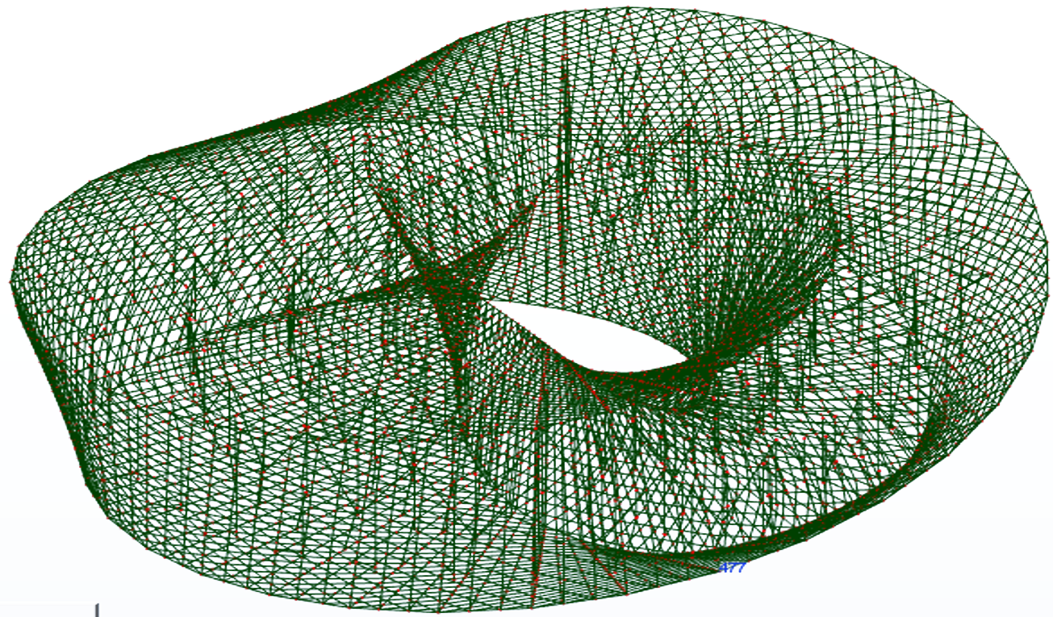
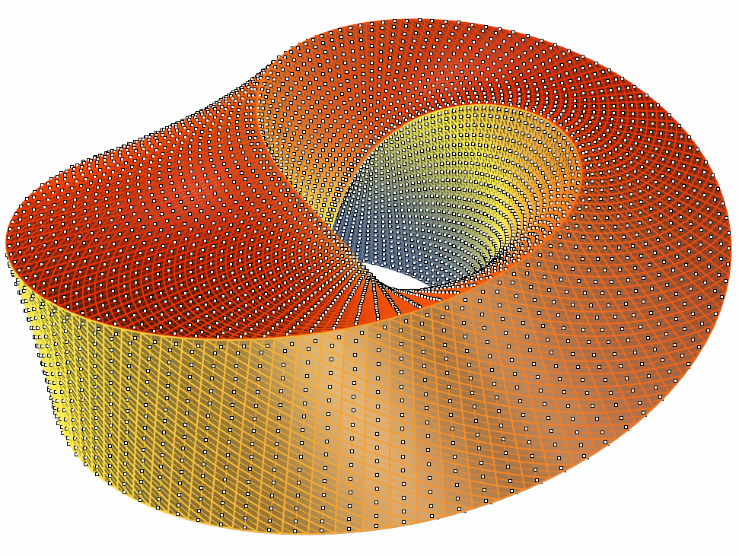

Slide 5
3D Modeling Tool
Algorithmic Design Tool
</>
Analytical Tool 1
...
Analytical Tool n

