Slide 1


Slide 2
DigiPen GGJ Team
DigiPen Staff and Faculty:
Angela Kugler
Sr. V.P. of External Affairs
Email: akugler@digipen.edu
Discord: SmilingDragon#1028
Jeff Hill
Director of Outreach
Email: jeff.hill@digipen.edu
Discord:
jeff.hill#6965
Jeremy Holcomb
Program Director:
BA in Game Design
Email:
jeremy.holcomb@digipen.edu
Discord: YasukiJeremy#7269
Chris Onorati
Lab Manager
Email:
c.onorati@digipen.edu
Discord:
ChrisOnorati#5495
DigiPen Alumni Volunteers:
Request More DigiPen Info:
Molly Jameson
BS in Computer Science in Real-Time Interactive Simulation
Discord: UltraRat#4563
Sean Sweeney
MS in Computer Science
Discord: Kadino#1734
Click here to request more information about DigiPen

Slide 3
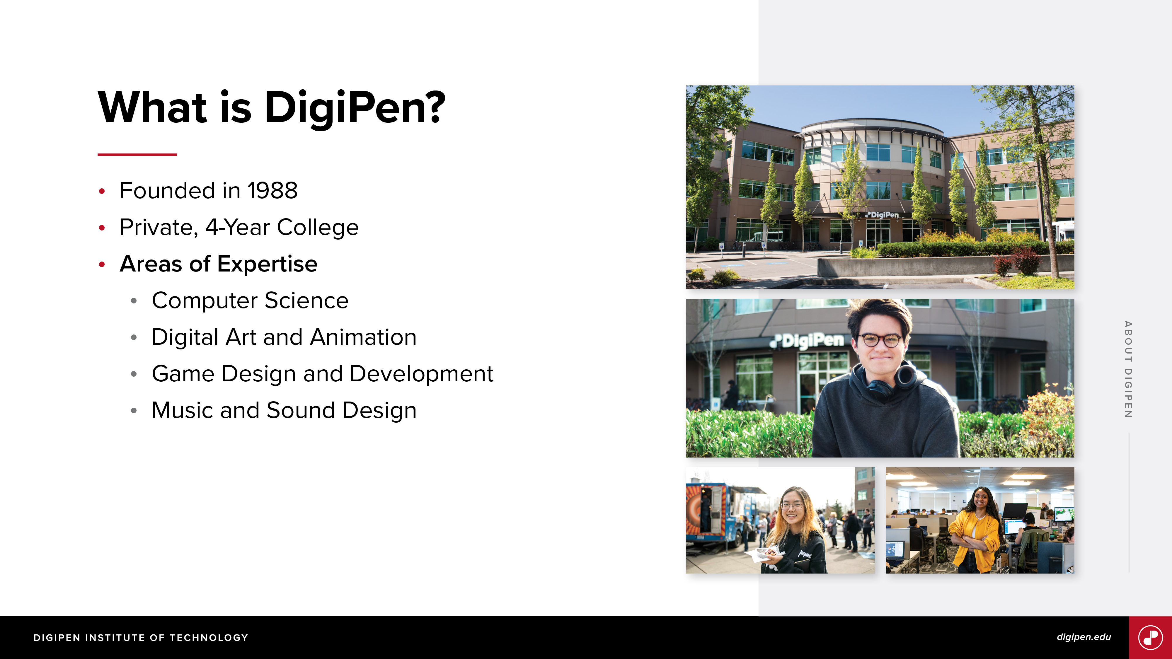

Slide 4
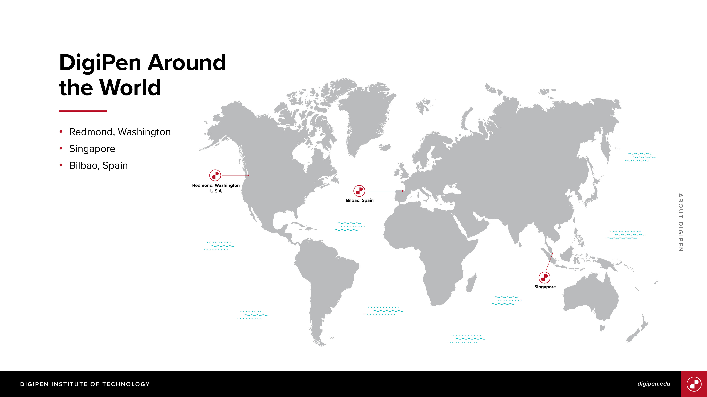

Slide 5

The Timeline (PST)
Wednesday, Jan 27th 7:00PM: Kick off meeting. You are here!
Thursday, Jan 28th 5:00PM: Game pitches due for Discord.
Thursday, Jan 28th 7:00PM: Review all pitches and have your team decided.
Thursday, Jan 28th 8:00PM: Team finalization – we’ll help out if you need a place to go.
Friday, Jan 29th – Sunday, Jan 31st: Work on your games with special guest visits!
Sunday, Jan 31st 12:00PM: Presentation preparation.
Sunday, Jan 31st 3:00PM: Games are due and must be uploaded
Sunday, Jan 31st 3:00PM – 5:00PM: Presentations
Sunday, Jan 31st 5:00PM – Live Closing Showcase

Slide 6

Global Game Jam 2021

Slide 7
Global Game Jam: Inclusiveness Policy and Code of Conduct
Click here for complete policy and code of conduct.

Slide 8
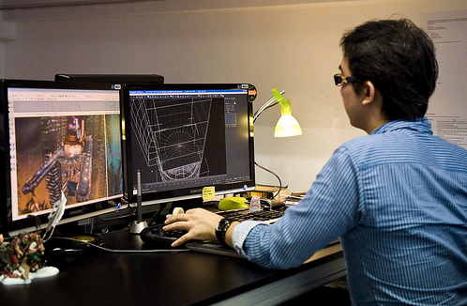
Diversifiers
If you are looking for an additional challenge, look at the diversifiers.
These add optional constraints onto your game!
You can choose chose up to four of these.
https://globalgamejam.org/news/ggj-online-diversifiers

Slide 9
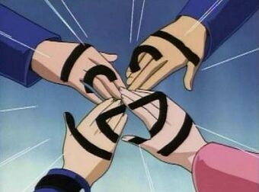
Working As A Team
Once a team roster is sent in, you’ll get a team-exclusive text and voice channel.
DigiPen Staff, Faculty, and Alumni are here to assist you.
We’ll be asking for your ideal time to get advice/mentoring later tomorrow.

Slide 10
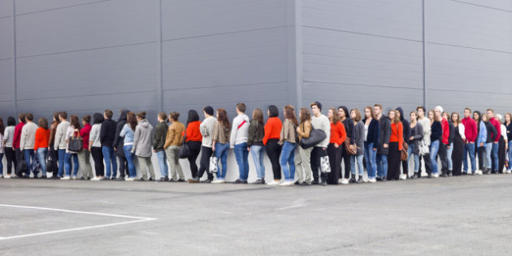
Finding Your Team
Click here to join our Discord server
Get social! Meet those who will be participating!
Share your ideas to attract some teammates in #game-pitches.
Email Onorati.c@digipen.edu your team roster. Template is in #resources.

Slide 11
Questions? Contact Us!
DigiPen Staff and Faculty:
Angela Kugler
Sr. V.P. of External Affairs
Email: akugler@digipen.edu
Discord: SmilingDragon#1028
Jeff Hill
Director of Outreach
Email: jeff.hill@digipen.edu
Discord:
jeff.hill#6965
Jeremy Holcomb
Program Director:
BA in Game Design
Email:
jeremy.holcomb@digipen.edu
Discord: YasukiJeremy#7269
Chris Onorati
Lab Manager
Email:
c.onorati@digipen.edu
Discord:
ChrisOnorati#5495
DigiPen Alumni Volunteers:
Request More DigiPen Info:
Molly Jameson
BS in Computer Science in Real-Time Interactive Simulation
Discord: UltraRat#4563
Sean Sweeney
MS in Computer Science
Discord: Kadino#1734
Click here to request more information about DigiPen

