Slide 1



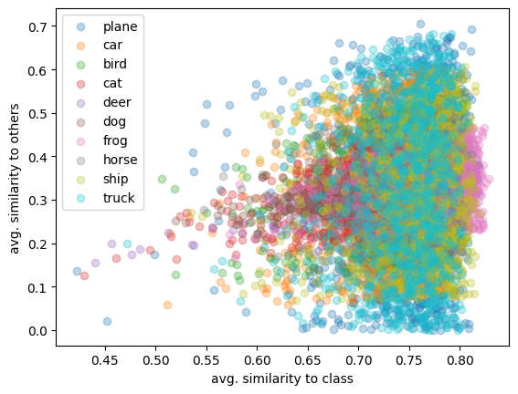
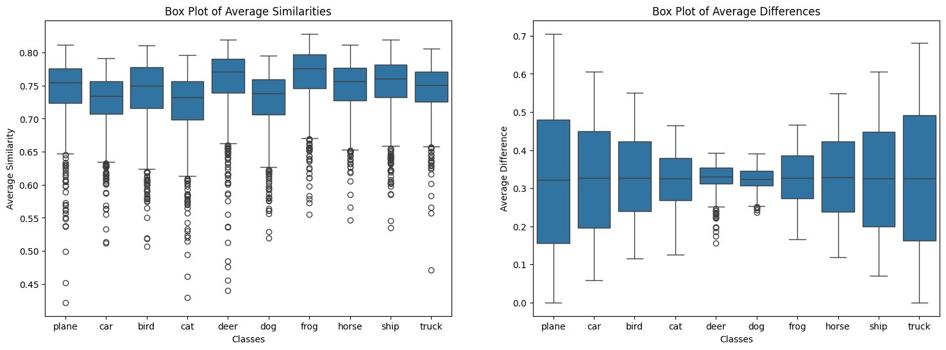
Classification of Objects via Vectorization
CHALLENGE: CAPTURING SEMANTIC MEANING FROM IMAGE REPRESENTAION
APPROACH
CONCLUSION
ARCHITECTURE
STRUGGLES WITH CURRENT METHODS
DATASETS & METRICS
IMPLEMENTATION
MODEL LIMITATIONS
GOOD PERFORMANCE ON LARGE DATASETS
OUR SOLUTION
Aidan Case | | Haven Kotara
Capturing & Maintaining Semantic Meaning from Image Representation
Our proposed encoder-decoder architecture effectively captures and preserves the semantic meaning of images, addressing key challenges in image representation.
By leveraging convolutional layers and pooling operations, we enhance image classification accuracy and facilitate better retrieval and similarity assessments, paving the way for more efficient image processing techniques.
Images hold important information, including colors, shapes, and textures. Managing this information in its original form can be challenging. Over-simplifying may lose important details. We need new techniques to represent images efficiently while preserving their essential features.
Encoder:
Multiple convolutional layers extract features from input images.
Average pooling reduces spatial dimensions while summarizing features.
Data is flattened into a one-dimensional array, followed by a linear layer producing a fixed-length vector as a compact image representation.
Decoder
Reconstructs the original image from the encoded vector using transposed convolutions, effectively up-sampling to original dimensions, allowing evaluation of encoding preservation.
Flickr30k
CIFAR-10
Huber Loss
Visual Similarity Assessments
Framework:
PyTorch was chosen for its flexibility and ease of experimentation, allowing dynamic computation graphs for architecture modification.
Normalization and Activation Functions:
Integrated normalization layers (e.g., Batch Normalization) and activation functions (e.g., ReLU) to enhance training stability and performance.
Highly diverse datasets
Scalability in real-world applications
Longer processing time and computational load for larger datasets
Difficulty conveying the context of images, limiting effectiveness in classification, retrieval, and generation.
Large, complex representations that are hard to manage.
Loss of important relationships between features.
Difficulty distinguishing between objects with similar characteristics.
RESULTS
An encoder-decoder structure employing convolutional layers and pooling operations, focusing on retaining image meaning to improve tasks like image retrieval and similarity searches. The approach aims to be faster and provide clearer insights into image relationships.

