Slide 1
Classification of Objects via Vectorization
Aidan Case & Haven Kotara

Slide 2
Challenge: Capturing Semantic Meaning from Image Representaion
One of the main challenges in working with images is finding a way to represent the complex, high-dimensional data in a simpler, lower-dimensional form while keeping the important features intact.
Images contain a lot of information, such as colors, shapes, and textures, which can be difficult to manage in their original, highly-detailed, form.
However, if we reduce the complexity too much, we risk losing crucial details that are important for understanding and analyzing the images.
We need new techniques that can efficiently represent images without losing the essential features that define them.
While many various approaches to this problem exist, few have successfully found a good balance between model complexity and performance in encoding images.

Slide 3
Common Issues In Existing Methods
Many current methods have difficulty conveying the context of images, which limits their effectiveness in tasks such as classification, retrieval, and generation.
Some common challenges include:
Large, complex representations that are hard to manage.
Loss of important relationships between features.
Difficulty in distinguishing between objects that have similar characteristics.
We need more efficient ways to encode images that preserve key details and accurately represent the relationships between features. Our approach aims to address these issues.

Slide 4
Our Solution
AI has demonstrated efficient classification results in many domains. Inspiring us to question whether a neural network-based approach could enhance both the accuracy and speed of image classification.
We propose an encoder-decoder structure that employs convolutional layers and pooling operations.
By focusing on keeping the meaning of the images, we aim to improve tasks like image retrieval and similarity searches.
Our approach should also be faster and provide clearer insights into how different images relate to each other.

Slide 5
Some Background on Existing Techniques
Convolutional Neural Networks (CNNs):
CNNs are widely used for image classification tasks because they can automatically learn spatial hierarchies of features from images.
By using layers of convolutional filters, CNNs can detect patterns, textures, and objects at various levels of abstraction.
Unfortunately, CNNs often require large amounts of labeled data for training and may struggle with generalization to unseen data.
Autoencoders for Unsupervised Learning of Image Representations:
Autoencoders are a type of neural network designed to learn efficient representations of data in an unsupervised manner.
They consist of an encoder that compresses the input into a lower-dimensional space and a decoder that reconstructs the original input from this representation.
While autoencoders can effectively capture underlying patterns in images, they often lack the ability to focus on relevant semantic features needed for specific tasks.
Attention Mechanisms:
These mechanisms allow the model to focus on specific parts of an image, enhancing the representation by emphasizing important features while downplaying less relevant ones. This approach has led to improvements in various tasks, including image captioning and generation.
However, implementing attention in image encoding can increase computational complexity and may not always yield significant improvements over traditional methods.

Slide 6
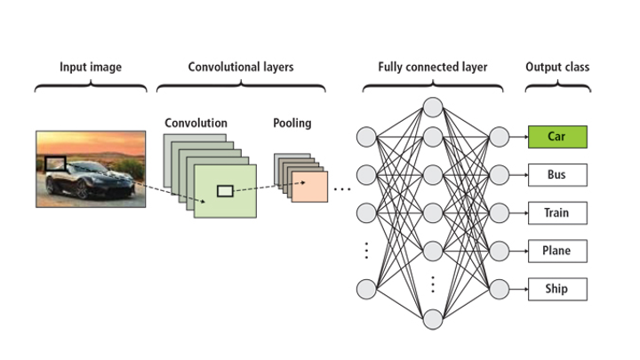
Approach: The Architecture
Encoder:
The encoder is designed with multiple convolutional layers that systematically extract features from the input images. After feature extraction, average pooling is applied to reduce the spatial dimensions, which helps in summarizing the features while maintaining important information.
Next, the data is flattened into a one-dimensional array, followed by a linear layer that produces a fixed-length vector. This vector serves as a compact representation of the image, capturing its essential characteristics.
Decoder:
The decoder is responsible for reconstructing the original image from the encoded vector. It uses transposed convolutions, which effectively upsamples the encoded vector back to the original image dimensions.
This process allows the model to generate an image that closely resembles the input, enabling evaluation of how well the encoding preserved the original data.

Slide 7
Approach: Challenges
Balancing Model Complexity with Computational Efficiency:
One of the main challenges is finding the right balance between a model that is complex enough to learn meaningful features and one that is efficient enough to process images quickly.
A more complex model may capture richer details but could lead to longer training times and increased computational costs.
Ensuring Relevant Feature Capture During Encoding:
Another challenge is to ensure that the encoder effectively captures all relevant features of the input images.
If significant features are overlooked, the encoded representation may not accurately reflect the image's content, which could hinder downstream tasks like retrieval and classification.

Slide 8
Approach: Implementation
Framework:
We chose to use PyTorch for its flexibility and ease of experimentation.
This framework allows for dynamic computation graphs, making it easier to modify the architecture and experiment with different configurations during the development process.
Normalization and Activation Functions:
To enhance training stability and improve model performance, we integrated normalization layers (such as Batch Normalization) and activation functions (like ReLU) throughout the architecture.
These choices help in speeding up convergence during training and in preventing issues like vanishing gradients, ultimately leading to a more robust model.

Slide 9
Datasets
Flickr30k:
This dataset consists of 30,000 images along with five captions for each image, allowing us to explore tasks related to image captioning and similarity measurement.
It provides a diverse range of visual contexts and subjects, making it ideal for evaluating how well our model captures semantic meaning.
CIFAR-10:
Comprising 60,000 images across ten distinct classes, this dataset is widely used for benchmarking image classification performance.
It allows us to rigorously test our model's ability to accurately classify images in a controlled setting, focusing on small, high-resolution images.

Slide 10
Metrics
Huber Loss
We employed Huber Loss as our primary loss function during training.
This loss function is robust to outliers, providing a balance between Mean Squared Error and Mean Absolute Error, making it suitable for image encoding.
Visual Similarity Assessments
After encoding images into fixed-length vectors, we conducted visual similarity assessments.
This involved comparing the generated vectors to evaluate how well the model captures the essence of images in terms of similarity, allowing us to measure the effectiveness of our encoding approach.

Slide 11
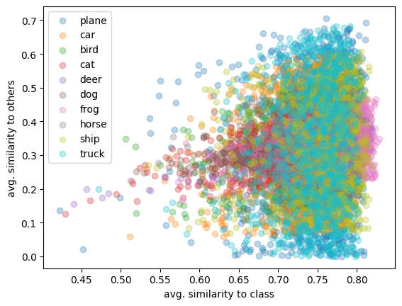
Results
After encoding images into fixed-length vectors, we performed visual similarity assessments.
By comparing these generated vectors, we were able to evaluate how well our model captures the essence of images.
The results indicate that our encoding approach effectively maintains visual similarities, validating its effectiveness in representing the images accurately.

Slide 12
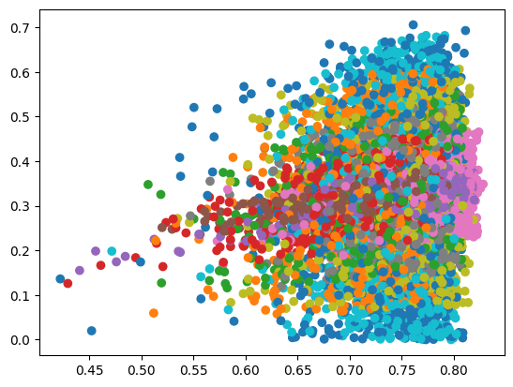
Results
Our model successfully captures semantic similarities between images, demonstrating its ability to recognize and group images that share similar features and contexts.
Visualizations of the encoded representations show meaningful clustering, indicating that the model not only understands the visual content but also the underlying concepts, which is crucial for tasks like image retrieval and categorization.

Slide 13
Limitations
Challenges with Diverse Datasets:
The model may encounter difficulties when working with highly diverse datasets, where the range of features varies significantly.
This diversity can complicate the encoding process, making it harder to accurately capture and represent the unique characteristics of different images.
As a result, clustering similar images may become less effective, potentially leading to inaccurate groupings.
Computational Requirements:
Processing larger datasets can impose substantial computational demands on the model.
High resource consumption may limit the model's scalability, making it challenging to apply in real-world scenarios where efficiency is crucial.
This limitation could affect the model's usability in applications that require rapid processing or real-time analysis of large volumes of image data.

Slide 14
References
LeCun, Y., Bottou, L., Bengio, Y., & Haffner, P. (1998). Gradient-Based Learning Applied to Document Recognition. Proceedings of the IEEE, 86(11), 2278-2324.
Vincent, P., Larochelle, H., Lajoie, I., Bengio, Y., & Manzagol, P. A. (2010). Stacked Denoising Autoencoders: Learning Useful Representations in a Deep Network with a Local Denoising Criterion. Journal of Machine Learning Research, 11, 3371-3408.
Wang, C., Yan, H., Huang, W., Sheng, W., Wang, Y., Fan, Y.-S., Liu, T., Zou, T., Li, R., & Chen, H. (2023). Neural encoding with unsupervised spiking convolutional neural network. Communications Biology, 6, Article 880.
PyTorch Documentation. (n.d.). Retrieved from https://pytorch.org/docs/stable/index.html.
Torchvision Documentation. (n.d.). Retrieved from https://pytorch.org/vision/stable/index.html.
Ritchie, A. (2021). The Incredible PyTorch: A curated list of tutorials, papers, projects, and more relating to PyTorch. Retrieved from https://github.com/ritchieng/the-incredible-pytorch.

Slide 15
Thank you
Any Questions?

