Slide 1
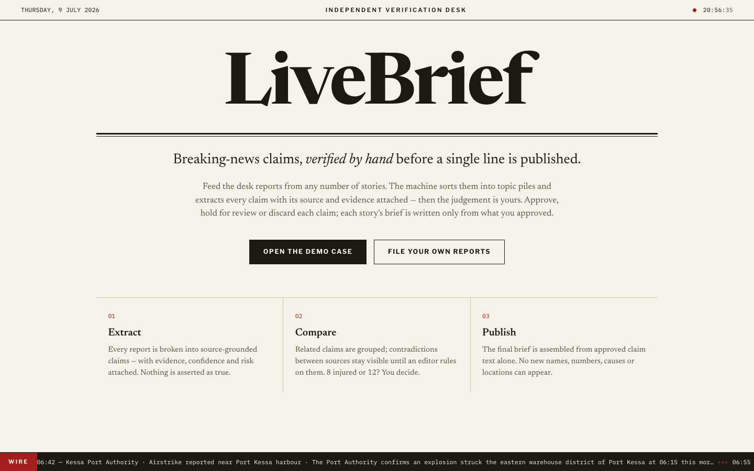
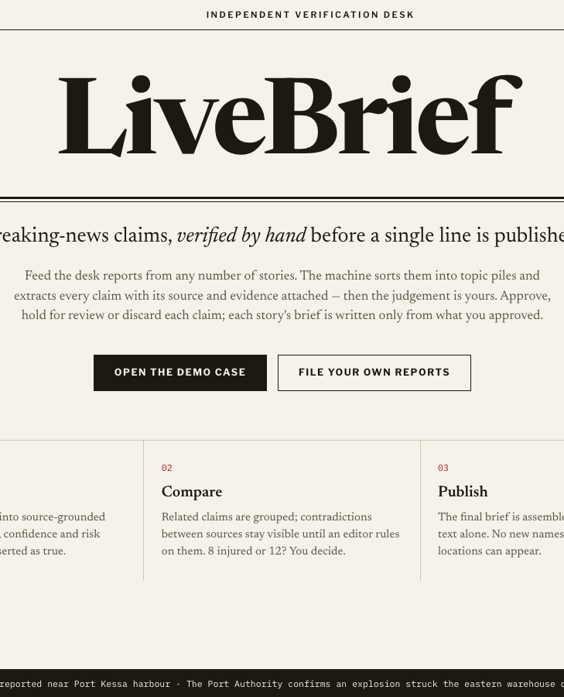
LIVEBRIEF
BREAKING NEWS VERIFICATION
AI-ASSISTED EDITORIAL VERIFICATION
Verify before you publish.
Story decks. Article cards. Human verdicts.
LOCAL EMBEDDINGS
SOURCE CLAIMS
EDITOR CONTROL
01

Slide 2
LIVEBRIEF
THE PROBLEM
SUMMARIES CAN HIDE RISK
Breaking news is a comparison problem.
OFFICIAL
2 injured
REVIEW
■
Counts disagree
LOCAL
6 injured
REVIEW
■
Causes are unverified
■
Timelines change
SOCIAL
10+ unverified
REVIEW
LiveBrief keeps disagreement visible until a journalist decides.
02

Slide 3
LIVEBRIEF
PRODUCT FLOW
ONE URL BECOMES ONE CARD
From source to approved brief.
01
Crawl URL
02
Clean text
03
Route deck
04
Review card
05
Compose brief
Local open-source embeddings group similar articles. No external embedding API.
03

Slide 4
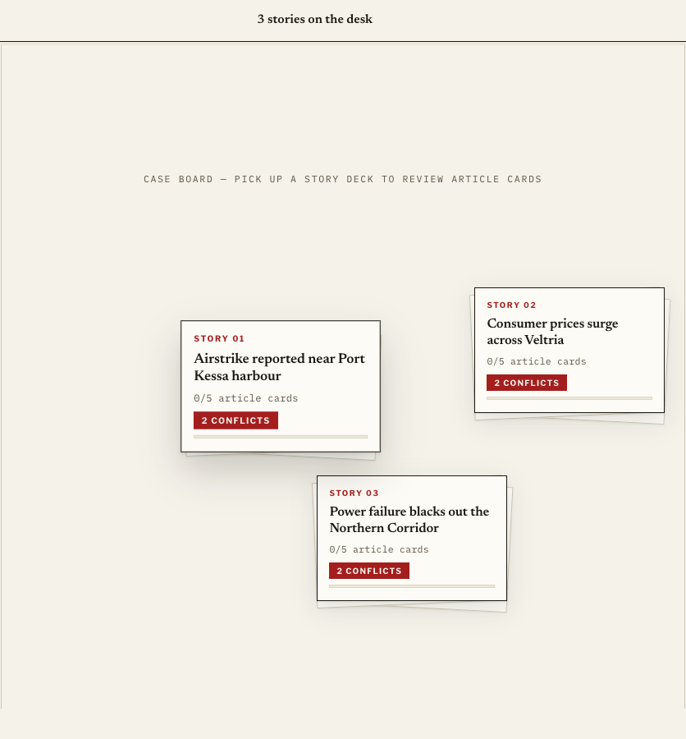
LIVEBRIEF
DEMO BOARD
STORY DECKS
Similar articles land together.
■
One deck = one story
■
One card = one article
■
Routing animation shows the target
04

Slide 5
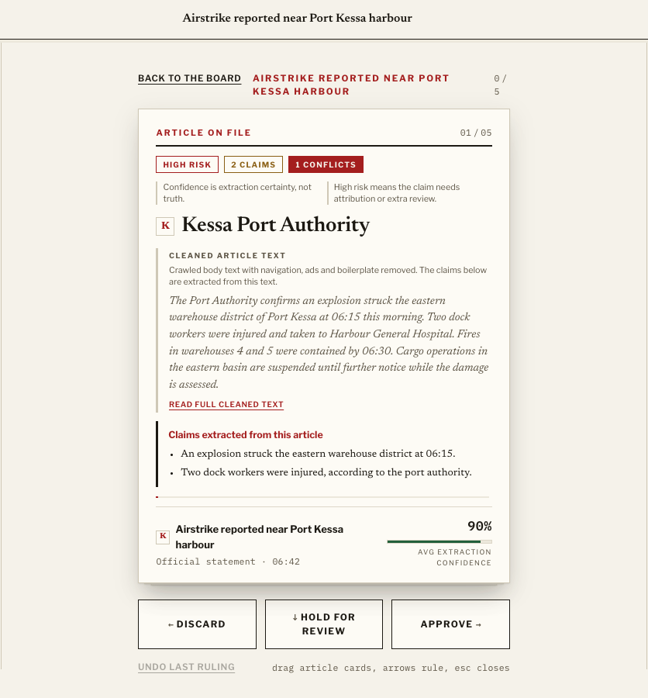
LIVEBRIEF
ARTICLE REVIEW
HUMAN VERDICT
Confidence is extraction certainty. Risk is editorial caution.
■
Approve: eligible
■
Hold: returns for review
■
Discard: excluded
05

Slide 6
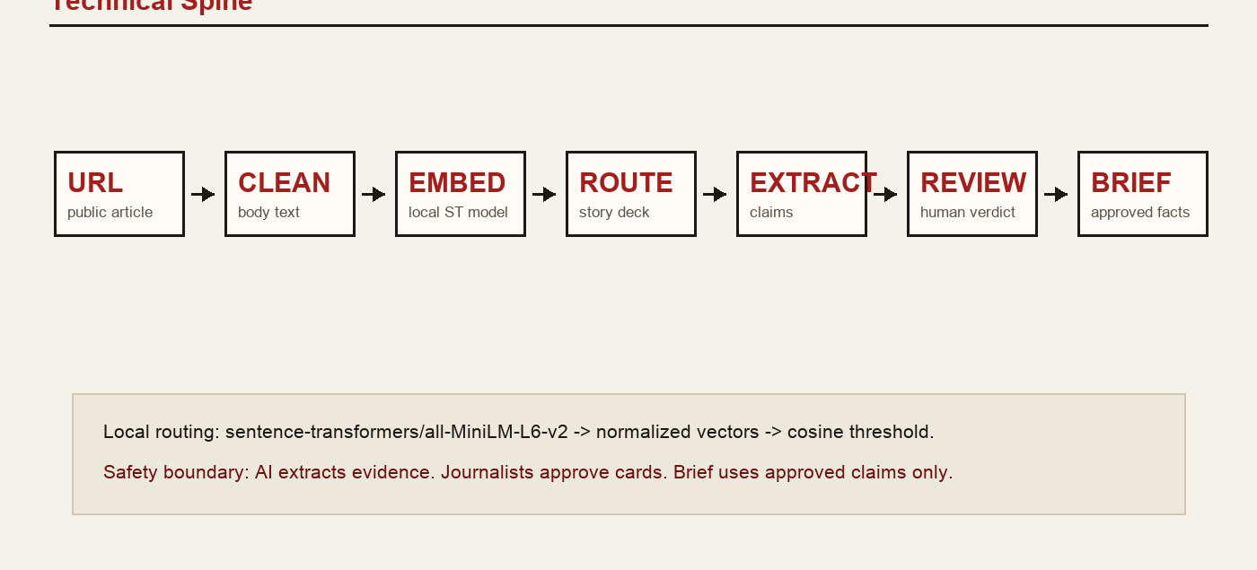
LIVEBRIEF
TECHNICAL ARCHITECTURE
FASTAPI BACKEND
Local embeddings plus editorial safeguards.
06

Slide 7
LIVEBRIEF
WHY JOURNALISTS USE IT
FASTER WITHOUT GIVING UP JUDGMENT
AI compares. Journalists decide.
Speed
Sort sources into story decks.
Accountability
Trace every claim to source text.
Safety
Briefs use approved claims only.
A sharper verification desk for deadline news.
07

