Slide 1
FPS Box Art
Chase Yates
April 25, 2023

Slide 2
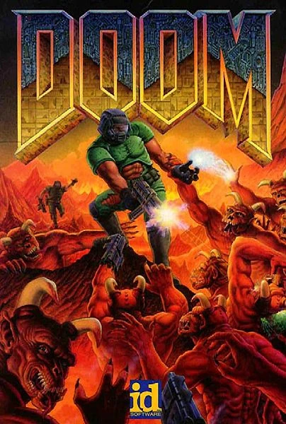

Slide 3
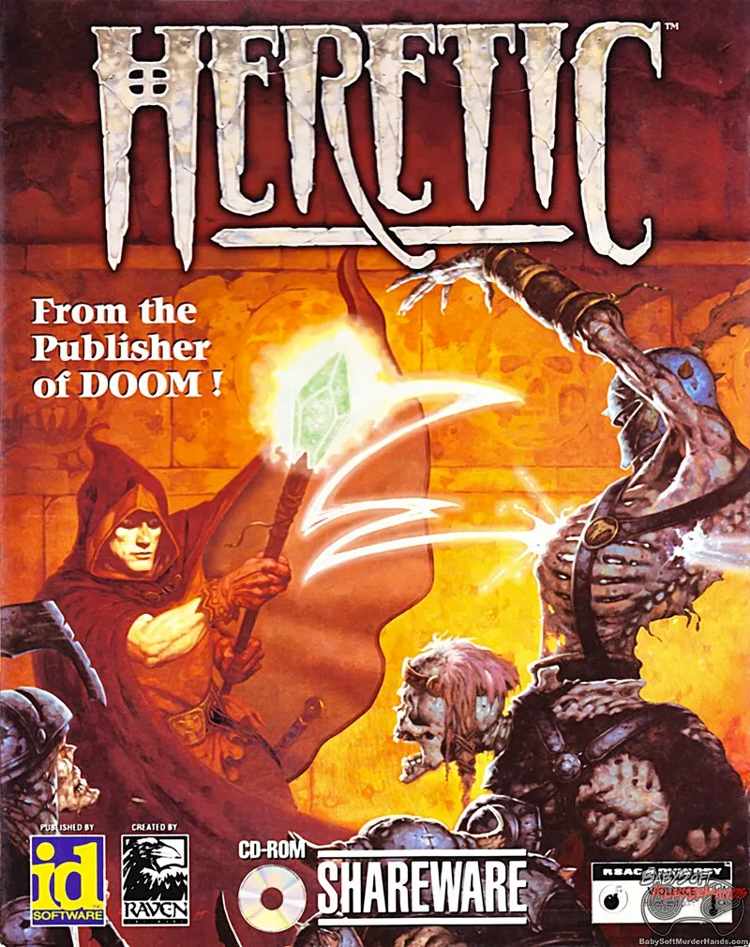
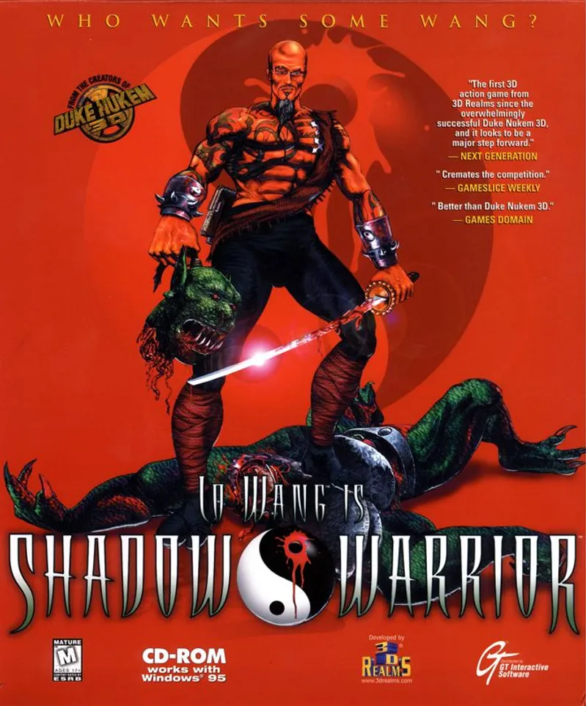

Slide 4
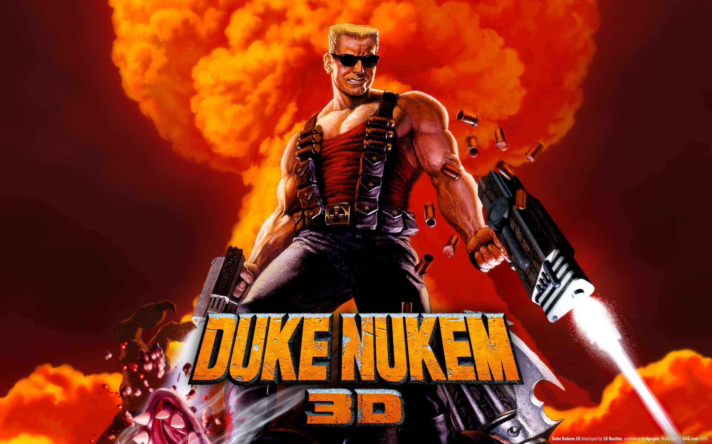

Slide 5
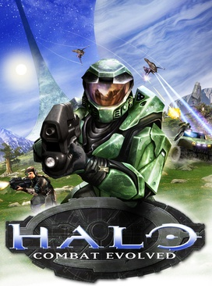

Slide 6
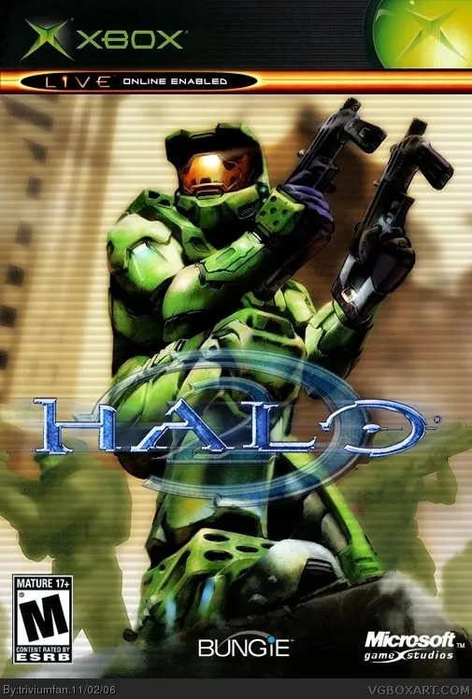
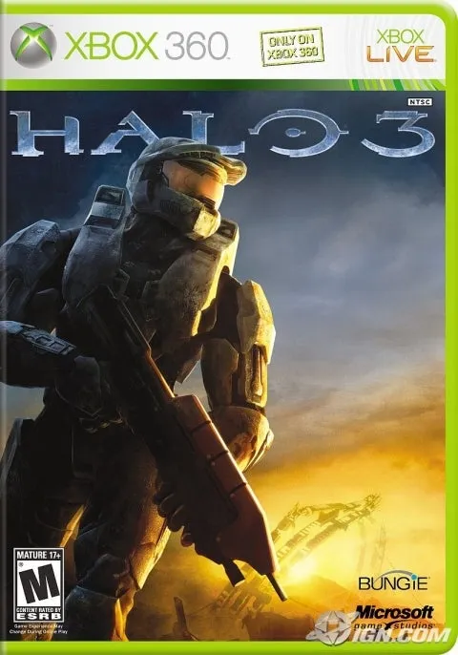

Slide 7
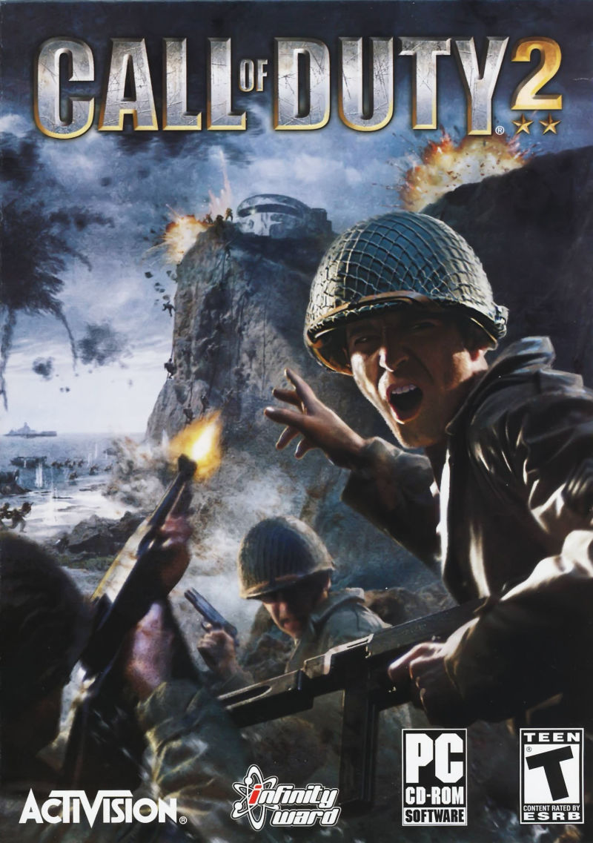

Slide 8

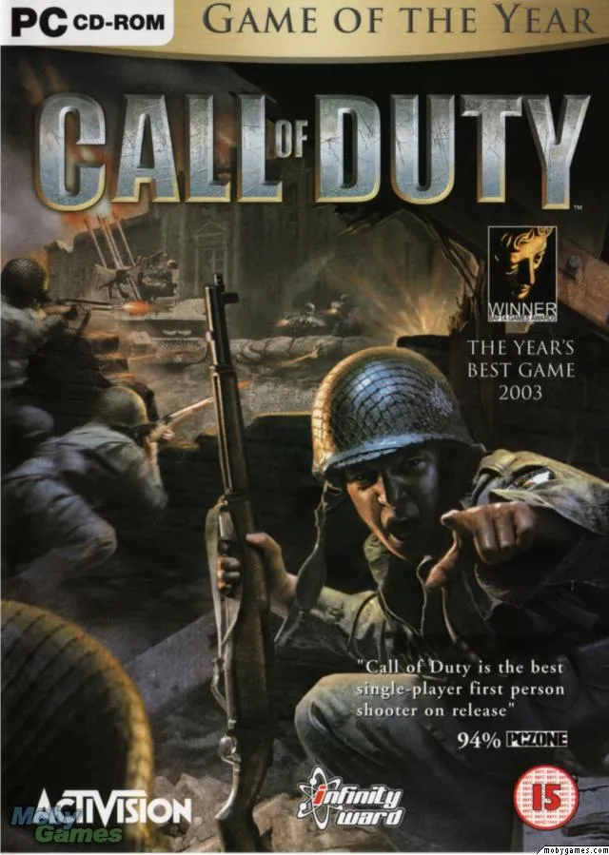

Slide 9


Slide 10
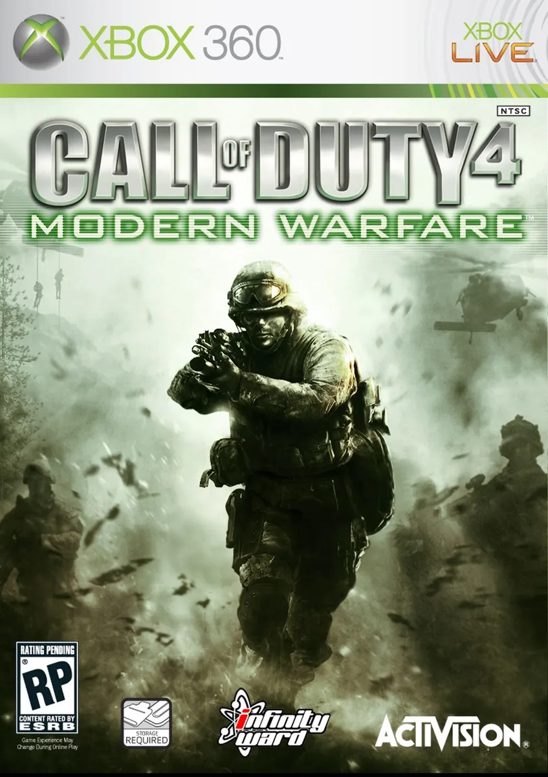


Slide 11


Slide 12


Slide 13


Slide 14
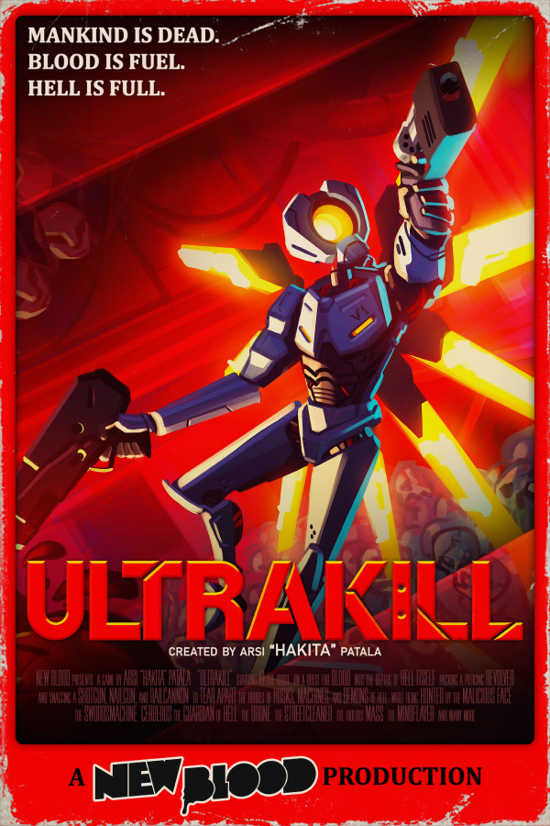

Slide 15
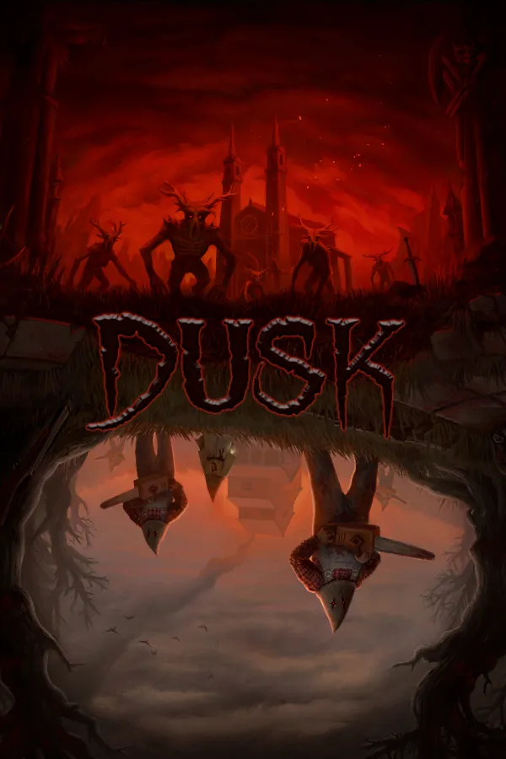



Slide 16
References
Doom (1993), Id Software; https://static.wikia.nocookie.net/doom/images/8/85/Doom.jpg/revision/latest?cb=20080913150951
Duke Nukem 3D (1996), 3D Realms; https://thatshelf.com/wp-content/uploads/2016/01/Duke-Nukem-3D-Featured.jpg
Halo: Combat Evolved (2001), Bungie; https://upload.wikimedia.org/wikipedia/en/8/80/Halo_-_Combat_Evolved_%28XBox_version_-_box_art%29.jpg
Call of Duty 2 (2005), Infinity Ward; https://i.redd.it/mxa2z5pxy0a21.jpg
Battlefield 4 (2013), DICE; https://etgeekera.files.wordpress.com/2013/10/battlefield-4-ps3-box-art.jpg?w=434
Tom Clancy’s Rainbow Six Siege (2015), Ubisoft Montreal; https://upload.wikimedia.org/wikipedia/en/4/47/Tom_Clancy%27s_Rainbow_Six_Siege_cover_art.jpg
Titanfall 2 (2016), Respawn Entertainment; https://external-preview.redd.it/uQwbpTiXflrxiZ-EhuoZb1oKcMh66BKU00_D1DJXcB8.png?auto=webp&s=d6a129b0ad4de75bbcac3099f4873e95ddfb8e4f
Ultrakill (2020), Arsi “Hakita” Patala; https://e.snmc.io/lk/l/x/84ebd2e33a406f33a5e1516074ac9581/9160785

Slide 17
References, Cont.
Heretic (1994), Raven Software; https://imgs.search.brave.com/djsfHIuLfuMYcRpc_-CDkJ58F04VYjw6KIS0YIhHFO0/rs:fit:800:1010:1/g:ce/aHR0cDovL2JhYnlz/b2Z0bXVyZGVyaGFu/ZHMuY29tL3dwLWNv/bnRlbnQvdXBsb2Fk/cy8yMDEzLzAxL0hl/cmV0aWMtQm94LUNv/dmVyLUFydC1ET1Mu/anBn
Shadow Warrior (1997), 3D Realms; https://imgs.search.brave.com/xMpFzkxB1_jRBMYKQ_CCnaVJBeyLwqUM45edactxrnQ/rs:fit:800:963:1/g:ce/aHR0cHM6Ly93d3cu/bW9ieWdhbWVzLmNv/bS9pbWFnZXMvY292/ZXJzL2wvNTUzLXNo/YWRvdy13YXJyaW9y/LWRvcy1mcm9udC1j/b3Zlci5qcGc
Halo 2 (2004), Bungie; https://imgs.search.brave.com/3pweq01-QDqIGFkBNHuH9QoVmXoMGuhFFoNOw7M0msE/rs:fit:505:748:1/g:ce/aHR0cDovL3ZnYm94/YXJ0LmNvbS9ib3hl/cy9YYm94LzUwMTct/aGFsby0yLW9sZC1m/dWxsLmpwZw
Halo 3 (2007), Bungie; https://imgs.search.brave.com/4rPsgT9sIYCJwOPqAis2eKLWj8qIl5IC8WFb5Ld_G1M/rs:fit:480:686:1/g:ce/aHR0cHM6Ly94Ym94/MzYwbWVkaWEuaWdu/LmNvbS94Ym94MzYw/L2ltYWdlL2FydGlj/bGUvNzk1Lzc5NTA0/Mi9oYWxvLTMtMjAw/NzA2MDgxMTAzNTEy/NTMtMDAwLmpwZw
Call of Duty 4: Modern Warfare (2007), Infinity Ward; https://imgs.search.brave.com/MVNaL6mUikkvcLNeXo_M8B5pIkIR-CzHb27mcKH9x1o/rs:fit:1000:1200:1/g:ce/aHR0cHM6Ly9tZWdh/Z2FtZXMuY29tL3Np/dGVzL2RlZmF1bHQv/ZmlsZXMvZ2FtZS1j/b250ZW50LWltYWdl/cy9jb2Q0X19jb3Zl/cl9icmF2bzEuanBn

Slide 18
References, Cont.
Call of Duty: World at War (2008), Treyarch; https://imgs.search.brave.com/xQb_4tv1SSPekX729RPV4AZFxI45ZGWxuhsjU_1qW5w/rs:fit:320:391:1/g:ce/aHR0cDovL2lwdjYu/dmdib3hhcnQuY29t/L2JveGVzL1BTMy8y/NjA1NS1jYWxsLW9m/LWR1dHktd29ybGQt/YXQtd2FyLmpwZw
Counter-Strike: Global Offensive (2012), Valve; https://imgs.search.brave.com/MCPbT1MWUkHQYUohAhfWGP_APkWZ94RewdXA5QmwMXo/rs:fit:300:450:1/g:ce/aHR0cHM6Ly92aWdu/ZXR0ZS53aWtpYS5u/b2Nvb2tpZS5uZXQv/Y3N3aWtpYS9pbWFn/ZXMvMS8xZS9Dc2dv/X3N0ZWFtX3N0b3Jl/X2hlYWRlcl9sYXRl/c3QuanBnL3Jldmlz/aW9uL2xhdGVzdD9j/Yj0yMDE3MDYzMDAz/NDIwMg
Dusk (2018), David Szymanski; https://imgs.search.brave.com/LO-Hi3yUF7-cRRehGD0btpfIpTtXCjeu0glr5INlPpU/rs:fit:600:900:1/g:ce/aHR0cHM6Ly9wcmV2/aWV3LnJlZGQuaXQv/bjcyaHFhZ2FvdmE0/MS5wbmc_YXV0bz13/ZWJwJnM9MzU4ZWE5/YzRiY2E0ZDNlOGQy/YzY4NzNlOWJiMDhl/NWYyOTY0NzBmNA
Amid Evil (2019), Indefatigable; https://imgs.search.brave.com/M8viiVJ_fR_UasBxERoWWqQKjaby0P7aVj9Y4lHzVw4/rs:fit:300:450:1/g:ce/aHR0cHM6Ly9ob3ds/b25ndG9iZWF0LmNv/bS9nYW1lcy81ODA4/Ml9BTUlEX0VWSUwu/anBnP3dpZHRoPTc2/MA
Project Warlock II (2021), Buckshot Software; https://imgs.search.brave.com/SWPli8pxP2FCbh1zp7Q-9kqsrLgqF_8jE8BLEqqKfEw/rs:fit:600:900:1/g:ce/aHR0cHM6Ly9wcmVz/c2FrZXkuY29tL2dm/eGdhbWVzL2JveGFy/dC9mdWxsL1Byb2pl/Y3QtV2FybG9jay1J/SS03MzQ3LTE2MjM2/OTQyNTguanBn

Slide 19
References, Cont.
Call of Duty (2003), Infinity Ward; https://imgs.search.brave.com/h0I7Q9hlkBNrAAZR617HDuczzSoUDcTUf63lpPu0rz8/rs:fit:640:899:1/g:ce/aHR0cDovLzIuYnAu/YmxvZ3Nwb3QuY29t/Ly1LQ0o4TVBRbDRJ/by9VYTJhZ3ZMVWlR/SS9BQUFBQUFBQUE5/SS9kRlRFRkU1X1lx/OC9zMTYwMC9GcmVl/RG93bmxvYWRHYW1l/cy1tYW5pYS5ibG9n/c3BvdC5jb20uanBn
Call of Duty 3 (2006), Treyarch; https://imgs.search.brave.com/mNkyZTsOeaEMX5mnZwXoq20v-3NOunciiTonCBVFt0A/rs:fit:800:921:1/g:ce/aHR0cDovL3d3dy5t/b2J5Z2FtZXMuY29t/L2ltYWdlcy9jb3Zl/cnMvbC85MTQ4MC1j/YWxsLW9mLWR1dHkt/My1wbGF5c3RhdGlv/bi0zLWZyb250LWNv/dmVyLmpwZw

