Slide 1
Data Visualization on Air Pollution DataSet (2020-2023)
By
P Pavani

Slide 2
Data collected from : https://www.kaggle.com/datasets/seshupavan/air-pollution-data-of-india-2020-2023
Imported Libraries:
Pandas
Numpy
Seaborn
Plotly
Matplotlib

Slide 3
What this dataset contains? This Dataset contains daily Air Pollution data from 2020 to 2023, with the following details: columns City: Name of the Indian City where air quality is measured Date: Date on which air quality is measured formatted in DD-MM-YYYY aqi: Air Quality Index, a numerical value that represents the overall air quality at a specific location and time. All the following pollutant columns are measured in μg/m3 CO: Carbon Monoxide, a colourless and odourless gas produced by the incomplete combustion of fossil fuels and biomass. NO: Nitric Oxide, a harmful gas emitted from burning fossil fuels and industrial processes. NO2: Nitrogen Dioxide, a harmful gas primarily emitted from combustion processes and traffic-related pollution. O3: Ozone, a gas that forms when sunlight reacts with pollutants like nitrogen oxides and volatile organic compounds. SO2: Sulphur Dioxide, a gas produced by burning fossil fuels, particularly in power plants and industrial processes.

Slide 4
PM2.5: Particulate Matter (PM) with a diameter of 2.5 micrometres or less, which is associated with fine particle pollution. PM10: Particulate Matter (PM) with a diameter of 10 micrometres or less, which is associated with coarse particle pollution.
NH3: Ammonia, a gas produced by agricultural activities, livestock, and industrial processes.
Cities :
Ahmedabad, Aizawl, Amaravati, Amritsar, Bengaluru, Bhopal, Brajrajnagar, Chandigarh, Chennai, Coimbatore, Delhi, Ernakulam, Gurugram, Guwahati, Hyderabad, Jaipur, Jorapokhar, Kochi, Kolkata, Lucknow, Mumbai, Patna, Shillong , Talcher, Thiruvananthapuram, Visakhapatnam

Slide 5
Plottings used are:
Box plot
Pie Chart
kde Plot
Count Plot
HeatMap

Slide 6
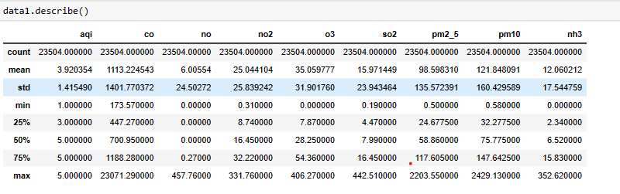
The whole description of the dataset :
Total number of datapoints : 23504
Total number of columns : 11
Data is collected each day : Started from :30-11-2020
Ended on : 25-05-2023

Slide 7
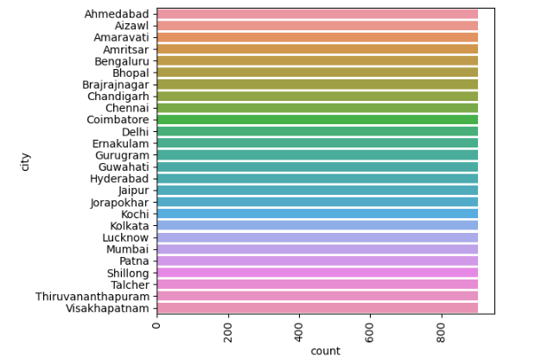
The data is collected from 26 cities of India for 904 days
Count plot of the cities in the dataset:

Slide 8
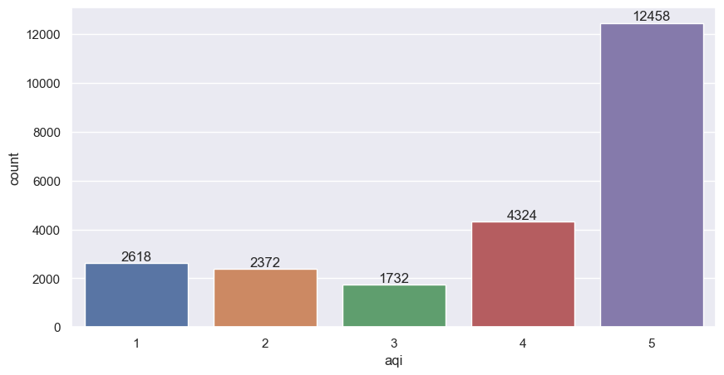
Count of citites having AQI :

Slide 9
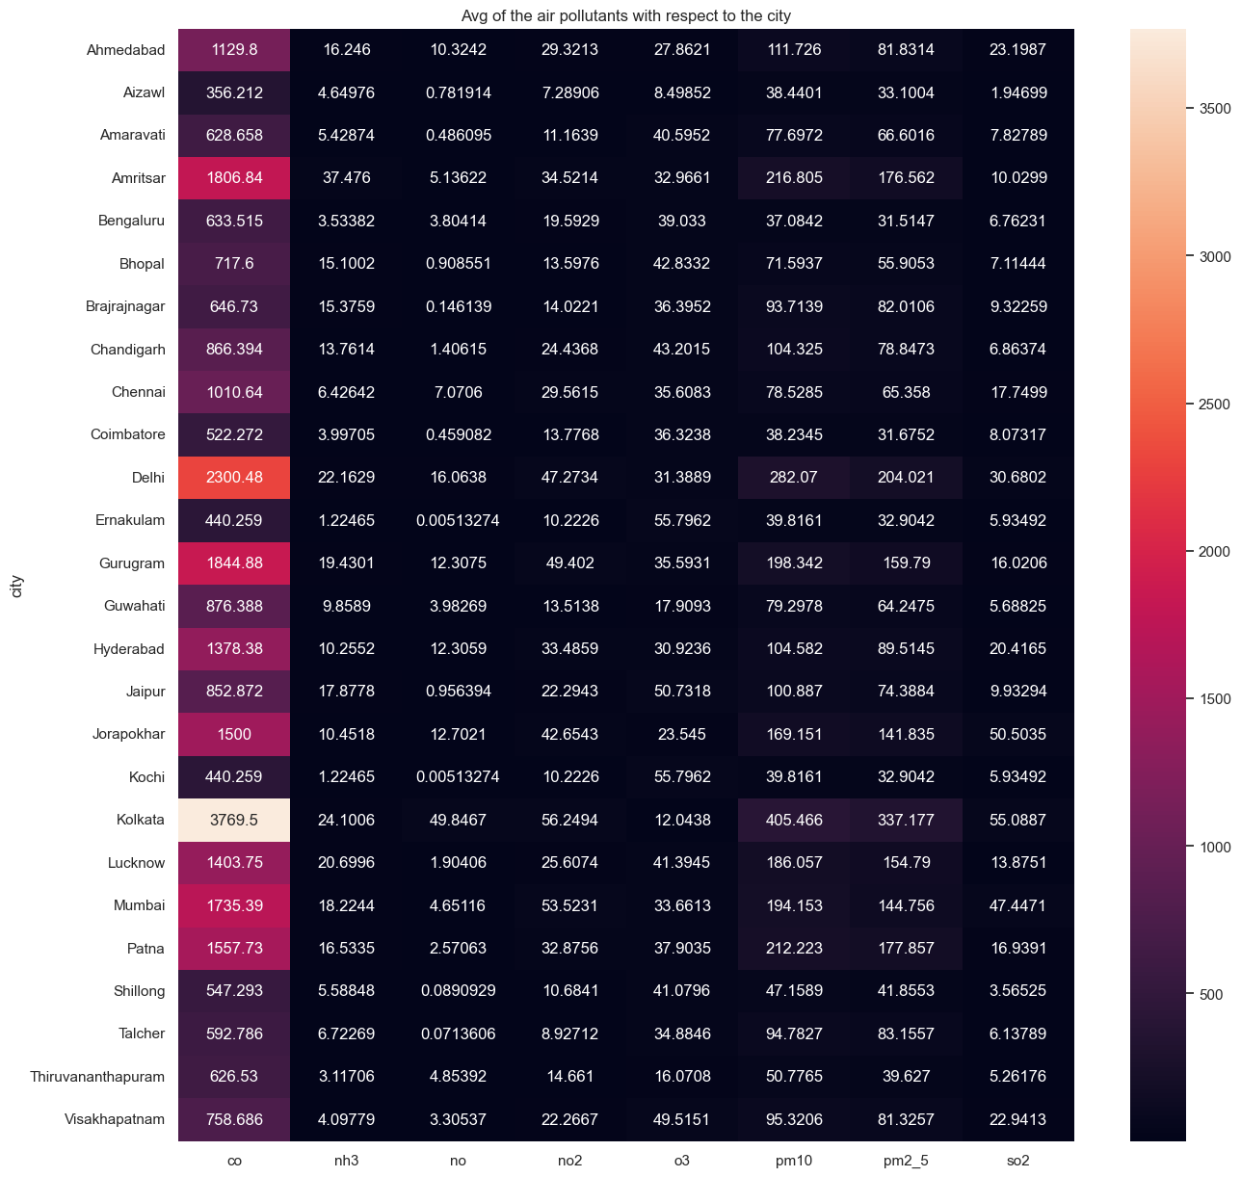
Average of the air pollutants with respect to the city:

Slide 10
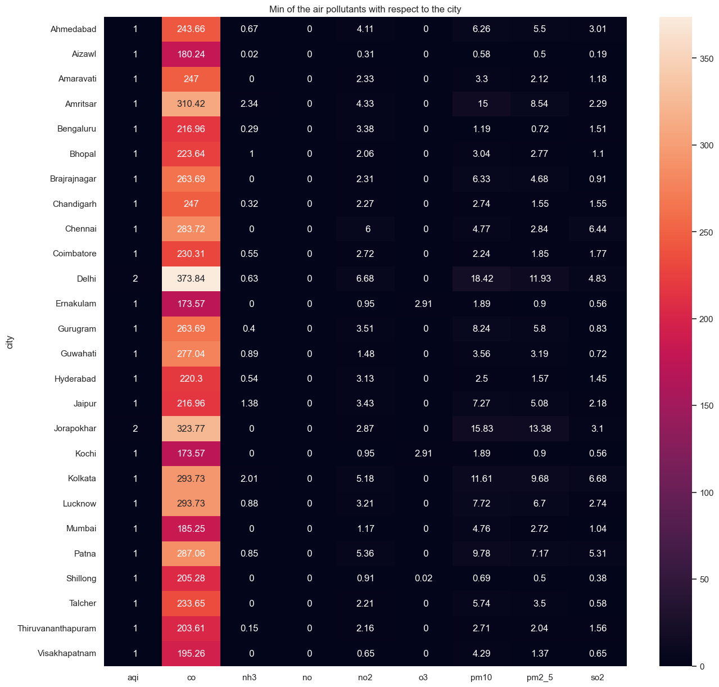
Minimum of the air pollutants in each city:

Slide 11
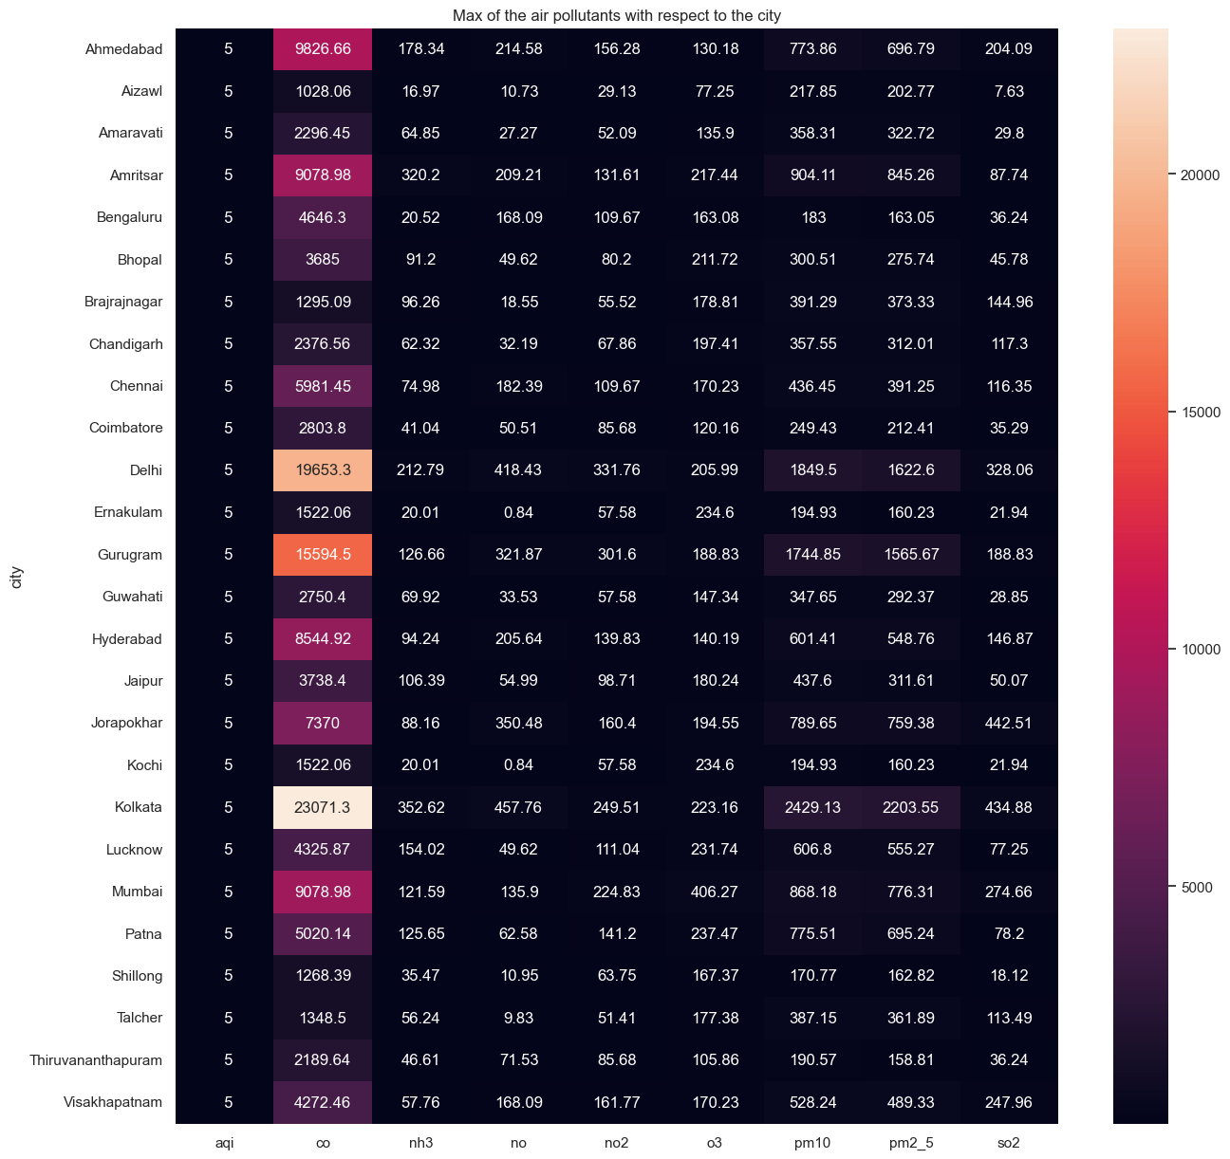
Maximum of the air pollutants with respect to the city:

Slide 12
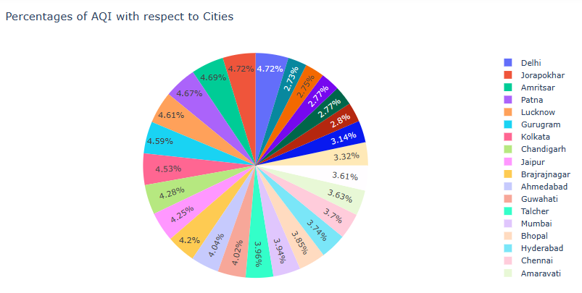
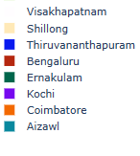
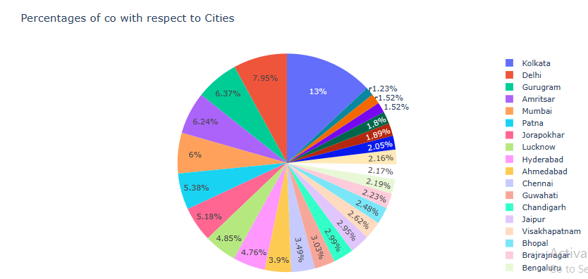
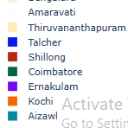

Slide 13
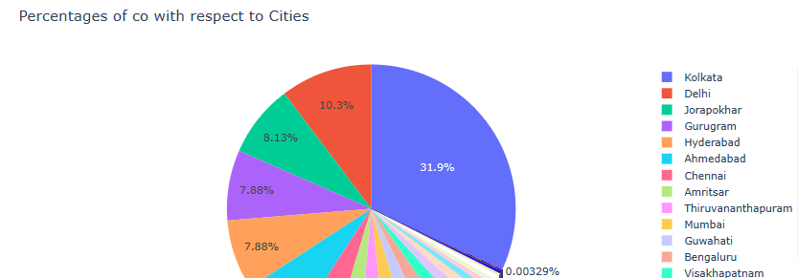
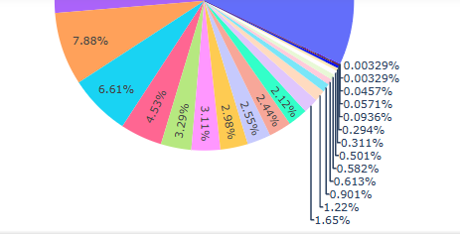
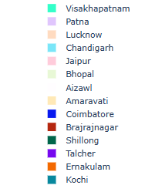

Slide 14
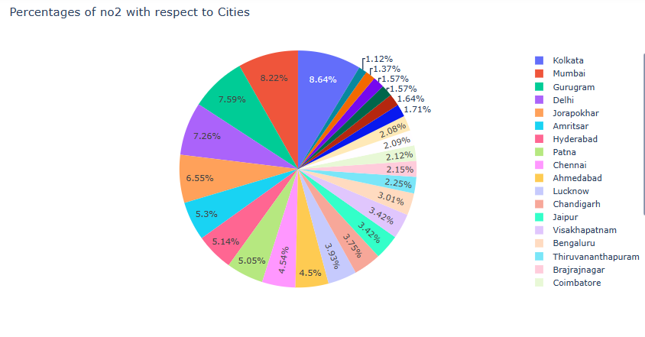
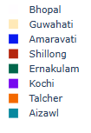
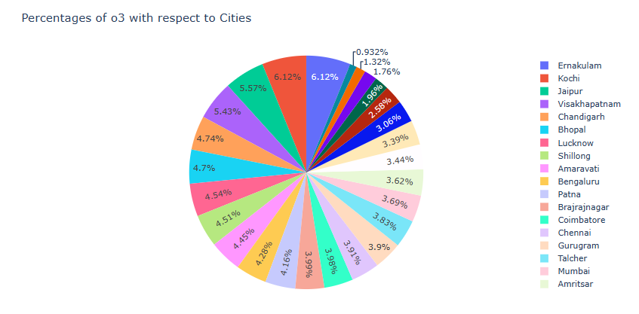
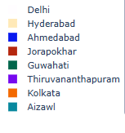

Slide 15
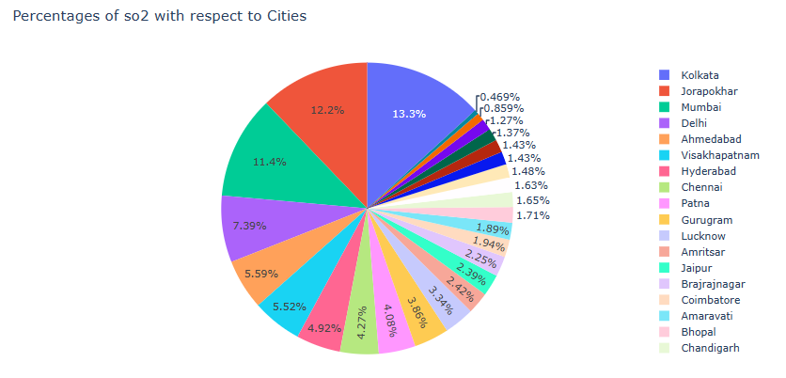
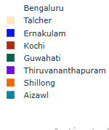
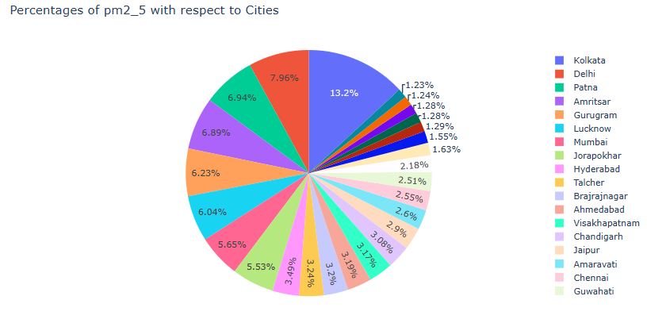
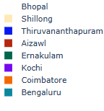

Slide 16
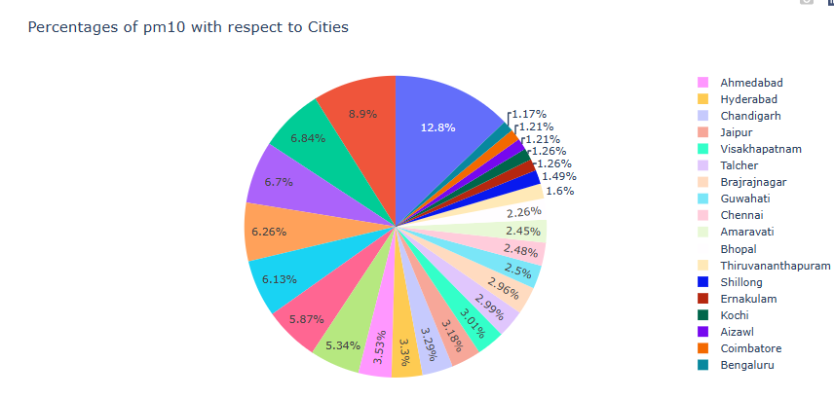
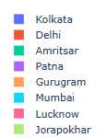
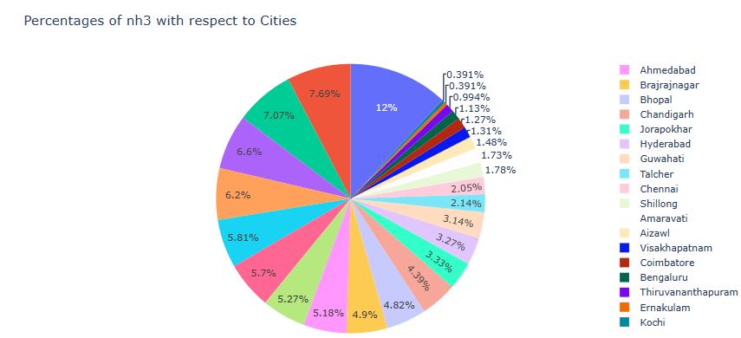
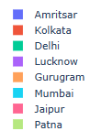

Slide 17
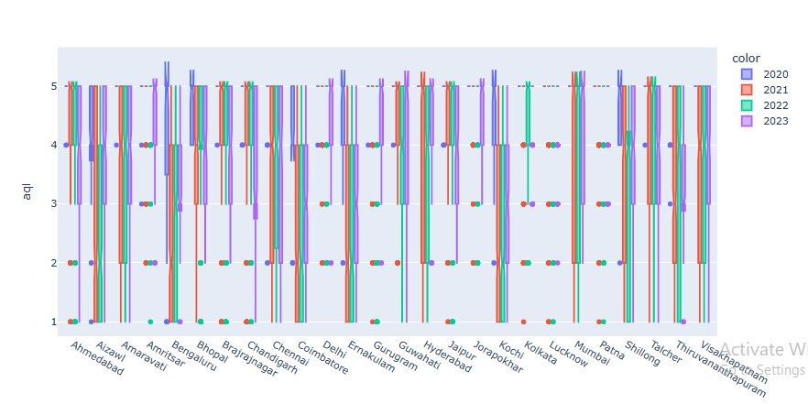
Boxplot of AQI of each year :

Slide 18
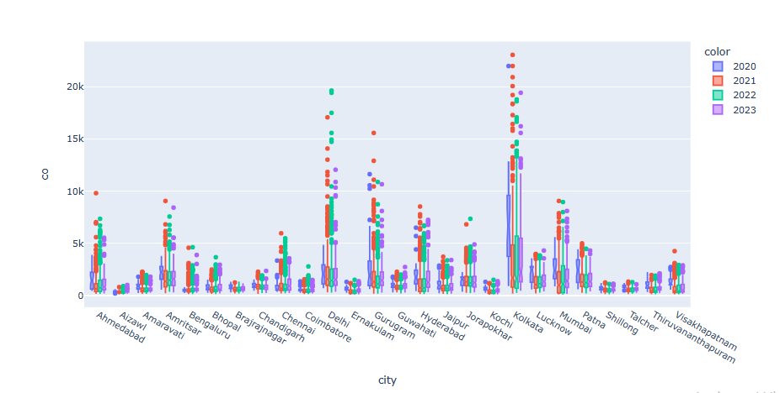
Boxplots of CO of each year :

Slide 19
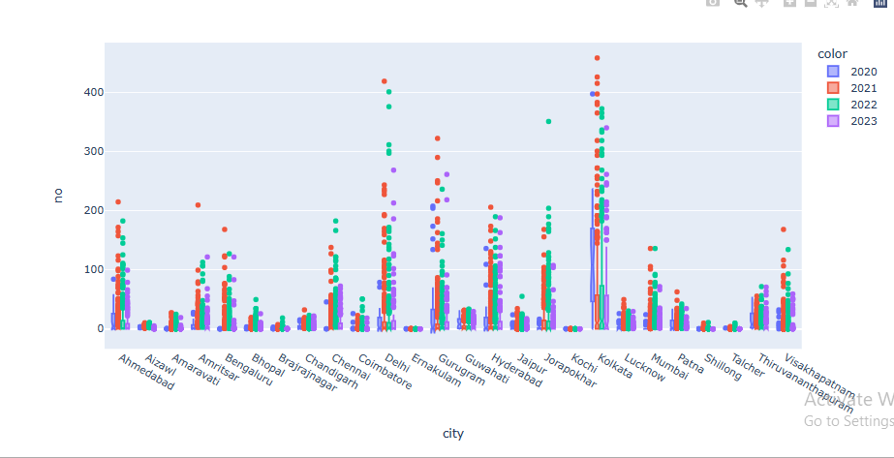
Box plots of NO each year :

Slide 20
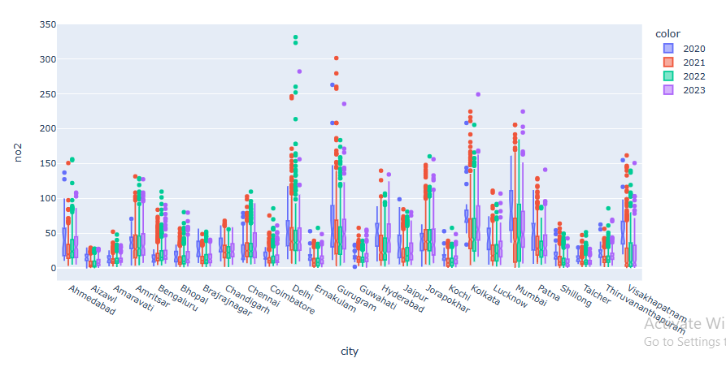
Box plots of NO2 of each year :

Slide 21
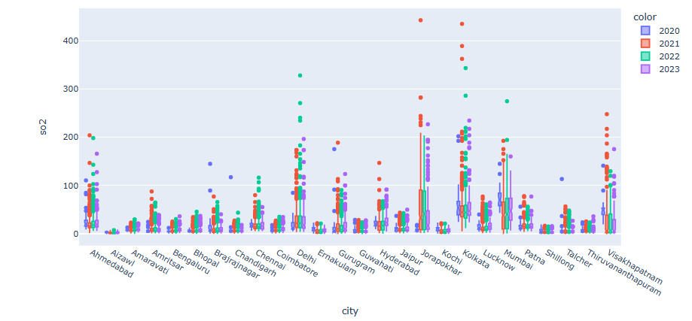

Slide 22
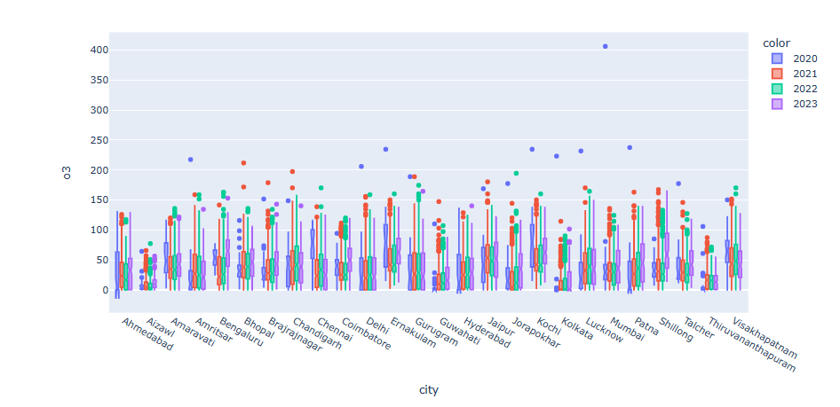

Slide 23
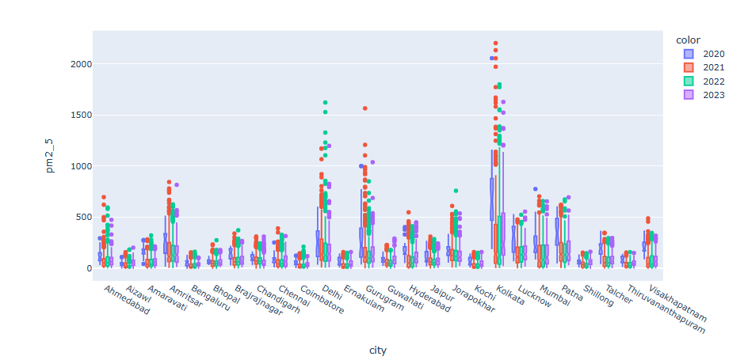

Slide 24
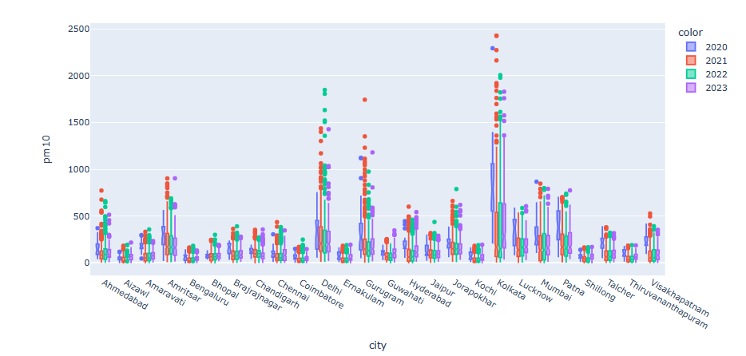

Slide 25
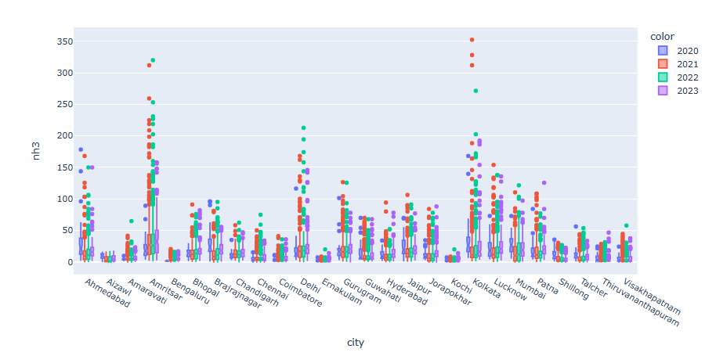

Slide 26
City having maximum air pollutant with date:
Air pollutant | City | Date | Value
co | Kolkata | 2021-07-01 | 23071.29
no | Kolkata | 2021-11-12 | 457.76
no2 | Delhi | 2022-10-29 | 331.76
o3 | Mumbai | 2020-11-30 | 406.27
pm2_5 | Kolkata | 2021-07-01 | 2203.55
pm10 | Kolkata | 2021-06-02 | 2429.13
nh3 | Kolkata | 2021-01-26 | 352.62
so2 | Joraphokar | 2021-05-01 | 442.51

Slide 27
City having minimum of air pollutant s with date:
Air pollutant | City | Date | Value
co | Ernakulam | 2021-08-30 | 173.57
no | Ahmedabad | 2020-11-12 | 0.0
no2 | Aizawl | 2020-11-30 | 0.31
o3 | Ahmedabad | 2020-03-12 | 0.0
pm2_5 | Aizawl | 2022-06-18 | 0.5
pm10 | Aizawl | 2022-06-19 | 0.58
nh3 | Amaravati | 2021-07-11 | 0.0
so2 | Aizawl | 2022-05-15 | 0.19

Slide 28
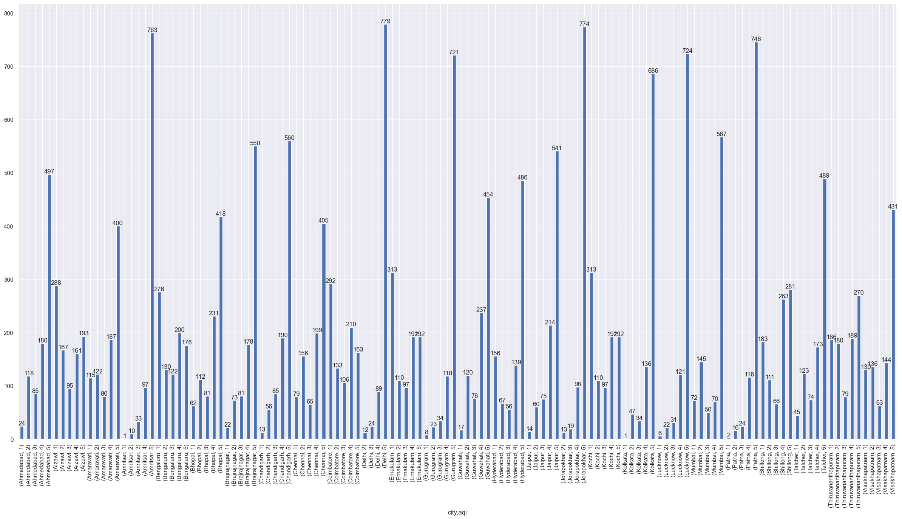

Slide 29
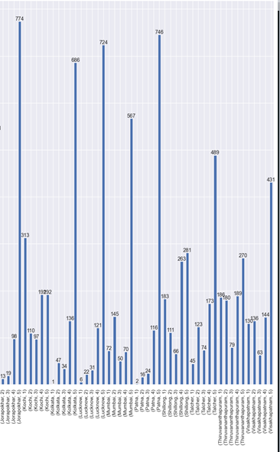

Slide 30
Conclusions:
Most of the Air Quality Index is either 4 or 5 which means that the air in those cities are not much healthy to breathe.
Maximum range of air pollutants was recorded in the city Kolkata.
Maximum polluted cities are Kolkata , Delhi , Ahmedabad , Mumbai…which are metropolitan areas and also industrial areas.
We can conclude that Delhi , Amritser , Jorakhpur , Kolkata , Lucknow , Patna are the cities which are having most of the days AQI as 5
Most of the days of Bengaluru , Ernakulam , Shillong , Thirivananthapuram , Shillong are having AQI as 1

Slide 31


