Slide 1


Integrating Prompt Templates and RAG Models for Human-Centered Conversational Assistants
Simplifying User Life with Smart Assistance
Guided by
Dr.M.Rajasekaran

Slide 2

Team Members
Name | Reg No
Padyala Himanshu | 99220040153
Pasupuleti Charan Kumar | 99220040158
Pasupuleti Dharani Kumar | 99220040159
Penumakula Sudhakar | 99220040164

Slide 3
Problem Statement
Users struggle with fragmented interfaces and repetitive digital tasks.
Lack of personalized automation across platforms and services.
Existing voice assistants offer limited contextual understanding.
Manual task execution reduces productivity and user satisfaction.
Need for a unified, intelligent assistant that adapts to individual workflows.

Slide 4

Literature Review
Sno | Title | Author | Year | Methodology
1 | CHATBOT: Design, Architecture, and Applications | Xufei Huang | 2021 | Combines rule based and machine learning Approaches discusses slot filling and statistical NLU techniques for chatbot design and deployment
2 | Chatbot using Natural Language Processing (NLP) Techniques | Sunny Kaushik, Rahul | 2023 | Reviews NLP algorithms for context-aware chatbot development; emphasizes speech management, intent recognition, and user satisfaction metrics
3 | Conversational AI Unleashed: A Comprehensive Review of NLP-Powered Chatbot Platforms | Shubham Chaurasia, Shubha Jain, Hari Om Vishwakarma, Nishant Singh | 2023 | Surveys rule-based, generative, and retrieval-based models; explores Pre-trained language models and ethical concerns in chatbot design
4 | Designing Personal Assistants with Deep NLU and Contextual Awareness | Priya Sharma, Ankit Verma | 2024 | Implements transformer based NLU models (e.g., BERT) for personalized task execution; integrates dialogue state tracking and contextual embeddings.

Slide 5
Existing System Overview
Google Assistant → strong voice, weak personalization
Alexa → IoT-focused, limited reasoning
Siri → restricted ecosystem
Copilot → productivity-focused
No contextual memory
No unified automation
Limitations:

Slide 6
Objective
Develop a personal AI chatbot with advanced NLU for task simplification.
Enable voice interaction and contextual conversation handling.
Automate routine tasks across apps, devices, and services.
Prompt templates implementation enhances search outputs.
Personalize responses based on user preferences and behaviour.
Integrate speech synthesis for natural, human-like communication.

Slide 7
Proposed System
Hybrid AI chatbot with:
RAG (Retrieval-Augmented Generation)
Voice-based interaction
Prompt templates
Task automation
.
Context-aware responses
Cross-application automation
Key Features

Slide 8
Introduction
Personal AI chatbots are digital assistants capable of interacting via voice or text.
Focused on enhancing user productivity through intuitive interaction.
Uses NLU to understand intent, context, and multi-turn dialogue.
Designed for scalability across domains like scheduling, reminders, and info retrieval.
Bridges the gap between conversational AI and real-world task execution.

Slide 9
Features
Natural Language Understanding: Intent recognition and entity extraction
Prompt templates: Simplify searching and produce better outputs.
Multimodal Interaction: Supports both voice and text inputs
Task Automation: Scheduling reminders, sending emails, retrieving updates
User Profiling: Learns user habits for better recommendations

Slide 10
Industry Analysis
Conversational AI market projected to exceed $40B by 2030.
Major players: Google Assistant, Amazon Alexa, Apple Siri, Microsoft Copilot.
Growing demand for domain-specific, customizable AI agents.
Enterprises investing in AI for customer support, HR, and operations.
Voice-first interfaces gaining traction in smart homes and mobile apps.

Slide 11
Modules
Module 1: RAG Engine
Document ingestion
Vector embedding
Semantic retrieval
Context-based response generation
Module 2: Voice Automation
Speech-to-text conversion
Intent recognition
Task execution (apps, web, scheduling)
Module 3: Educational Module
Quiz generation
Podcast summaries
Adaptive learning

Slide 12
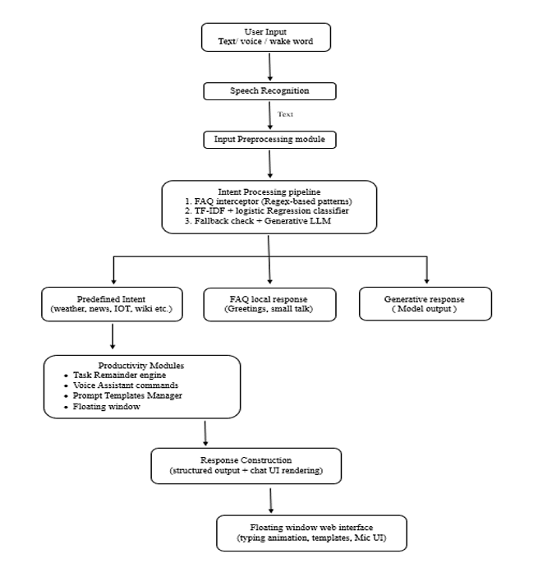
Work Flow:

Slide 13
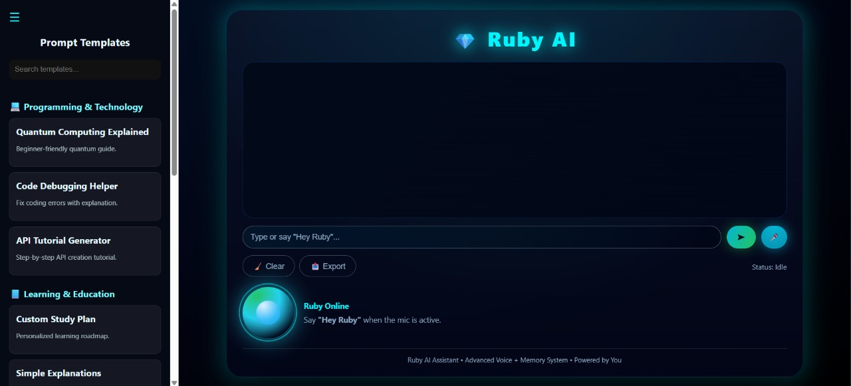
Results

Slide 14
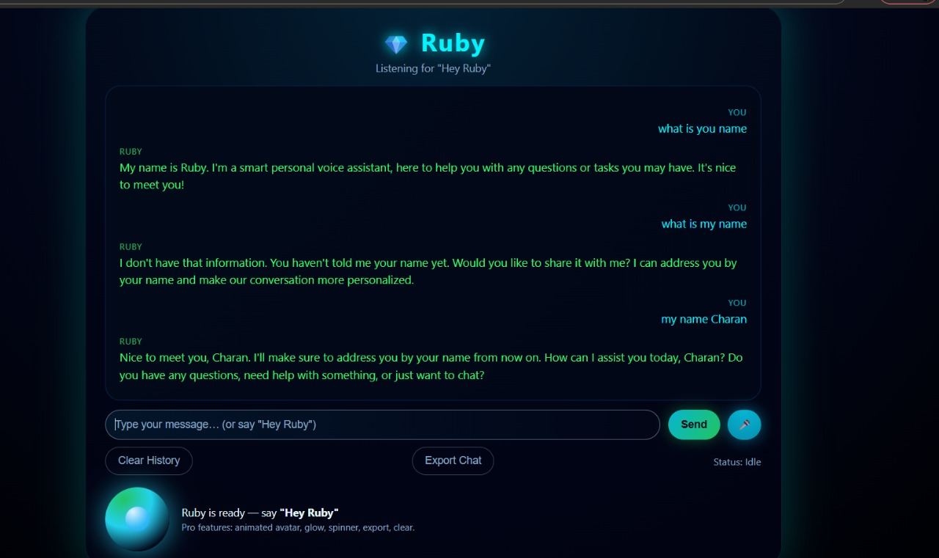


Slide 15
Market Potential & Business Model
Rising adoption of AI in personal productivity and smart devices.
Huge opportunity in underserved segments: freelancers, students, SMBs.
Increasing demand for multilingual, culturally adaptive assistants.
Potential for integration with wearables, IoT, and enterprise tools.
Subscription-based models and API monetization offer scalable revenue.

Slide 16
Conclusion
Developed hybrid AI assistant
Combines RAG + Voice + Automation
Improves productivity and accuracy
Practical real-world application
Offline AI models
Edge computing integration
Emotion-aware AI
IoT integration
Advanced personalization
Future Enhancements

Slide 17
References
1. L. Jiang, M. Zhang, Y. Chen, et al. “Adaptive Retrieval-Augmented Generation for Conversational Systems” arXiv:2407.21712 (July 2024).
2. K. Chen, J. Lee, P. Zhao, et al.”A Systematic Literature Review of Retrieval-Augmented Generation (RAG)” arXiv:2508.06401 (August 2025).
3. R. Yang, Z. Liu, S. Wang, et al. “A Systematic Review of Key Retrieval-Augmented Generation Techniques” arXiv:2507.18910v1 (July 2025).
4. S. K. Reddy, A. Sharma, V. Patel, et al .”A Banking Chatbot Using Retrieval Augmented Generation” IJIRT, Vol. 17, Paper 178847 (2025)
5. A. Mehta, R. Kumar, S. Nair, et al.”A Healthcare Chatbot Powered by Retrieval-Augmented Generation” IJCRT, Paper BE02109 (July 2025).

Slide 18
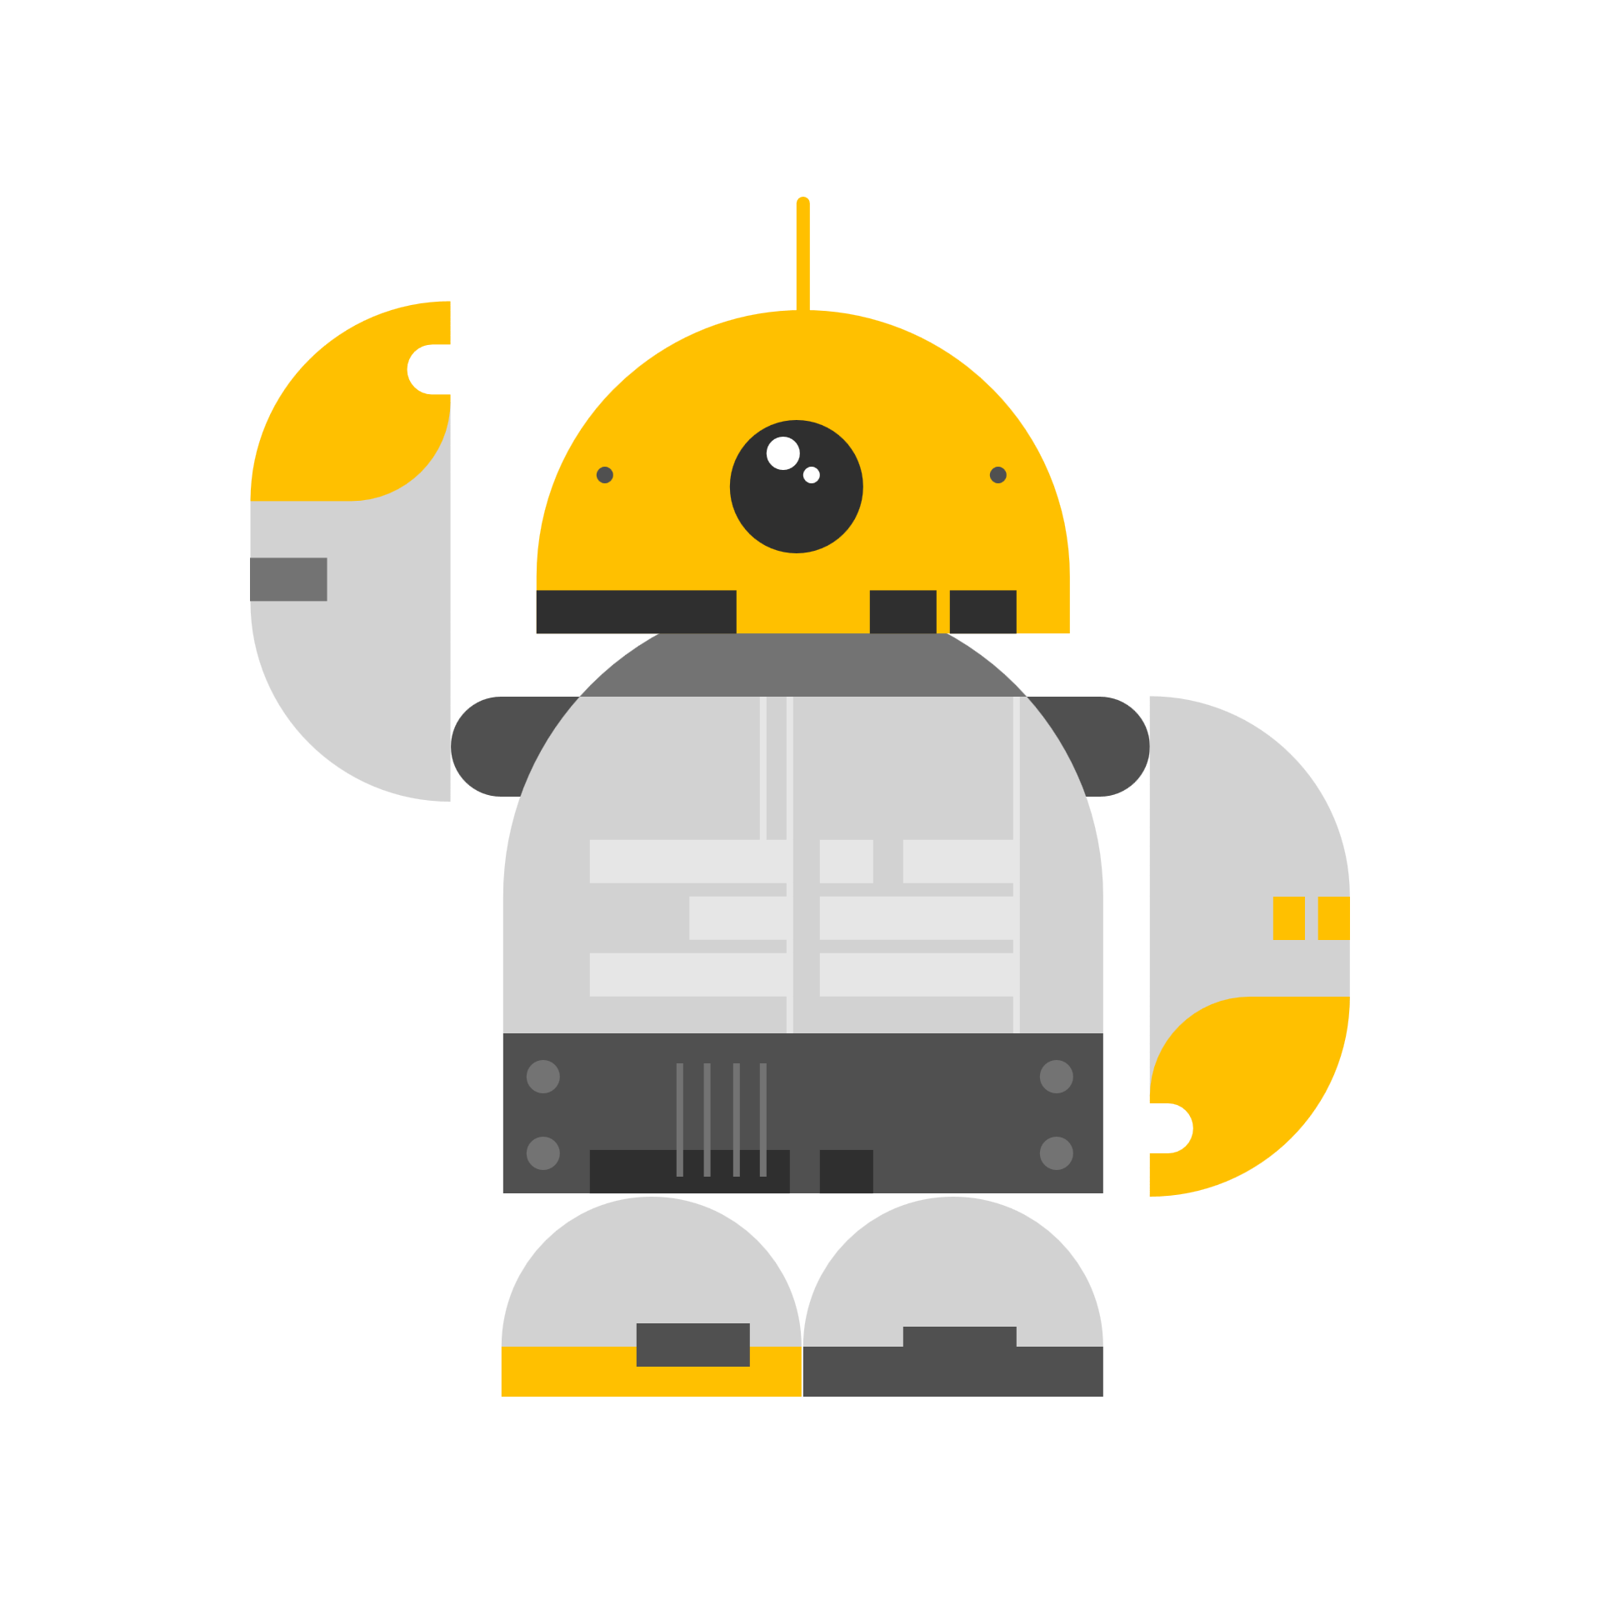
THANK YOU

