Slide 1

Clinical Trial Management

Slide 2
Clinical Trial Management Overview
« As a Clinical Trial Manger, I need to view all studies in portfolio …
… then I can organize the planning and resources »
« As a Clinical People Manager, I need to manage patients and physicians
… then I can ensure availability of human resources »
« As a Global Quality Manager, I need users to have dedicated roles
… then I can ensure the compliance of my company »
« As an IT Security Manager, I need users to be loged each time the application is open …
… then only autorized people can view data »

Slide 3



Clinical Trial Management Architecture
Serveurs
Front
React and bootstrap
Database
Clients
Back
ExpressJS
MySQL

Slide 4
Clinical Trial Management Used technologies
React
React-router dom
React-pdf
Bootstrap
Express
Dotenv
JwT
MySQL 12
nodemon for dev
Front
Back
MySQL
Database

Slide 5
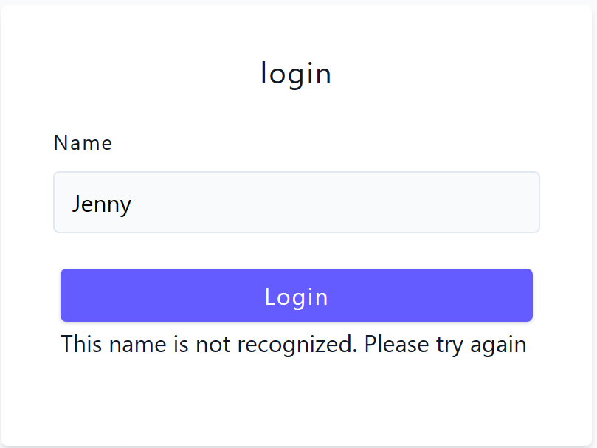
Clinical Trial Management Quality and Security compliance
« As a Global Quality Manager, I need users to have dedicated roles … then I can ensure the compliance of my company »
« As an IT Security Manager, I need users to be loged each time the application is open … then only autorized people can view data »
Users must have an account recorded in the database
If the user is recognized, the backend sends a security token
The user’s rôle is provided by the db
Modification features are visible depending of the rôle
Information in pages are in view mode only

Slide 6
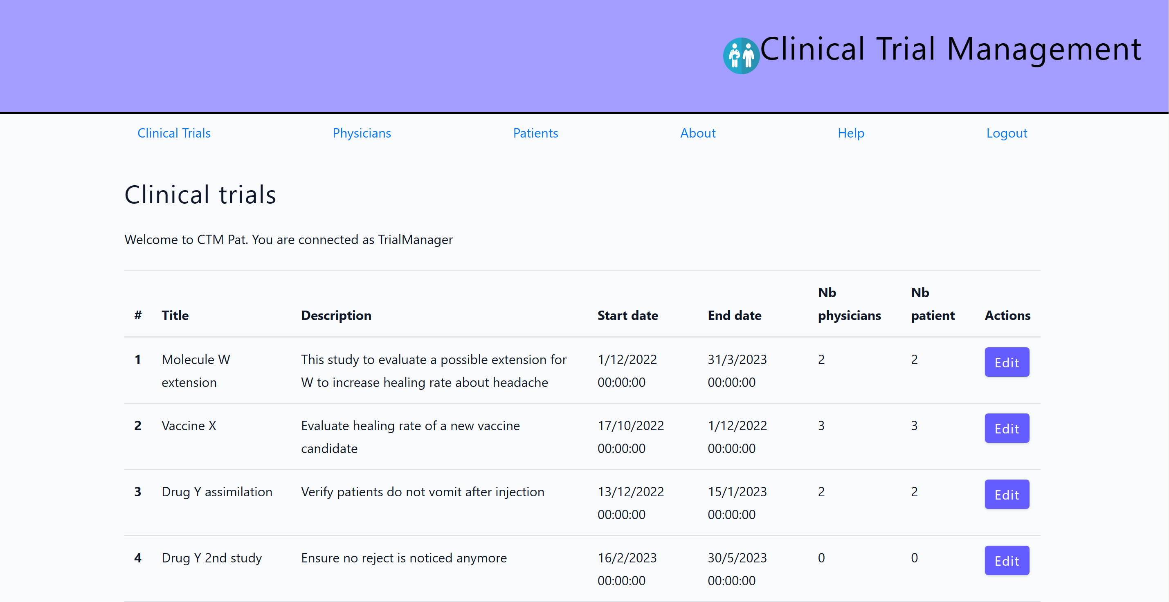
Clinical Trial Management « As a Clinical Trial Manger, I need to view all studies in portfolio … … then I can organize the planning and resources »

Slide 7
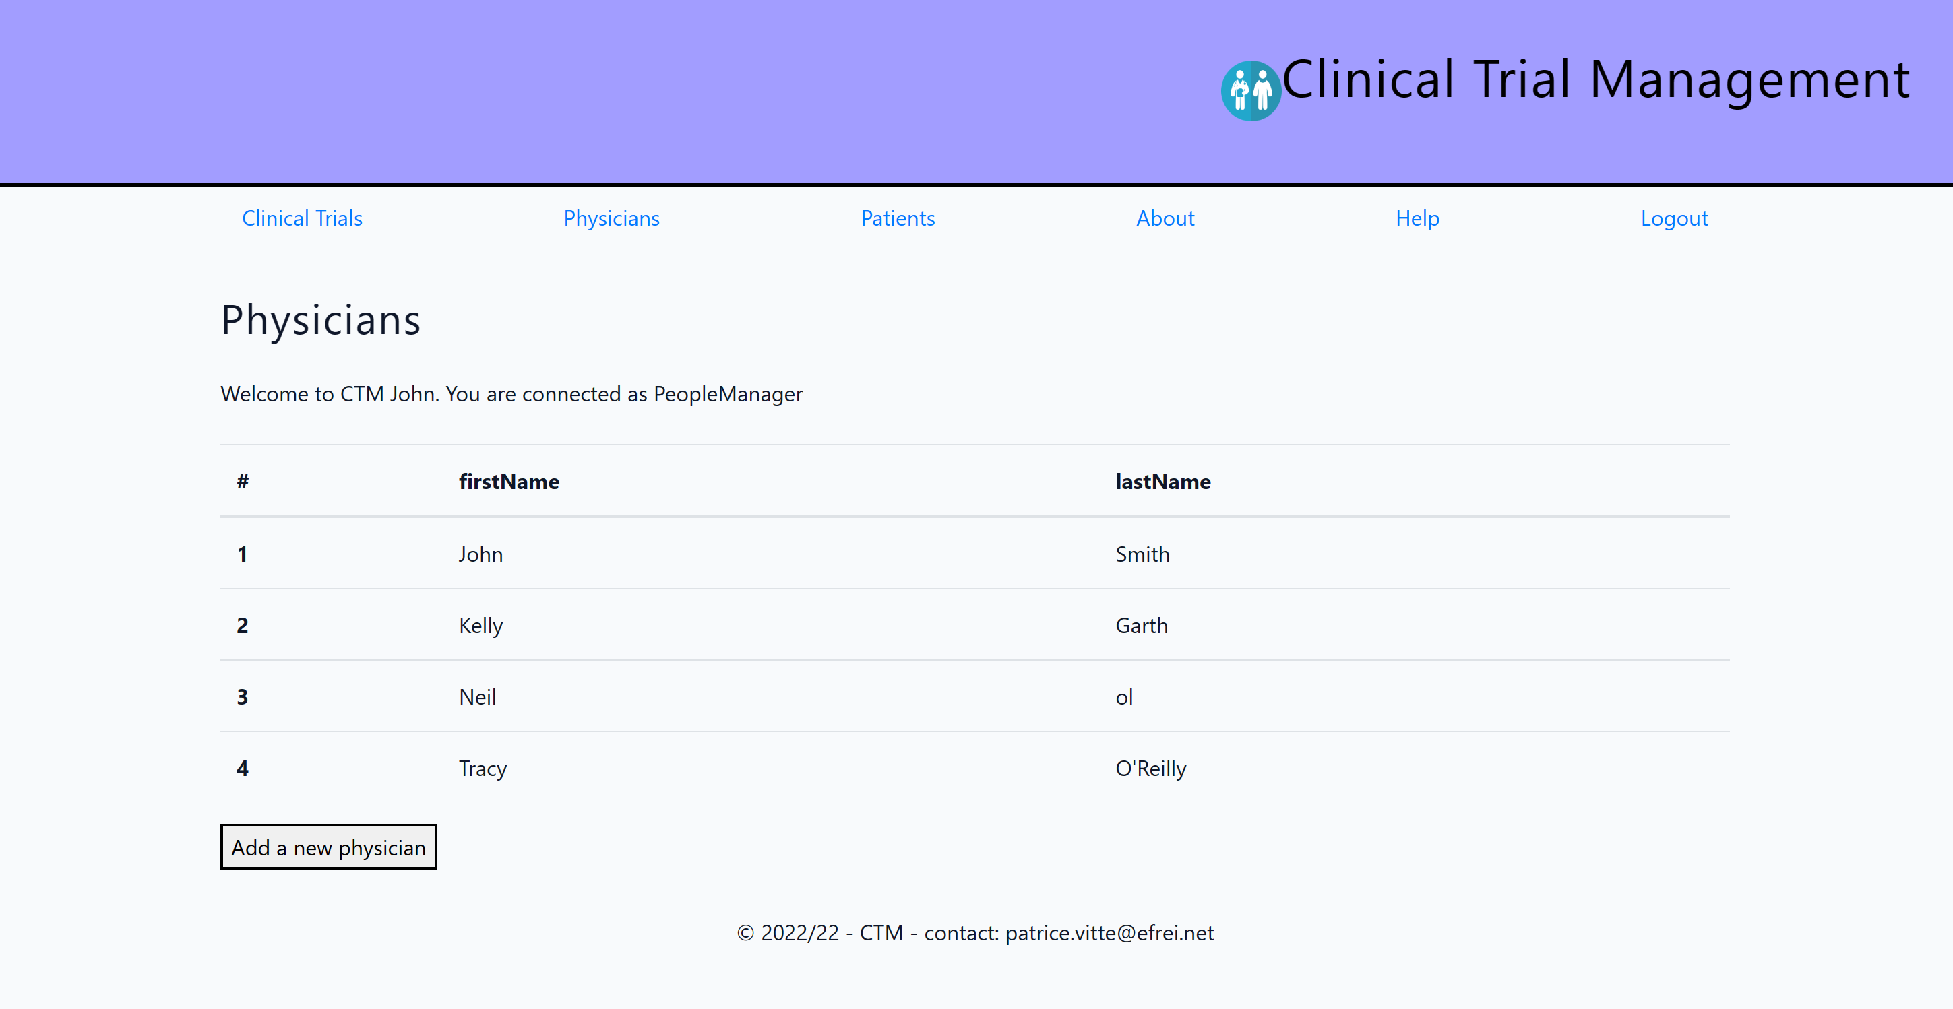
Clinical Trial Management « As a Clinical People Manager, I need to manage patients and physicians … then I can ensure availability of human resources »

