Slide 1
MediCue 24*7

Slide 2
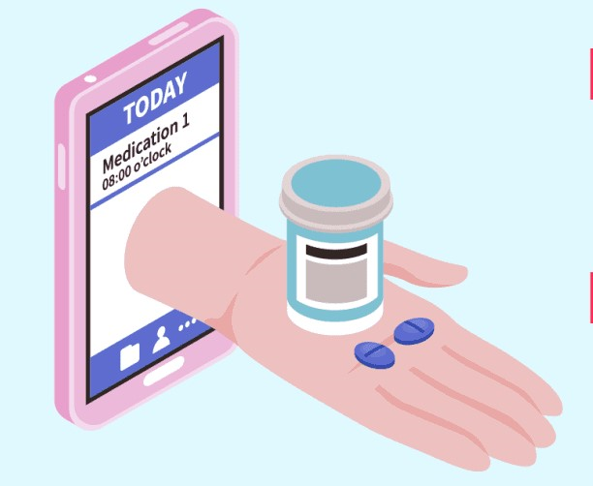
GUIDE & TEAM MEMBERS
Guide:
Team members :
ANUPAM ANUSHKA GAURI

Slide 3
TABLE OF CONTENTS
01
02
Objectives
Methods
03
04
APP DEVELOPMENT
Conclusion
Health is top priority our app will restore your all medical records and notify you on time
App let you carry your medical history and remainder in your pocket
JAVA +KOTLIN

Slide 4
01
OBJECTIVES

Slide 5
There are many people that uses more than few medicine daily. Our objective is to make it easier for users to remember the medicine that they need to take. Many would ask the difference between our project and the regular Reminder that both iOS and Android have. Our application is specified for only medicine purposes which allows to add, delete and view multiple medicine records including logs and time.

Slide 6
INTRODUCTION
The busy schedule of people can make them forget about their medication at times. The app offers personalized reminders for each day, as well as important drug interaction warnings, missed medication alerts, reminders when you’re running low, and family scheduling tools. That way you and a caregiver will get notifications.

Slide 7
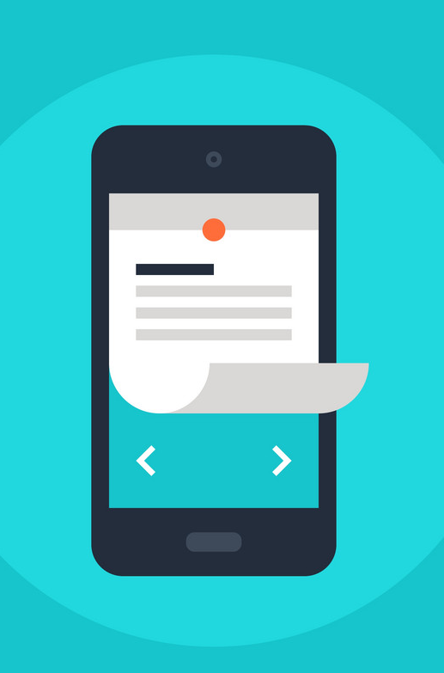
So we are introducing an Android application whose objective is to remind the patients of their dosage timings through Alarm system so that they can stay fit and healthy. This application focusses on the people who forget to take medicines on time. It allows users to set an alarm along with the fields of date, time and medicine description(name) which will allow them to set alarm for multiple medicines at different time intervals .

Slide 8
IMPORTANT GOALS
This simple and easy-to-use app allows users to track their medications, receive alerts as reminders to take their pills, and set reminders for medical appointments.
It can also be used by the registered user to track, collect and share the past and present information regarding their health or the health of someone you care. With the use of this recording tool, one can save money and other inconveniences like repeating several medical tests
The healthcare app ideas also have great potential to strengthen the medical system.

Slide 9
“Time and Health are two precious assets that we don’t recognize and appreciate until they have been depleted”.
-Denis Waitley

Slide 10
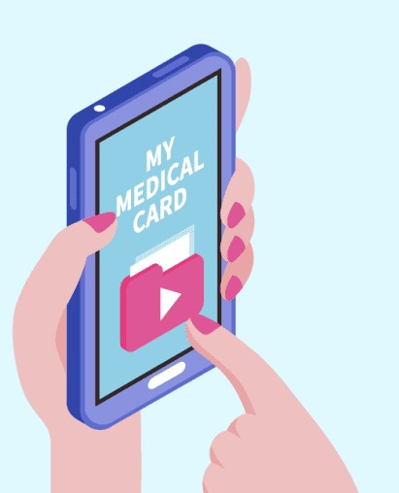
TECHNOLOGY USED :
1. PROGRAMMING LANGUAGE : JAVA ,KOTLIN
2.ANDROID STUDIO
3.API

Slide 11
Why there is need of this app?
5% of people in the age group of 18-29 years have health applications installed on their smartphones. Moreover, this number is 8% for users in the age group of 30-49 years.
25% of senior citizens in the India are currently using a health application on their smartphones.
In a 2017 high level study involving 1,198 adults, they were found to have medication delays 80–85 percent of the time and to have forgotten medication 44–46 percent of the time.

Slide 12
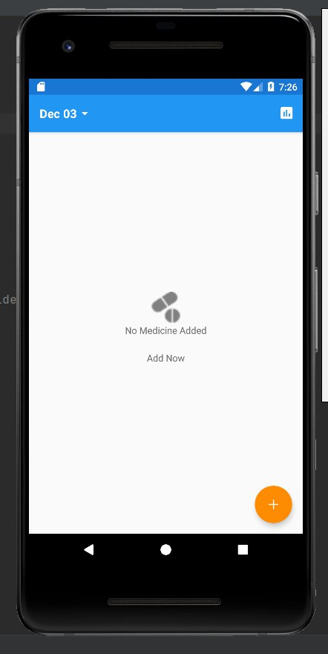
Working and design
Screen 1: Show start of Application

Slide 13
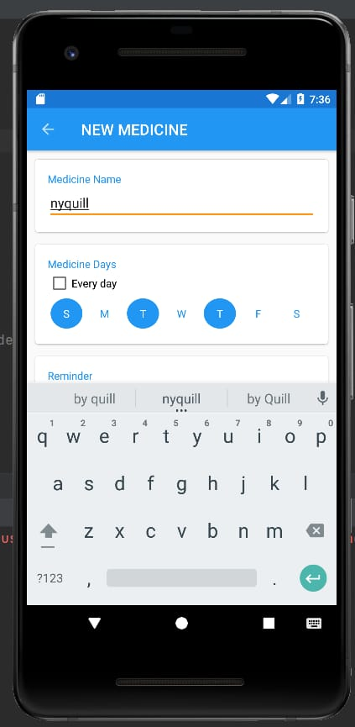
Screen 2
Main activity:-show first interface of application which contain several option which use for different purpose
1) MEDICINE NAME
2)MEDICINE DAYS
3)MEDICNE REMAINDER

Slide 14
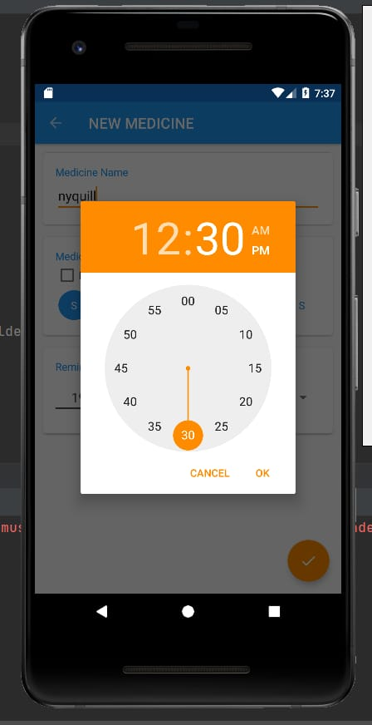
MEDICINE SET ALARM/REAMINDER
Use to create alarm for take medicine on time
by enter time , date and medicine name

Slide 15
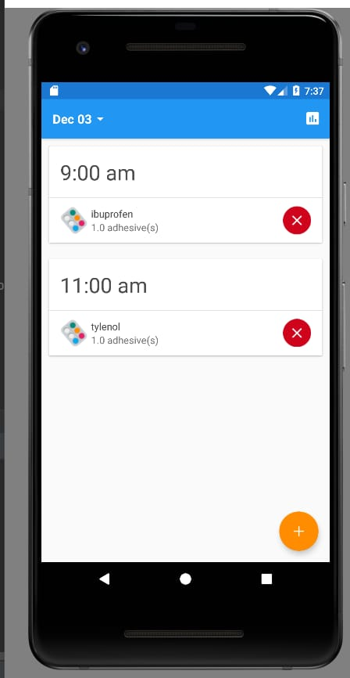
SCREEN 3
Notification module:
After medicine set successfully ,we can see the interface where alarm is set then the user gets the notification. The users can cancel accordingly. If he does not require the notification he/she can cancel it .

Slide 16
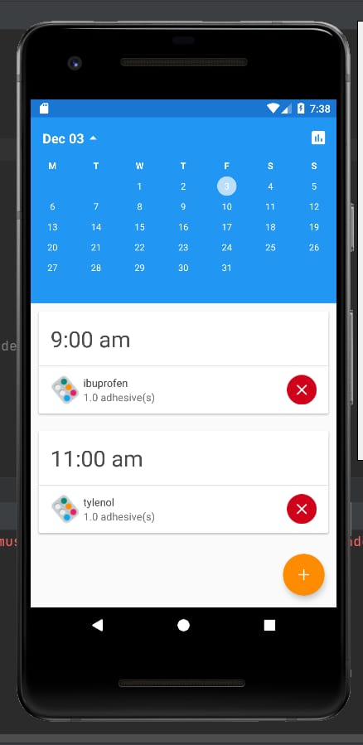
CALENDAR FACILITY
shows the calendar facility where he can/she can check the suitable date according to their preferences of medicine doses.

Slide 17
Conclusion and future work
Many Medication Reminder Systems have been developed on different platforms. Many of these systems require special hardware devices to remind the patients about the medicine in-take timings. Purchasing new hardware devices becomes costly and more time and money consuming. So in the given work an attempt has been made to implement a system which is economical, easily accessible and improves medication adherence. The MediCue 24/7 medication reminder is a straightforward smartphone app. You’ll record when you take your medications and receive medication reminders.

Slide 18

THANK YOU

