Slide 1






VASANTDADA PATIL PRATISHTHAN’S COLLEGE OF ENGINEERING & VISUAL ARTS
Problem Statement:
Sector: Rural development
Domain:
Team Name: Trail Blazers
Team Members: Vinit Juikar
Gauri Patil
Rohit Bagade
Kamakshi Arya somayajula

Slide 2
IDEA / APPROACH DETAILS
Describe your Idea / Solution / Prototype Details.
Idea is focussed on improving the livelihood of people by increasing the economic growth of the country.
Motive is to build an application that would help underprivileged people to get employment opportunities.
So through the application we would be creating a direct connection between the user (i.e. Provider) who needs to get work done and the job seeker (i.e. seeker) without any mediators.
The job seekers may include the carpenters, painters, electricians etc.
To go through the application both the provider and seeker need to fill in the basic personal information about themselves.
In case of providers the personal information and the services they require.
In case of seekers the skills they are accustomed with and the job they are looking for and need to upload a photo of oneself to prove the identification.
A verification is conducted in both the sections to ensure the safety of both the parties.

Slide 3
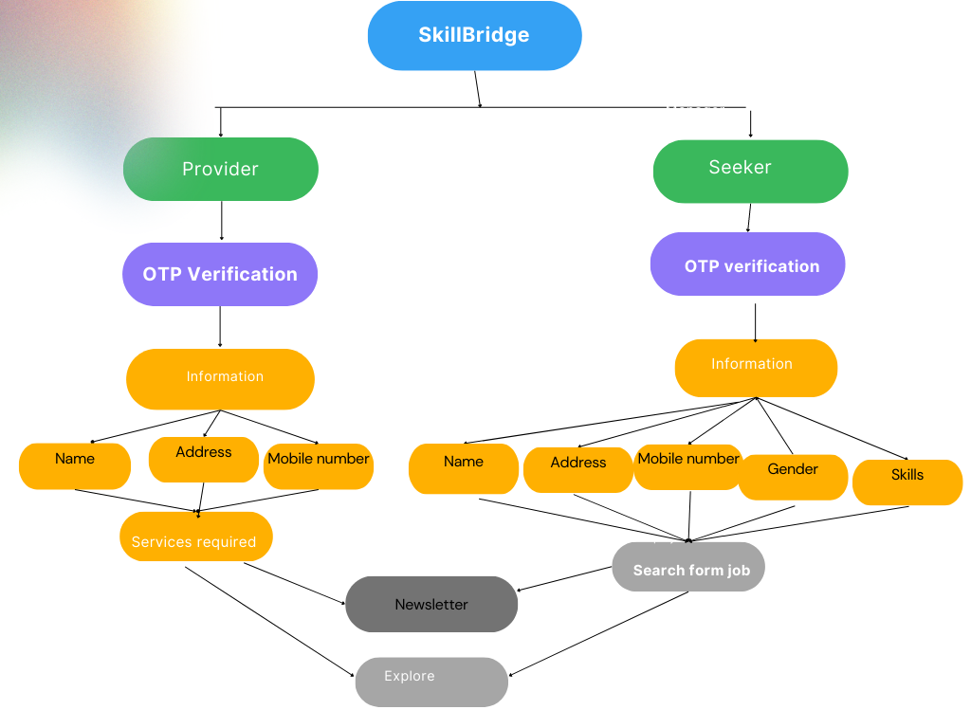
FLOWCHART / ARCHITECTURAL DIAGRAM
Provide your process flow diagram or architectural diagram.

Slide 4
USE CASES
Describe your potential use cases of your project.
Job searching – To find job opportunities and apply for jobs
Recruiting - Post job openings and search for qualified candidates
Networking - Connect with other professionals and build your network
Personal branding - Showcase your skills, experience, and accomplishments
Sales and marketing - Reach potential customers and promote products or services
Learning and development - Take online courses and tutorials to develop new skills.

Slide 5
TECHNOLOGIES / HARDWARE USED
Provide an overview of the technical architecture of your solution.
1. Flutter : An open source framework by Google for building beautiful, natively compiled, multi-platform applications from a single codebase.
2. Firebase: A set of hosting services for any type of application. It offers NoSQL and real-time hosting of databases, content, social authentication, and notifications, or services, such as a real-time communication server.
3. Figma: A collaborative web application for interface design, with additional offline features enabled by desktop applications for macOS and Windows.

Slide 6
BUSINESS MODEL CANVAS
Create a comprehensive business model canvas that encompasses all the relevant factors.
In the application we provide details about the nearest seekers according to the providers request.
Provider:
Premium feature : It comes to use after first few trials given to the provider for getting the information about the necessary and nearest information about seeker. It is a paid feature.
Equipments : In this section the provider would be able to sell and buy equipments according to their needs and requirements.
Branding : Can be considered as self branding allowing providers to showcase their skills and have trainings and workshops for the seekers.
Seekers :
Online courses : Courses would be available in case the seeker would like to enhance their skills for better employment opportunities.
Self Promotion : Seekers would be able to showcase their skills.
Equipments : Can buy and sell equipments goes well for both seekers and providers.
Ad revenue: Providers can submit advertisements regarding workshops, employment, branding and equipments which will be displayed in the application.

Slide 7



IMPORTANT POINTS TO REMEMBER
Kindly keep the maximum slides limit to 6 pages.
Use clear, readable fonts and avoid cluttered or busy slides
All the topics should be utilized for the description of your idea. Try to avoid paragraphs and post your idea in points.
Keep your explanation precise and easy to understand.
A higher score will be assigned if the idea has potential for commercial viability.
Name the PPT: sectorname_teamname_projectname

