Slide 1
Multithreaded Reader and Writer Problem
Lawrence Ferretti, Moon Lee, Steven Kuhfahl
CSC 716 Fall 2015
Dr. Huo

Slide 2
Problem Description
Readers and Writers problem
This is an example of concurrency when multiple threads are executing simultaneously.
This problem has multiple reader and writer threads trying to access the same file.

Slide 3
Solution Methods
Semaphore - Moon
Monitor - Lawrence
Test and Set - Steven

Slide 4
Method 1:Semaphore
Semaphore is a counter
Using wait()/signal() to block/unblock thread
To guarantee mutual exclusion
Avoid busy waiting, thus more efficient than mutex

Slide 5
Language:
C++11 Standard
Implementation of Semaphore:
Use a Mutex and a Condition Variable pair to implement a Semaphore because C++ standard library does not define a semaphore type.

Slide 6
std::condition_variable Member Funcitons
Name | Description
notify_one() | notify one waiting thread
notify_all() | notify all waiting thread
wait() | blocks current thread until notified
wait_for() | block current thread until notified or specified duration passed
wait_until() | block current thread until notified or specified time point reached

Slide 7
wait()
unique_lock lck(mutex);
condition_variable.wait(lck);

Slide 8
wait()
At the moment of blocking the thread, it automatically calls lck.unlock() to unlock mutex, allowing other locked threads to continue.
Once notified, the thread is unblocked and calls lck.lock() to lock mutex. The thread should then check the condition and resume waiting if the wake up was spurious.

Slide 9
Initialize variables
mutex mtx; // reader writer mutex for condition variable
condition_variable readwrite_cv;
atomic<int> rw_flag(0); // global variable. read write flag.

Slide 10
void reader()
{
while(1) {
/* prefix */
while(rw_flag < 0) {
unique_lock lck(mutex);
wait(lck);
}
rw_flag++;
read file;
rw_flag--;
signal;
/* suffix */
}
}

Slide 11
void writer()
{
while(1) {
/* prefix */
while(rw_flag) {
unique_lock lck(mutex);
wait(lck);
}
rw_flag = -1;
read and write file;
rw_flag = 0;
signal;
/* suffix */
}
}

Slide 12
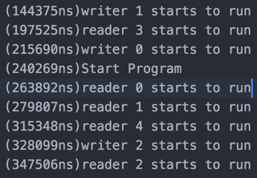
Problem 1: Rarely I found some threads start to run while initializing reader and writer threads.
we can see that writer 0, 1 and reader 3 start to run before all threads are initialized. "Start Program" is the point all threads are initialized.

Slide 13
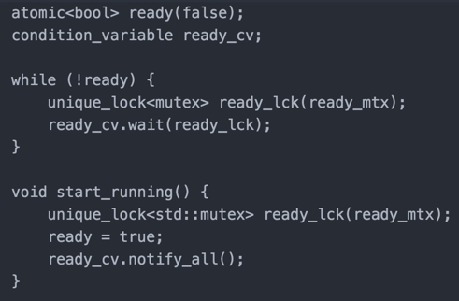
Solution

Slide 14
Problem 2: Printed messages are overlapped in Xcode output in OS X. But not in Ubuntu.
(924803550ns)Reader id: 0(Sleep for 315(( (9(9m9292i2424l4848l8181i2337s1705e5704c3335o4n6nnnsnsds)s)s)R)R)ceRe 2aea daddeeerrr iiiddd::: 341(((SSSllleeeeeeppp fffooorrr 448784750 mmmiiilllllliiissseeecccooonnndddsss)))

Slide 15
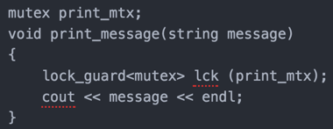
Solution

Slide 16
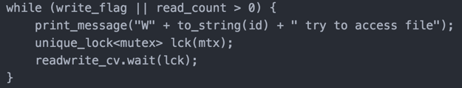
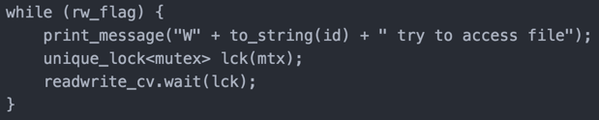
Problem 3: In writer's while loop it has potential to cause race condition.
Solution

Slide 17
Semaphore Demo

Slide 18
Method 2 :Monitor
Monitor is a similar method to semaphore that is used to allow multiple threads to have mutual exclusion. This is accomplished by encapsulating the resources This method uses Mutex to lock and unlock threads. There is only one lock.

Slide 19
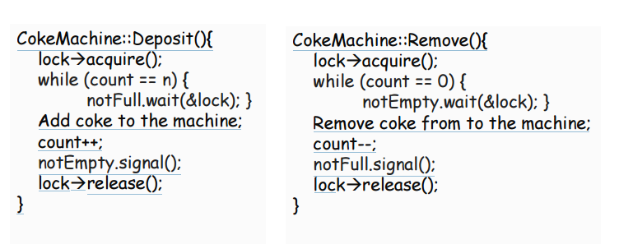
Monitor Example

Slide 20
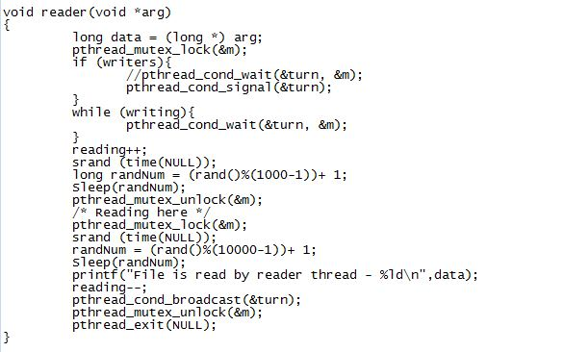
Reader Function

Slide 21
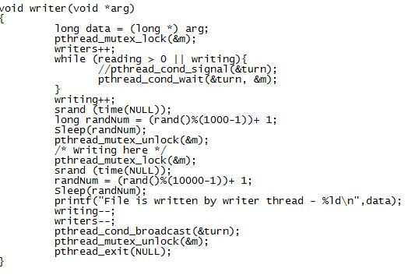
Writer Function

Slide 22
Monitor Demo

Slide 23
Method 3 :Test and Set
An instruction that perform two operations atomically.
This means that both instructions are performed together, without interruption, or none are performed.
Possible pseudocode of Test and Set Method
bool TS(bool lock)
{
if(lock) {return true;} //lock denied
else{
lock = true;
return false; //lock granted
}
}

Slide 24
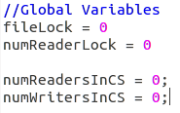
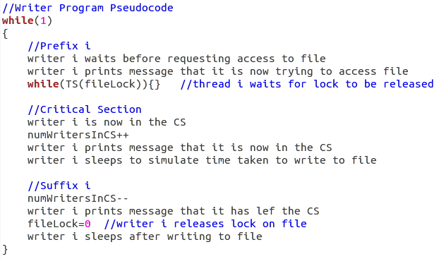
Writer Program

Slide 25
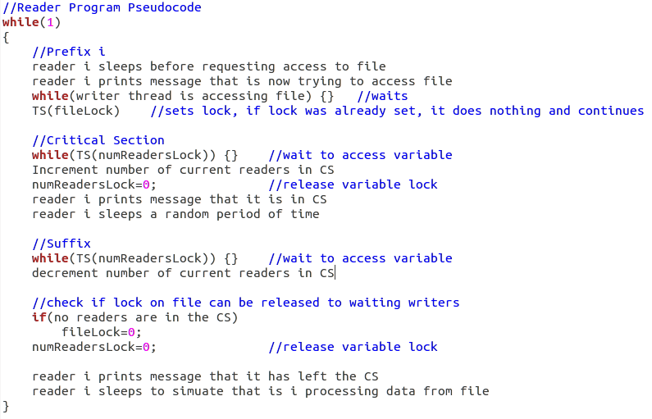
Reader Program

Slide 26
Test and Set Problems
With only a lock on the file, it was impossible to allow multiple readers into the CS at once.
This was solved by adding variables to keep track of the number of current readers and the number of current writers accessing the file.
Remember to release locks!
Can lead to deadlocks when none of the threads are able to access the resource.

Slide 27
Test and Set Demo

Slide 28
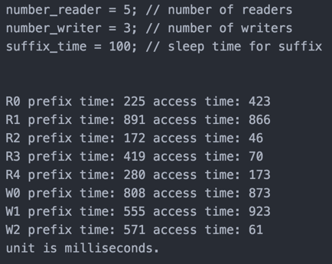
Test Data

Slide 29
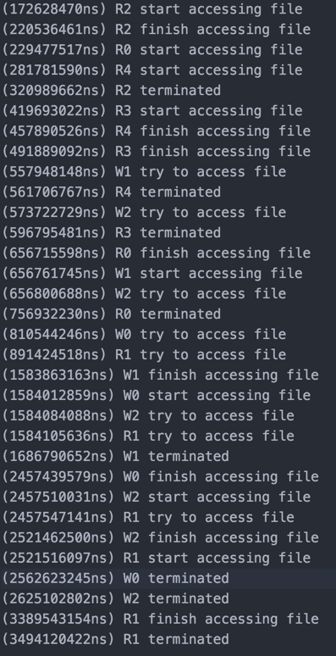
Semaphore Output

Slide 30
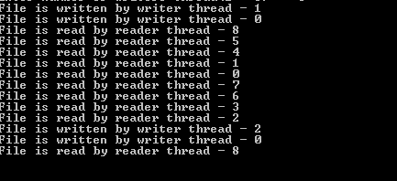
Monitor Output

Slide 31
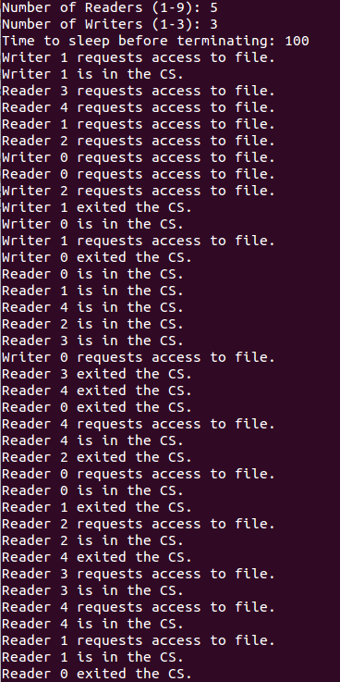
Test and Set Output

Slide 32
Comparison
Semaphore
Semaphore uses rw_flag as well as mutex and condition variable to assure several readers can access file concurrently, but only one writer can access file at a time.
Since each reader and writer notify all waited threads, and waited threads will resume after being notified, it guarantees no threads will be in deadlock.

Slide 33
Comparison
Monitor –
Monitor also uses mutex locks in addition to wait and signal. The difference is that access is not granted outside the function. For example only one process can be active at a time. Mutual exclusion is guaranteed since every process is blocked until the next is finished

Slide 34
Comparison
Test and Set
Uses atomic instructions to test and set a lock variable
Mutual Exclusion
If a writer thread is accessing the file, all other threads are waiting
Multiple reader threads are allowed to access the file at once
Race Condition avoided using locks
Locks are released after being used, preventing deadlocks
Chance of writer starvation increases with more reader threads

Slide 35
Conclusion
After comparing three techniques for multithreading-Semaphore, Monitor, Test and Set methods, we found that all three methods guarantee mutual exclusion and there is no deadlock. But unfortunately we found that writers are more likely to starve than readers since readers can access the file concurrently.

Slide 36
Conclusion (cont.)
Monitor is the best synchronization technique for reader-writer problem
Test and Set
Busy waiting
consume CPU cycles
Semaphore
No busy waiting
Shared data can be modified anywhere inside program
Monitor
Also adopt Semaphore
Shared data and member functions are encapsulated
More secure

Slide 37
Thank You!

