Slide 1
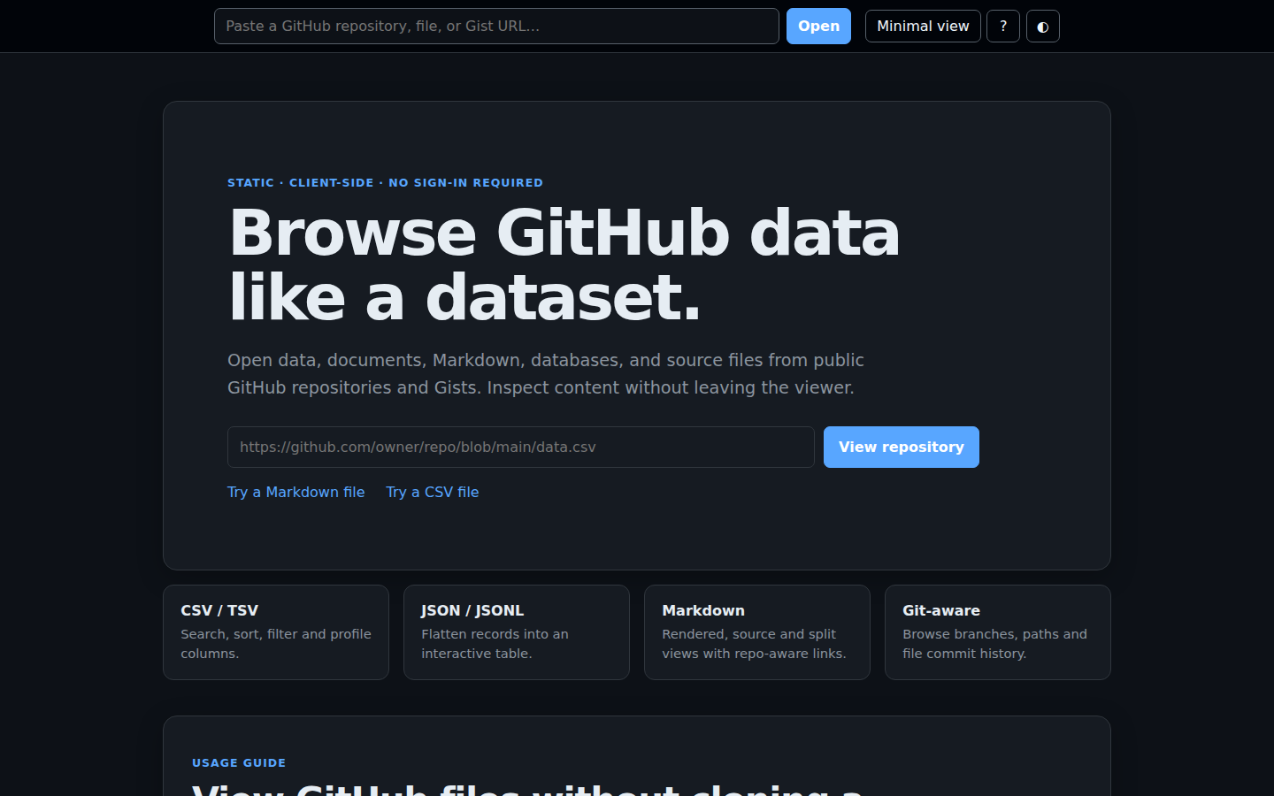
FlatGit
GitHub data and
document viewer
Browse public repositories, structured data, documents and source files—entirely in the browser.
patlittle.github.io/flatgit

Slide 2
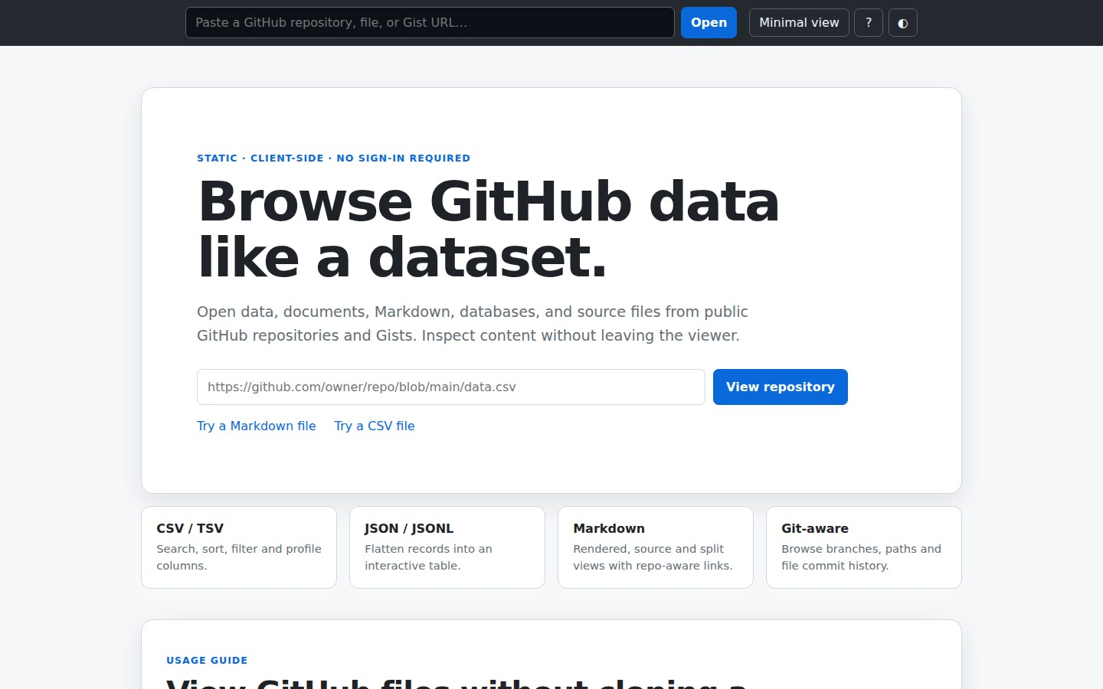
Browse GitHub data like a dataset.
Open data, documents, Markdown, databases, and source files from public GitHub repositories and Gists. Inspect content without leaving the viewer.
CSV / TSV: Search, sort, filter and profile columns.
JSON / JSONL: Flatten records into an interactive table.
Markdown: Rendered, source and split views with repo-aware links.
Git-aware: Browse branches, paths and file commit history.

Slide 3
Interactive data inspection
FlatGit turns common repository data formats into a browser-based work surface.
Search across every column and filter individual fields
Sort, resize, reorder, hide and reveal columns
Jump between pages and change the number of visible rows
Export the filtered visible data as CSV
Run read-only queries against SQLite files

Slide 4
Supported preview families
The landing page describes each recognized extension and the viewer used for it.
Delimited data
JSON data
Markdown
Mermaid
Parquet
SQLite
PDF
Raster images
SVG
Microsoft Word
Microsoft Excel
Microsoft PowerPoint
Other Microsoft formats
Code and text

Slide 5
Two layouts for different jobs
Full view
Minimal view
Repository, branch, folder and file navigation with history and comparison tools
A focused, shareable file preview that keeps the main content at full width
https://patlittle.github.io/flatgit/
Client-side HTML, CSS and JavaScript

