Slide 1

Scaling Direct Cloud Upload Auditing via Autonomous AI Agents
Major Project Review - 1
Batch ID: AIML-B17
Project Guide
Project Batch Members
Mr.Thumbooru Naga Siva Kumar
Assistant Professor, CSM, VVIT
P. Arshiya (23BQ1A61A0)
M. Chaitanya (23BQ1A6188 )
K. Pujitha (23BQ1A6172 )

Slide 2
Guide: T N SIVA KUMAR
Batch ID:AIML-B17
Regd No#1: 23BQ1A61A0, Regd No#2: 23BQ1A6188, RegdNo#3: 23BQ1A6172
Scaling Direct Cloud Upload Auditing via Autonomous AI Agents
Problem statement
Direct-to-cloud upload workflows are widely used in modern web applications.
These workflows can expose security weaknesses in authentication, upload permissions, file restrictions, storage access, and callbacks.
Traditional security testing often requires manual observation of multi-step upload workflows
Existing research has identified several upload-related vulnerabilities, but systematic automated auditing remains limited.
Different security checks need to be performed across different stages of the upload workflow.
Therefore, there is a need for an automated approach to observe and systematically audit direct-to-cloud upload workflows.

Slide 3
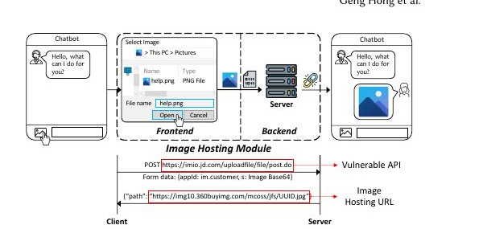
Guide: T N SIVA KUMAR
Batch ID:AIML-B17
Regd No#1: 23BQ1A61A0, Regd No#2:23BQ1A6188,
Regd No#3: 23BQ1A6172
Scaling Direct Cloud Upload Auditing via Autonomous AI Agents
Literature Review
Ref 01 – Understanding and Detecting Abused Image Hosting Modules as Malicious Services
Author Geng Hong et al., 2023 – ACM CCS
| Proposed Method | Data & Setup | key Results | Strengths & Limitations | Relevance to my research |
Proposed Viola, a tool for detecting vulnerable Image Hosting Modules (IHMs).
It analyzes the complete image-upload lifecycle of web applications.
It identifies how attackers can abuse image-upload APIs to host malicious content.
It examines the upload APIs and their security controls to detect possible weaknesses.
It studies how uploaded images can be reused by attackers for malicious purposes.
It provides mitigation recommendations to help web services protect their image-upload functionality.
Fig1. The IHM workflow (Hong et al., 2023)

Slide 4
Guide: Regd No:23BQ1A61A0
Batch ID:AIML-B17
Regd No#1:23BQ1A61A0, Regd No#2:23BQ1A6188,
Regd No#3:23BQ1A6172
Scaling Direct Cloud Upload Auditing via Autonomous AI Agents
Literature Review
Ref 01 – Understanding and Detecting Abused Image Hosting Modules as Malicious Services
Author Geng Hong et al., 2023 – ACM CCS
| Proposed Method | Data & Setup | key Results | Strengths & Limitations | Relevance to my research |
Open-Source AIMIEs: Studied 89 open-source AIMIEs (Abused IHMs as Malicious Services).
Upload APIs:109 unique image-upload APIs were identified for analysis.
Websites: 122 image-hosting websites were examined.
Upload Testing:The image-upload functionality was tested to detect vulnerable upload APIs.
Affected Services: These APIs were linked to 338 web services and 207 websites..
Viola Detection: Viola analyzed the upload APIs and identified vulnerable IHM services.
Evidence Collected: 1,151 images were uploaded through 26 APIs during testing..

Slide 5
Guide: T N SIVA KUMAR
Batch ID:AIML-B17
Regd No#1: 23BQ1A61A0, Regd No#2:23BQ1A6188,
Regd No#3: 23BQ1A6172
Scaling Direct Cloud Upload Auditing via Autonomous AI Agents
Literature Review
Ref 01 Understanding and Detecting Abused Image Hosting Modules as Malicious Services
Author Geng Hong et al., 2023 – ACM CCS
| Proposed Method | Data & Setup | key Results | Strengths & Limitations | Relevance to my research |
Viola detected 477 vulnerable image-upload APIs, showing that many upload services had security weaknesses that could be misused.
These vulnerable APIs were connected to 338 different web services, showing that the problem was found across many online services.
The study identified 207 websites that could be misused for hosting images, showing the possible impact of the vulnerable upload functionality.
During the testing, 1,151 explicit images were uploaded through 26 APIs, providing real evidence of how the vulnerable services could be abused.
The researchers reported the identified security problems to 311 websites so that the affected services could take action.

Slide 6
Guide: T N SIVA KUMAR
Batch ID:AIML-B17
Regd No#1: 23BQ1A61A0, Regd No#2: 23BQ1A6188,
Regd No#3: 23BQ1A6172
Scaling Direct Cloud Upload Auditing via Autonomous AI Agents
Literature Review
Ref 01 – Understanding and Detecting Abused Image Hosting Modules as Malicious Services
Author Geng Hong et al., 2023 – ACM CCS
| Proposed Method | Data & Setup | key Results | Strengths & Limitations | Relevance to my research |
Strengths
Limitations
Automatically detects vulnerable image-upload APIs.
Analyzes the complete image-upload lifecycle.
Performs large-scale analysis of real-world web services.
Provides practical mitigation recommendations.
Mainly focuses on Image Hosting Modules (IHMs).
Focuses specifically on image-upload API abuse.
Does not address other types of web vulnerabilities.

Slide 7
Guide: T N SIVA KUMAR
Batch ID:AIML-B17
Regd No#1: 23BQ1A61A0, Regd No#2: 23BQ1A6188,
Regd No#3: 23BQ1A6172
Scaling Direct Cloud Upload Auditing via Autonomous AI Agents
Literature Review
Ref 01 – Understanding and Detecting Abused Image Hosting Modules as Malicious Services
Author Geng Hong et al., 2023 – ACM CCS
| Proposed Method | Data & Setup | key Results | Strengths & Limitations | Relevance to my research |
Provides a foundation for monitoring upload workflows automatically rather than relying only on manual observation.
This Shows how upload requests and their security controls can be analyzed to identify weaknesses in the upload process.
Our project extends the idea by checking multiple security conditions (V1–V6) across authentication, upload restrictions, storage access, overwrite, and callbacks.
Thus, this paper provides the basis for the automated auditing part of our Cloud Upload Auditor.
Our project extends this idea to direct-to-cloud upload workflows and V1–V6 vulnerability testing.
Example: If a user uploads a file to cloud storage, our AI agents observe the upload workflow and automatically check whether the upload process has security weaknesses.

Slide 8
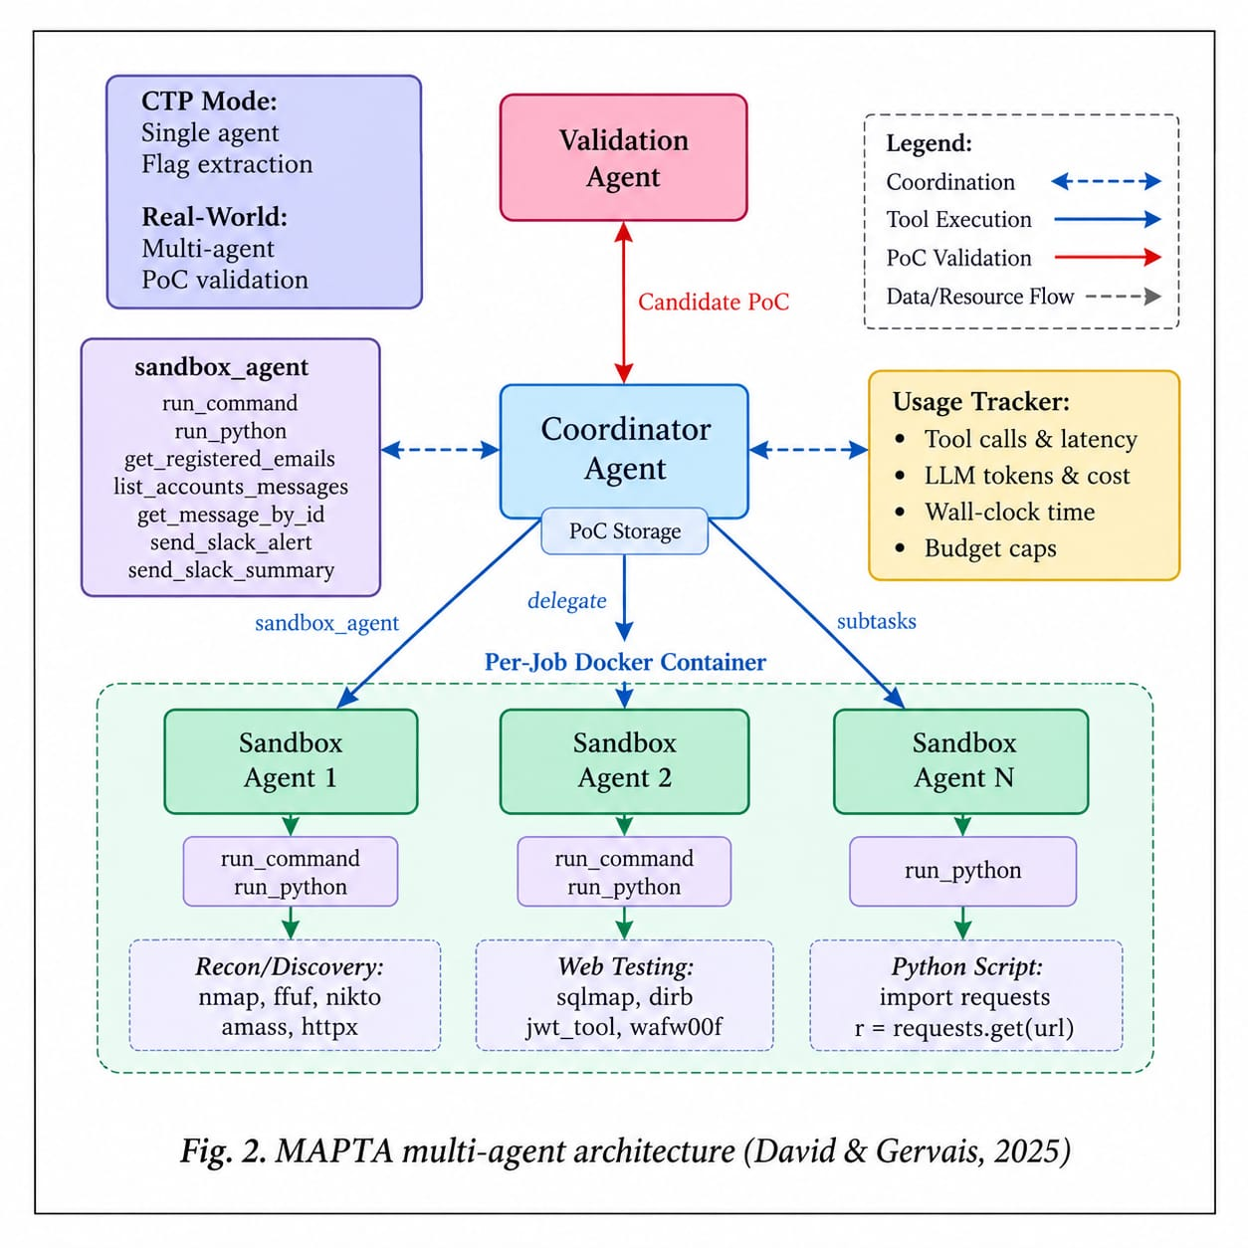
Guide: T N SIVA KUMAR
Batch ID:AIML-B17
Regd No#1: 23BQ1A61A0, Regd No#2: 23BQ1A6188,
Regd No#3: 23BQ1A6172
Scaling Direct Cloud Upload Auditing via Autonomous AI Agents
Literature Review
Ref 02 – Multi-Agent Penetration Testing AI for the Web
Isaac David and Arthur Gervais, 2025
| Proposed Method | Data & Setup | key Results | Strengths & Limitations | Relevance to my research |
Proposed MAPTA (Multi-Agent Penetration Testing AI) for automated web penetration testing.
Uses multiple AI agents with different roles: Coordinator, Sandbox Agents, and Validation Agent.
Coordinator plans and manages the penetration-testing process.
Sandbox agents perform security testing using different tools and techniques.
Validation agent checks and confirms discovered vulnerabilities.
Uses tool-driven testing with tools such as Nmap, Python, and FFUF.
Generates proof-of-concept exploits to validate whether vulnerabilities are real.
.

Slide 9
Guide: T N SIVA KUMAR
Batch ID:AIML-B17
Regd No#1: 23BQ1A61A0, Regd No#2: 23BQ1A6188,
Regd No#3:23BQ1A6172
Scaling Direct Cloud Upload Auditing via Autonomous AI Agents
Literature Review
Ref 02 – Multi-Agent Penetration Testing AI for the Web
Isaac David and Arthur Gervais, 2025
| Proposed Method | Data & Setup | key Results | Strengths & Limitations | Relevance to my research |
Evaluation: MAPTA was evaluated using 104 web security challenges from the XBOW benchmark.
AI Agents: Different AI agents were assigned separate roles such as planning, security testing, and validation.
Security Tests: The system checked vulnerabilities such as SSRF, SSTI, SQL Injection, Command Injection, XSS, and Blind SQL Injection.
Testing Tools: Agents used tools like Nmap, Python, and FFUF to perform different security tests.
Security Tests: The system checked vulnerabilities such as SSRF, SSTI, SQL Injection, Command Injection, XSS, and Blind SQL Injection.
Safe Testing: All security tests were performed in a controlled sandbox environment.
Result Verification: A validation agent checked whether the detected vulnerabilities were genuine, helping to reduce false results.

Slide 10
Guide: T N SIVA KUMAR
Batch ID:AIML-B17
Regd No#1: 23BQ1A61A0, Regd No#2: 23BQ1A6188,
Regd No#3: 23BQ1A6172
Scaling Direct Cloud Upload Auditing via Autonomous AI Agents
Literature Review
Ref 02 – Multi-Agent Penetration Testing AI for the Web
Isaac David and Arthur Gervais, 2025
| Proposed Method | Data & Setup | key Results | Strengths & Limitations | Relevance to my research |
Overall Success: MAPTA achieved a 76.9% overall success rate on the XBOW benchmark, showing that multiple AI agents can perform web security testing effectively.
Server-Side Request Forgery (SSRF): Achieved 100% success in detecting SSRF and misconfiguration vulnerabilities..
Server-Side Template Injection (SSTI): Achieved 85% success in SSTI and 83% in SQL Injection, showing good performance in these tests.
Blind SQL Injection: This was the most difficult vulnerability, with 0% success.
Testing Cost: The complete XBOW benchmark evaluation cost approximately $21.38, showing the cost involved in performing automated multi-agent security testing.
Real-World Testing: MAPTA discovered 19 vulnerabilities, including 14 high/critical vulnerabilities in real-world applications.

Slide 11
Guide: T N SIVA KUMAR
Batch ID:AIML-B17
Regd No#1: 23BQ1A61A0, Regd No#2: 23BQ1A6188,
Regd No#3:23BQ1A6172
Scaling Direct Cloud Upload Auditing via Autonomous AI Agents
Literature Review
Ref 02 – Multi-Agent Penetration Testing AI for the Web
Isaac David and Arthur Gervais, 2025
| Proposed Method | Data & Setup | key Results | Strengths & Limitations | Relevance to my research |
Strengths
Limitations
Uses multiple AI agents with different roles for effective penetration testing.
Supports automated, end-to-end vulnerability discovery and validation.
Uses real security tools such as Nmap, FFUF, and Python.
Validation helps reduce false positives.
Performs well on several vulnerability types, especially SSRF and misconfiguration.
Struggles with blind SQL injection, achieving 0% success.
XSS remains challenging compared with other vulnerability types.
Requires multiple tool calls and computational resources for complex testing.

Slide 12
Guide: T N SIVA KUMAR
Batch ID:AIML-B17
Regd No#1: 23BQ1A61A0, Regd No#2: 23BQ1A6188,
Regd No#3: 23BQ1A6172
Scaling Direct Cloud Upload Auditing via Autonomous AI Agents
Literature Review
Ref 02 – Multi-Agent Penetration Testing AI for the Web
Isaac David and Arthur Gervais, 2025
| Proposed Method | Data & Setup | key Results | Strengths & Limitations | Relevance to my research |
Multi-Agent Penetration Testing AI (MAPTA) demonstrates how multiple AI agents can work together for automated security testing.
The multi-agent approach shows how planning, testing, and vulnerability validation can be automated as one security workflow.
The agent coordination concept can be used to divide security auditing tasks among different AI agents
Our project extends the MAPTA concept to direct-to-cloud upload workflows, where AI agents can observe, test, and validate upload security.
Example:
For a cloud file upload, one AI agent can observe the upload workflow, another can test security conditions, and another can verify the detected vulnerability.

Slide 13
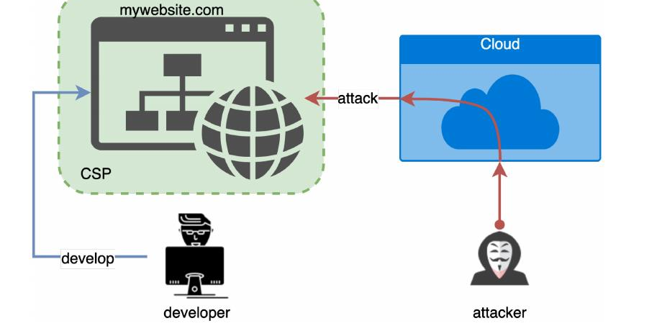
Guide: T N SIVA KUMAR
Batch ID:AIML-B17
Regd No#1: 23BQ1A61A0, Regd No#2:23BQ1A6188,
Regd No#3: 23BQ1A6172
Scaling Direct Cloud Upload Auditing via Autonomous AI Agents
Literature Review
Ref 03 – Do Not Trust the Clouds Easily: The Insecurity of Content Security Policy Based on Object Storage
Yangzixing Lv et al., 2023 – IEEE Internet of Things Journal
| Proposed Method | Data & Setup | key Results | Strengths & Limitations | Relevance to my research |
Proposed a new front-end web attack that uses cloud object storage to bypass Content Security Policy (CSP).
Analyzed how object-storage domains can weaken CSP protection.
Studied object storage services from Google Cloud and Amazon.
Performed a systematic large-scale analysis of websites using CSP.
Proposed a “double protection” mechanism involving both CSP and cloud service providers.
The approach aims to prevent attackers from using trusted cloud storage to bypass CSP restrictions.
Fig 3. Threat model: bypassing CSP via cloud object storage (Lv et al., 2023)

Slide 14
Guide: T N SIVA KUMAR
Batch ID:AIML-B17
Regd No#1: 23BQ1A61A0, Regd No#2: 23BQ1A6188,
Regd No#3: 23BQ1A6172
Scaling Direct Cloud Upload Auditing via Autonomous AI Agents
Literature Review
Ref 03 Do Not Trust the Clouds Easily: The Insecurity of Content Security Policy Based on Object Storage
Yangzixing Lv et al., 2023 – IEEE Internet of Things Journal
| Proposed Method | Data & Setup | key Results | Strengths & Limitations | Relevance to my research |
Cloud Storage: Studied object storage services from Google Cloud and Amazon to understand their security risks..
Website Analysis: Analyzed real-world websites using Content Security Policy (CSP) to identify possible security weaknesses.
Implementation: Performed a large-scale and systematic analysis of CSP configurations and the domains trusted by these policies..
Tech Stack: Used CSP configurations, cloud object-storage services, and web security analysis techniques to perform the study.
Security Testing: Examined whether trusted cloud-storage domains in CSP whitelists could be misused to bypass CSP protection.
Impact Analysis: Evaluated the security impact of these cloud-storage risks on real-world websites.

Slide 15
Guide: T N SIVA KUMAR
Batch ID:AIML-B17
Regd No#1: 23BQ1A61A0, Regd No#2:23BQ1A6188,
Regd No#3: 23BQ1A6172
Scaling Direct Cloud Upload Auditing via Autonomous AI Agents
Literature Review
Ref 03 – Do Not Trust the Clouds Easily: The Insecurity of Content Security Policy Based on Object Storage
Yangzixing Lv et al., 2023 – IEEE Internet of Things Journal
| Proposed Method | Data & Setup | key Results | Strengths & Limitations | Relevance to my research |
More than 95% of the analyzed websites using the relevant Google Cloud object-storage root domain were found to be vulnerable.
78.3% of the inspected CSP whitelists had the identified security risk.
The study estimated that at least 9 million websites were potentially vulnerable.
The results show that attackers can exploit trusted cloud object-storage domains to bypass CSP protection.
The authors proposed a double-protection mechanism combining CSP and cloud-provider security measures.

Slide 16
Guide: T N SIVA KUMAR
Batch ID:AIML-B17
Regd No#1: 23BQ1A61A0, Regd No#2:23BQ1A6188,
Regd No#3: 23BQ1A6172
Scaling Direct Cloud Upload Auditing via Autonomous AI Agents
Literature Review
Ref 03 – Do Not Trust the Clouds Easily: The Insecurity of Content Security Policy Based on Object Storage
Yangzixing Lv et al., 2023 – IEEE Internet of Things Journal
| Proposed Method | Data & Setup | key Results | Strengths & Limitations | Relevance to my research |
Strengths
Limitations
Identifies a new attack method that can bypass CSP using cloud object storage.
Provides a large-scale security analysis of real-world websites.
Examines object storage from Google Cloud and Amazon.
Shows the security risks of trusting cloud storage domains in CSP whitelists.
Proposes a double-protection mechanism using CSP and cloud providers.
Mainly focuses on CSP and cloud object-storage-based attacks.
The analysis is centered on Google and Amazon object-storage services.
Does not cover all types of web security vulnerabilities.

Slide 17
Guide: T N SIVA KUMAR
Batch ID:AIML-B17
Regd No#1: 23BQ1A61A0, Regd No#2:23BQ1A6188,
Regd No#3: 23BQ1A6172
Scaling Direct Cloud Upload Auditing via Autonomous AI Agents
Literature Review
Ref 03 – Do Not Trust the Clouds Easily: The Insecurity of Content Security Policy Based on Object Storage
Yangzixing Lv et al., 2023 – IEEE Internet of Things Journal
| Proposed Method | Data & Setup | key Results | Strengths & Limitations | Relevance to my research |
Cloud Security: The paper helps us understand security risks in cloud object storage.
Configuration Risks: It shows how improper cloud-storage configurations can create security weaknesses.
This Paper Supports our motivation to audit direct cloud upload workflows.
Automated Checking: The paper gives ideas for automatically checking cloud-related security controls.
Our Extension: Our project applies these ideas to direct-to-cloud uploads and checks multiple upload vulnerabilities (V1–V6).
Example: If a cloud upload permission is incorrectly configured, an attacker may misuse the upload workflow. Our AI agents automatically check such security conditions during auditing.

Slide 18
Guide: T N SIVA KUMAR
Batch ID:AIML-B17
Regd No#1: 23BQ1A61A0, Regd No#2:23BQ1A6188,
Regd No#3: 23BQ1A6172
Scaling Direct Cloud Upload Auditing via Autonomous AI Agents
Literature Review - Summary
Reference | Year | Main Idea | Strengths | Limitations
Geng Hong et al. Understanding and Detecting Abused Image Hosting Modules | 2023 | Viola detects abused and vulnerable image-hosting modules. | Large-scale automated detection | Mainly focuses on image-hosting abuse
Isaac David & Arthur Gervais Multi-Agent Penetration Testing AI | 2025 | MAPTA uses multiple AI agents for automated web penetration testing. | Automated testing and vulnerability validation | Struggles with blind SQLi and XSS
Yangzixing Lv et al. Cloud Object Storage & CSP Security | 2023 | Identifies CSP bypass attacks using cloud object storage. | Large-scale analysis and new attack detection | Mainly focuses on CSP and cloud storage

Slide 19

Guide: T N SIVA KUMAR
Batch ID: AIML – B17
Regd No#1: 23BQ1A61A0, Regd No#2: 23BQ1A6188,
Regd No#3: 23BQ1A6172
Scaling Direct Cloud Upload Auditing via Autonomous AI Agents
Review – 1

