Slide 1
DO NOW
ENGAGE
LEARN
BUILD
APPLY
REVIEW
Reference C: marking and review slides
DO NOW
What does ECF stand for?
1
How many marks is a level of response question usually worth?
Year 10 · Chemistry
2
Learning Objectives:
1. Mark exam answers accurately against a mark scheme
What is indicative content?
3
Why must units be given in a calculation answer?
4
What does 'do not accept' mean on a mark scheme?
5
Key Words:
indicative content · level of response · error carried forward
Name one thing that never earns a mark.
6
Silent start · pen out · attempt all questions
Learning objective: Mark exam answers accurately against a mark scheme

Slide 2
DO NOW
ENGAGE
LEARN
BUILD
APPLY
REVIEW
☞ Purple pen time · mark and correct your answers
What does ECF stand for?
Error carried forward
How many marks is a level of response question usually worth?
6
What is indicative content?
The marking points an answer could contain
Why must units be given in a calculation answer?
The final mark is usually for the unit
What does 'do not accept' mean on a mark scheme?
That wording scores zero even if the rest is right
Name one thing that never earns a mark.
Repeating the question wording
Learning objective: Mark exam answers accurately against a mark scheme

Slide 3
DO NOW
ENGAGE
LEARN
BUILD
APPLY
REVIEW
☞ Purple pen time · mark and correct your answers
CORE PAPER
Question | Pages
Rate of reaction definition and units | 180
Collision theory explanation | 182 to 183
CHALLENGE PAPER
Question | Pages
Tangent method for rate at an instant | 186
Learning objective: Mark exam answers accurately against a mark scheme

Slide 4
DO NOW
ENGAGE
LEARN
BUILD
APPLY
REVIEW
BUILD · MODEL ANSWER — Q3.2 [6 marks]
Powder
has
a
bigger
surface
area.
More
INDICATIVE CONTENT
SURFACE AREA
• powder has a larger surface area
• more particles are exposed to the acid
COLLISION THEORY
• collisions are more frequent
• so the rate increases (dependent on MP3)
YIELD
• the same mass of marble is used and the same volume of acid
• so the final volume of gas is unchanged
BANDS
Level 3 (5 to 6 marks): Links surface area to collision frequency and to the unchanged yield
Level 2 (3 to 4 marks): Links surface area to rate but not to yield
Level 1 (1 to 2 marks): States powder is faster with no mechanism
EXCLUSIONARY CLAIMS
✗ powder has more energy
✗ the particles get smaller so they react more
✗ more product is made with powder
acid
particles
can
hit
the
marble
at
once.
So
collisions
are
more
frequent.
Rate
goes
up.
Same
mass
of
marble
so
the
same
total
gas.
The
curve
is
steeper
but
ends
at
the
same
height.
Learning objective: Mark exam answers accurately against a mark scheme

Slide 5
DO NOW
ENGAGE
LEARN
BUILD
APPLY
REVIEW
BUILD · MODEL ANSWER — Q4.1 [3 marks]
rate
=
V
÷
t
INDICATIVE CONTENT
SUBSTITUTION
• correct equation stated or implied
• correct substitution 48 ÷ 60
ANSWER
• answer 0.8 with unit cm³/s
ECF: An arithmetic slip after correct substitution still earns the substitution mark and the unit mark.
rate
=
48
÷
60
rate
=
0.8
cm³/s
Learning objective: Mark exam answers accurately against a mark scheme

Slide 6
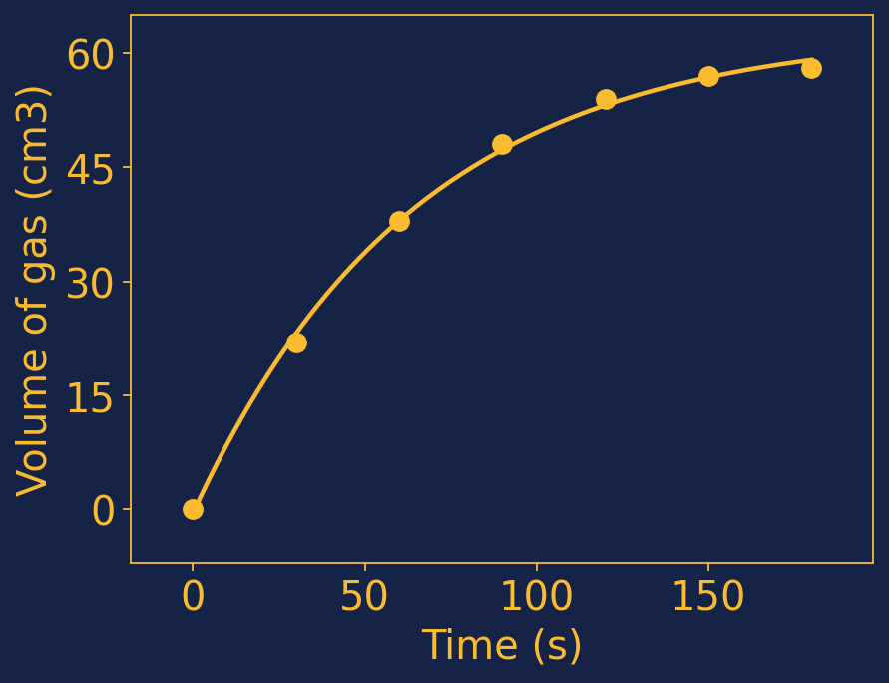
DO NOW
ENGAGE
LEARN
BUILD
APPLY
REVIEW
BUILD · MODEL ANSWER — Q4.3 [4 marks]
INDICATIVE CONTENT
• axes labelled with quantity and unit
• sensible linear scales
• all points plotted accurately
• smooth curve of best fit, not dot to dot
EXCLUSIONARY CLAIMS
✗ points joined with straight lines
✗ line forced through the origin at the expense of fit
Learning objective: Mark exam answers accurately against a mark scheme

Slide 7
DO NOW
ENGAGE
LEARN
BUILD
APPLY
REVIEW
BUILD · MARK THE ANSWERS — Q5 [6 marks]
Q Explain how increasing the concentration of the acid changes the rate of reaction.
Mark each answer against the mark scheme. Give it a level and a mark out of 6.
INDICATIVE CONTENT
CONCENTRATION
• more acid particles in the same volume
• particles are closer together
COLLISION THEORY
• collisions are more frequent
• more successful collisions per second
OUTCOME
• so the rate increases
• the total gas produced is unchanged unless acid is limiting
BANDS
Level 3 (5 to 6): Full collision theory link with correct use of frequency
Level 2 (3 to 4): Some collision theory, imprecise language
Level 1 (1 to 2): States the rate increases with no mechanism
EXCLUSIONARY CLAIMS
✗ the particles have more energy
✗ the collisions are harder
Student A
There
is
more
acid
so
it
goes
faster.
The
particles
bump
more.
Student B
More
particles
in
the
same
volume
so
they
are
closer.
That
means
more
collisions
so
the
rate
goes
up.
Student C
The
particles
have
more
energy
so
they
hit
harder
and
the
reaction
is
faster.
Learning objective: Mark exam answers accurately against a mark scheme

Slide 8
DO NOW
ENGAGE
LEARN
BUILD
APPLY
REVIEW
BUILD · MARK THE ANSWERS: MARKS AWARDED
Q Explain how increasing the concentration of the acid changes the rate of reaction.
How many marks did each answer earn — and what were they for?
INDICATIVE CONTENT
CONCENTRATION
• more acid particles in the same volume
• particles are closer together
COLLISION THEORY
• collisions are more frequent
• more successful collisions per second
OUTCOME
• so the rate increases
• the total gas produced is unchanged unless acid is limiting
BANDS
Level 3 (5 to 6): Full collision theory link with correct use of frequency
Level 2 (3 to 4): Some collision theory, imprecise language
Level 1 (1 to 2): States the rate increases with no mechanism
EXCLUSIONARY CLAIMS
✗ the particles have more energy
✗ the collisions are harder
Student A Level 1 · 2/6
✓ rate increases
✗ no mention of frequency ✗ no link to particles per volume
Everyday language, no collision theory.
Student B Level 2 · 4/6
✓ more particles per volume ✓ collisions increase ✓ rate increases
✗ does not say collisions are more frequent
Close to Level 3. Needs the word frequent.
Student C Level 1 · 1/6
✓ rate increases
✗ mechanism is wrong
Classic misconception: concentration confused with temperature.
Learning objective: Mark exam answers accurately against a mark scheme

Slide 9
DO NOW
ENGAGE
LEARN
BUILD
APPLY
REVIEW
BUILD · CORRECT THE STATEMENT
These statements are incorrect. Correct each one in your book.
A
catalyst
is
used
up
in
the
reaction.
Powder
produces
more
gas
than
chips.
✓ A catalyst is chemically unchanged at the end.
✓ Powder produces the same gas, just faster.
Higher
concentration
gives
particles
more
energy.
The
rate
is
highest
when
the
graph
is
flat.
✓ Higher concentration gives more frequent collisions, not more energy.
✓ The rate is zero when the graph is flat.
Learning objective: Mark exam answers accurately against a mark scheme

Slide 10




DO NOW
ENGAGE
LEARN
BUILD
APPLY
REVIEW
BUILD · CORRECT THE STATEMENT
Raster handwriting mode, same layout rendered as an image.
✓ Cooling slows a reaction down.
✓ Rate is measured in cm3/s or g/s.
✓ Only collisions with enough energy and correct orientation react.
✓ Surface area changes only the rate.
Learning objective: Mark exam answers accurately against a mark scheme

Slide 11
DO NOW
ENGAGE
LEARN
BUILD
APPLY
REVIEW
BUILD · DATA + GRAPH
Time (s) | Volume of gas (cm3)
0 | 0
30 | 22
60 | 38
90 | 48
120 | 54
150 | 57
180 | 58
Learning objective: Mark exam answers accurately against a mark scheme

Slide 12
DO NOW
ENGAGE
LEARN
BUILD
APPLY
REVIEW
IPEVO Visualiser
Model answers under the visualiser · Reference C Marking Slides
https://apps.ipevo.com/pwa/visualizer.app/
↑ Click to open
Learning objective: Mark exam answers accurately against a mark scheme

Slide 13
DO NOW
ENGAGE
LEARN
BUILD
APPLY
REVIEW
APPLY · CHOOSE YOUR LEVEL
DEVELOPING
REACHING
MASTERING
Q1 State what indicative content means. [1 mark]
Q1 Explain why a mark scheme lists 'do not accept' wording. [2 marks]
Q1 Mark Student C's answer and justify your decision using the mark scheme. [4 marks]
Q2 Give the unit of rate by gas volume. [1 mark]
Q2 Explain what error carried forward allows. [2 marks]
Q2 Rewrite Student A's answer so it would reach Level 3. [4 marks]
Q3 State one thing that never earns a mark. [1 mark]
Q3 Describe the difference between Level 2 and Level 3 here. [2 marks]
Q3 Explain why band marking suits a 6 mark explanation but not a calculation. [3 marks]
Learning objective: Mark exam answers accurately against a mark scheme

Slide 14
DO NOW
ENGAGE
LEARN
BUILD
APPLY
REVIEW
Review · TODAY’S LEARNING
☞ Purple pen time · mark and correct your answers
What does ECF allow?
Later method marks after an earlier slip
What separates Level 2 from Level 3?
Linking mechanism to outcome, not just stating it
Why is 'the collisions are harder' excluded?
It is the temperature explanation, not concentration
Learning objective: Mark exam answers accurately against a mark scheme

Slide 15
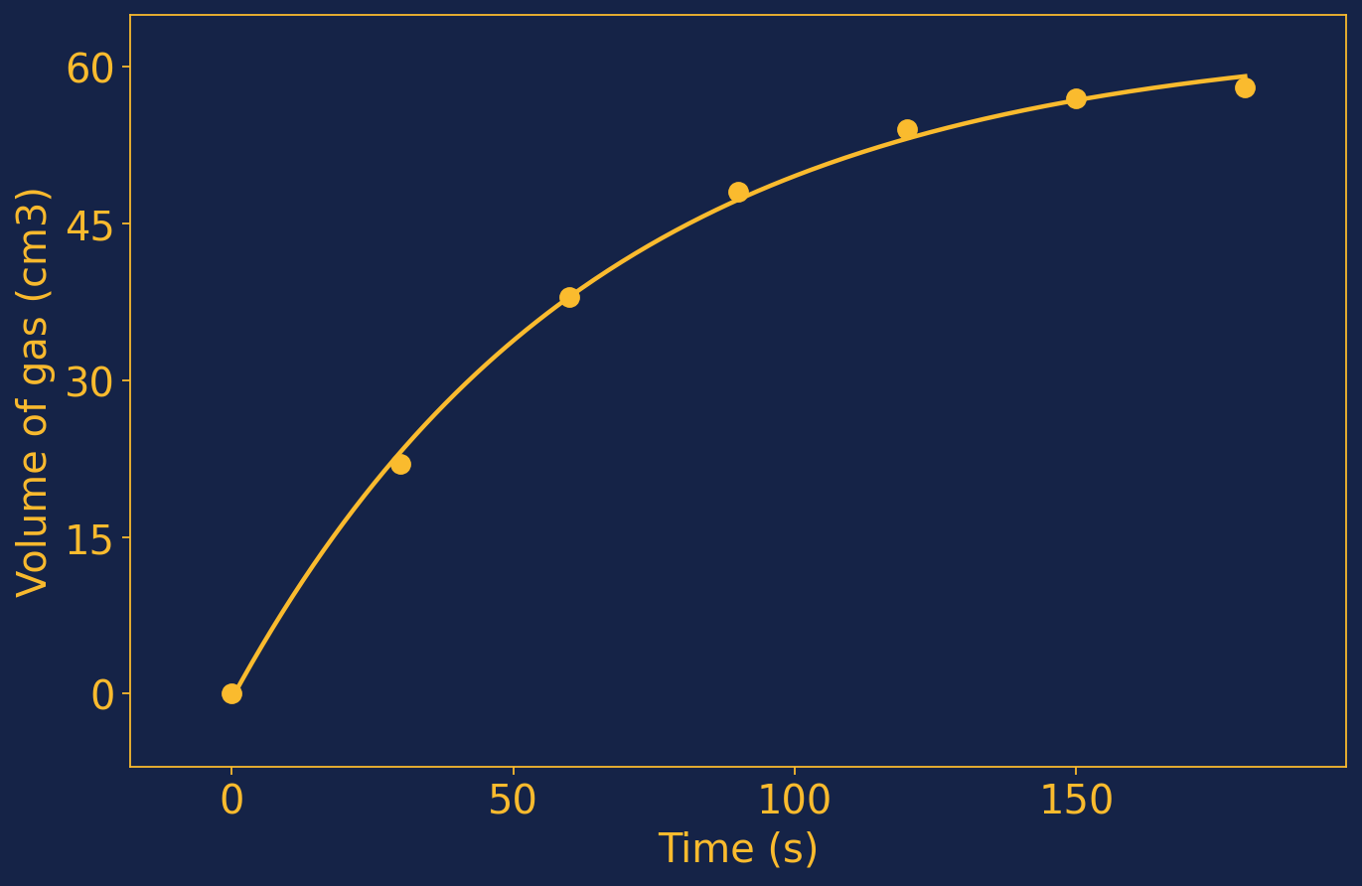
IMAGE BANK — sources and assets used in this lesson
Results graph

