Slide 1
DO NOW
ENGAGE
LEARN
BUILD
APPLY
REVIEW
Reference B: every Build activity
DO NOW · 5 minutes
Name two things that speed up a reaction.
1
What does a catalyst do to the activation energy?
Year 10 · Chemistry
2
Learning Objectives:
1. Describe how surface area affects the rate of a reaction
2. Explain rate changes using collision theory
State the unit for rate of reaction by mass.
3
Why does powdered marble react faster than chips?
4
What two conditions must a collision meet to be successful?
5
Key Words:
rate · collision · surface area · catalyst
Sketch the shape of a mass loss curve.
6
Silent start · pen out · attempt all questions
Learning objective: Describe how surface area affects the rate of a reaction

Slide 2
DO NOW
ENGAGE
LEARN
BUILD
APPLY
REVIEW
☞ Purple pen time · mark and correct your answers
Name two things that speed up a reaction.
Higher temperature and higher concentration
What does a catalyst do to the activation energy?
Lowers it
State the unit for rate of reaction by mass.
g/s
Why does powdered marble react faster than chips?
Larger surface area gives more frequent collisions
What two conditions must a collision meet to be successful?
Correct orientation and enough energy
Sketch the shape of a mass loss curve.
Steep at first, then levelling off flat
Learning objective: Describe how surface area affects the rate of a reaction

Slide 3
DO NOW
ENGAGE
LEARN
BUILD
APPLY
REVIEW
ENGAGE · MYSTERY IMAGE
Why do flour mills explode but bags of flour do not?
Suspended flour dust has an enormous surface area, so the whole cloud can burn at once.

Slide 4
DO NOW
ENGAGE
LEARN
BUILD
APPLY
REVIEW
BUILD · CHECK YOUR UNDERSTANDING
Which change always increases the rate of a reaction?
A Cooling the mixture
B Raising the temperature
C Adding more water
D Using larger lumps
THINK (silent) → DECIDE → SHOW on 3 – 2 – 1
✓ Answer: B · Higher temperature means faster particles and more frequent successful collisions.
Learning objective: Describe how surface area affects the rate of a reaction

Slide 5
DO NOW
ENGAGE
LEARN
BUILD
APPLY
REVIEW
BUILD · CHECK YOUR UNDERSTANDING
A catalyst increases rate because it
A raises the temperature
B is used up in the reaction
C provides a route with lower activation energy
D increases the concentration
THINK (silent) → DECIDE → SHOW on 3 – 2 – 1
✓ Answer: C · The catalyst is not used up and the temperature is unchanged.
Learning objective: Describe how surface area affects the rate of a reaction

Slide 6
DO NOW
ENGAGE
LEARN
BUILD
APPLY
REVIEW
BUILD · CHECK YOUR UNDERSTANDING
Which graph shape shows a reaction that has finished?
A A straight rising line
B A curve that levels off
C A falling straight line
D A line through the origin
THINK (silent) → DECIDE → SHOW on 3 – 2 – 1
✓ Answer: B · Levelling off means no more product is being made.
Learning objective: Describe how surface area affects the rate of a reaction

Slide 7
DO NOW
ENGAGE
LEARN
BUILD
APPLY
REVIEW
BUILD · CHECK YOUR UNDERSTANDING
Which flask will produce gas fastest?
D
Powder gives the largest surface area and warm acid gives the most energetic collisions, so both factors act together.
A Large chips, cold acid
B Large chips, warm acid
C Powder, cold acid
D Powder, warm acid
THINK (silent) → DECIDE → SHOW on 3 – 2 – 1
Learning objective: Describe how surface area affects the rate of a reaction

Slide 8
DO NOW
ENGAGE
LEARN
BUILD
APPLY
REVIEW
BUILD · TRUE OR FALSE
1 A catalyst is used up during the reaction.
T / F
2 Powdered solids react faster than lumps.
T / F
3 Cooling a reaction always speeds it up.
T / F
4 The steepest part of a rate graph is at the start.
T / F
Decide T or F for each — be ready to justify on 3-2-1
Learning objective: Describe how surface area affects the rate of a reaction

Slide 9
DO NOW
ENGAGE
LEARN
BUILD
APPLY
REVIEW
BUILD · TRUE OR FALSE: ANSWERS
☞ Purple pen time · mark and correct your answers
1 A catalyst is used up during the reaction. ✗ FALSE — It is chemically unchanged at the end.
2 Powdered solids react faster than lumps. ✓ TRUE
3 Cooling a reaction always speeds it up. ✗ FALSE — Cooling slows it down.
4 The steepest part of a rate graph is at the start. ✓ TRUE
Learning objective: Describe how surface area affects the rate of a reaction

Slide 10
DO NOW
ENGAGE
LEARN
BUILD
APPLY
REVIEW
BUILD · SORT
Sort each change into the correct column.
1 Heating the acid
2 Using bigger lumps
3 Adding a catalyst
4 Diluting the acid
5 Grinding to a powder
6 Cooling in ice
Learning objective: Describe how surface area affects the rate of a reaction

Slide 11
DO NOW
ENGAGE
LEARN
BUILD
APPLY
REVIEW
BUILD · SORT: ANSWERS
SPEEDS IT UP
SLOWS IT DOWN
· Heating the acid
· Adding a catalyst
· Grinding to a powder
· Using bigger lumps
· Diluting the acid
· Cooling in ice
Learning objective: Describe how surface area affects the rate of a reaction

Slide 12
DO NOW
ENGAGE
LEARN
BUILD
APPLY
REVIEW
BUILD · MEASURING RATE BY MASS LOSS
Marble chips react with hydrochloric acid and the flask loses mass as carbon dioxide escapes.
Place the flask on the balance and zero it.
1
Add the acid, then the marble chips, and plug with cotton wool.
2
Record the mass every 30 seconds for 5 minutes.
3
EQUIPMENT PER GROUP
• Conical flask
• Marble chips, 5 g
• Hydrochloric acid, 50 cm3
• Balance
• Cotton wool
Plot mass lost against time.
4
Warning: Wear eye protection. Hydrochloric acid is an irritant.
Learning objective: Describe how surface area affects the rate of a reaction

Slide 13
DO NOW
ENGAGE
LEARN
BUILD
APPLY
REVIEW
BUILD · PRACTICAL QUESTIONS: ANSWERS
☞ Purple pen time · mark and correct your answers
Why is the flask plugged with cotton wool?
It lets gas out but stops acid spray escaping
Why does the graph level off?
One reactant has been used up
Learning objective: Describe how surface area affects the rate of a reaction

Slide 14
DO NOW
ENGAGE
LEARN
BUILD
APPLY
REVIEW
BUILD · MODEL DATA
Class results, 5 g marble chips with 50 cm3 of 1.0 mol/dm3 hydrochloric acid.
Time (s) | Volume of gas (cm3)
0 | 0
30 | 22
60 | 38
90 | 48
120 | 54
150 | 57
180 | 58
210 | 58
Learning objective: Describe how surface area affects the rate of a reaction

Slide 15
DO NOW
ENGAGE
LEARN
BUILD
APPLY
REVIEW
BUILD · WHAT PEOPLE GET WRONG
THE CLAIM “A catalyst makes the reaction produce more product.”
WHY IT FEELS TRUE You see the reaction finish sooner, so it feels like more has happened in the same time.
WHAT’S ACTUALLY TRUE A catalyst changes only the rate. The final yield is exactly the same.
Hold up A if you believed the claim before today
Learning objective: Describe how surface area affects the rate of a reaction

Slide 16
DO NOW
ENGAGE
LEARN
BUILD
APPLY
REVIEW
10 degrees
A 10 degree Celsius rise roughly doubles the rate of many reactions.
Learning objective: Describe how surface area affects the rate of a reaction

Slide 17
DO NOW
ENGAGE
LEARN
BUILD
APPLY
REVIEW
BUILD · REORDER THE METHOD
A Record the mass every 30 seconds
B Zero the balance with the empty flask
C Plug with cotton wool and start the timer
D Add acid to the flask
E Add the marble chips
Work out the correct order and write the letters in sequence.
Learning objective: Describe how surface area affects the rate of a reaction

Slide 18
DO NOW
ENGAGE
LEARN
BUILD
APPLY
REVIEW
BUILD · REORDER THE METHOD: ANSWERS
☞ Purple pen time · mark and correct your answers
1 (shown as B)
Zero the balance with the empty flask
2 (shown as D)
Add acid to the flask
3 (shown as E)
Add the marble chips
4 (shown as C)
Plug with cotton wool and start the timer
5 (shown as A)
Record the mass every 30 seconds
Learning objective: Describe how surface area affects the rate of a reaction

Slide 19
DO NOW
ENGAGE
LEARN
BUILD
APPLY
REVIEW
BUILD · LABEL THE APPARATUS
KEY
1 — Conical flask holding the reactants
2 — Delivery tube
3 — Gas syringe
4 — Reaction mixture
2
1
3
4
Learning objective: Describe how surface area affects the rate of a reaction

Slide 20
DO NOW
ENGAGE
LEARN
BUILD
APPLY
REVIEW
BUILD · WORKED EXAMPLE → YOUR TURN
WORKED EXAMPLE
YOUR TURN
48 cm³ of gas is collected in 60 s. Find the mean rate.
36 cm³ of gas is collected in 45 s. Find the mean rate.
1. Write the equation: rate = volume ÷ time
2. Substitute: rate = 48 ÷ 60
3. Solve: rate = 0.8
4. Add the unit: 0.8 cm³/s
rate = 36 ÷ 45 = 0.8 cm³/s
Learning objective: Describe how surface area affects the rate of a reaction

Slide 21
DO NOW
ENGAGE
LEARN
BUILD
APPLY
REVIEW
BUILD · WORKED EXAMPLE · MEAN RATE
What are you given?
Volume of gas = 60 cm³, time = 40 s
G
What is unknown?
Mean rate of reaction
U
What is the equation?
rate =
V
E
V
t
rate
t
Substitute the numbers
rate = 60 ÷ 40
S
Solve (add units)
rate = 1.5 cm³/s
S
Learning objective: Describe how surface area affects the rate of a reaction

Slide 22
DO NOW
ENGAGE
LEARN
BUILD
APPLY
REVIEW
BUILD · YOUR TURN · MEAN RATE
Q1 24 cm³ of gas in 30 s. Find the rate. [2 marks]
EQUATION
rate =
V
t
ANSWER 0.8 cm³/s
Q2 90 cm³ of gas in 45 s. Find the rate. [2 marks]
V
ANSWER 2 cm³/s
rate
t
Q3 A rate of 0.5 cm³/s for 80 s. Find the volume. [3 marks]
ANSWER 40 cm³
Learning objective: Describe how surface area affects the rate of a reaction
Notes:
Answers:
1. 0.8 cm^3/s
2. 2 cm^3/s
3. 40 cm^3

Slide 23
DO NOW
ENGAGE
LEARN
BUILD
APPLY
REVIEW
BUILD · SPOT THE MISTAKE
1 rate = time \div volume
2 rate = 40 \div 60
3 rate = 0.67
4 rate = 0.67 cm^3/s
Your task:
1 Which line is wrong?
2 Why is it wrong?
3 Write the corrected line.
Write your answer here
Learning objective: Describe how surface area affects the rate of a reaction

Slide 24
DO NOW
ENGAGE
LEARN
BUILD
APPLY
REVIEW
BUILD · SPOT THE MISTAKE: ANSWER
☞ Purple pen time · mark and correct your answers
1 rate = time \div volume
2 rate = 40 \div 60
3 rate = 0.67
4 rate = 0.67 cm^3/s
✓ rate = volume \div time = 60 \div 40 = 1.5 cm^3/s
Error on line 1
Error type: Equation written upside down
Corrected: rate = volume \div time = 60 \div 40 = 1.5 cm^3/s
Learning objective: Describe how surface area affects the rate of a reaction

Slide 25
DO NOW
ENGAGE
LEARN
BUILD
APPLY
REVIEW
BUILD · READ THE GRAPH: ANSWERS
☞ Purple pen time · mark and correct your answers
Volume of gas against time
Q1 Where is the reaction fastest? [1 mark]
[Paste image — suggested search: gas volume against time curve that rises steeply then levels off]
At the start, where the curve is steepest
Q2 What does the flat section show? [2 marks]
The reaction has stopped, a reactant is used up
Q3 How would a powder change the curve? [2 marks]
Steeper at the start, levelling at the same final volume
Learning objective: Describe how surface area affects the rate of a reaction

Slide 26
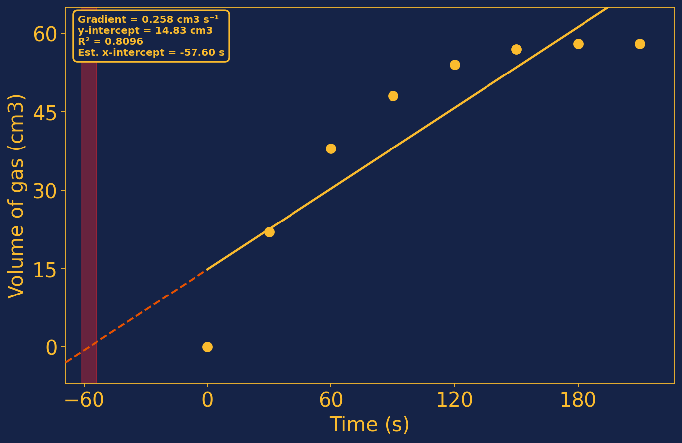
DO NOW
ENGAGE
LEARN
BUILD
APPLY
REVIEW
BUILD · RESULTS GRAPH
Reading the graph
1 The steepest gradient is at t = 0, where concentration is highest.
2 The gradient falls steadily as the acid is used up.
3 The curve flattens when one reactant runs out.
Same final volume, different time to get there.
Learning objective: Describe how surface area affects the rate of a reaction

Slide 27
DO NOW
ENGAGE
LEARN
BUILD
APPLY
REVIEW
BUILD · MAKE A PREDICTION
Two flasks hold the same mass of marble and the same acid. One holds chips, the other holds powder.
Which flask stops bubbling first, and will they lose the same total mass?
Write your prediction in your book now.
Commit your prediction before seeing the answer
Learning objective: Describe how surface area affects the rate of a reaction

Slide 28
DO NOW
ENGAGE
LEARN
BUILD
APPLY
REVIEW
BUILD · CHECK YOUR PREDICTION
☞ Purple pen time · mark and correct your answers
YOUR PREDICTION
WHAT ACTUALLY HAPPENS
Which flask stops bubbling first, and will they lose the same total mass?
The powder finishes first, but both lose exactly the same total mass.
WHY: Surface area changes the rate, not the amount of product.
Learning objective: Describe how surface area affects the rate of a reaction

Slide 29
DO NOW
ENGAGE
LEARN
BUILD
APPLY
REVIEW
IPEVO Visualiser
Model rate calculations under the visualiser
https://apps.ipevo.com/pwa/visualizer.app/
↑ Click to open
Learning objective: Describe how surface area affects the rate of a reaction

Slide 30
DO NOW
ENGAGE
LEARN
BUILD
APPLY
REVIEW
APPLY · CHOOSE YOUR LEVEL
Read more — AQA Chemistry (Kerboodle), pp. 130–136
DEVELOPING
REACHING
Q1 Name three factors that change the rate of a reaction. [3 marks]
Q2 State what a catalyst does. [1 mark]
Q3 Give the unit of rate measured by gas volume. [1 mark]
Q1 Explain why powdered marble reacts faster than chips. [3 marks]
Q2 Explain the shape of a mass loss curve. [3 marks]
Q3 60 cm3 of gas is collected in 25 s. Calculate the mean rate. [2 marks]
MASTERING
Q1 Using collision theory, explain fully why raising the temperature of a reacting mixture by 10 degrees Celsius can roughly double the rate of reaction, and explain why a catalyst has a different effect on the same mixture. [6 marks]
Learning objective: Describe how surface area affects the rate of a reaction

Slide 31
DO NOW
ENGAGE
LEARN
BUILD
APPLY
REVIEW
Review · DEVELOPING
☞ Purple pen time · mark and correct your answers
Three factors that change rate
Temperature, concentration, surface area
What a catalyst does
Speeds the reaction without being used up
Unit of rate by gas volume
cm3/s
Learning objective: Describe how surface area affects the rate of a reaction

Slide 32
DO NOW
ENGAGE
LEARN
BUILD
APPLY
REVIEW
Review · REACHING
☞ Purple pen time · mark and correct your answers
Why powder beats chips
More surface area, more frequent collisions
Why the curve levels off
A reactant has run out
60 cm3 in 25 s
2.4 cm3/s
Learning objective: Describe how surface area affects the rate of a reaction

Slide 33
DO NOW
ENGAGE
LEARN
BUILD
APPLY
REVIEW
Review · MASTERING
☞ Purple pen time · mark and correct your answers
Temperature and catalyst compared
Temperature raises collision energy and frequency, a catalyst lowers activation energy
Learning objective: Describe how surface area affects the rate of a reaction

Slide 34
IMAGE BANK — sources and assets used in this lesson
Results graph
mcq_image
practical
annotatedDiagram

